Slide 1
Predictive Modeling for Manufacturing Quality Control
By Sevak Glorikian, Dinor Nallbani, Nabeel Sharif
Notes:
Dinor

Slide 2
Problem Overview and Motivation
Traditional Quality Control is Reactive: Standard practice often relies on post-production inspection.
This leads to significantly higher scrap rates and operational costs before defects are identified and corrected.
The Goal: Develop a proactive predictive quality model to forecast the "Quality Rating" based on real-time process data.
Motivation: Allow manufacturers to dynamically adjust parameters in real-time, eliminating waste and reducing costs.
Notes:
Script: 30-40 sec Nabeel
The fundamental problem we are addressing is the reactive nature of traditional quality control. Manufacturers typically inspect products after they are fully produced. This process often results in high scrap rates and increased costs because defects are only discovered at the end of the line, wasting all the material and time that went into that product."
"Our objective was to shift this paradigm by developing a proactive model that can forecast the 'Quality Rating' of a product in real-time, based on live process data. Over the next few minutes, we will detail our methodology, compare the performance of two different models, and provide actionable recommendations for real-world quality improvement."

Slide 3
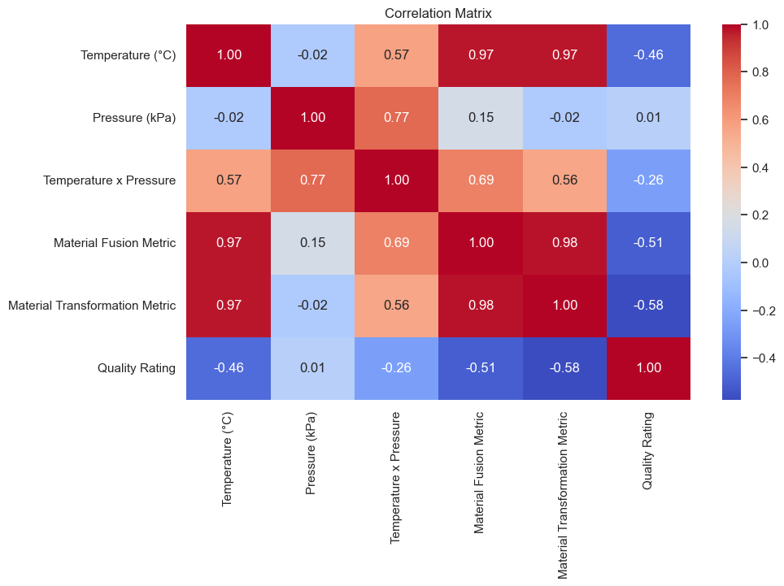
Dataset Description & Preprocessing
Target Variable (Y): Quality Rating (Overall quality score, 0-100).
Key Input Features (X):
Process Parameters: Temperature (Celcius) and Pressure (kPa).
Derived Metrics: Material Fusion Metric and Material Transformation Metric.
Preprocessing: Data was high-quality (no missing values/duplicates).
Scaling: We used StandardScaler to standardize features
(mean=0, std dev=1) for the Linear Regression model.
Correlation Insight: Strong correlations were observed between the base parameters and the derived metrics, suggesting potential nonlinear dependencies.
Notes:
Script: Sevak
"The data for our analysis comes from the 'Manufacturing Quality Prediction Dataset' on Kaggle. We focused on a crucial manufacturing metric: the Quality Rating, which served as our target variable, or the 'Y' we are trying to predict."
"Our input features, the 'X' variables, are a combination of two types: First, the basic Process Parameters like Temperature and Pressure. Second, the Derived Metrics, which are non-linear transformations of those parameters—things like the Material Fusion Metric and the Material Transformation Metric. These metrics often capture complex chemical or physical interactions better than the basic parameters alone." -20 sec
"Before modeling, our data was found to be very clean, with no missing values. We did, however, use a StandardScaler to normalize the features. This is critical for models like Linear Regression to ensure that no single feature dominates the learning process simply because it has a larger scale."
"If you look at the Correlation Heatmap on the slide, you can immediately see the relationships. Notice the strong correlation between some of the derived metrics and the final Quality Rating. This suggests a complex, but predictable, relationship." -15 sec
"Given these complex relationships, we knew we couldn't rely on just one type of model. We needed a robust comparison. " -10 sec

Slide 4
Modeling Methodology
Objective: Compare a simple parametric baseline against a non-parametric ensemble model to handle potential non-linearities in the manufacturing process.
Data Strategy: Used an 80/20 Train-Test Split to evaluate performance on unseen data.
Model 1: Linear Regression (Baseline)
Assumes a linear relationship.
Pro: High Interpretability.
Con: Struggles with non-linear relationships.
Model 2: Random Forest Regressor
An ensemble method that builds a multitude of decision trees.
Final prediction is the average of all trees.
Pro: Robust against overfitting; handles complex interactions effectively.
Notes:
Dinor
"To find the most effective predictive tool, we decided to compare two distinct modeling approaches. The goal was to see if a simple, interpretable model could handle the non-linear complexity we saw in the data, or if we needed a more powerful, complex approach."
"For rigorous testing, we used a standard 80/20 train-test split. This ensures that 20% of our data is completely unseen during training, giving us an unbiased measure of how well the models generalize to new, real-world products." -15 sec
"Our first model was Linear Regression, which served as our interpretable baseline. It assumes the relationship between inputs and quality is a simple straight line. This model has the advantage of high interpretability: if it works, you know exactly how each parameter affects the quality score." -15 sec
Our second model was the Random Forest Regressor, which is a non-parametric method. Random Forest works by building hundreds of individual decision trees and then averaging their predictions to arrive at a final score. ****"
"This approach is good at capturing highly complex, non-linear relationships and interaction effects, but it is often considered a 'black box' because the logic is harder to trace. The comparison between these two allowed us to weigh accuracy versus interpretability." -20 sec

Slide 5
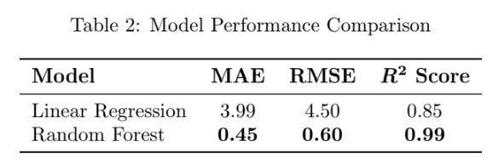
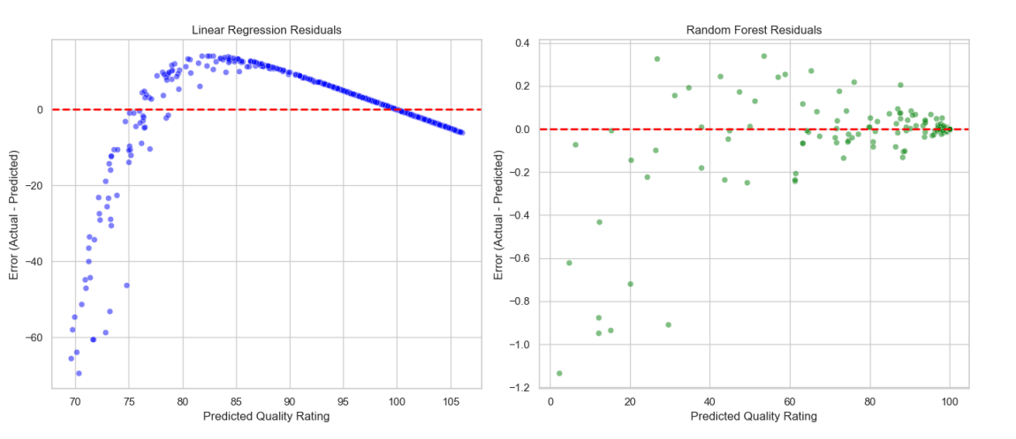
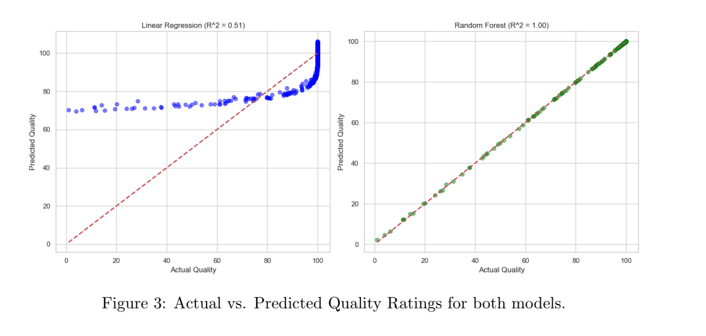
Results and Performance Comparison
Notes:
Nabeel:
"Looking at our performance table, both models actually performed quite well, but there is still a clear winner. Our baseline Linear Regression model achieved an R-squared of 0.85 and an RMSE of 4.50. While an R^2 of 0.85 is generally considered strong, in a high-precision manufacturing environment, a margin of error this wide can still result in significant waste.
"The Random Forest model, however, took performance to the next level. It achieved an R-squared of 0.99 and slashed the RMSE down to just 0.60. This tells us that the Random Forest is capturing nearly all the variance in product quality, likely due to its ability to process those complex interaction terms we created earlier, like the Material Transformation Metric.
"If you look at the Actual vs. Predicted plots on the slide [Point to Figure 3], you can visually see this difference. The Linear Regression points show some noticeable vertical spread or 'noise' around the line. In contrast, the Random Forest points are almost perfectly aligned with the diagonal. This means its predictions are incredibly consistent across the entire range of quality scores."
"Finally, our Residual Plots [Point to Figure 4] confirm this. The Random Forest errors are tightly packed near the zero line, whereas the Linear Regression errors are much more scattered. This gives us the confidence that the Random Forest model is the far more reliable choice for a live production environment."

Slide 6
Key Insights and Applicability
Tolerance Test (Real-World Metric): We defined operational success as being within a 土 1.0 point tolerance of the actual quality rating.
Linear Regression achieved 10.98% accuracy within tolerance.
Random Forest achieved 99.87% accuracy within tolerance.
The Random Forest model is reliable enough for real-world deployment and automated quality sorting.
Top Feature Importance Drivers:
Material Transformation Metric
Temperature
Material Fusion Metric
Notes:
Sevak:
"Beyond just looking at R^2 scores, we wanted to see how these models would perform in a real factory setting. We conducted a Tolerance Test, where a prediction is only considered 'successful' if it falls within plus/minus 1.0 point of the actual quality rating."
"The results were staggering. The Linear Regression model was only accurate 11% of the time under these strict conditions. However, the Random Forest model achieved nearly 100% accuracy. This tells us that the Random Forest isn't just statistically better—it is operationally reliable for an automated production line."
One of the most valuable outputs of our Random Forest model is the Feature Importance ranking. Even though the model is complex, it clearly shows us which 'knobs' have the most impact on quality."
"The Material Transformation Metric and Temperature were the dominant drivers. This is a critical insight for engineers because it tells them exactly where to focus their attention. If quality starts to slip, the first thing they should check isn't the pressure or the fusion speed—it’s the thermal stability and the transformation metrics of the material."
"Ultimately, we learned that while simple models are easier to explain, they can't handle the physics of manufacturing. In this case, the complexity of the Random Forest is a necessary trade-off for the precision required in quality control.

Slide 7
Recommendations for Quality Improvement
1. Prioritize Precision Control of Temperature:
Temperature and its derived metrics are the dominant factors in quality variation.
Investment in high-precision thermal sensors will yield the highest Return on Investment (ROI) for quality improvement.
2. Implement Real-Time Predictive Monitoring:
Deploy the Random Forest model to the production line.
If the model predicts quality below a pre-set threshold, the system should automatically pause for calibration or adjust parameters immediately.
Notes:
Dinor
"Based on our findings, we have two primary recommendations. First, manufacturers must prioritize precision control of Temperature. Our feature importance analysis proved that Temperature and its derived metrics are the most influential factors in determining product quality. By investing in high-precision thermal sensors and more responsive cooling or heating systems, companies can tackle the root cause of most quality deviations."
"Second, we recommend the deployment of the Random Forest model for real-time monitoring. Because this model achieved over 99% accuracy within our testing it can be trusted to serve as an automated 'early warning system.'
The model should be integrated into the production line software to automatically pause the process or trigger an alert when it predicts a quality dip. This moves the facility away from expensive 'inspect and discard' cycles toward a 'predict and prevent' workflow."
"By shifting to this proactive approach, manufacturers can expect a measurable decrease in scrap rates, optimized material usage, and significantly lower operational costs. Thank you for your time, and we are now happy to take any questions."

Slide 8
Questions?
Notes:
Nabeel
"Why did Linear Regression perform so poorly?"
Answer: "The relationship between manufacturing variables like pressure and temperature is non-linear and synergistic. Linear regression can't capture the 'Material Transformation' interaction effectively, which our Random Forest model handled with ease."
"Is the Random Forest model too slow for a real-time line?"
Answer: "Actually, while Random Forest takes longer to train, its prediction time (inference) is measured in milliseconds, making it perfectly suitable for high-speed production environments."
"What happens if a new material is introduced?"
Answer: "The model is currently trained on specific material metrics. If a new material is introduced, we would need to collect a small 'burn-in' dataset and re-train the model to ensure it learns the new physical properties."

