Slide 1
ASSEMBLY LANGUAGE PROGRAMMING OF 8085
https://collegeek.com/8085_microprocessor/example.html#exmpale6

Slide 2
ASSEMBLY LANGUAGE PROGRAM
Get two numbers
Add them
Store result
Stop
Load 1st no. in register D
Load 2nd no. in register E
MVI D, 2H
MVI E, 3H
Copy register D to A
Add register E to A
MOV A, D
ADD E
Copy A to register C
MOV C, A
Stop processing
HLT

Slide 3
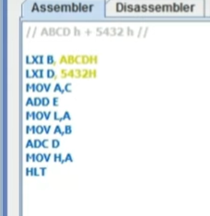

Slide 4
Write an assembly language program to add two numbers (decimal) 38 and 64, then subtract decimal number 3 from the sum. The final answer is to be stored in memory location 2100 H.
MVI A,26H // Loads the first number to accumulator
MVI B,40H // Loads the second number to B-register
MVI C,03H // Loads the third number to C-register
ADD B // Adds the contents of B-register with the contents of accumulator and the answer is stored in A
SUB C // Content of C gets subtracted from accumulator and difference is stored in A
STA 2100H // Answer is stored in 2100 H location
HLT // Stop processing

Slide 5
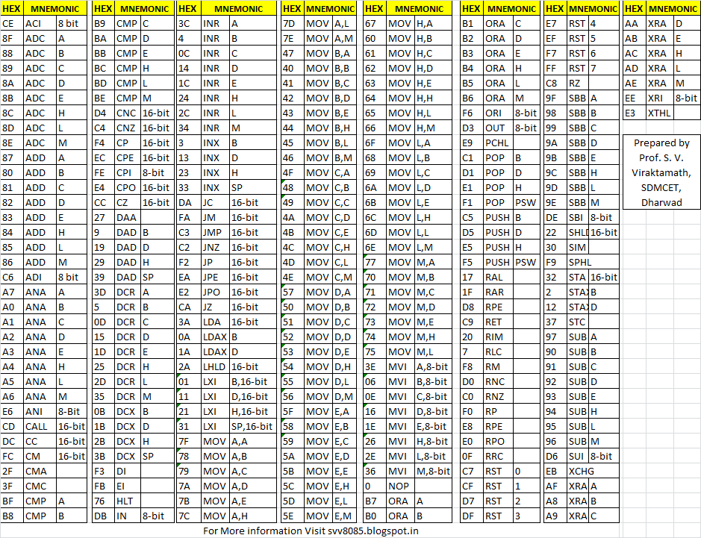

Slide 6
Write assembly language program to subtract two 8-bit numbers and Display
Solution:
MVI A,A9H // Loads the A9h to Accumulator
MVI B,ABH // Loads the ABh to B-register
MVI C,00H // Loads the 00h to C-register
SUB B // Subtract the content of B-register from Accumulator and result stored in Accumulator.
JNC SKIP // Jump on no Carry to SKIP
INR C // Increment C-register
CMA // Complements Accumulator content
INR A // Increment Accumulator
SKIP: STA 2100H // Stores the answer to memory location 2100 H
MOV A,C // moves the content of C-register to accumulator (A < - C)
HLT // Stop processing

Slide 7
Write an assembly language program to multiply two decimal numbers 23 and 9 and store the answer in some memory location.
MVI A,00H // Loads the accumulator with 00H
MVI B,17H // Loads B-register with 17H
MVI C,09H // Loads C-register with 09H
AGAIN: ADD B // Adds the content of B-register to accumulator
DCR C // Decrements C-register
JZ END // Checks for zero; if zero jump to END
JMP AGAIN // Repeats the addition
END: STA 2100H // Stores the answer to memory location 2100 H
HLT // Stop processing

