Slide 1
Name – Dinesh Sonawane
Project – M5 Sales Forecasting
Date – May’2024

Slide 2

Project Details
Project Aim:
Aim is to forecast daily sales for next 28 days by using use hierarchical sales data for past 1941 days.
Inputs Provided:
Expectations from provided data (problem statement)
Datasets (.csv file) containing the hierarchical daily sales data
Past references of data analysis and suggestions of forecasting methods
Project Expectations:
Application of traditional time series methods
Application of deep learning frameworks for time series data
Conceptual clarity and approaches followed
Report out detailing the problem, data and solutions

Slide 3


High Level Approach
Data information
Identify and treat the missing data
Identify and treat the duplicate data
Prepare data frame for deep dive
Deep dive of data
Total sales trend over time
Total sales by category
Total sales by store
Impact of promotions on sales
Insights required from business owner’s eyes:
Which states or stores to be focused for potential sales?
Lean Supply – Can I keep supply intact without increasing inventory cost?
Are these promotional offers really working?
Which products to be focused for promotional offers and which should not?
Suggestions on actions to improve overall sales

Slide 4
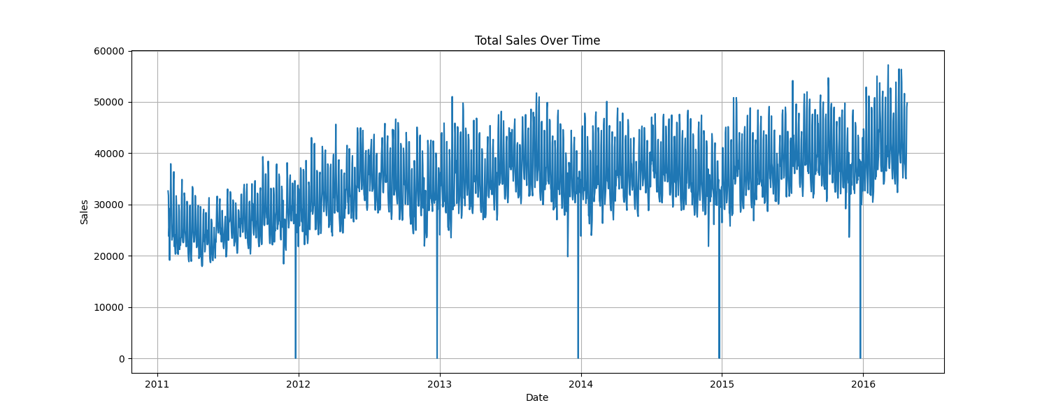
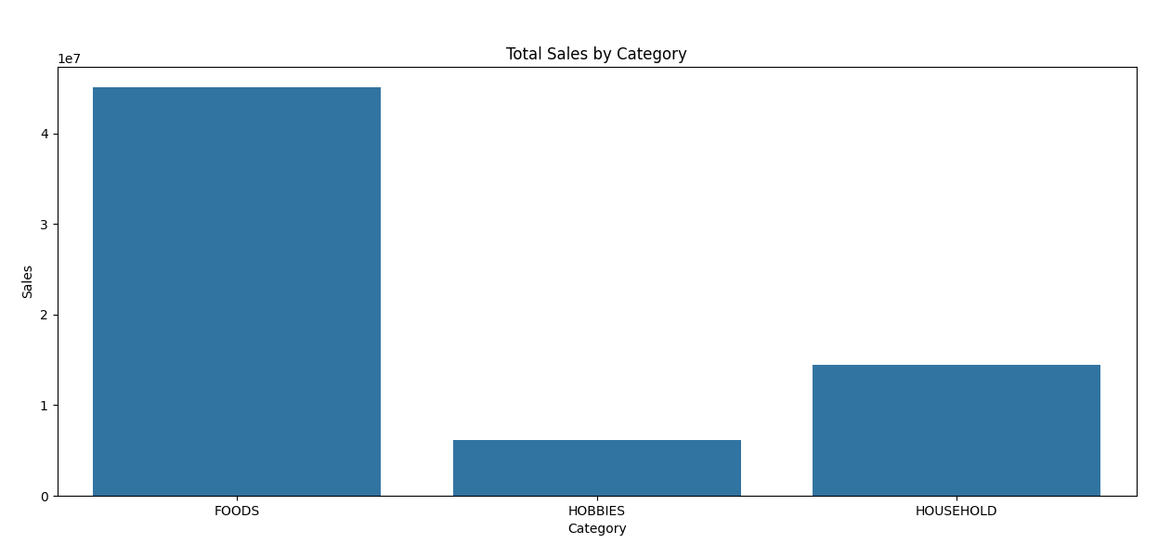
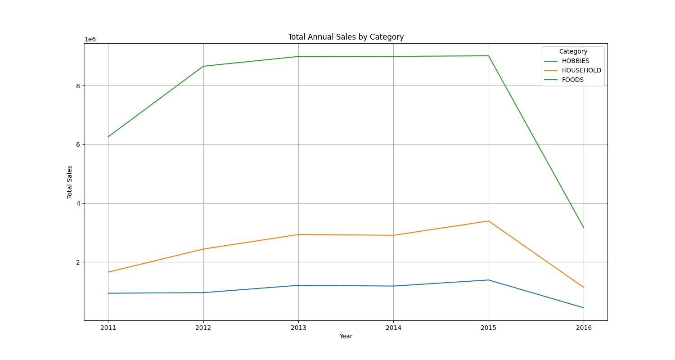
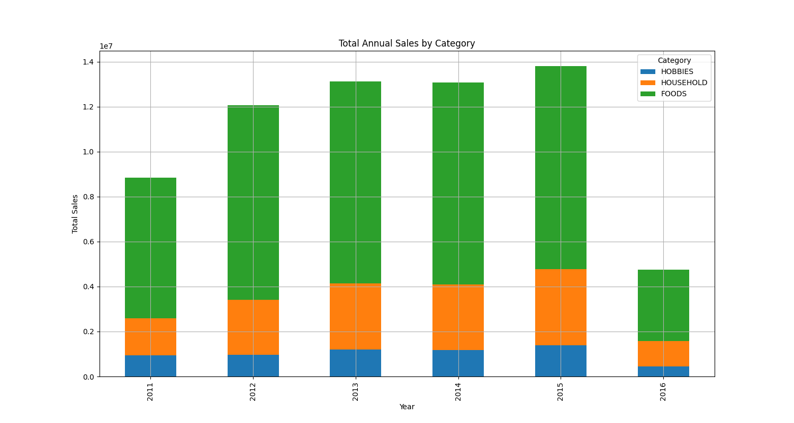
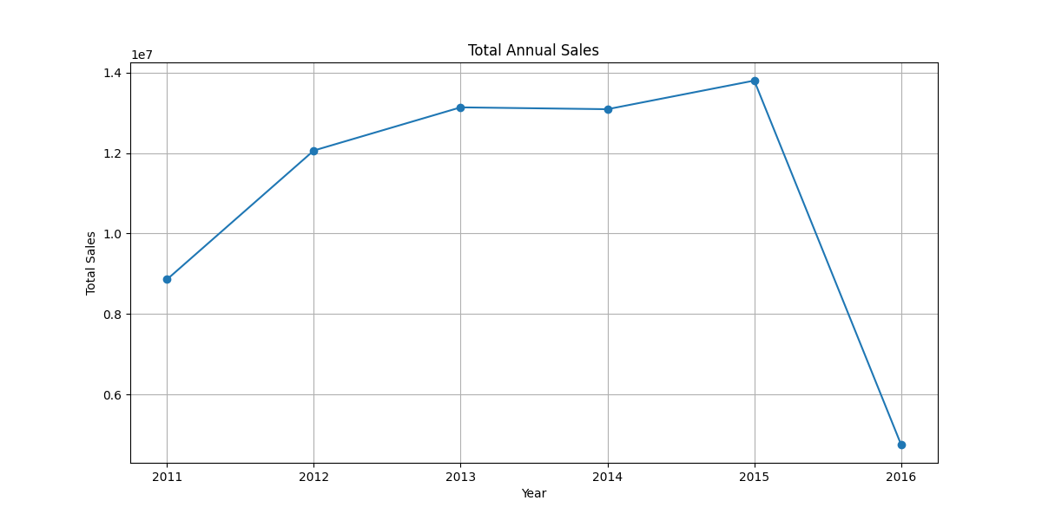
Exploratory Data Analysis
Aim – Sales growth and inventory management
Total sales trend over time
Total Sales by Category
Total annual sales trend over time

Slide 5
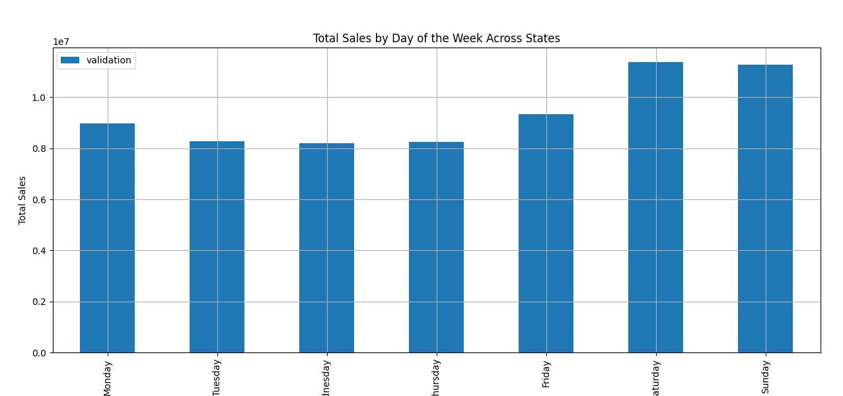
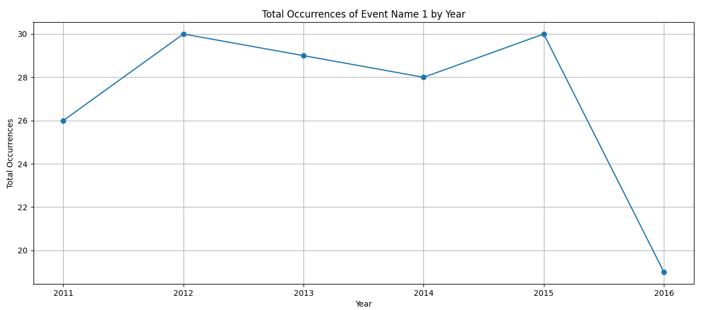
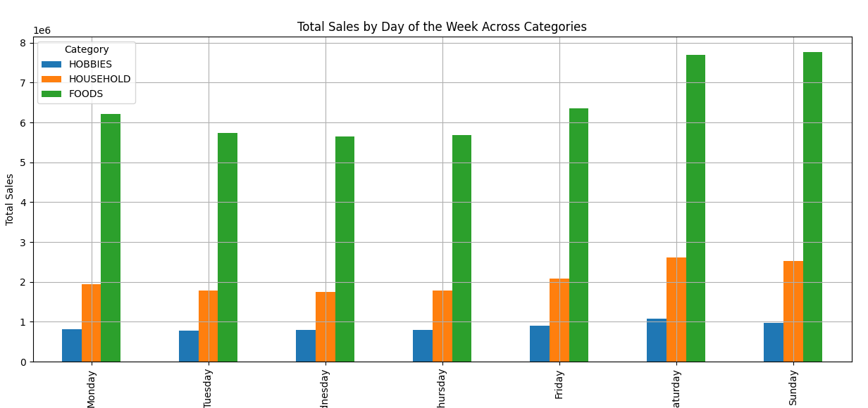
Exploratory Data Analysis
Aim - Sales growth and inventory management
Total number of event_1 per year
Sales as per day of the week
We clearly observe that number of event across stores were dropped in 2012 and in 2013
Total sales was slightly increased in 2012 and it was flat in 2013.
So there is possibility that event_1 may not be boosting sales, this needs further investigations
Sales as per day for the week for each category

Slide 6
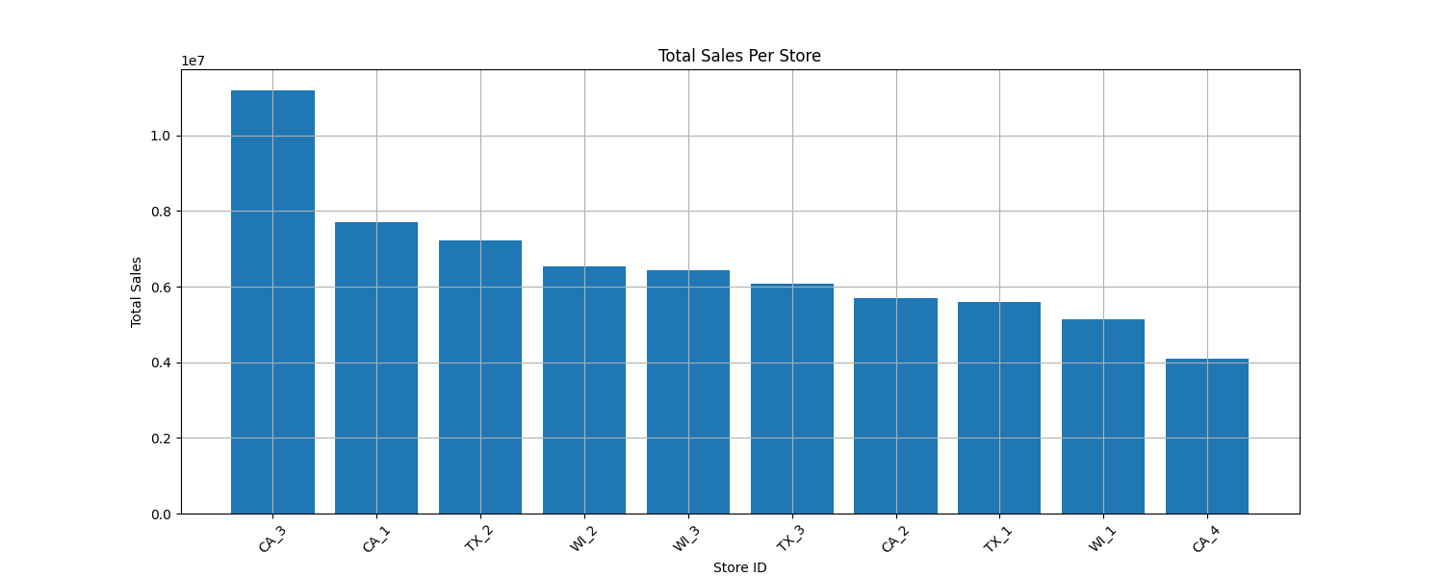
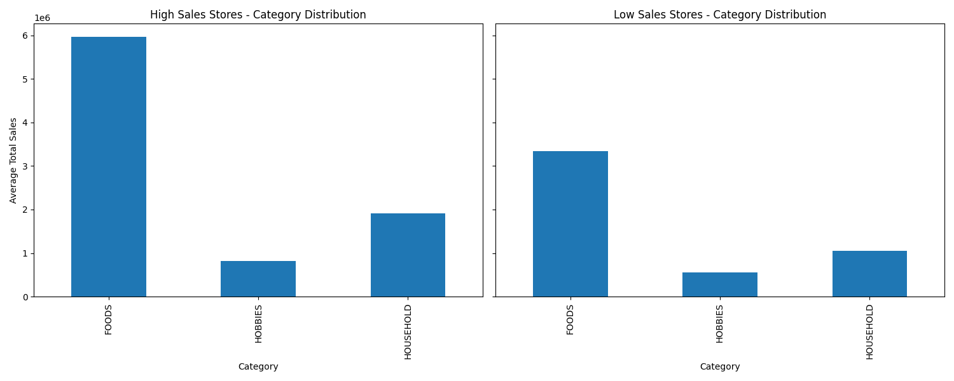
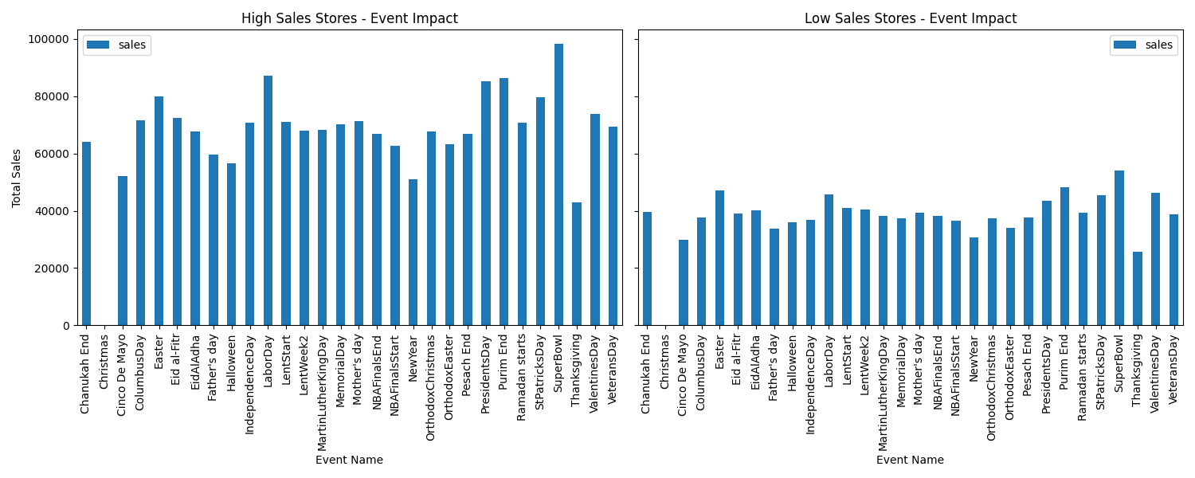
Deep Dive of Data
Aim - Sales growth and inventory management
Sales per store
Sales per store – category distribution
Which best practices we can follow from high selling stores to low selling stores?
Low sales Store
High sales Store
Action 1 - Store Layout and Customer Experience:
Evaluate the store layout and customer experience of high sales stores.
Implement similar layouts, customer service training, and in-store promotions in low sales stores.
Action 2 - Local Market Analysis:
Conduct local market analysis to understand customer preferences and demographics.
Tailor inventory and marketing strategies to match local demand in low sales areas.

Slide 7
Time Series Forecasting – Sales Pred
Aim - Sales growth and inventory management
Overall Approach Followed –
Start with prediction at store level aggregate sales
Use the traditional approach for sales prediction of one store, CA_1 – SARIMAX model
Use automated approach using SARIMA model for CA_1 store – pmdarima model
Use same automated approach extended to all other stores – pmdarima model on multiple series
Sales prediction using deep learning framework –
Use DeepAR Estimator for daily sales prediction
Use DeepAR Estimator for store level sales prediction
Use LSTM time series forecasting for store level sales prediction

Slide 8
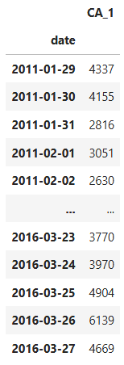
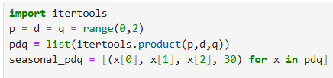
Traditional approach for sales prediction
For single Series
Aim - Sales growth and inventory management
Prepare dataset
Check if the series has auto correlation or not - Durbin Watson Test
Check the time series components, decompose the series
Check whether time series data is stationary or not, Augmented Dickey Fuller Test
Identify the p,d,q parameters for Trend and Seasonality in time series
Iterate over diffrent values of p,d,q parameters and choose those giving minimum AIC value
The Durbin-Watson test is used to detect the presence of autocorrelation
The test statistic ranges from 0 to 4
Interpretation:
Value of 2: no autocorrelation.
Value near 0: strong +ve autocorrelation.
Value near 4: strong –ve autocorrelation.
Presence of auto-correlation is necessary to use time series models like ARIMA
Durbin Watson test show Autocorrelation in CA_1 series data
Why Decompose a Time Series?
Understanding Patterns
Anomaly Detection
Simplifying Analysis
Presence of strong seasonality in CA_1
Upcoming trend in CA_1 (non-linear)
Presence of noise
A time series is considered stationary if its statistical properties, such as mean, variance, and autocorrelation, remain constant over time
time series forecasting models, such as ARIMA, assume that the series is stationary
The ADF test is a statistical test used to determine if a time series is stationary
CA_1 time series found to be non-stationary
Series made stationary with differencing period of 30 days
p - Autoregressive (AR) Order: Represents the number of lag observations included in the model
d - Difference Order: Represents the number of times the data needs to be differenced to achieve stationarity
q - Moving Average (MA) Order: It specifies the number of past forecast errors that are used to predict the current value
P,D,Q and m: Seasonality parameters over period of m
For CA_1 series:
Trend - p=1, q=1, d=1
Seasonality - P=1, Q=1, D=1
Parameters were assigned any value from 0,1,2 and allowed to create combinations
These combinations passed over SARIMAX model and observed resulted AIC
Final parameters with min AIC received are:
(1, 0, 1), (1, 1, 1, 30)
For multiple time series modeling, utilized pmdarima package which auto-calculates the parameters. However, single time series is used for training independent of other time series'. Demonstrated the application of pmdarima and received good results.
REF - Exploring Auto ARIMA in Python for Multiple Time Series Forecasting

Slide 9
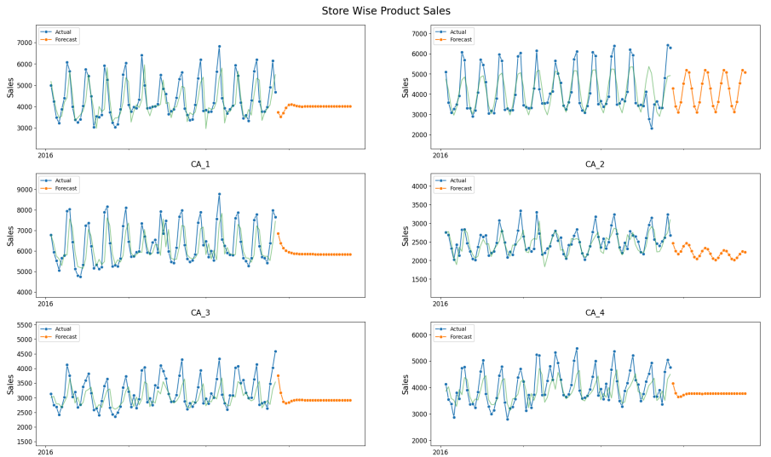
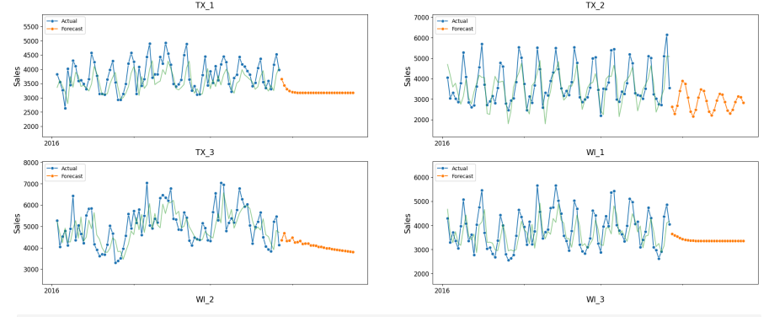
Traditional approach for sales prediction
For single Series
Aim - Sales growth and inventory management
SARIMA for using pmdarima (auto-arima) for multiple time series at store level

Slide 10
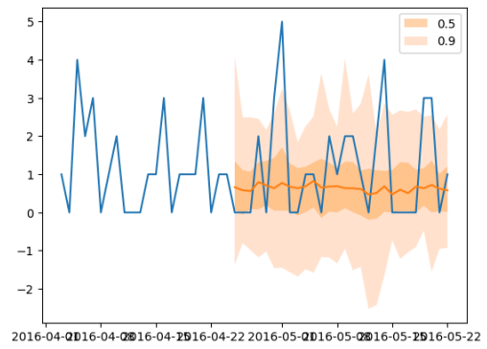
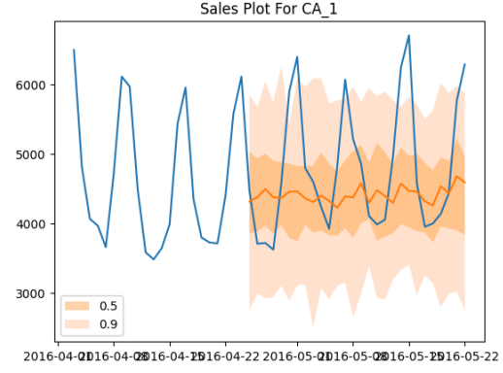
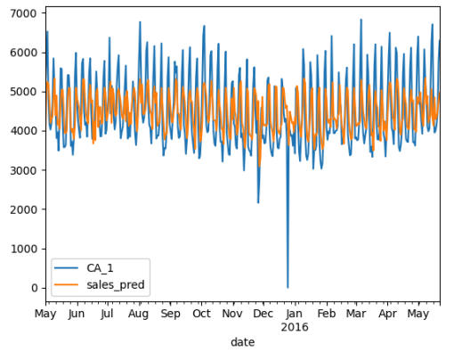
Deep Learning Framework for sales prediction
For Multiple Series
Aim - Sales growth and inventory management
DeepAR Estimator for multiple time series at product level
DeepAR Estimator for multiple time series at store level
LSTM for multiple time series at store level
Actual Vs Forecasts with probabilistic predictions for one of the series
Actual Vs Forecasts with probabilistic predictions for CA_1 sales series
Actual Vs Forecasts predictions for CA_1 sales series
Overall RMSE – 847
Training RMSE – 0.1044
Testing RMSE – 0.1081
Overall RMSE – 1.89

Slide 11
Concluding Summary
Aim - Sales growth and inventory management
Data Analysis Observations:
Overall trend for total sales is trending up. Same behaviour is shown by category sales too
There is possibility that event_1 may not be boosting sales, this needs further investigations
Saturday and Sunday shows increased sales relative to other weekdays. Same behaviour is shown by categories also.
Recommendations:
Store Layout and Customer Experience:
Evaluate the store layout and customer experience of high sales stores
Implement similar layouts, customer service training, and in-store promotions in low sales stores
Local Market Analysis:
Conduct local market analysis to understand customer preferences and demographics.
Tailor inventory and marketing strategies to match local demand in low sales areas.
LSTM model can be utilized for predicting sales of a store. This will help to estimate growth of business from particular store and actions can be planned upfront for further expansion
DeepAR model can be utilized for product level prediction, which will help to manage inventory specifically for food items

