Slide 1
Better Place
SWOT Analysis
דמיטרי זברסקי 311854004
ולדי קגנר 321779662
נטליה סקברו 321962649
מרגריטה סימקין 323657817
פבל גולצ'ין 317990653
סרגיי סבירידינקוב 323464073

Slide 2
Introduction
Inspired by Klaus Schwab quote “How do you make the world a better place by 2020?”. Better Place aimed replacing all today’s cars with next generation electric cars.

Slide 3
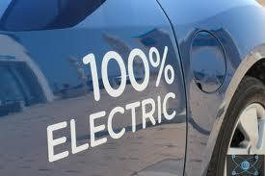
Introduction - vision
Make world better by making cars more ecologically clean (replace them with electric cars).
Move to renewable energy sources.
Make electric cars as cheap and usable as gasoline cars today.

Slide 4
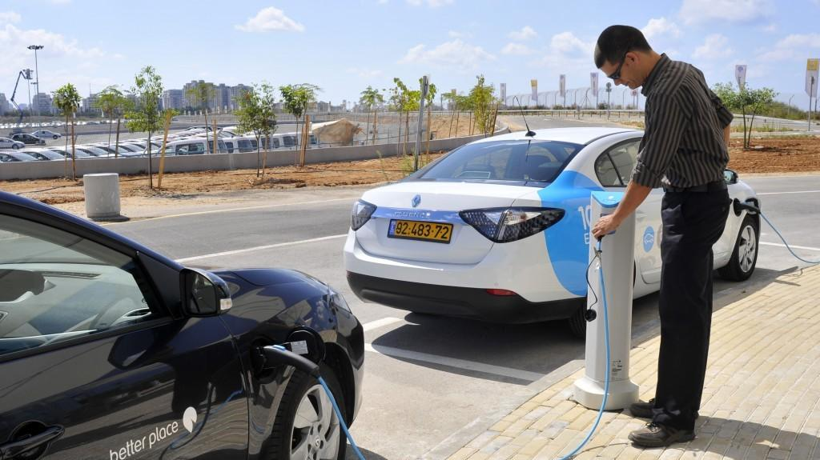
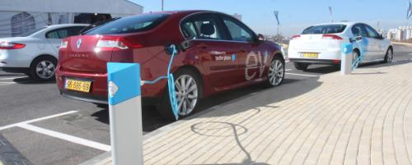

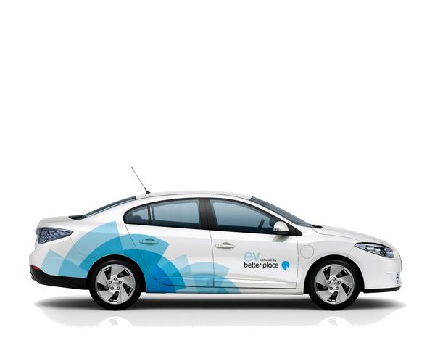
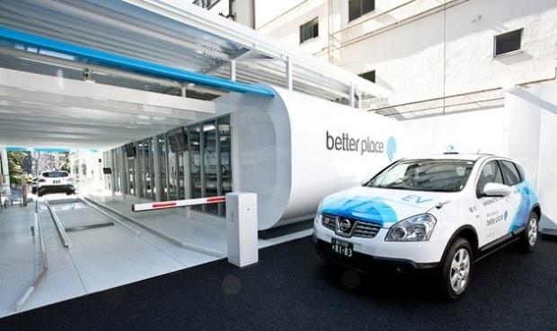

Slide 5
SWOT Analysis
Strengths
Weaknesses
Opportunities
Threats

Slide 6
Strengths
New business – no other companies selling electric cars to consumers and no other companies provide infrastructure for electric cars
Financial Leverage
Partner's brand improve own brand
Global impact - global impact on ecology brings global support
Advantage in largeness in supply chain
Proven battery pack replacement station technology

Slide 7
Weaknesses
Complex infrastructure (cars/programs)
Very large initial investment
Expensive infrastructure and expensive management
No initial clients
Unknown prices of supplied services

Slide 8
Opportunities
A few car makers invest into electric cars
Political support - tax free, road pricing, special lanes
Consumer awareness
Battery performance
Gasoline prices
Press focus

Slide 9
Threats
Inconvenience to consumers
Lack of knowledge (complex product)
Competing technologies (PHEV,HEV,ICE)
Lack of demand for EVs
Rising prices on electricity
Uncertainty of investments for customers

Slide 10
Better place
Thank you

