Slide 1


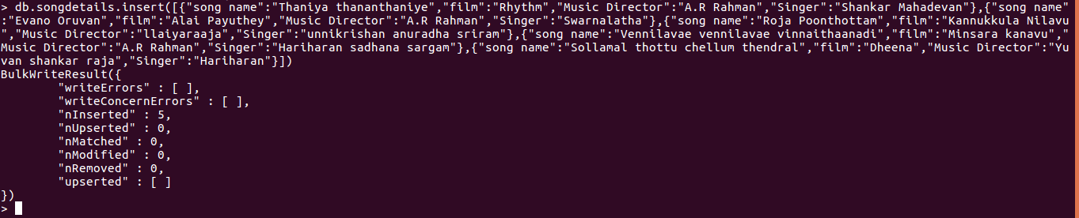
1) Create a Database called music​.
2) Create a collection called songdetails​.
3) Create the above 5 song documents.
4) List all documents created.

