Slide 1
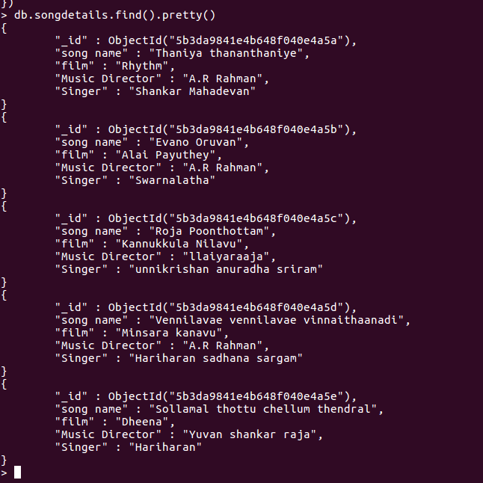
4) List all documents created.

