Slide 1
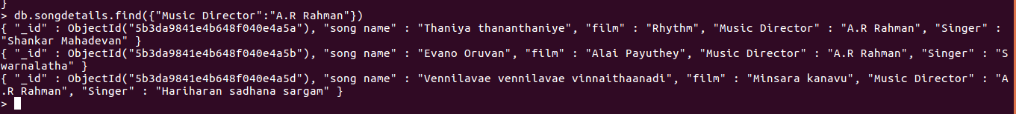
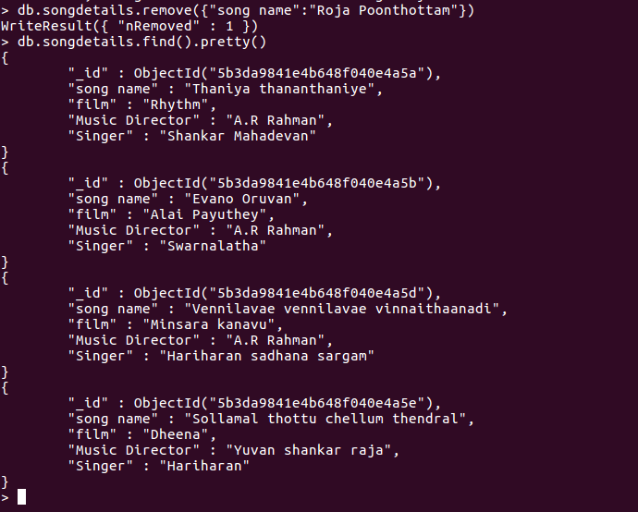
5) List A.R.Rahman’s songs.
6) List A.R.Rahman’s songs sung by Unnikrishnan.
7) Delete the song which you don’t like.

