Slide 1
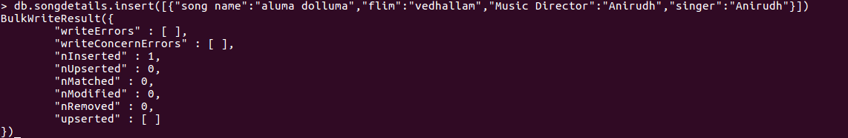
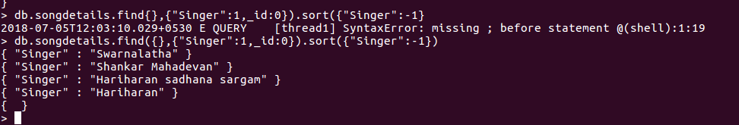
8) Add new song which is your favourite.
9) List Songs sung by Hariharan from Minsara kanavu film.
10)List out the singers’ names in your document.

