Slide 1
Disjoint Set ADT and Self-Organizing List
Introduction
A self-organizing list is a list that re-orders its elements based on some self-organizing method in order to improve average access time.
It uses a re-organizing algorithm to adapt to various query distributions at runtime.
A disjoint-set is a data structure that stores non overlapping or disjoint subset of elements
It provides operations to efficiently manage these subsets and is commonly used in several algorithms.

Slide 2
Agenda
Disjoint Set ADT
Self Organising List
Functions Used
Applications
Software Development Life Cycle
Students and their Roles

Slide 3
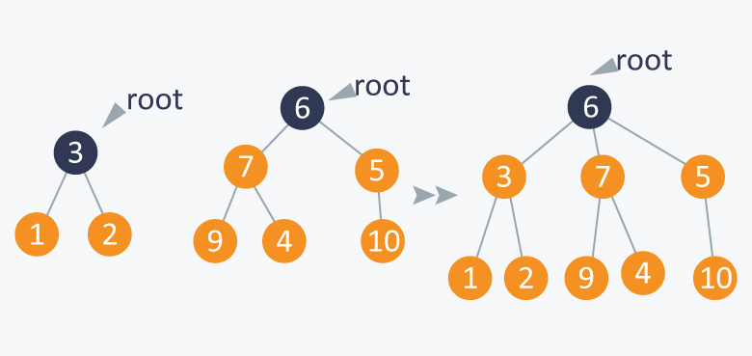
Disjoint Set ADT
A disjoint-set data structure (also known as a union-find data structure) is a data structure that keeps track of a collection of disjoint (non-overlapping) sets.

Slide 4
Self-Organizing List
A self-organizing list is a type of dynamic data structure in which the elements that are frequently accessed are moved closer to the front of the list to improve access time.
Unlike traditional data structures where elements are stored in a fixed order, in a self-organizing list, the order of elements can change based on their access patterns.
The goal is to reduce the average access time by organizing the elements in a way that optimizes the most frequent access patterns.

Slide 5
Functions Used
Disjoint Set ADT:
1. find(int x):
Finds the representative (parent) of the set that element x belongs to.
Uses Recursion to find the parent of the set.
Returns the parent of x (if exists), NULL otherwise.
Time Complexity: O(log n).
Worst Case: O(n).
2. union(int x, int y):
Merges the sets containing elements x and y into a single set.
Uses union by rank or union to optimize the operation.
Returns a set containing {x U y}.
Time Complexity: O(log n).
Worst Case: O(n).

Slide 6
Self-Organizing List:
1. search(int key):
Searches for an element with the specified key in the list.
After finding the element, the list is reorganized according to the chosen self-organizing strategy (move-to-front, transpose or count method).
Time Complexity: O(n)
2. insert(int value):
Inserts a new element with the specified value into the list.
Time Complexity: O(1)
3. delete(int key):
Removes an element with the specified key from the list.
Time Complexity: O(n)
4. Self-Organizing Strategies:
1) Move to front method:
Moves the accessed element with the specified key to the front of the list.
2) Transpose method:
Swaps the accessed element with its predecessor in the list.
3) Count method:
Increments the access count of the element and reorganizes the list based on the count values.

Slide 7
Applications
Disjoint Set ADT :-
1. Disjoint-Set-Forests: Used in implementing Kruskal’s minimum spanning tree algorithm.
2. Dynamic-Connectivity-Problem: Used in network connectivity applications, such as computer networks or social networks, to determine whether two nodes are connected within a network.
3. Image Processing: Used in image segmentation algorithms, where pixels with similar characteristics are grouped together into regions.
4. Games: Disjoint-set data structures are used in various board games to efficiently determine the connected components or territories on a game board, such as in Go or Hex.

Slide 8
Self-Organizing Lists :-
Caching Systems: Self-organizing lists are used in caching systems where frequently accessed data needs to be quickly accessible. By organizing the cache based on access frequency, the most frequently accessed data can be stored closer to the front, improving cache hit rates and overall performance.
2. Web Browsers: Web browsers often use self-organizing lists to manage the history of visited web pages. Frequently visited pages are moved closer to the front of the list, making them easily accessible via back and forward navigation.
3. Network Routing: In network routing algorithms, self-organizing lists can be used to maintain a list of frequently accessed routes. Routes that are frequently used are moved closer to the front of the list, reducing lookup time for packet forwarding.
4. File Systems: Self-organizing lists can be employed in file systems to manage directory structures or maintain lists of frequently accessed files. This can improve file access times and overall system performance.

Slide 9

1)Project Manager
2)Business Analyst
1)Developers
1)Developers
2)Project
Manager
1)Testers
1)Developers
2)Project Managers
3)Business
Analyst
1)Testers
2)Developers

Slide 10
Students and their Roles
4.Testers:
Disjoint Set:
Santhosh A
Self Organising List:
Goutham Siva R
Adhithya S
Project Manager: Ankith V
Business Analyst: Anuj Siddharth B
Developers:
Disjoint Set:
Dinesh Kumar CP
Hari A
Sudharshan LN
Self Organising List:
Mithunakumar VG
Kenson Francis W
Sharan K

