Slide 1

Students’ appraised family and friends’ support and e-learning engagement of undergraduates in Sri Lanka
CS5651 - Statistical Inference
Department of Computer Science and Engineering
University of Moratuwa
MSc in Computer Science
K.D.R. Perera
(219382E)

Slide 2


Survey
Matrices to identify Family support
- Having a separate area to engage in e-learning activities
Having an uninterrupted environment to engage in academic activities
Family being able to facilitate the technological requirements and services that are required for distant learning
Family encouragement on studies
Satisfaction with the current family support regardless the above factors

Slide 3

Survey cont.
Matrices to identify friends’ support
University colleagues be contacted whenever needed during the distant-learning period
Friends’ encouragement on studies
Support for the academic activities
Satisfaction with the current support regardless the above factors

Slide 4
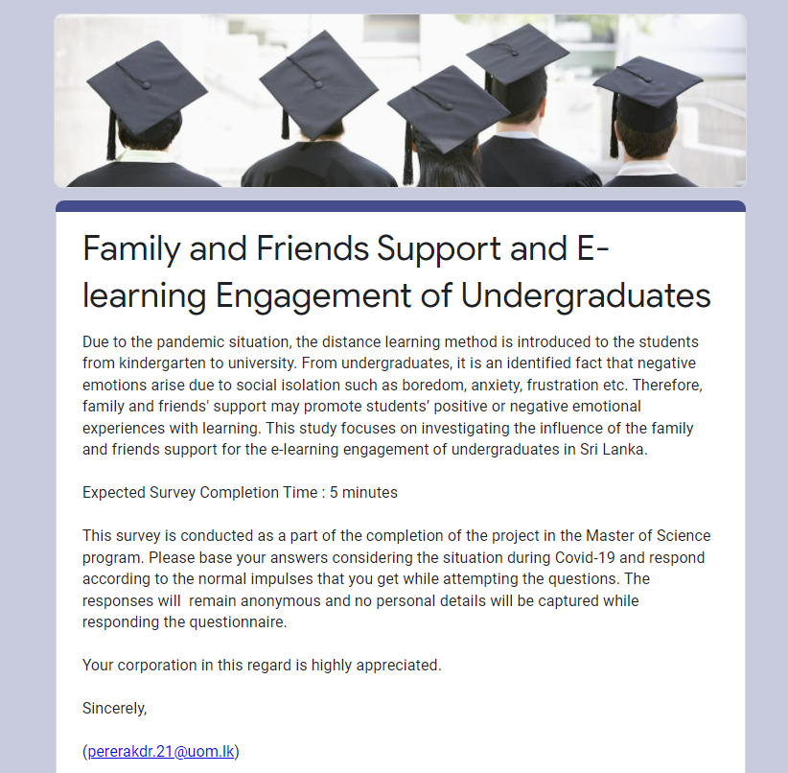
Survey
Expected Survey Completion Time : 5 minutes
Matrices to identify family support : 5
Matrices to identify family support : 4
Demographic questions: 6
Number of Responses: 166

Slide 5
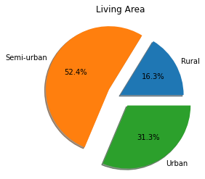
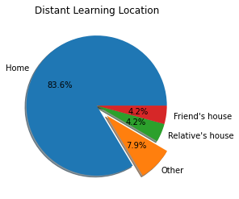
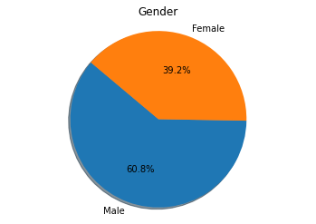
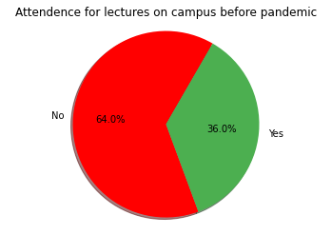
Descriptive analysis

Slide 6
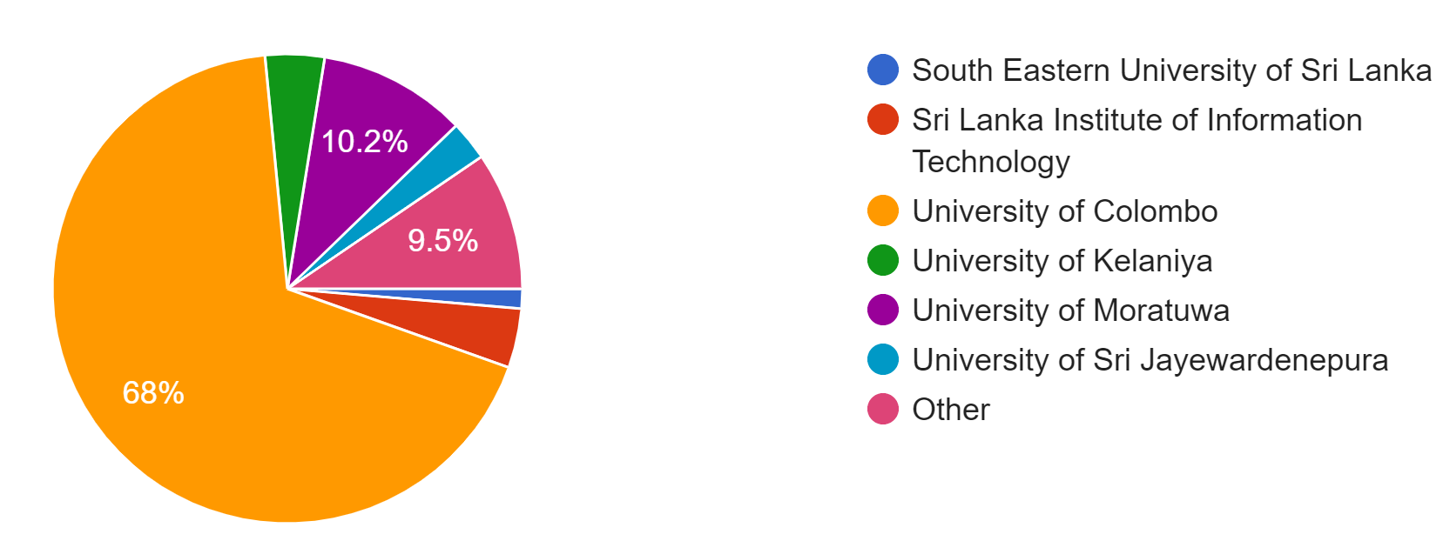
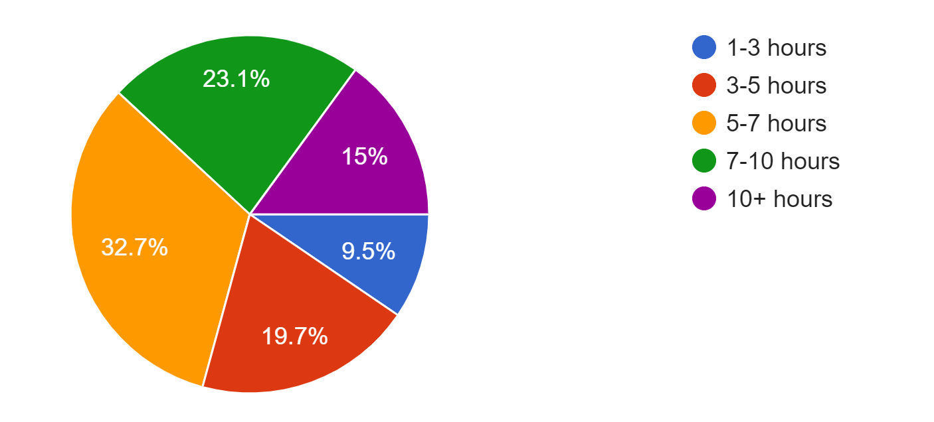
Descriptive analysis

Slide 7
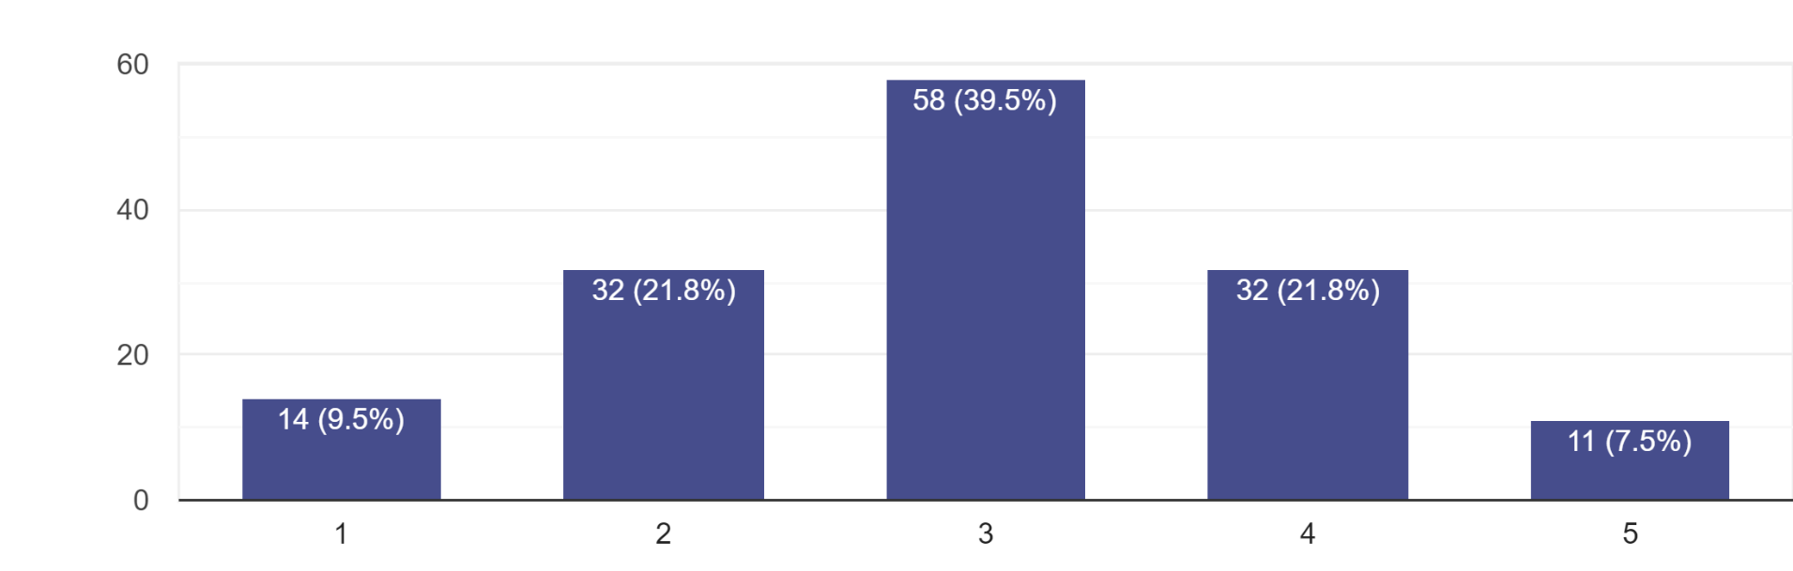
Effectiveness of remote learning

Slide 8
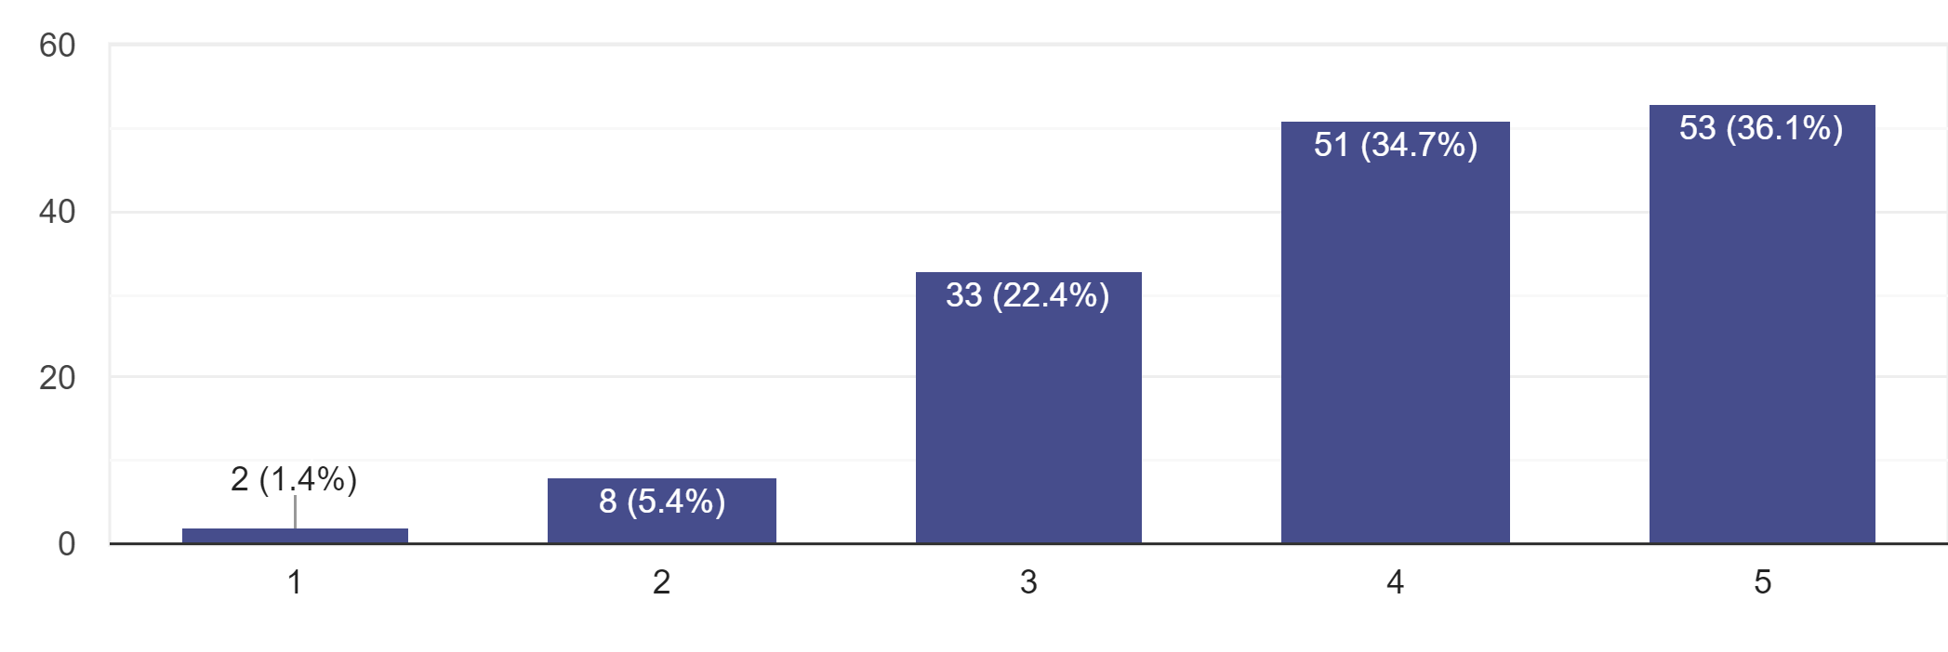
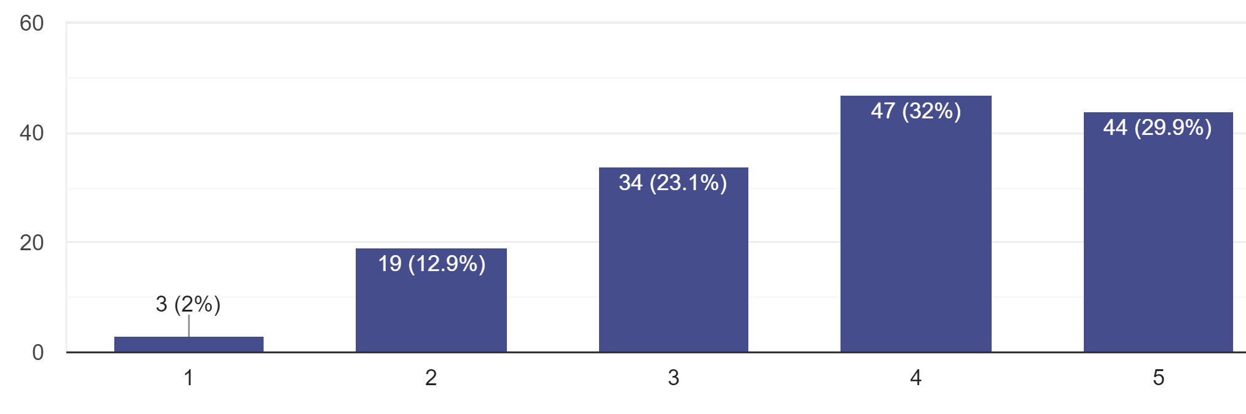
Impact of family support for e-learning engagement
Impact of friends' support for e-learning engagement

Slide 9
Hypothesis
H01: Positive impact on motivating the e-learning engagement of female with family support has no difference from its male parameter (H01: 𝝁f - 𝝁m = 0)
Ha1: Positive impact on motivating the e-learning engagement of female with family support is greater than of its male parameter (H01: 𝝁f - 𝝁m >0)
H02: Positive impact on motivating the e-learning engagement of female with friends' support has no difference from its male parameter (H02: 𝝁f - 𝝁m = 0)
Ha2: Positive impact on motivating the e-learning engagement of female with friends’ support is greater than of its male parameter (H02: 𝝁f - 𝝁m >0)

Slide 10
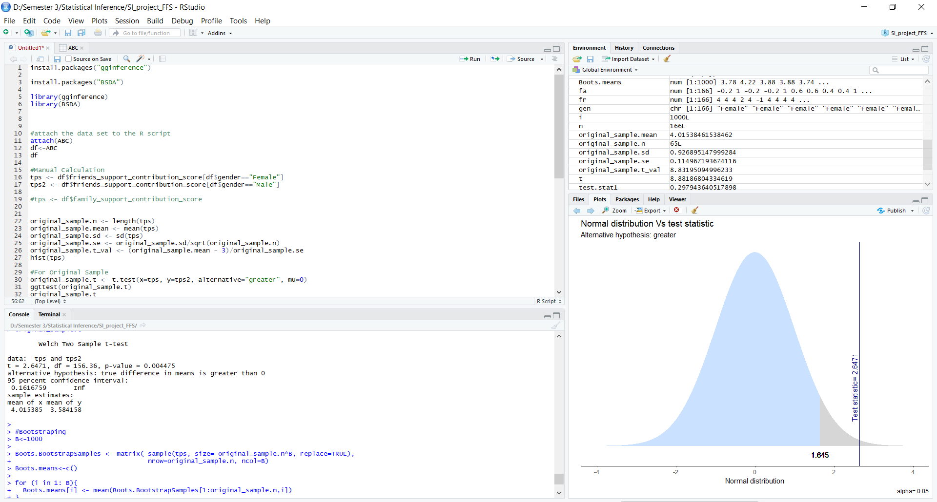

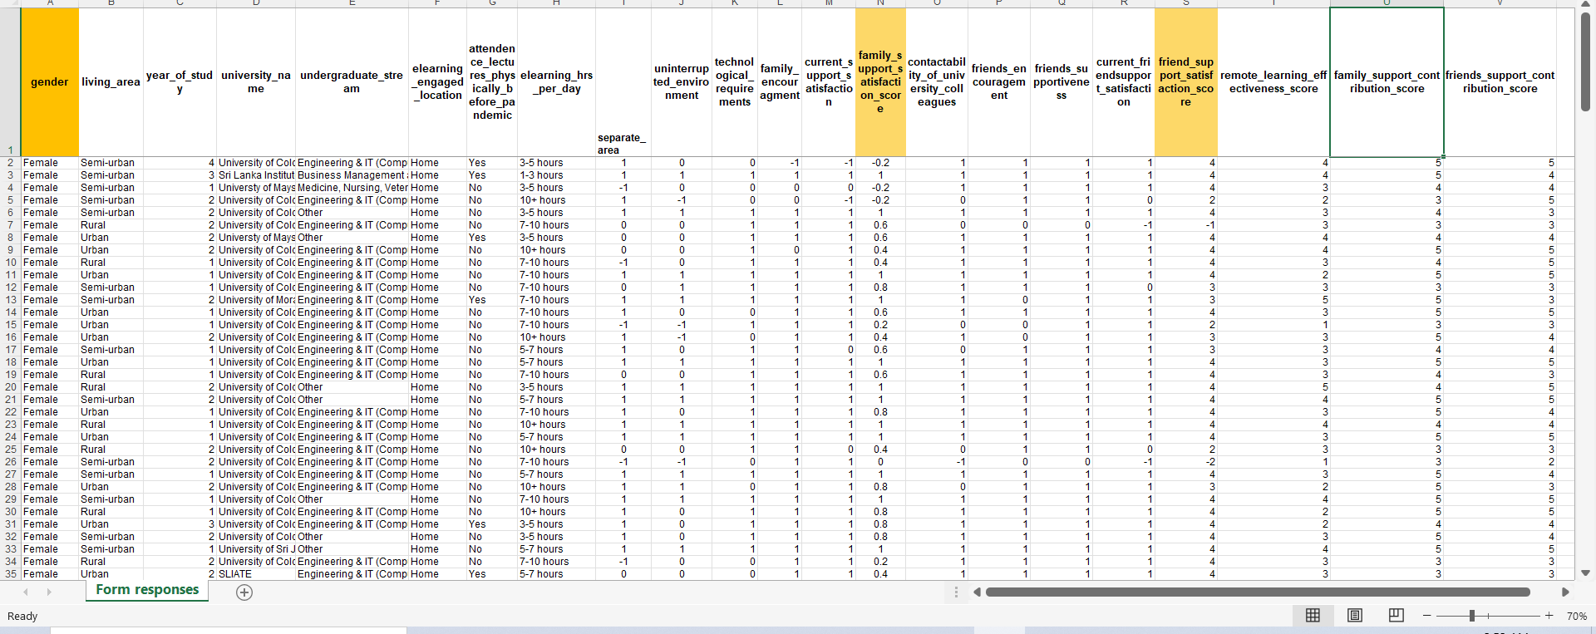
Analysis
Data Preprocessing
And
Encoding
Define H0 and Ha
Apply Two Sample T-test on gender and
satisfaction
scores
Plot the Normal Distribution
P-value < 𝜶
Reject H0, else Do not reject H0

Slide 11
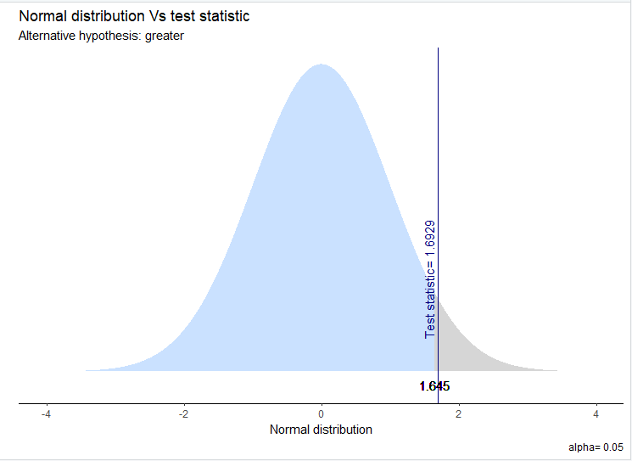
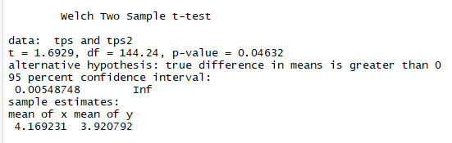
Impact of Family Support for e-learning engagement on gender
P-value < 𝜶
𝜶 = 0.05
P-value = 0.0463
Reject H0

Slide 12
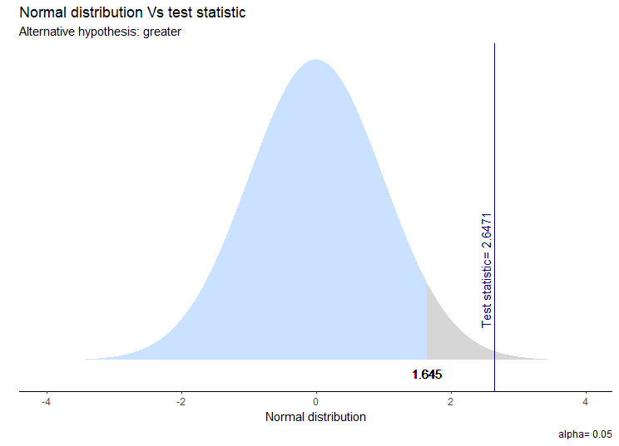
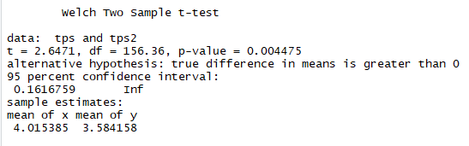
Impact of Friends’ Support for e-learning engagement on gender
P-value < 𝜶
𝜶 = 0.05
P-value = 0.0045
Reject H0

Slide 13
Conclusion (Insight)
We do not have enough evidence to say that positive impact on motivating the e-learning engagement of female with family support has no difference from its male parameter.
We do not have enough evidence to say that positive impact on motivating the e-learning engagement of female with friends’ support has no difference from its male parameter.

Slide 14

Thank you

