Slide 1
Vehicle Tracking System (VTS)
Presented by
SysCall
Batch 11
Faculty of Information Technology
University of Moratuwa
2013

Slide 2
Team Members Team SysCall M. F. H. M. Adheeb 114003 E T. M. K. B. Thennakoon 114150 B M. H. U. K. Jayasinghe 114058 B A. K. D. M. Karunarathne 114066 X A. L. H. H. Liyanage 114169 P Supervised by: Dr. Lochandaka Ranathunga

Slide 3
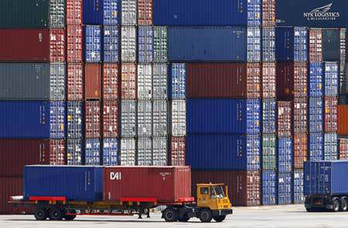
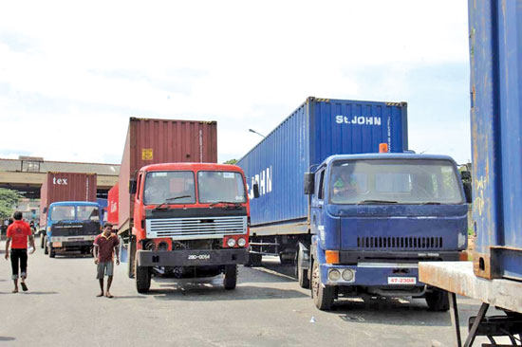
Overview
Introduction
Aim & Objectives
Others’ Approaches
Our Approach
Design
Implementation
Evaluation
Further work
Demonstration

Slide 4
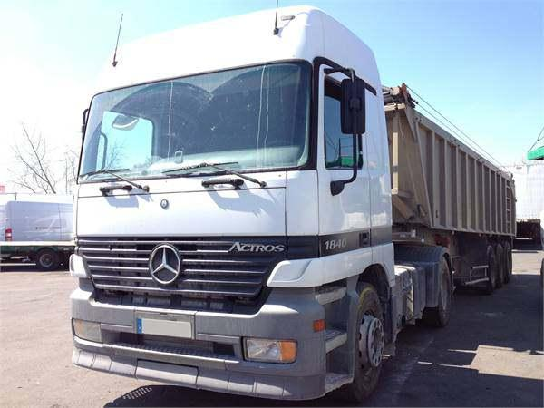
Introduction
This project had been designed for our client, Sri Lanka Ports Authority (SLPA).
The main purpose of this project is to develop a tracking System for the prime movers which are inside the port and nearby Colombo.
As a core operation of SLPA, efficient and effective vehicle allocation management and planning holds a great importance.
VTS such as this will eliminate
the obstacles affecting this
operation.

Slide 5
Aim Objectives
Develop a system to track prime movers and their locations show on a digital map to subscribe users using GPS technology.
Take an idea about the domain; be familiar with the port environment.
Identifying the problem.
Designing and developing the system to solve the problem
Implementing the system with the use of GSM / GPRS and GPS technology
Evaluation of the implemented Vehicle Tracking System.
Preparation of final documentation

Slide 6
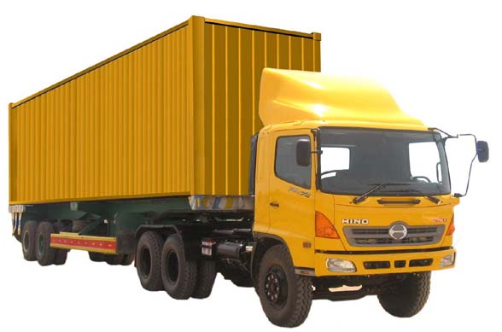
Others’ Approaches
There are some of GPS vehicle tracking systems used in other developed countries. The techniques used by these systems are highly advanced.
In Sri Lanka also, there are some advanced systems which are used for the similar purposes.
Tekno Track vehicle tracking systems
Sala ProSat vehicle tracking systems
Accuar-Tech vehicle tracking systems
Smart Track vehicle tracking systems

Slide 7
The technologies used in overseas countries are highly advanced and expensive.
We used our own knowledge gathered by many references when we are developing this system.
Therefore this VTS will be a low cost product comparing with other systems.
We strongly believe system will avoid the drawbacks of existing systems.

Slide 8
Our Approach
Technology adapted
Global Positioning System (GPS)
General Packet-Radio System (GPRS)
Transmission Control Protocol (TCP)
Socket Programming
Web Technologies
Database Management Technologies
Inputs
TCP GPS Coordinates Listener receives coordinates from the GPS module
When Coordinates received, they are stored in database

Slide 9
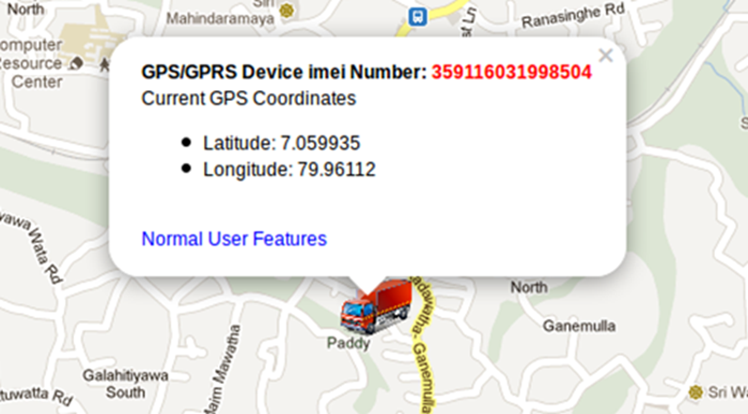
Output
Showing tracked prime movers on a digital map
The digital map shows the real time movement of the tracked vehicles.
There are features that you can view history or driver details as well.

Slide 10
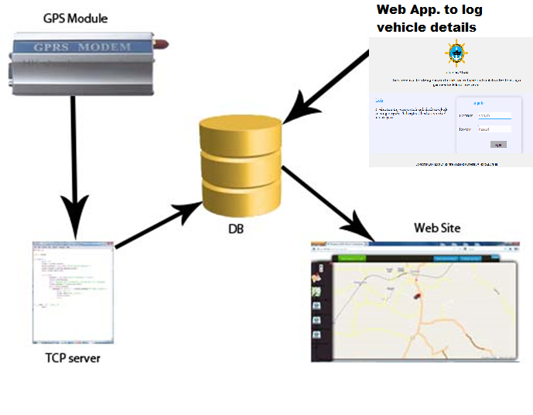
Design

Slide 11
Designing of the system mainly divided in to 4 major parts.
i). TCP GPS Coordinates Listener
This is able to receive location coordinates from the vehicles and store them in the database.
ii). Tile Server for storing maps
Instead of using online digital map we thought of store digital map of Sri Lanka as tiles in a tile server on the intranet.
Therefore the users can use this system without access to the public internet.

Slide 12
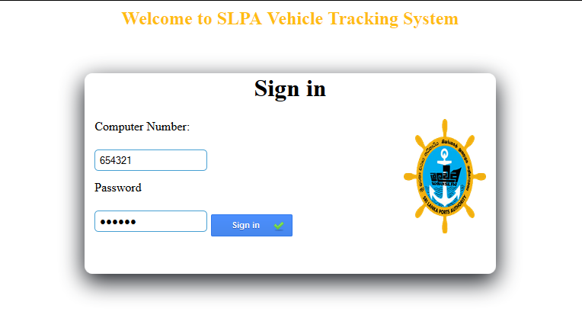
iii). Web site and Admin panel
After a successful login the
user can see the tracked
vehicles on the digital map.
iv). Application to log details of
drivers and vehicles, which are leaving the port
There is no existing system to keep records of the drivers and vehicles that are leaving the port.
The system will responsible for log driver details, vehicle information and add new locations.

Slide 13
Implementation
Implementation of VTS is divided into following steps.
i). Configuration of GPS/GPRS module
Module mode must be changed into the GPRS mode.
APN, IP Address & the Port number must be configured on the module.
ii). Implementation of TCP GPS Coordinates Listener
This can listens a specific port of the computer.
If any data received from that port it can identify and store the received data in a database.
Python language is used for coding the TCP Listener in VTS.

Slide 14
Implementation (Contd…)
iii). Implementation of Tile Server
Digital map is stored in the tile server to make the system available, without internet access too.
Tiles for Sri Lankan Maps from the Open Street Maps downloaded and stored in a PC which can be access through the intranet
iv). Implementation of Web site and admin panel
Main application of the system.
Implemented using PHP, JavaScript and Ajax technologies.
Two user groups in the this application. (Administrators & Normal Users)

Slide 15
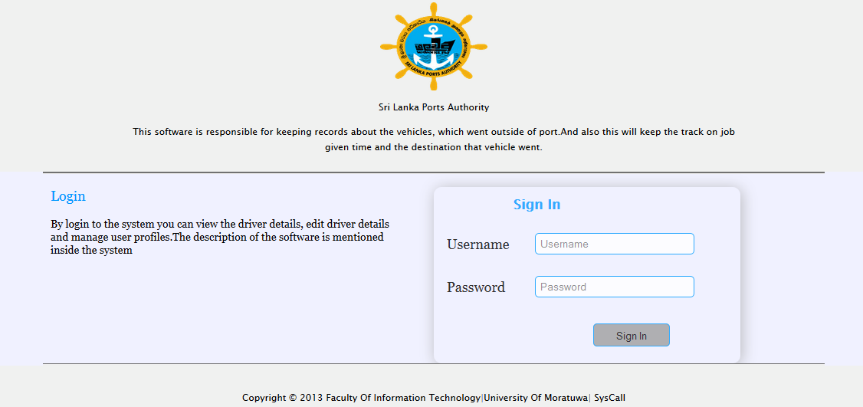
Implementation (Contd…)
v). Implementation of Application to log vehicle details
leaving the port
The major purpose of
this system is to keep
records of the drivers
and vehicles, which are
leaving the port.
Maintains two user
levels. (Administrators and Normal Users)

Slide 16
Evaluation
In this project our main goal was to develop a Vehicle Tracking System for Sri Lanka Ports Authority.
We did many designs and experiments and we always discussed with SLPA about them to find the best way to reach our goal.
We have done number of test cases to ensure that this project works properly without any failure.

Slide 17
Evaluation (Contd…)
We had showed our design our client, time to time and asked for changes as they are the users of this system.
Security of this SLPA should be highly ensured as it is one of the largest and highly responsible government agencies in the country. Therefore we have to make sure that our website is a secured one.
We have done many test cases on login to the system to prevent unauthorized access to the system.

Slide 18
Conclusion
Our main objective is to develop a real time vehicle tracking system to track, prime movers of SLPA.
We have used GPRS enabled GPS device which is attached prime mover is used to get the location of the prime mover.
When we consider about our achievements of this project, we are glad to say that we could achieve almost all objectives successfully.
Currently we are planning to make our system more efficient and user friendly.

Slide 19
Further work
Add facility to monitor fuel level/ oil level of the prime mover
Add facility to generate reports per prime mover and per month according to users’ requests
Add facility to communicate with the prime mover using system

Slide 20
Thank You

