Slide 1


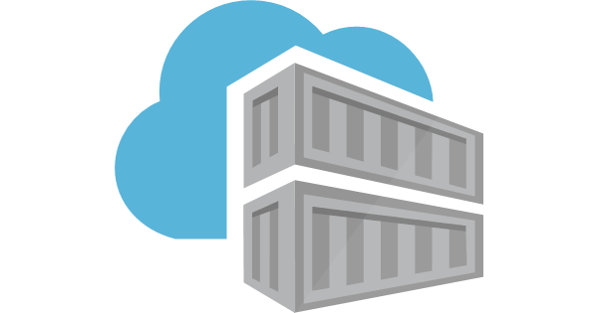
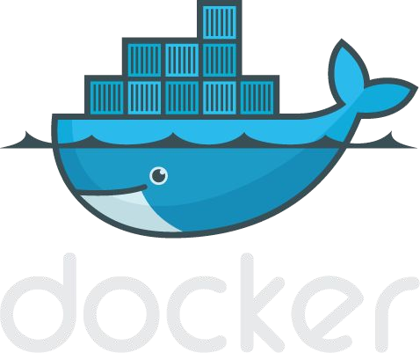
Introduction to Containerisation & Docker
Dinu Mathai
Dinu.Mathai@ust.com

Slide 2
The Problem - Why Containerisation?
Application Management - Deployment team must manage libraries, application software and application
Environment Issues : The application that works on environment may not work on a new one or another one because of config issue.
Resource Optimization
Optimize application for deployment in cloud

Slide 3
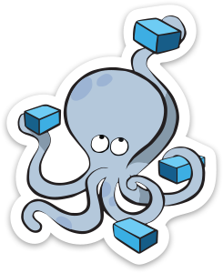
Agenda
Section 1:
What is Container?
What is Docker?
Section 3:
DEMO
Section 2:
Docker file Docker volumes
Section 4:
Docker compose Kubernetes

Slide 4
Section 1: What is Container?
What is Docker?

Slide 5
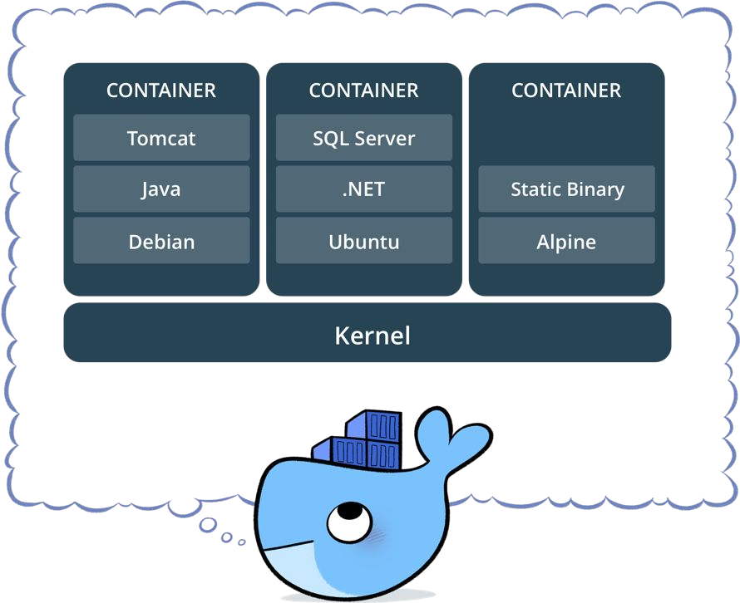
What is a container?
Standardized packaging for software and dependencies
Isolate apps from each other
Share the same OS kernel
Light weight compared to VM

Slide 6
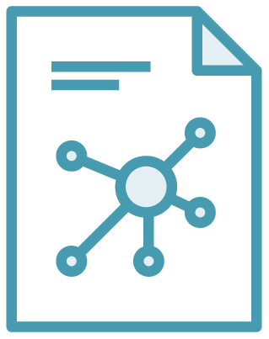

The Role of Images and Containers
Docker Image(read only)
Docker Container
Example: Ubuntu with Node.js and Application Code
Created by using an image. Runs your application.

Slide 7
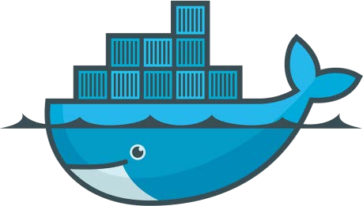
Docker package applications in containers, allowing them to be portable
Lightweight, open, secure platform.
Runs natively on Linux or Windows Server
Runs on Windows or Mac Development machines (with a virtual machine)
Relies on "images" and "containers"
What Is Docker?

Slide 8
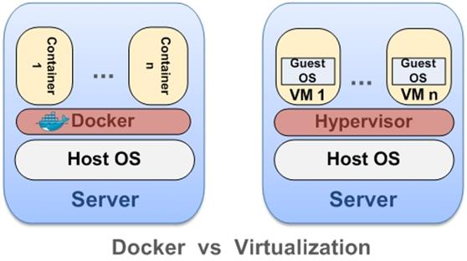
Docker Containers Vs Virtual Machines

Slide 9

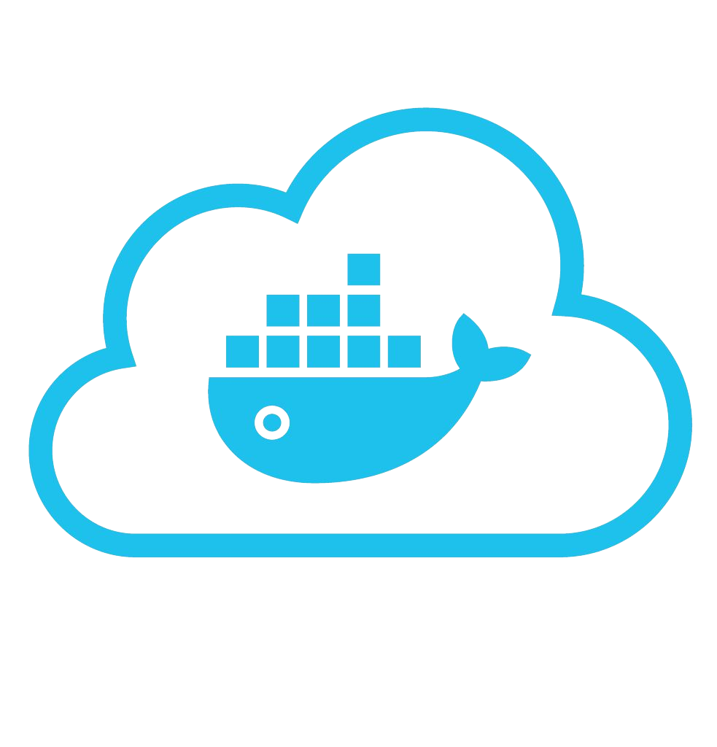










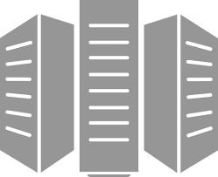



Using Docker: Build, Ship, Run Workflow
Developers IT Operations
BUILD
Development Environments
SHIP(Docker registry)
Create & Store Images
RUN
Deploy, Manage, Scale

Slide 10




Some Docker vocabulary
Docker Image
The basis of a Docker container. Represents a full application
Docker Container
The standard unit in which the application service resides and executes
Docker Engine
Creates, ships and runs Docker containers deployable on a physical or virtual, host locally, in a datacenter or cloud service provider
Registry Service (Docker Hub(Public) or Docker Trusted Registry(Private))
Cloud or server based storage and distribution service for your images

Slide 11
Section 2:
Docker File Docker Volumes

Slide 12
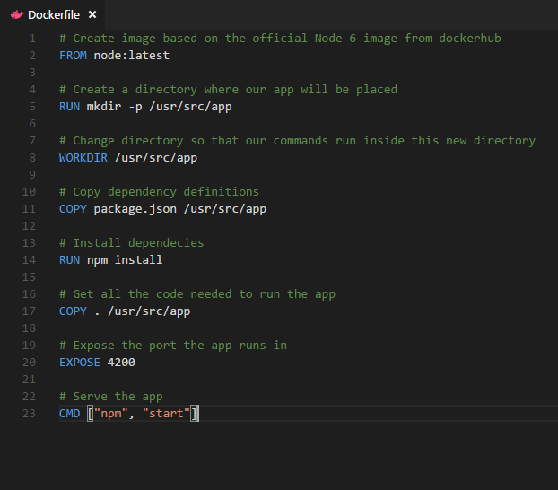
Dockerfile – Linux Example
Instructions on how to build a Docker image
Looks very similar to “native” commands
Important to optimize your Dockerfile
14

Slide 13
Each Dockerfile Command Creates a Layer
…
EXPOSE
COPY
WORKDIR
RUN
FROM
Kernel

Slide 14
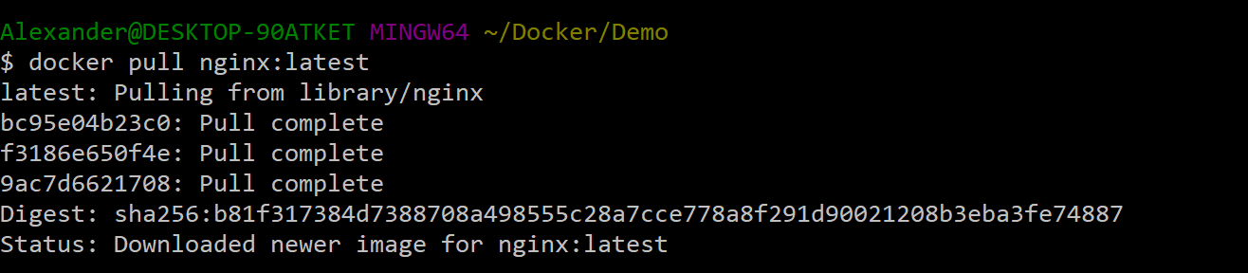
Docker Image Pull: Pulls Layers

Slide 15
Docker Volumes
Volumes mount a directory on the host into the container at a specific location
Can be used to share (and persist) data between containers
Directory persists after the container is deleted
Unless you explicitly delete it
Can be created in a Dockerfile or via CLI

Slide 16
Why Use Volumes
Mount local source code into a running container
docker container run -v $(pwd):/usr/src/app/ myapp
Improve performance
− As directory structures get complicated traversing the tree can slow system performance
Data persistence

Slide 17
Section 3: DEMO

Slide 18
Basic Docker Commands
$ docker image pull node:latest
$ docker image ls
$ docker run –d –p 5000:5000 –-name node node:latest
$ docker ps
$ docker stop node(or <container id>)
$ docker rm node (or <container id>)
$ docker image rmi (or <image id>)
$ docker build –t node:2.0 .
$ docker image push node:2.0
$ docker --help

Slide 19
Section 4: - What is Docker Compose - What is Kubernetes

Slide 20




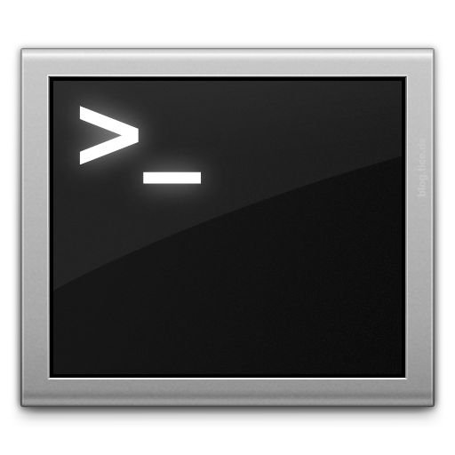







Docker Compose: Multi Container Applications
Build and run one container at a time
Manually connect containers together
Must be careful with dependencies and start up order
Define multi container app in compose.yml file
Single command to deploy entire app
Handles container dependencies
Works with Docker Swarm, Networking, Volumes, Universal Control Plane
49

Slide 21

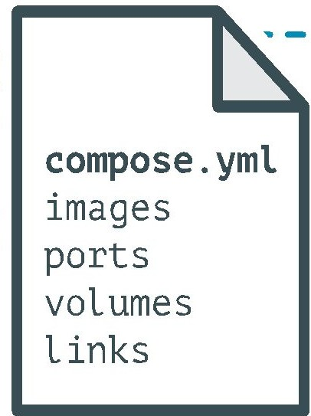
Docker Compose: Multi Container Applications
version: '2' # specify docker-compose version
# Define the services/containers to be run
services:
angular: # name of the first service
build: client # specify the directory of the Dockerfile
ports:
- "4200:4200" # specify port forewarding
express: #name of the second service
build: api # specify the directory of the Dockerfile
ports:
- "3977:3977" #specify ports forewarding
database: # name of the third service
image: mongo # specify image to build container from
ports:
- "27017:27017" # specify port forewarding

Slide 22
What is Kubernetes
Service discovery and load balancing Kubernetes can expose a container using the DNS name or using their own IP address
Storage orchestration Kubernetes allows you to automatically mount a storage system of your choice
Scaling, Automated rollouts and rollbacks You can describe the desired state for your deployed containers using Kubernetes
Automatic bin packing You tell Kubernetes how much CPU and memory (RAM) each container needs. Kubernetes can fit containers onto your nodes to make the best use of your resources.
Secret and configuration management Kubernetes lets you store and manage sensitive information and app configuration

Slide 23
Questions ?

Slide 24
Thank You !!!

