Slide 1

Medicine Database
Team Members List
PES Data Science Presentation

Slide 2
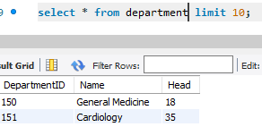
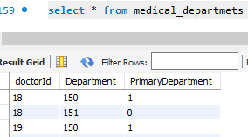
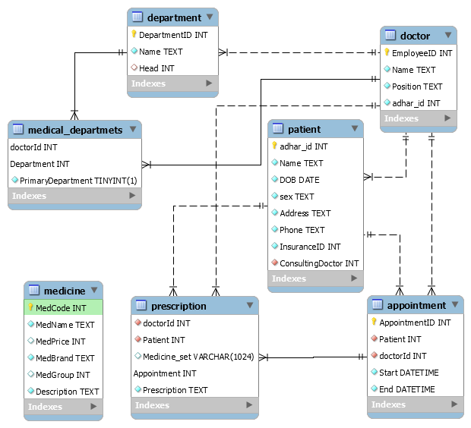
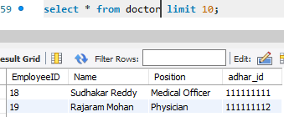
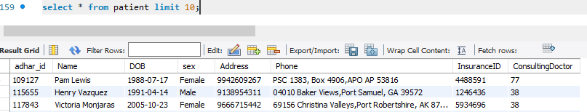
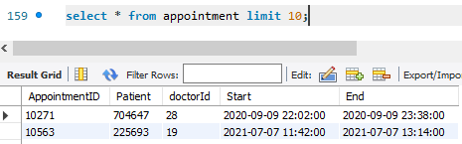
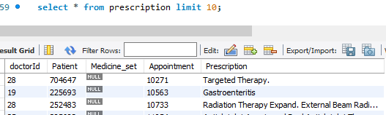
Database Design
Dummy Data Preparation Tools [Link]
Design and Code [github/pesmtech]
PES Data Science Presentation

Slide 3
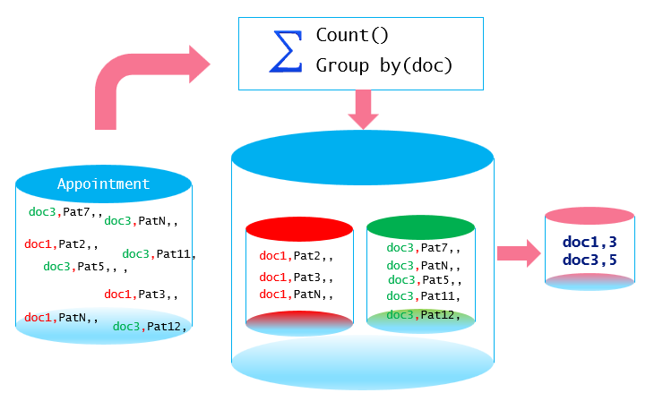
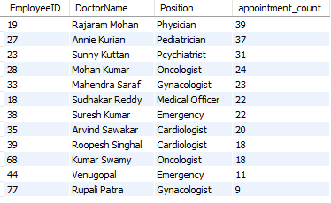
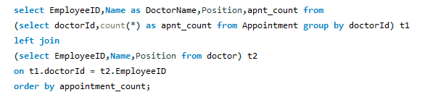
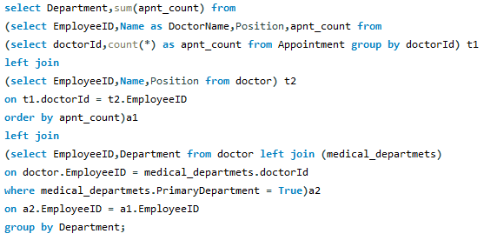
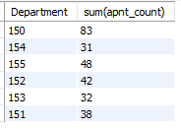
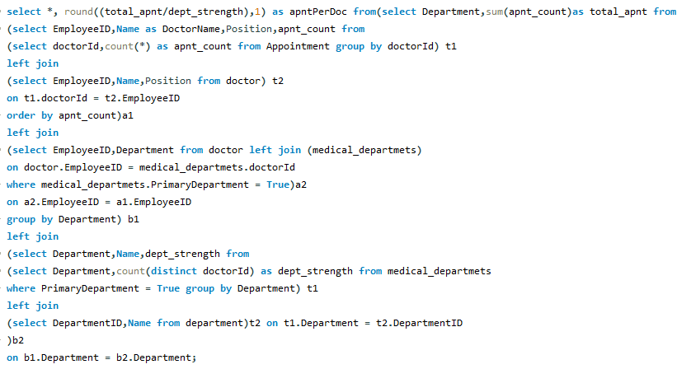
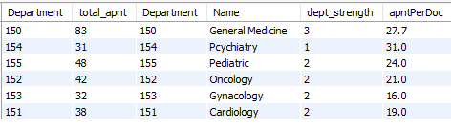
Aggregate Functions - Concepts
Consultation Count per Doctor
Consultation Count per Department wise
Aggregate Function Summarizes data
Operates on Sets of Values
Name | Description
AVG() | Return the average value of the argument
COUNT() | Return a count of the number of rows returned
COUNT(DISTINCT) | Return the count of a number of different values
GROUP_CONCAT() | Return a concatenated string
JSON_ARRAYAGG() | Return result set as a single JSON array
MAX() | Return the maximum value
MIN() | Return the minimum value
STD() | Return the population standard deviation
STDDEV() | Return the population standard deviation
STDDEV_POP() | Return the population standard deviation
STDDEV_SAMP() | Return the sample standard deviation
SUM() | Return the sum
VAR_POP() | Return the population standard variance
VAR_SAMP() | Return the sample variance
VARIANCE() | Return the population standard variance
Which Doctors are overloaded?
PES Data Science Presentation

Slide 4
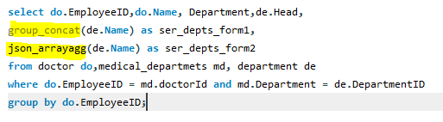
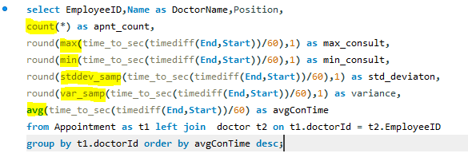
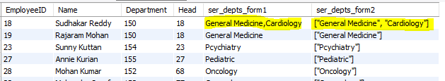
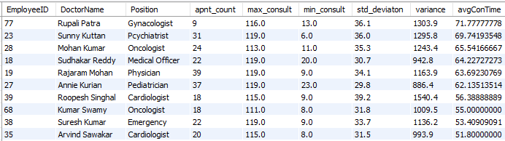
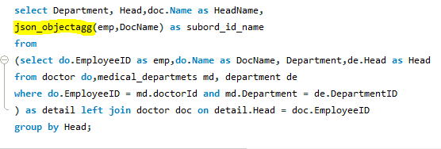
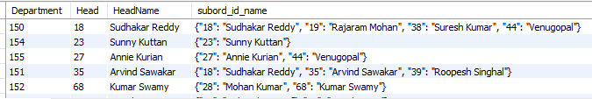
Different Functions – Group By
Concatanation, JsonArray
Descripive Statistic Functions
JsonObjects
PES Data Science Presentation

Slide 5
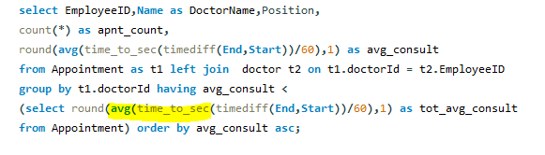
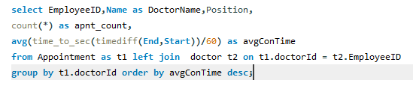

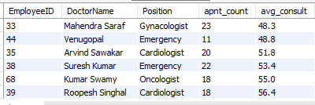
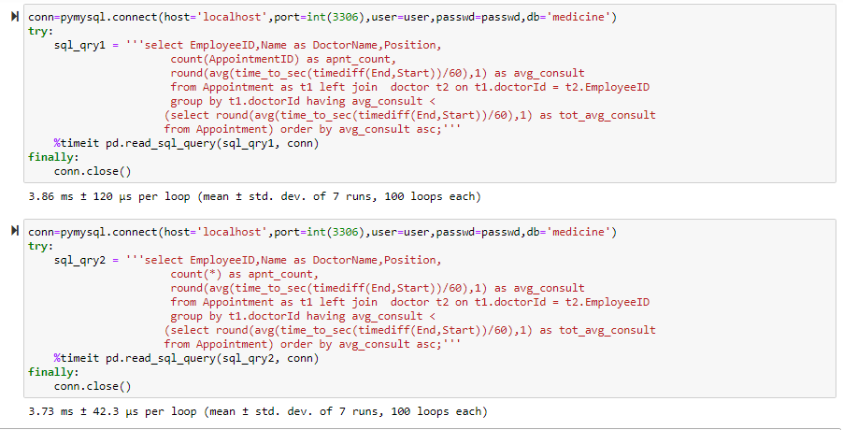
Miscellaneous
Sub Queries
The SUM() and AVG() aggregate functions do not work with temporal values, convert to numeric units beforeaggregation
if the value is a non-NULL, you should always use count(*) instead of count(value)
PES Data Science Presentation

Slide 6
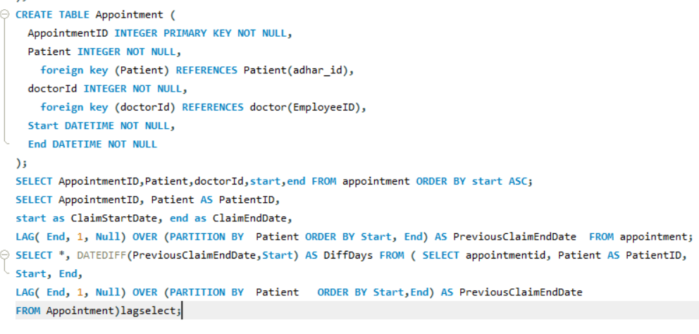
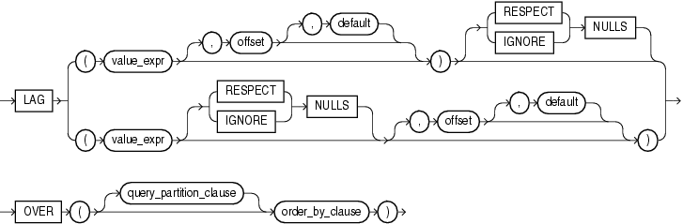
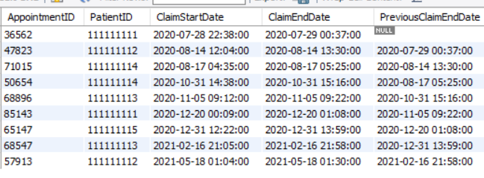
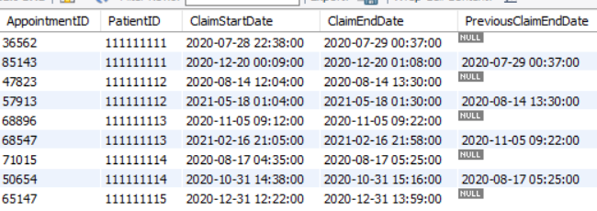
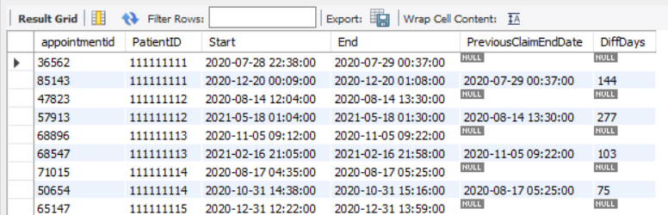
SQL Lag function
Syntax of Lag function
LAG (scalar_expression [,offset] [,default])
OVER ( [ partition_by_clause ] order_by_clause )
PES Data Science Presentation

Slide 7
Conclusion
In this Presentation, we learned the SQL Lag function and its usage to retrieve a value from previous rows. Here is the quick summary of the lag function:
Lag function fetches the value from the previous rows based on the offset defined
Offset one is the default offset value, and in this Lag, the function retrieves a value from the previous row
PARTITION BY clause defines a logical boundary of data based on the specified condition
The lag function uses default value NULL for out-of-range data
We can use the Lag function with common table expression, stored procedures, and functions for computation purposes…….
PES Data Science Presentation

Slide 8


Thank You
PES Project Team
PES Data Science Presentation

