Slide 1

Medicine Database
Charithra Chandrashekar
Dinu Thomas
Fathima Hafeez
Kashyap Bhargav Ram
Sharath
PES Data Science Presentation

Slide 2
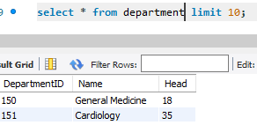
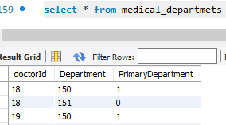
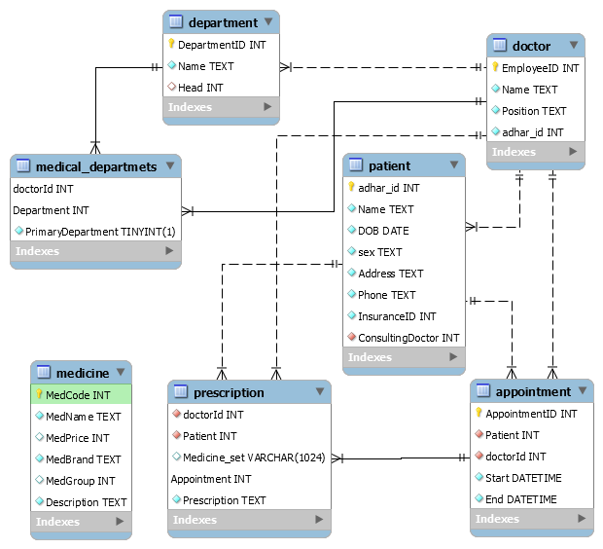
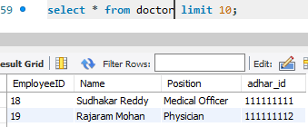
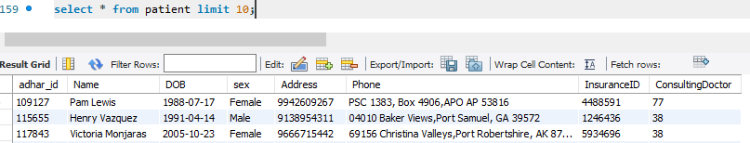
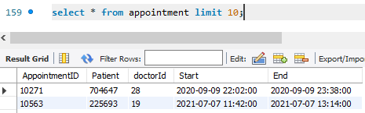
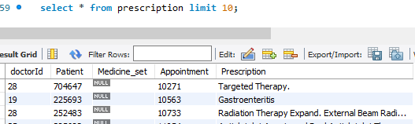
Database Design
Dummy Data Preparation Tools [Link]
Design and Code [github/pesmtech]
PES Data Science Presentation

Slide 3
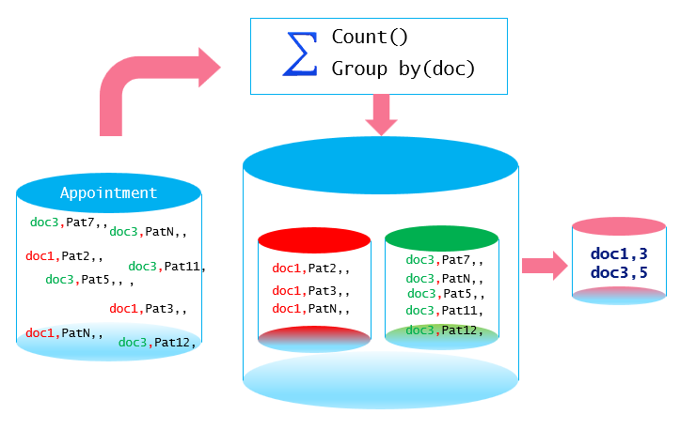
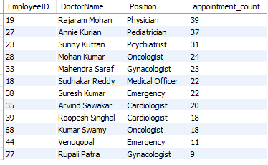
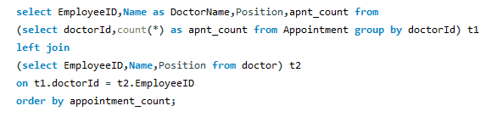
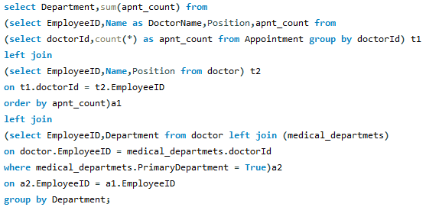
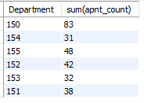
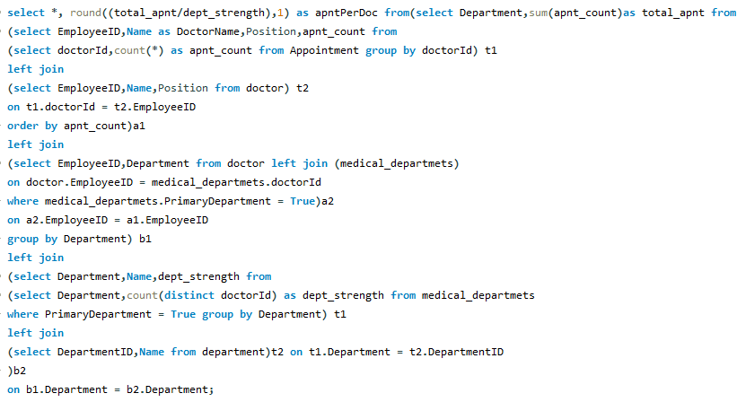
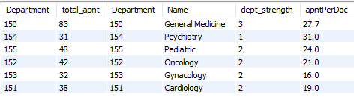
Aggregate Functions - Concepts
Consultation Count per Doctor
Consultation Count per Department wise
Aggregate Function Summarizes data
Operates on Sets of Values
Name | Description
AVG() | Return the average value of the argument
COUNT() | Return a count of the number of rows returned
COUNT(DISTINCT) | Return the count of a number of different values
GROUP_CONCAT() | Return a concatenated string
JSON_ARRAYAGG() | Return result set as a single JSON array
MAX() | Return the maximum value
MIN() | Return the minimum value
STD() | Return the population standard deviation
STDDEV() | Return the population standard deviation
STDDEV_POP() | Return the population standard deviation
STDDEV_SAMP() | Return the sample standard deviation
SUM() | Return the sum
VAR_POP() | Return the population standard variance
VAR_SAMP() | Return the sample variance
VARIANCE() | Return the population standard variance
Which Doctors are overloaded?
PES Data Science Presentation

Slide 4
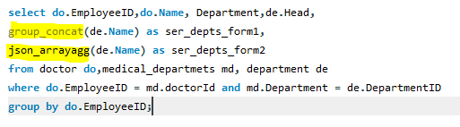
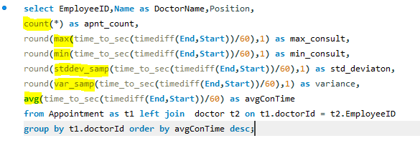
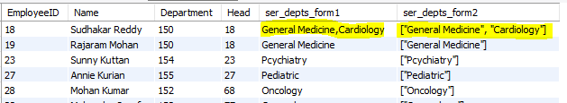
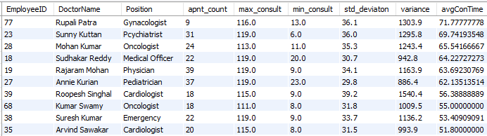
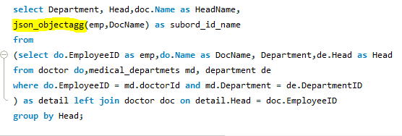
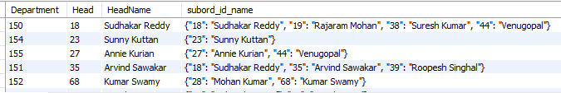
Different Functions – Group By
Concatanation, JsonArray
Descripive Statistic Functions
JsonObjects
PES Data Science Presentation

Slide 5
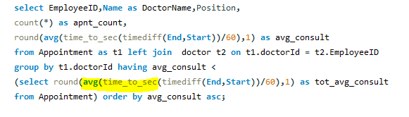
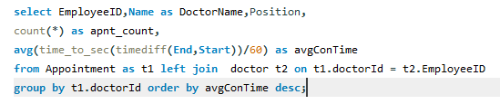

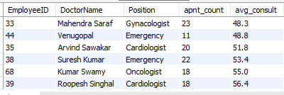
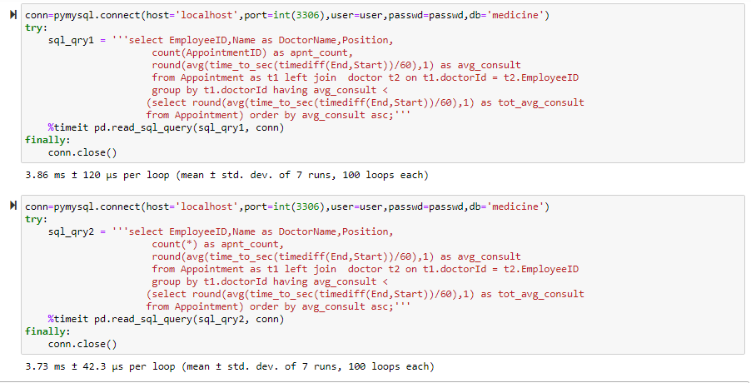
Miscellaneous
Sub Queries
The SUM() and AVG() aggregate functions do not work with temporal values, convert to numeric units beforeaggregation
Which Doctors have less patients than average?
if the value is a non-NULL, you should always use count(*) instead of count(value)
PES Data Science Presentation

Slide 6
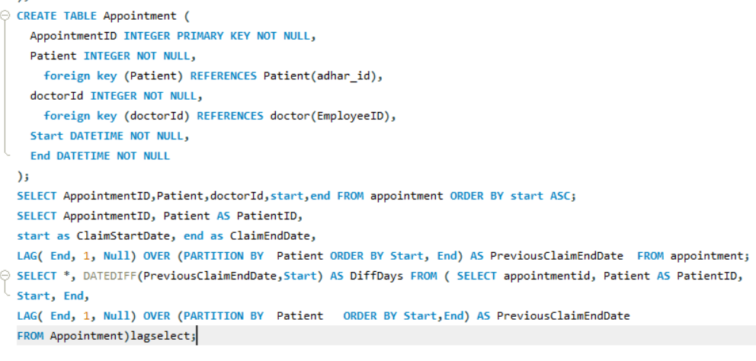
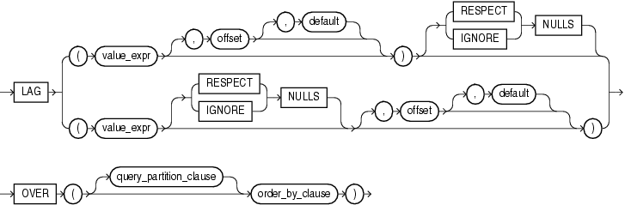
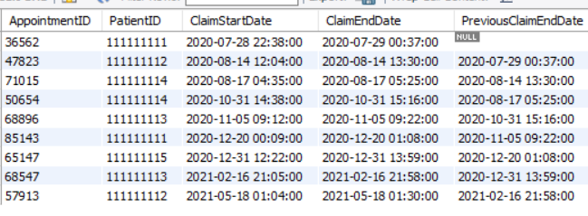
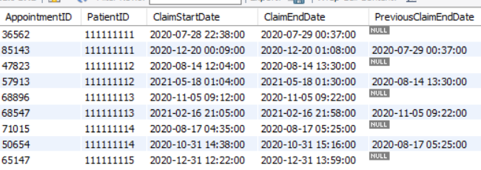
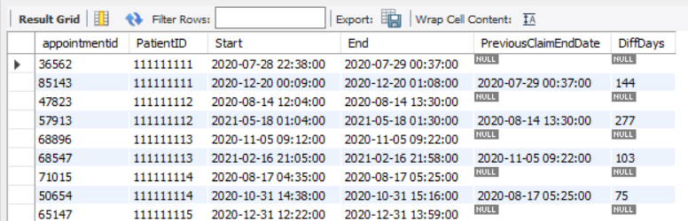
SQL Lag function
Syntax of Lag function
LAG (scalar_expression [,offset] [,default])
OVER ( [ partition_by_clause ] order_by_clause )
PES Data Science Presentation

Slide 7
Conclusion
In this Presentation, we learned the SQL Lag function and its usage to retrieve a value from previous rows. Here is the quick summary of the lag function:
Lag function fetches the value from the previous rows based on the offset defined
Offset one is the default offset value, and in this Lag, the function retrieves a value from the previous row
PARTITION BY clause defines a logical boundary of data based on the specified condition
The lag function uses default value NULL for out-of-range data
We can use the Lag function with common table expression, stored procedures, and functions for computation purposes…….
PES Data Science Presentation

Slide 8


Thank You
PES Project Team
PES Data Science Presentation

