Slide 1

Medicine Database
Charithra Chandrashekar
Dinu Thomas
Fathima Hafeez
Kashyap Bhargav Ram
Sharath
PES Data Science Presentation

Slide 2
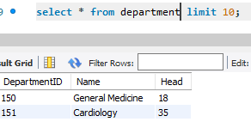
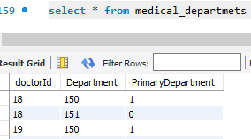
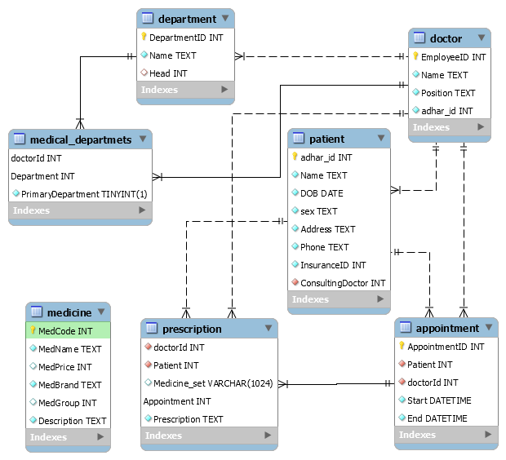
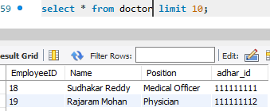
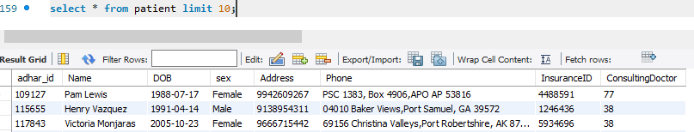
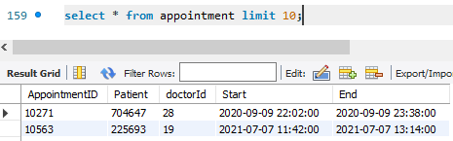
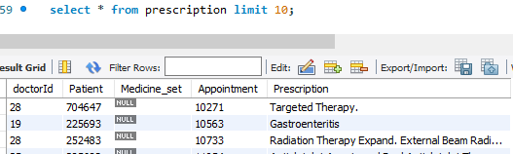
Database Design
Dummy Data Preparation Tools [Link]
Design and Code [github/pesmtech]
PES Data Science Presentation

Slide 3
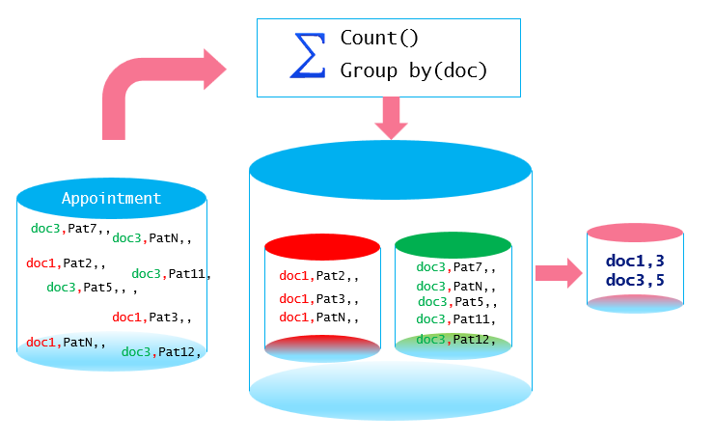
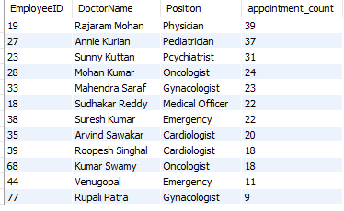
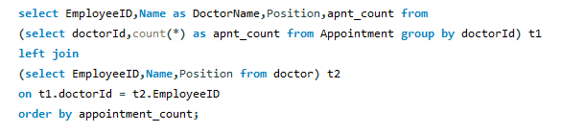
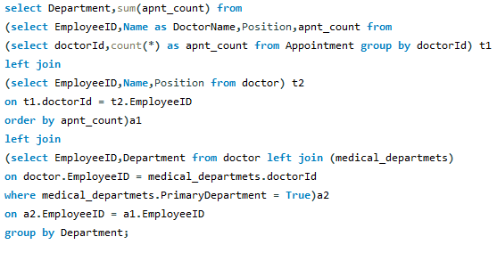
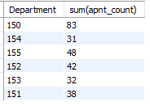
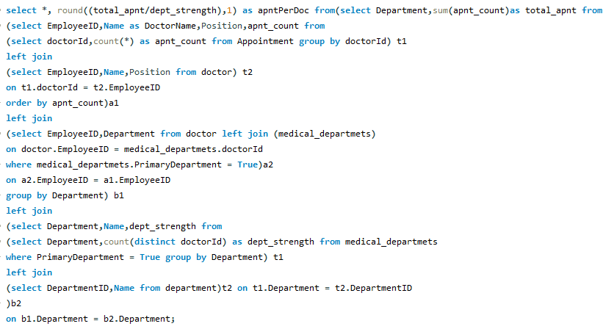
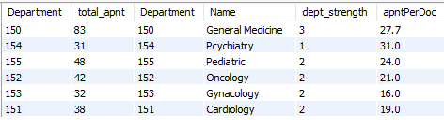
Aggregate Functions - Concepts
Consultation Count per Doctor
Consultation Count per Department wise
Aggregate Function Summarizes data
Operates on Sets of Values
Name | Description
AVG() | Return the average value of the argument
COUNT() | Return a count of the number of rows returned
COUNT(DISTINCT) | Return the count of a number of different values
GROUP_CONCAT() | Return a concatenated string
JSON_ARRAYAGG() | Return result set as a single JSON array
MAX() | Return the maximum value
MIN() | Return the minimum value
STD() | Return the population standard deviation
STDDEV() | Return the population standard deviation
STDDEV_POP() | Return the population standard deviation
STDDEV_SAMP() | Return the sample standard deviation
SUM() | Return the sum
VAR_POP() | Return the population standard variance
VAR_SAMP() | Return the sample variance
VARIANCE() | Return the population standard variance
Which Doctors are overloaded?
PES Data Science Presentation

Slide 4
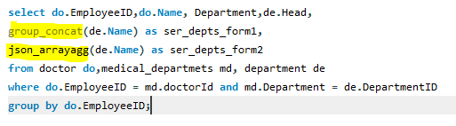
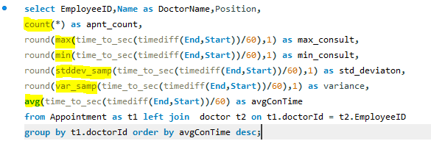
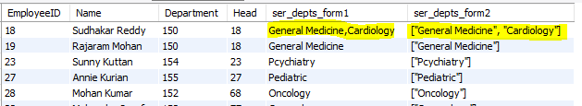
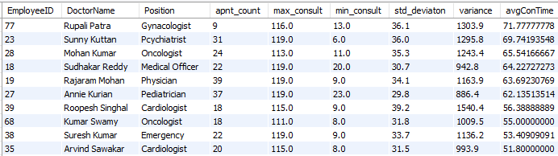
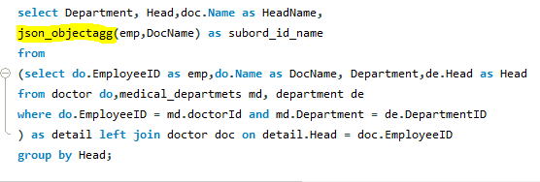
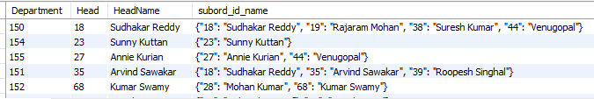
Different Functions – Group By
Concatanation, JsonArray
Descripive Statistic Functions
JsonObjects
PES Data Science Presentation

Slide 5
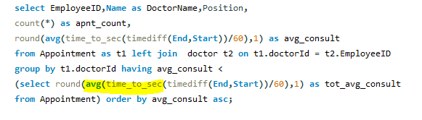
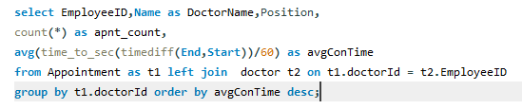

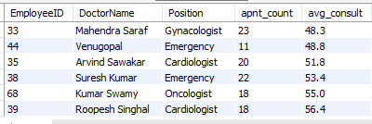
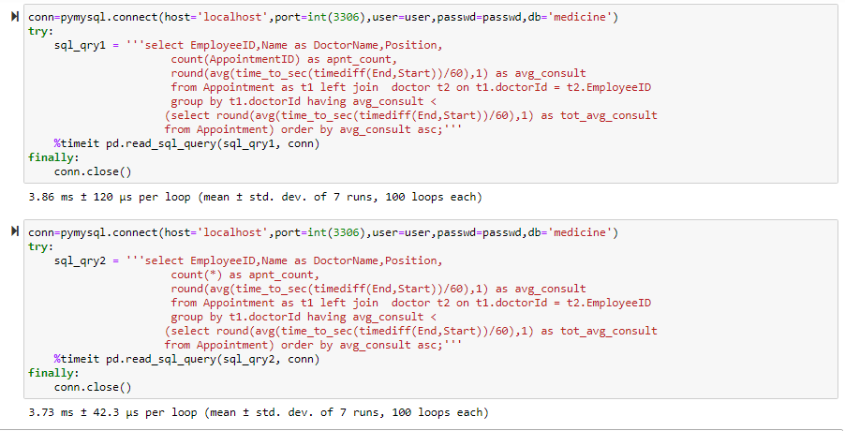
Miscellaneous
Sub Queries
The SUM() and AVG() aggregate functions do not work with temporal values, convert to numeric units beforeaggregation
Which Doctors have less patients than average?
if the value is a non-NULL, you should always use count(*) instead of count(value)
PES Data Science Presentation

Slide 6
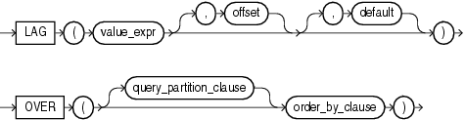
LAG
LAG is an analytic function. It provides access to more than one row of a table at the same time without a self join.
Given a series of rows returned from a query and a position of the cursor, LAG provides access to a row at a given physical offset prior to that position.
If you do not specify offset, then its default is 1. The optional default value is returned if the offset goes beyond the scope of the window.
If you do not specify default, then its default is null.
Syntax of Lag function
LAG (scalar_expression [,offset] [,default])
OVER ( [ partition_by_clause ] order_by_clause )
PES Data Science Presentation

Slide 7
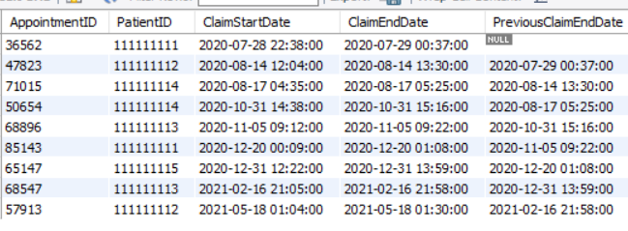
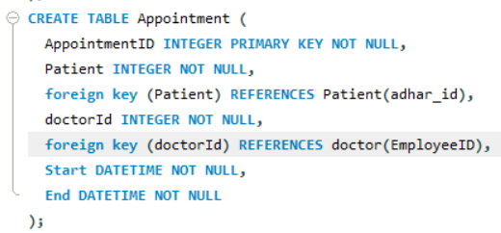
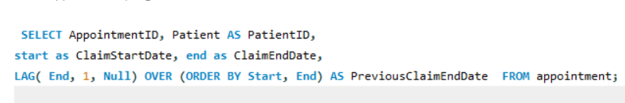
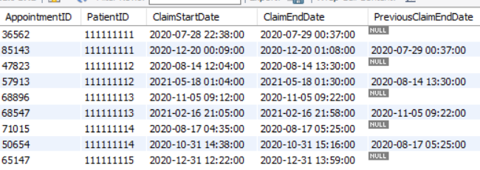
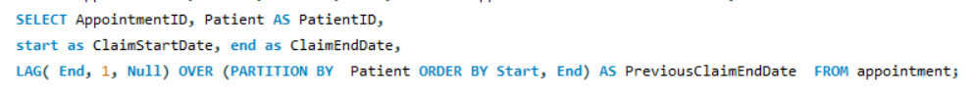
Patient Visit History
PES Data Science Presentation

Slide 8
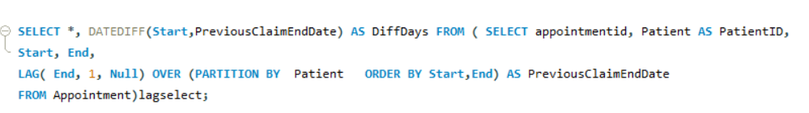
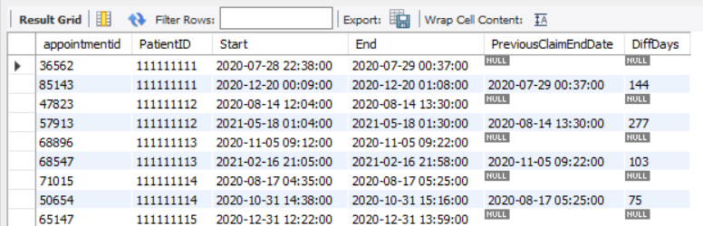
LAG Offsets
PES Data Science Presentation

Slide 9
cume_dist()
The CUME_DIST() is a window function that returns the cumulative distribution of a value within a set of values. It represents the number of rows with values less than or equal to that row’s value divided by the total number of rows.
The returned value of the CUME_DIST() function is greater than zero and less than or equal one (0 < CUME_DIST() <= 1). The repeated column values receive the same CUME_DIST() value.
CUME_DIST() OVER (
PARTITION BY expr, ...
ORDER BY expr [ASC | DESC], ...
)
SYNTAX
In this syntax, the PARTITION BY clause divides the result set returned by the FROM clause into partitions to which the CUME_DIST() function applies.
The ORDER BY clause specifies the logical order of the rows in each partition or the whole result set in case the PARTITION BY is omitted. The CUME_DIST() function calculates the cumulative distribution value of each row based on its order in the partition.
PES Data Science Presentation

Slide 10
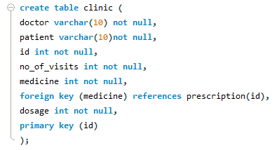

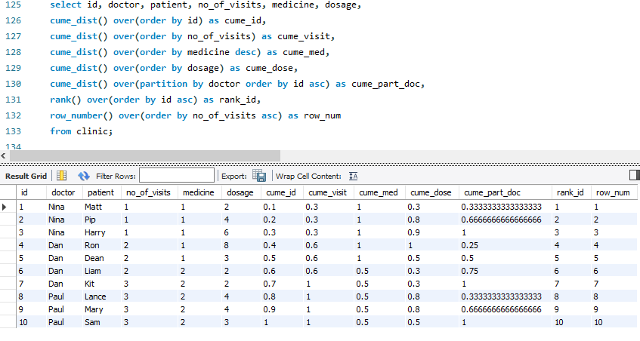
CUME_DIST()
=
ROW_NUMBER() total_rows
PES Data Science Presentation

Slide 11
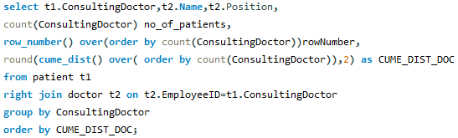
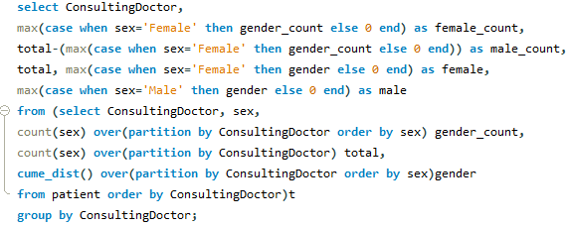
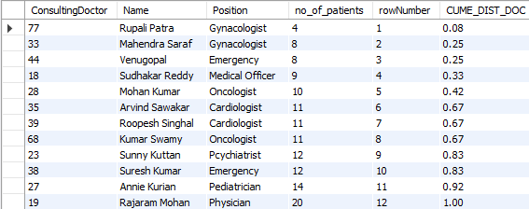
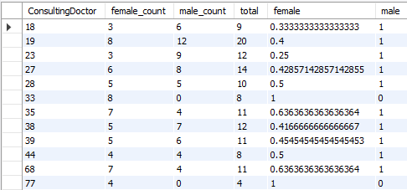
Application on Medicine database
To find the patient distribution over doctors
Get the cumulative distribution of gender of patients visiting a particular doctor
PES Data Science Presentation

Slide 12
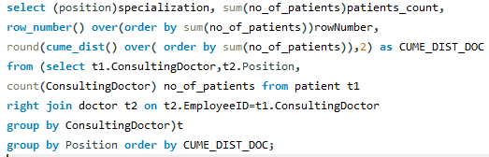
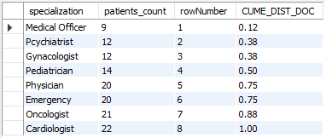
Find specialization which has highest number of patients
PES Data Science Presentation

Slide 13
Dense_rank()
The DENSE_RANK() is a window function that assigns a rank to each row within a partition or result set with no gaps in ranking values.
The rank of a row is increased by one from the number of distinct rank values which come before the row..
DENSE_RANK() OVER ( PARTITION BY <expression>[{,<expression>...}] ORDER BY <expression> [ASC|DESC], [{,<expression>...}] )
SYNTAX
First, the PARTITION BY clause divides the result sets produced by the FROM clause into partitions. The DENSE_RANK() function is applied to each partition.
Second, the ORDER BY clause specifies the order of rows in each partition on which the DENSE_RANK() function operates.
PES Data Science Presentation

Slide 14
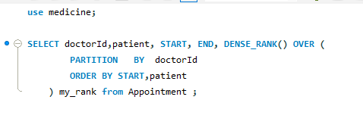
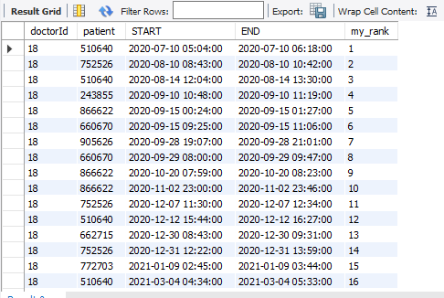
Find Patient appointments:
PES Data Science Presentation

Slide 15


Thank You
PES Project Team
PES Data Science Presentation

