Slide 1
SQL Lag() function
Problem
Analytics in the Health Care industry requires locating previous visits or claims that indicate if a patient/member is being readmitted to a hospital or rehab facility.
Solution
The LAG functions in SQL help find a previous record related to the key fields. The addition of these functions help with readability and simplicity.
The following Appointment is a view of the structure. Our date columns used will be StartDate and End Date.

Slide 2
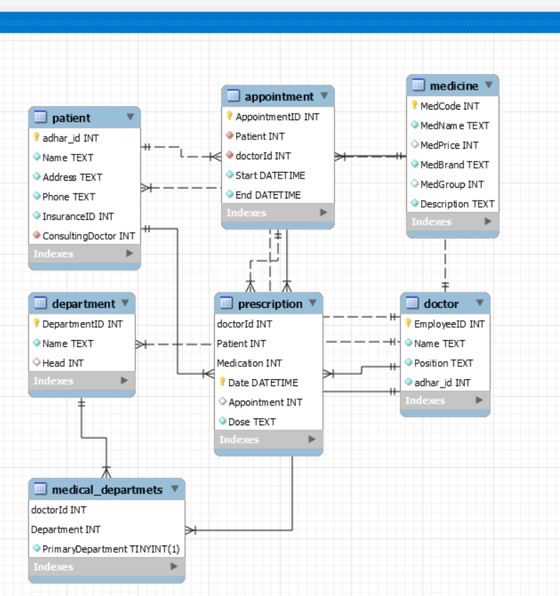

Slide 3
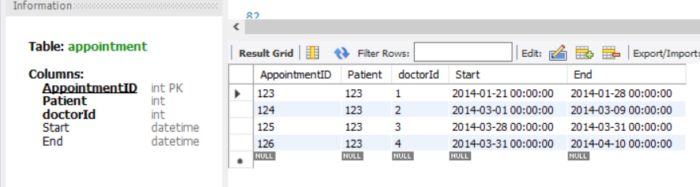
Scripts
Here are the CREATE TABLE and INSERT statements for this example
CREATE TABLE Appointment ( AppointmentID INTEGER PRIMARY KEY NOT NULL, Patient INTEGER NOT NULL, doctorId INTEGER NOT NULL, Start DATETIME NOT NULL, End DATETIME NOT NULL);
INSERT INTO Appointment VALUES(123,'0123','01','2014-01-21','2014-01-28');INSERT INTO Appointment VALUES (124,'0123','02','2014-03-01','2014-03-09');INSERT INTO Appointment VALUES ('125','0123','03','2014-03-28','2014-03-31');INSERT INTO Appointment VALUES ('126','0123','04','2014-03-31','2014-04-10’);

Slide 4
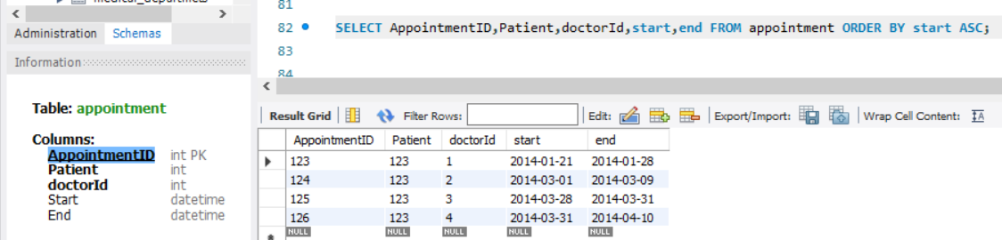
A Look at the Data
We are going to use the Claim End Date and Start Date to find our readmissions. Here is a view of some of the data and what we are trying to accomplish.

Slide 5
Using the SQL Server LAG Function to get Previous End Date
If you look closely, you will see that the first claims started on 1/21/14 and ended 1/28/14. The next claim starts on 3/1/14. This indicates that the second admission did not happen within 30 days of the previous claim. Thus, it is not a readmission within 30 days.
But, the third claim started on 3/28/14 and the previous (2nd claim) ended 3/9/14 which is within 30 days of each other.
Let’s use the LAG functions to get the days between claims. The first parameter in the function is the date we are using in the current row – Claim End Date. The second parameter (i.e. 1) is the previous occurrence in the set returned with Null being used for the last parameter for the return value if nothing is found by the LAG function.

Slide 6
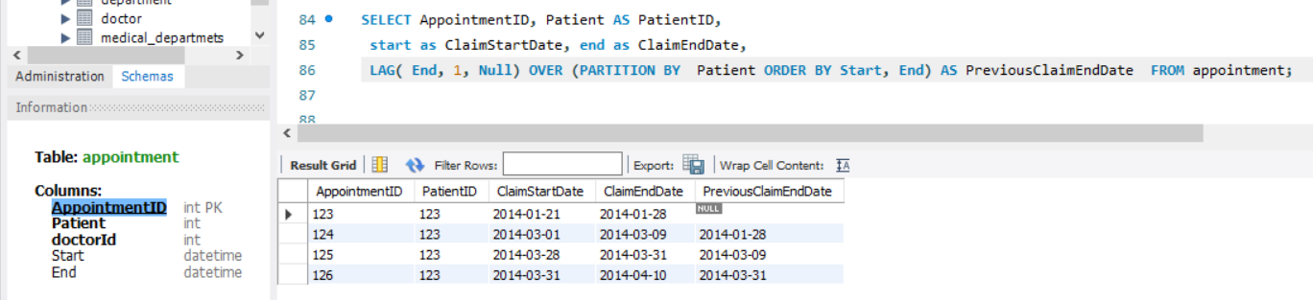
OVER divides the data into partitions (PARTITIONED BY - PatID) containing a row set from the FROM (Appointment) clause using ORDER BY (StartDate and End Date) to sort the set. This is how we get claims for a Patient ordered by ClaimEndDate ascending.

Slide 7
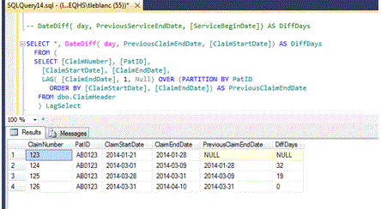
The use of the LAG function gives us the Previous ClaimEndDate and with this we can calculate the day difference between Start and End.
SELECT *, DATEDIFF ( day, PreviousClaimEndDate, ClaimStartDate) AS DiffDays FROM ( SELECT Appointmentid, PatID AS PatientID,
ClaimStartDate, ClaimEndDate,
LAG( ClaimEndDate, 1, Null) OVER (PARTITION BY PatID ORDER BY ClaimStartDate, ClaimEndDate) AS PreviousClaimEndDate
FROM Appointment)lagselect;

Slide 8
Conclusion
From this output, we can see the first Claim does not have a previous claim, so it is not a re-admit within 30 days. The second claim can be excluded from readmit count because the DiffDays is 32 days.
Now, the third claim is within 19 days of the previous, so it will be included in the 30 readmit count, but 4th claim has a DiffDays of 0. This was interesting because it would seem the patient went home and was re-admitted the same day of discharge. The Metrics team took note of this and examined the data more closely and was able to find other columns in the claim that indicated a transfer to a different facility, thus excluding it from the count.
So, the LAG (and possibly the LEAD) functions can really help in looking at before and after records to compute date differences from a single MY-SQL statement that is more readable and logical than previous methods for gathering this information.

Slide 9
Thank you
Fathima Hafeez

