Slide 1
Cryptocurrency Analysis
Van Chien Dinh
Nguyen Dang Khanh
Marco Infante Serrano.

Slide 2
NOTE:
NOTE: The Form of the project is in a Jupyter notebook can be found in the GitHub repository and it is called “Cryptocurrency Analysis.ipynb”
-ECON2206---Cryptocurrency-Analysis/Cryptocurrency Analysis.ipynb at main · dinv00/-ECON2206---Cryptocurrency-Analysis (github.com)
https://github.com/dinv00/-ECON2206---Cryptocurrency-Analysis/blob/main/Cryptocurrency%20Analysis.ipynb

Slide 3
Explaining the project

Slide 4
Explaining the project
MOTIVATION
Our goal for the project was to analyze cryptocurrency prices in order to get a better understanding of different currencies and possibly gain some insight into their behavioral patterns. Another point to our motivation was to contribute knowledge about cryptocurrency trading and provide basis of information to investors and other stakeholders.
QUESTIONS
Which currencies are the most volatile?
On which months are the currencies more volatile?

Slide 5
Data Source
“Cryptocurrency prices for the year” by the Kaggle user ARTEM BURENOK.
It has the following columns: Date, Open, High, Low and Close.
Link: https://www.kaggle.com/datasets/artemburenok/cryprocurrency-prices-for-the-year?select=BTC-USD.csv

Slide 6
Code and Results

Slide 7
1 Data retrieval

Slide 8
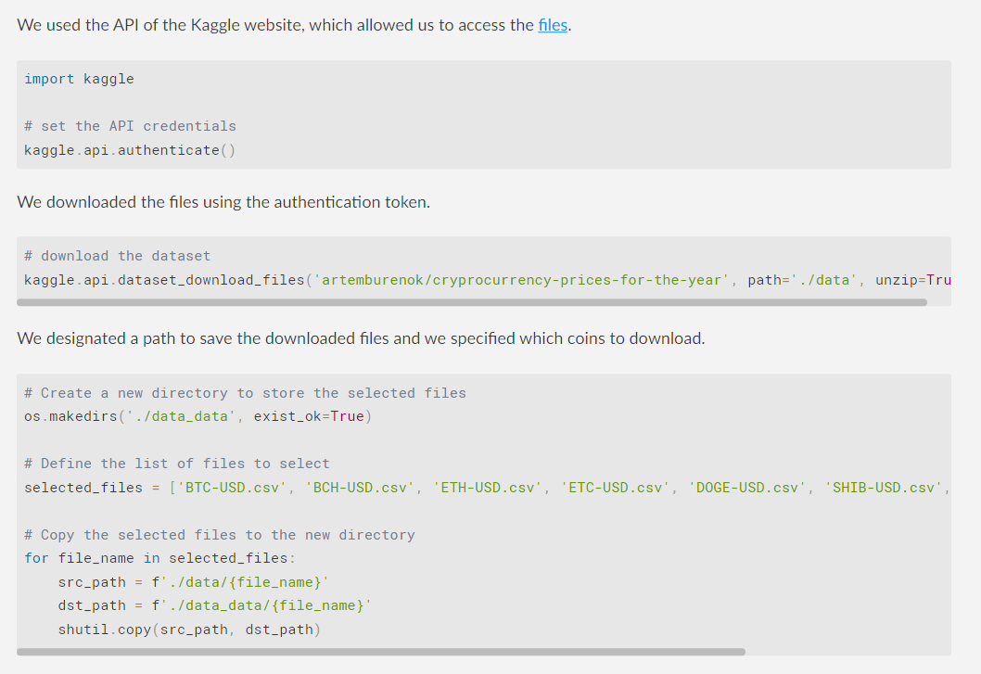
1.1 Scraping Methodology

Slide 9
1.1 Data Cleaning

Slide 10
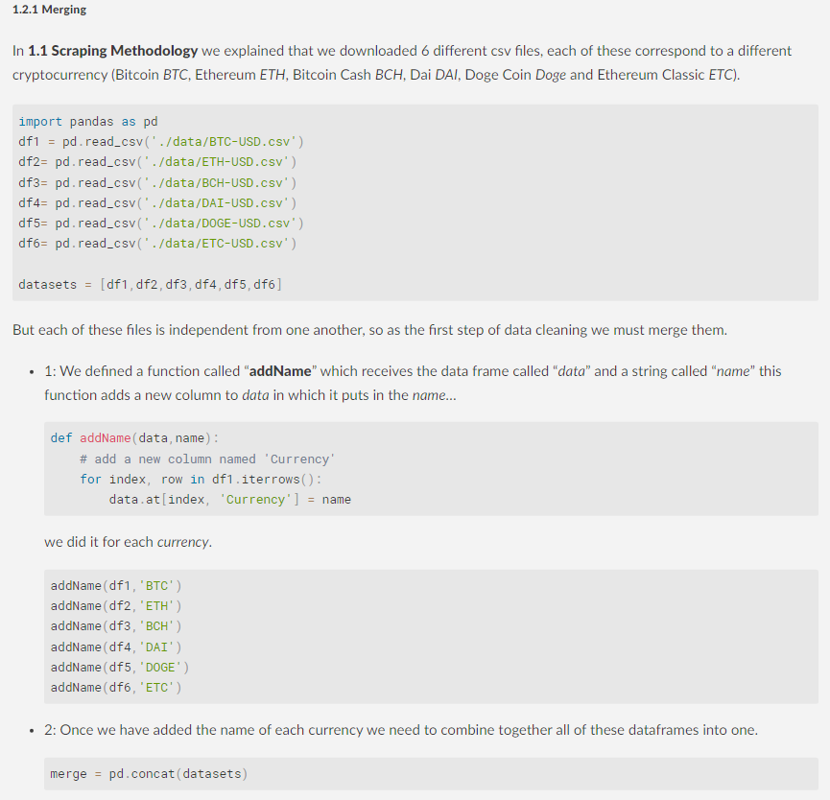
1.2.1 Merging

Slide 11
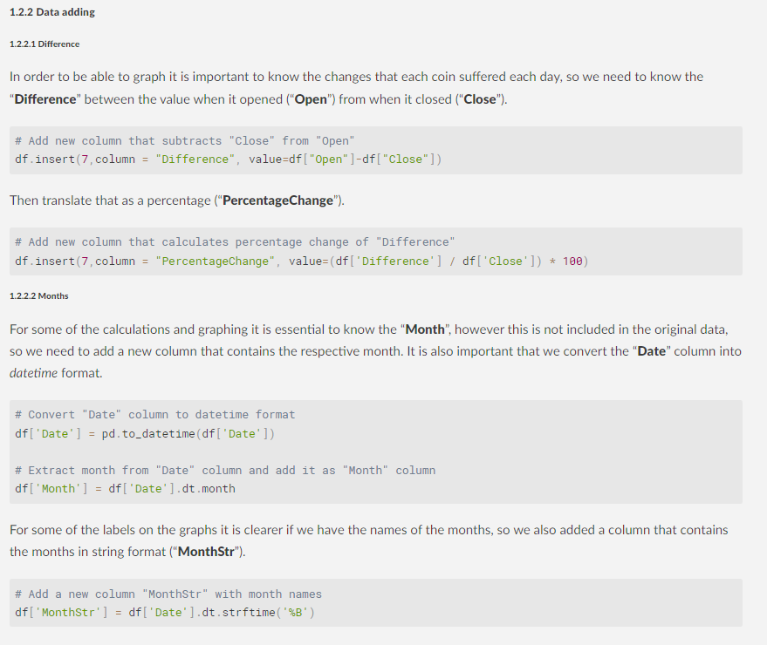
1.2.2 Data Adding
1.2.2.1 Difference
1.2.2.2 Months

Slide 12
2 Data Visualization

Slide 13
2.1 Bar Graphs

Slide 14
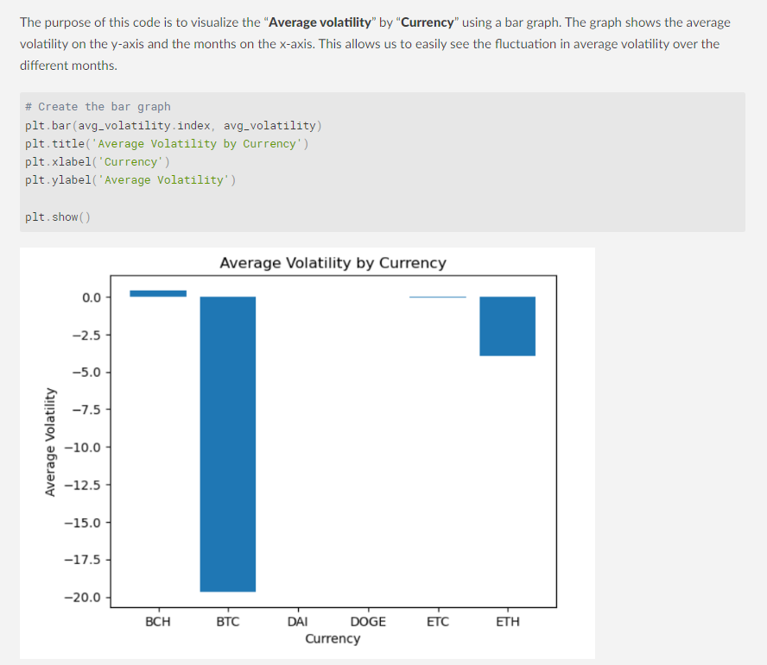
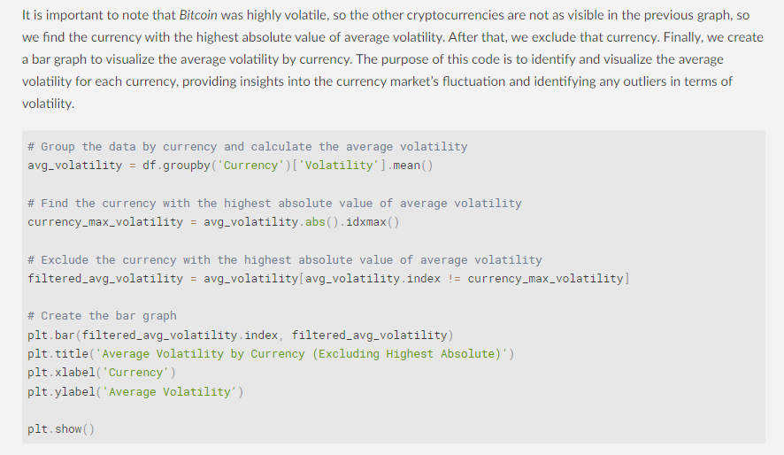
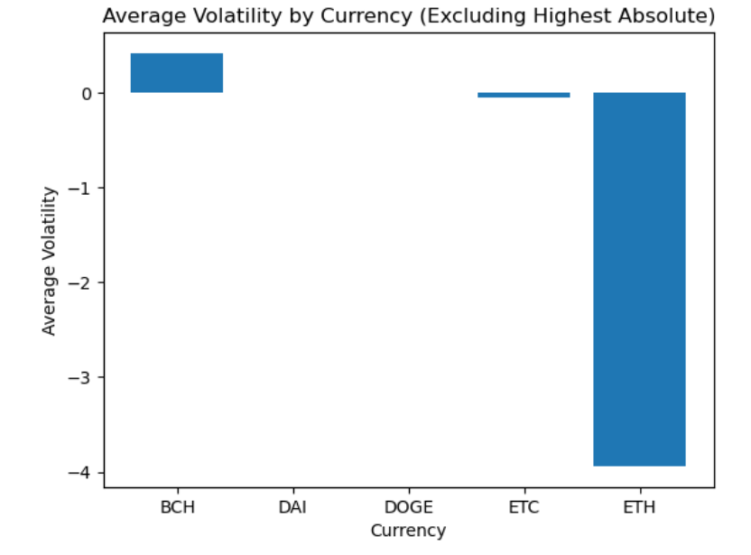
2.1.1 Per Currency

Slide 15
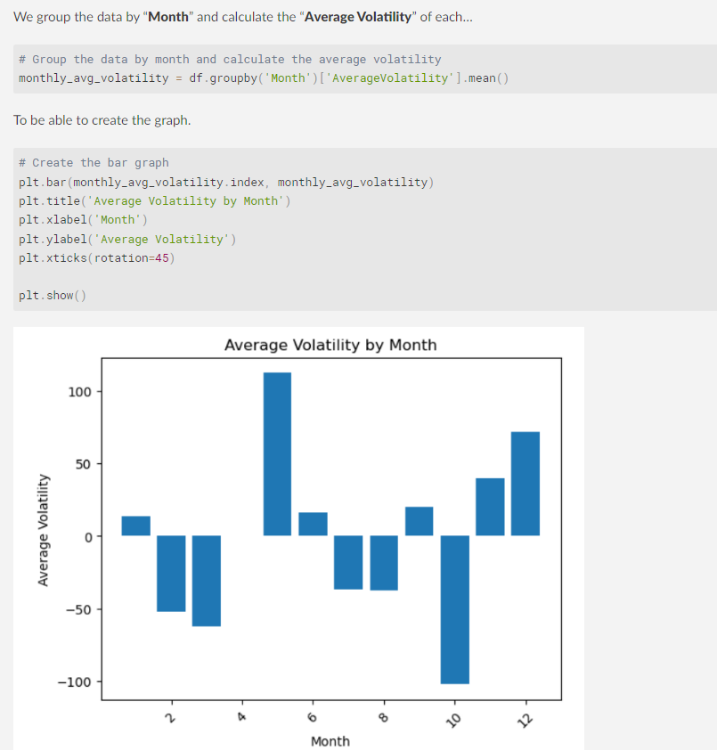
2.1.2 Per Month

Slide 16
2.2 Line Graphs

Slide 17
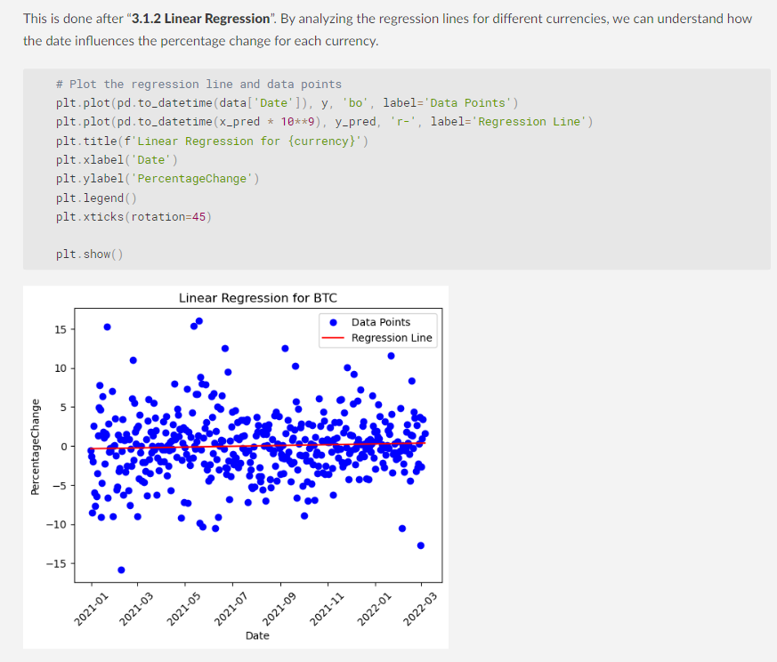
2.2.1 Per Currency

Slide 18
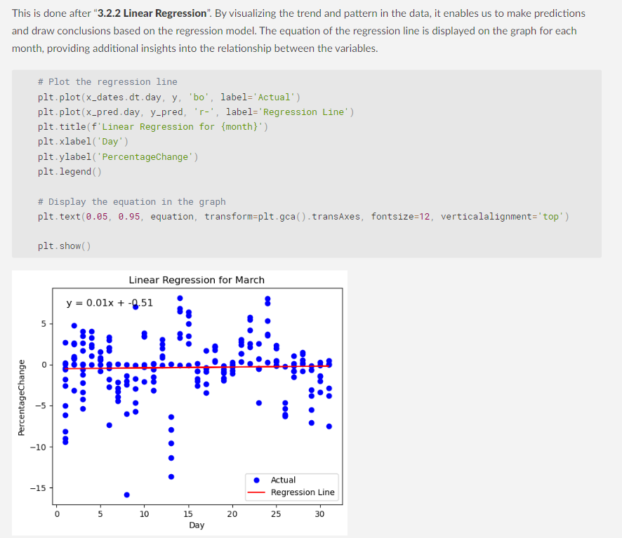
2.2.2 Per Month

Slide 19
3 Data Modeling

Slide 20
3.1 Per Month

Slide 21
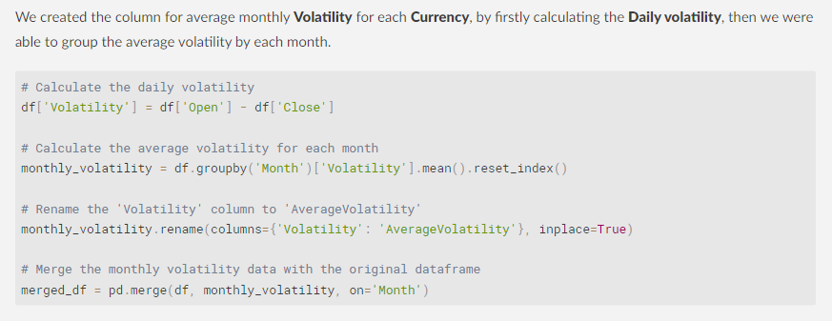
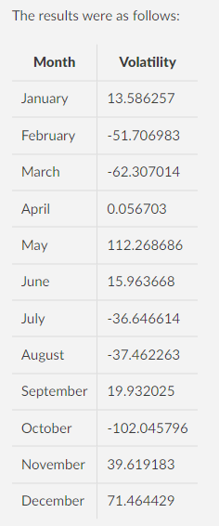
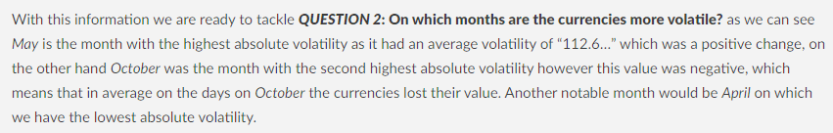
3.1.1 Volatility

Slide 22
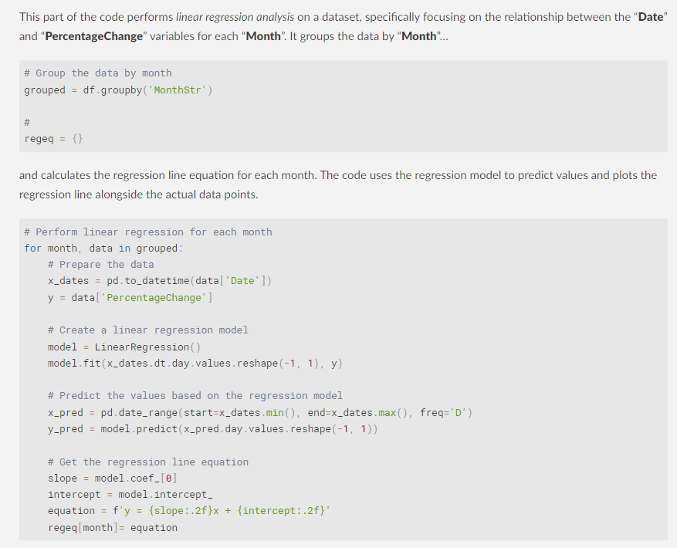
3.1.2 Linear Regression

Slide 23
3.2 Per Currency

Slide 24
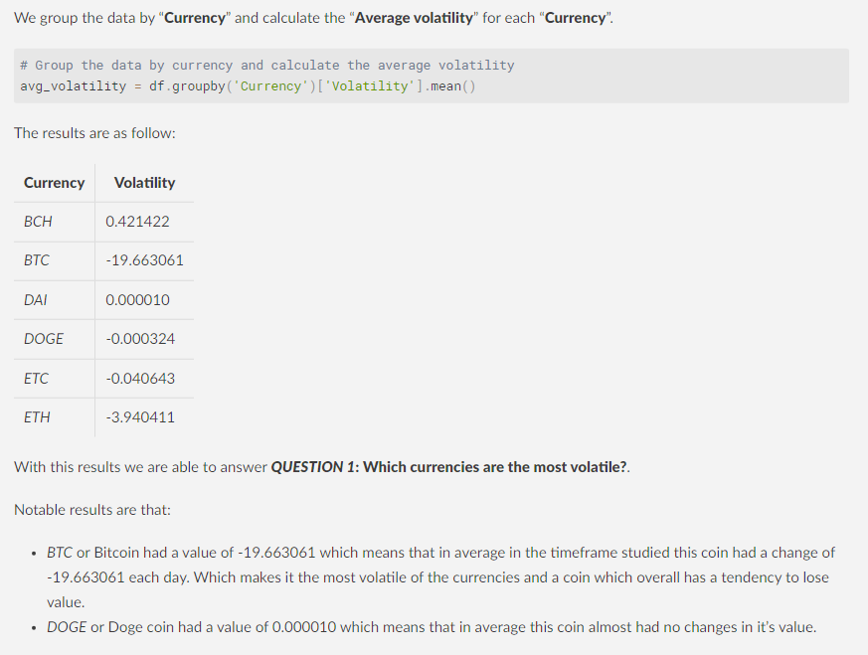
3.2.1 Volatility

Slide 25
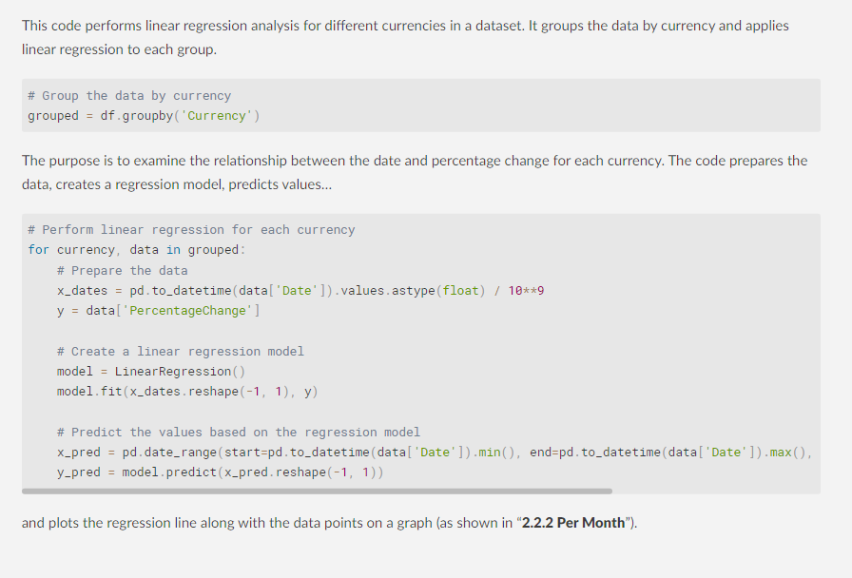
3.2.2 Linear Regression

