Slide 1
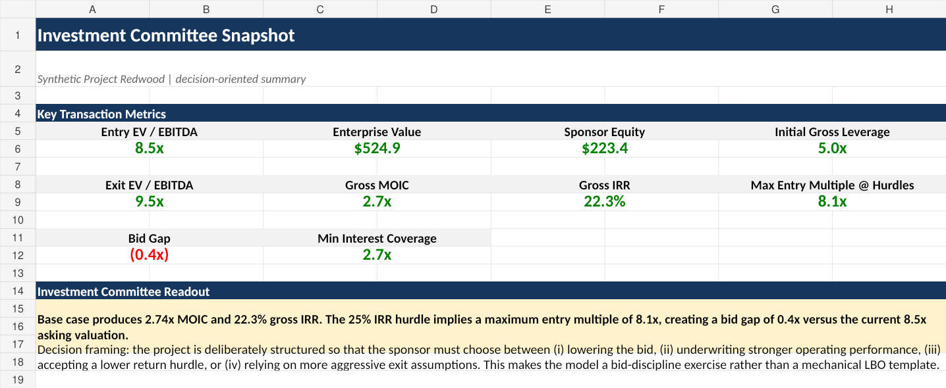
TAKE-PRIVATE REVERSE LBO &
PROBABILISTIC UNDERWRITING
Project Redwood - Private Equity Case Study
Investment Banking
Private Equity
Python Risk Engine
Core question
What is the highest price a sponsor can pay while preserving return hurdles, debt capacity and downside protection?
Investment committee snapshot
8.5x
22.3%
8.0x
10,000
Seller Ask
Base-Case Return
Risk-Adjusted Bid
Risk Engine
Entry EV / EBITDA
Gross IRR vs 25.0% hurdle
>=50% chance of 25% IRR
Synthetic deal paths
PROJECT REDWOOD | FICTIONAL EDUCATIONAL CASE STUDY

Slide 2
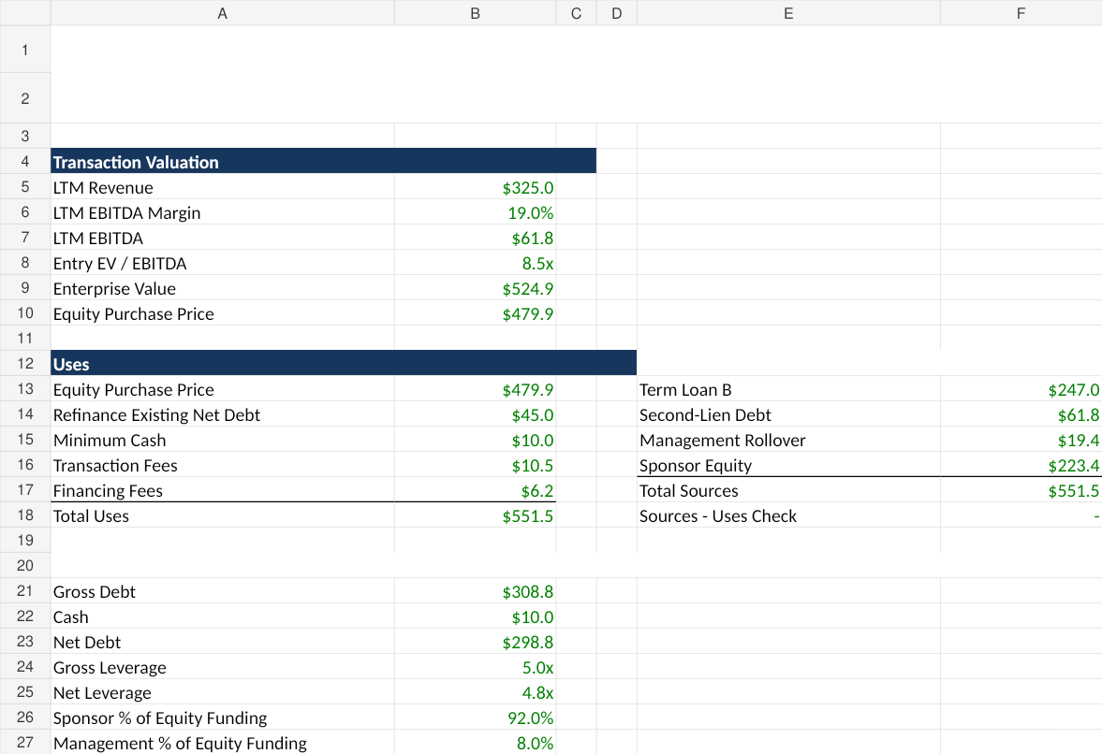
The deal is a pricing question, not just an LBO output
A sponsor should not force the seller ask to work; it should solve what the business can support.
Seller ask
Financing
Operating case
Exit
Sponsor return
8.5x EBITDA
5.0x gross leverage
5-year FCF model
9.5x EBITDA
22.3% IRR
What makes the case stronger
Reverse LBO: solves the maximum entry price consistent with return hurdles.
Hurdle solver: shows what has to improve if the ask is too high.
Probabilistic underwriting: runs 10,000 synthetic paths instead of relying on one base case.
Sources & Uses: purchase price, fees, leverage and sponsor equity
PROJECT REDWOOD | FICTIONAL EDUCATIONAL CASE STUDY

Slide 3
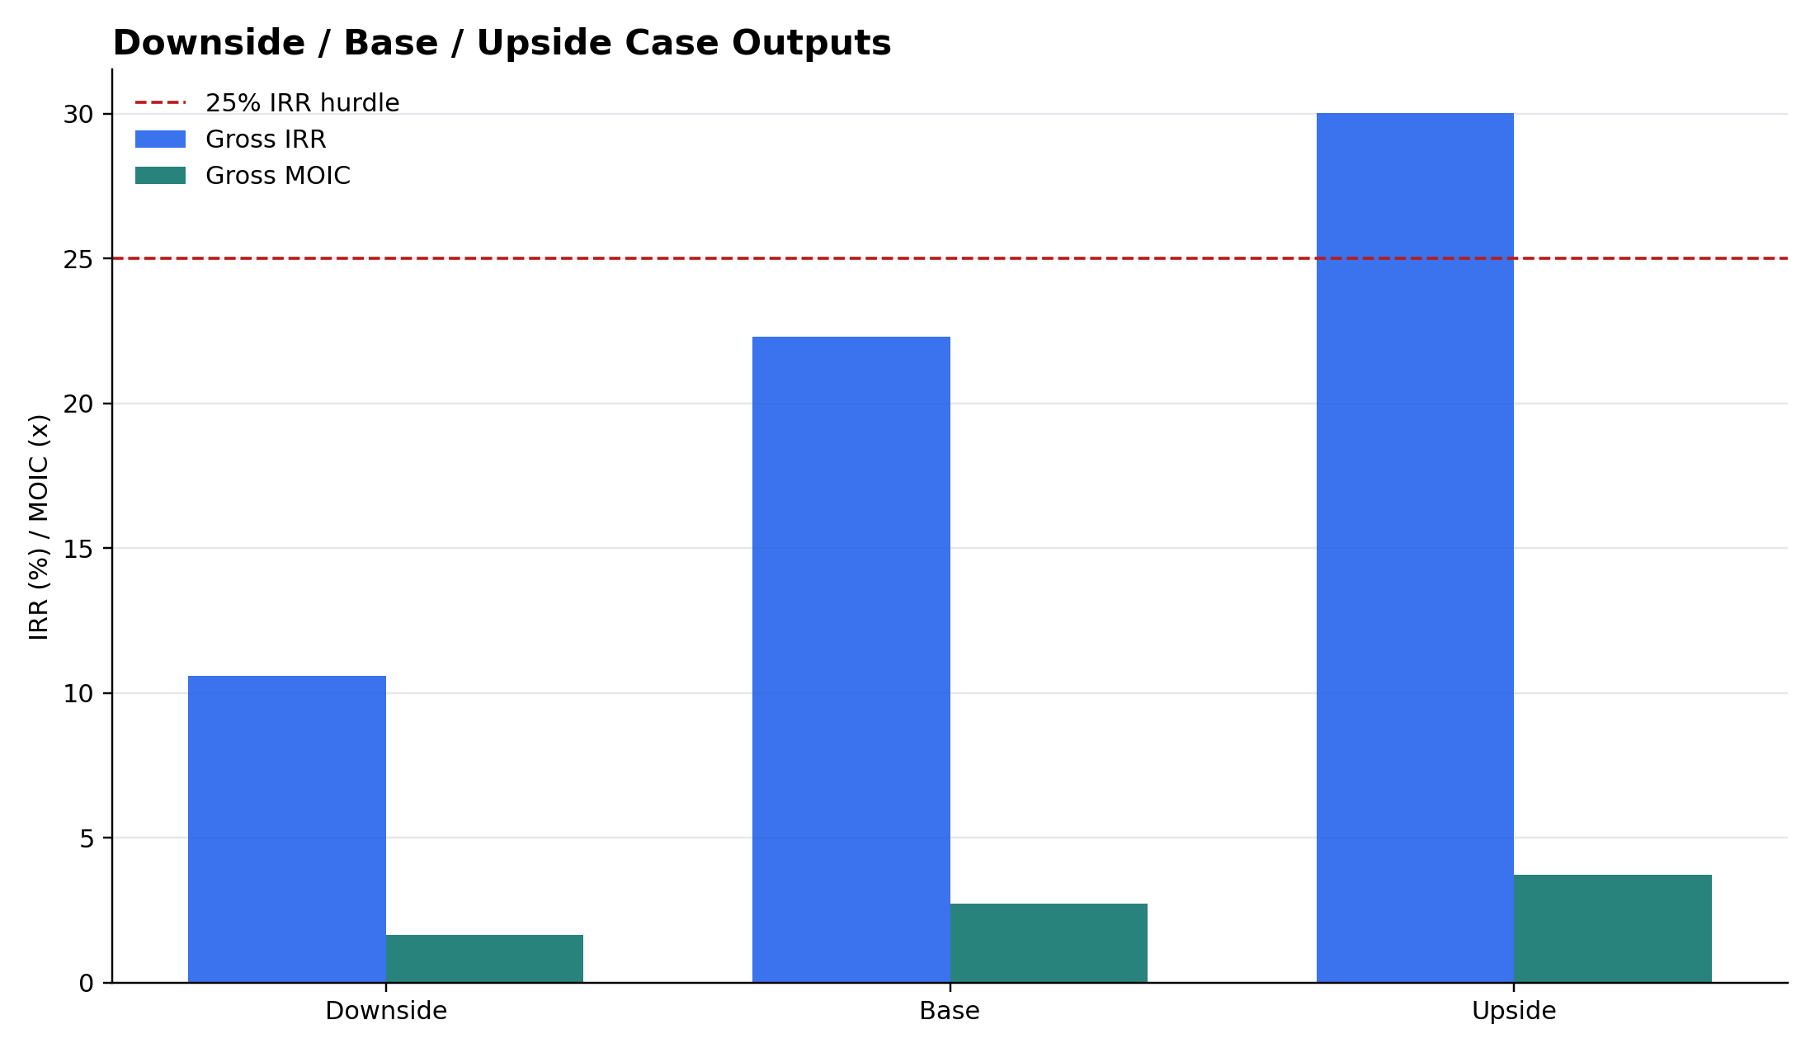
Base case: attractive MOIC, but the ask misses the IRR hurdle
The deterministic model creates a real underwriting debate rather than an automatically attractive LBO.
22.3%
2.74x
2.7x
5.0x
Gross IRR
Gross MOIC
Minimum Coverage
Initial Leverage
Below 25.0% sponsor hurdle
Above 2.5x hurdle
Above 2.0x threshold
Gross debt / EBITDA
Excel IC Summary
Downside / Base / Upside returns
PROJECT REDWOOD | FICTIONAL EDUCATIONAL CASE STUDY

Slide 4
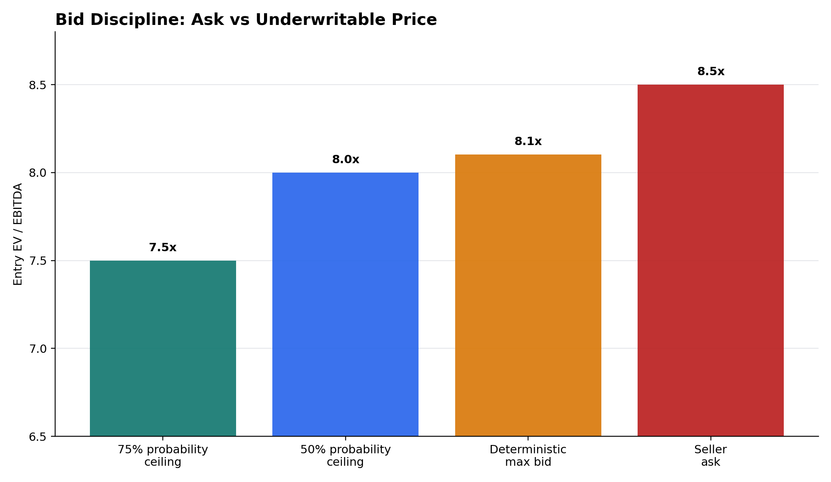
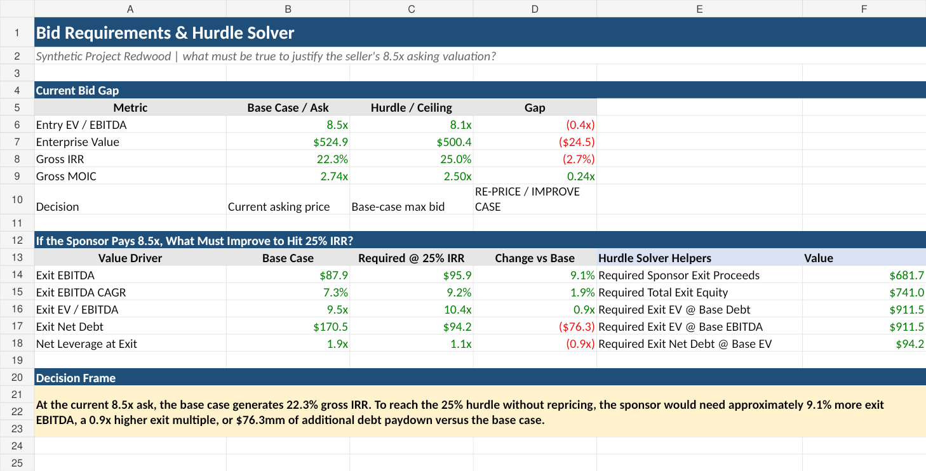
Reverse LBO: solve the price before making the bid
The model backs into the highest entry multiple supported by the sponsor return hurdle.
Hurdle solver snapshot
If paying 8.5x, the sponsor needs one of:
• 9.1% more exit EBITDA
• 10.4x exit multiple instead of 9.5x
• $76.3mm additional debt paydown
Ask vs underwritable price
PROJECT REDWOOD | FICTIONAL EDUCATIONAL CASE STUDY

Slide 5
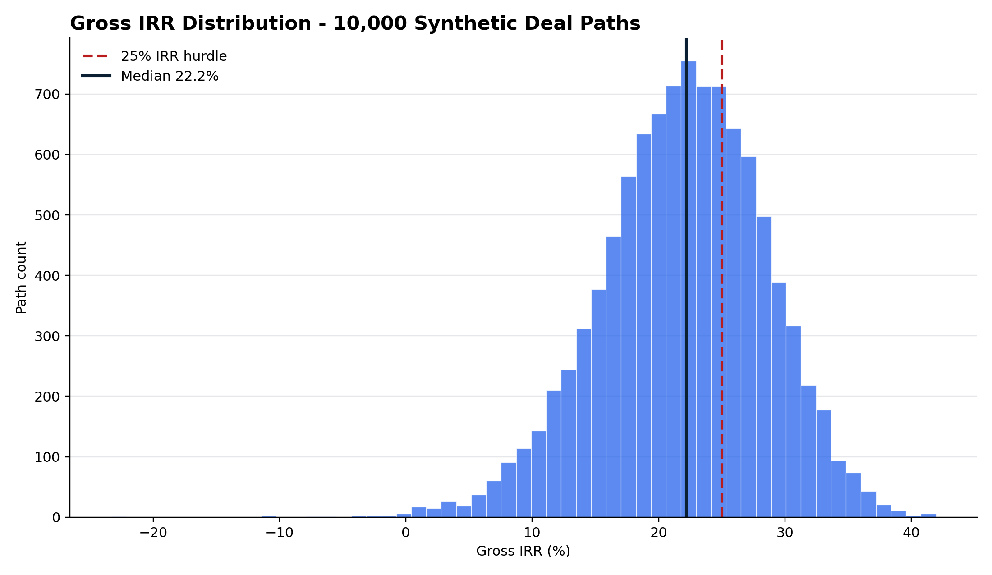
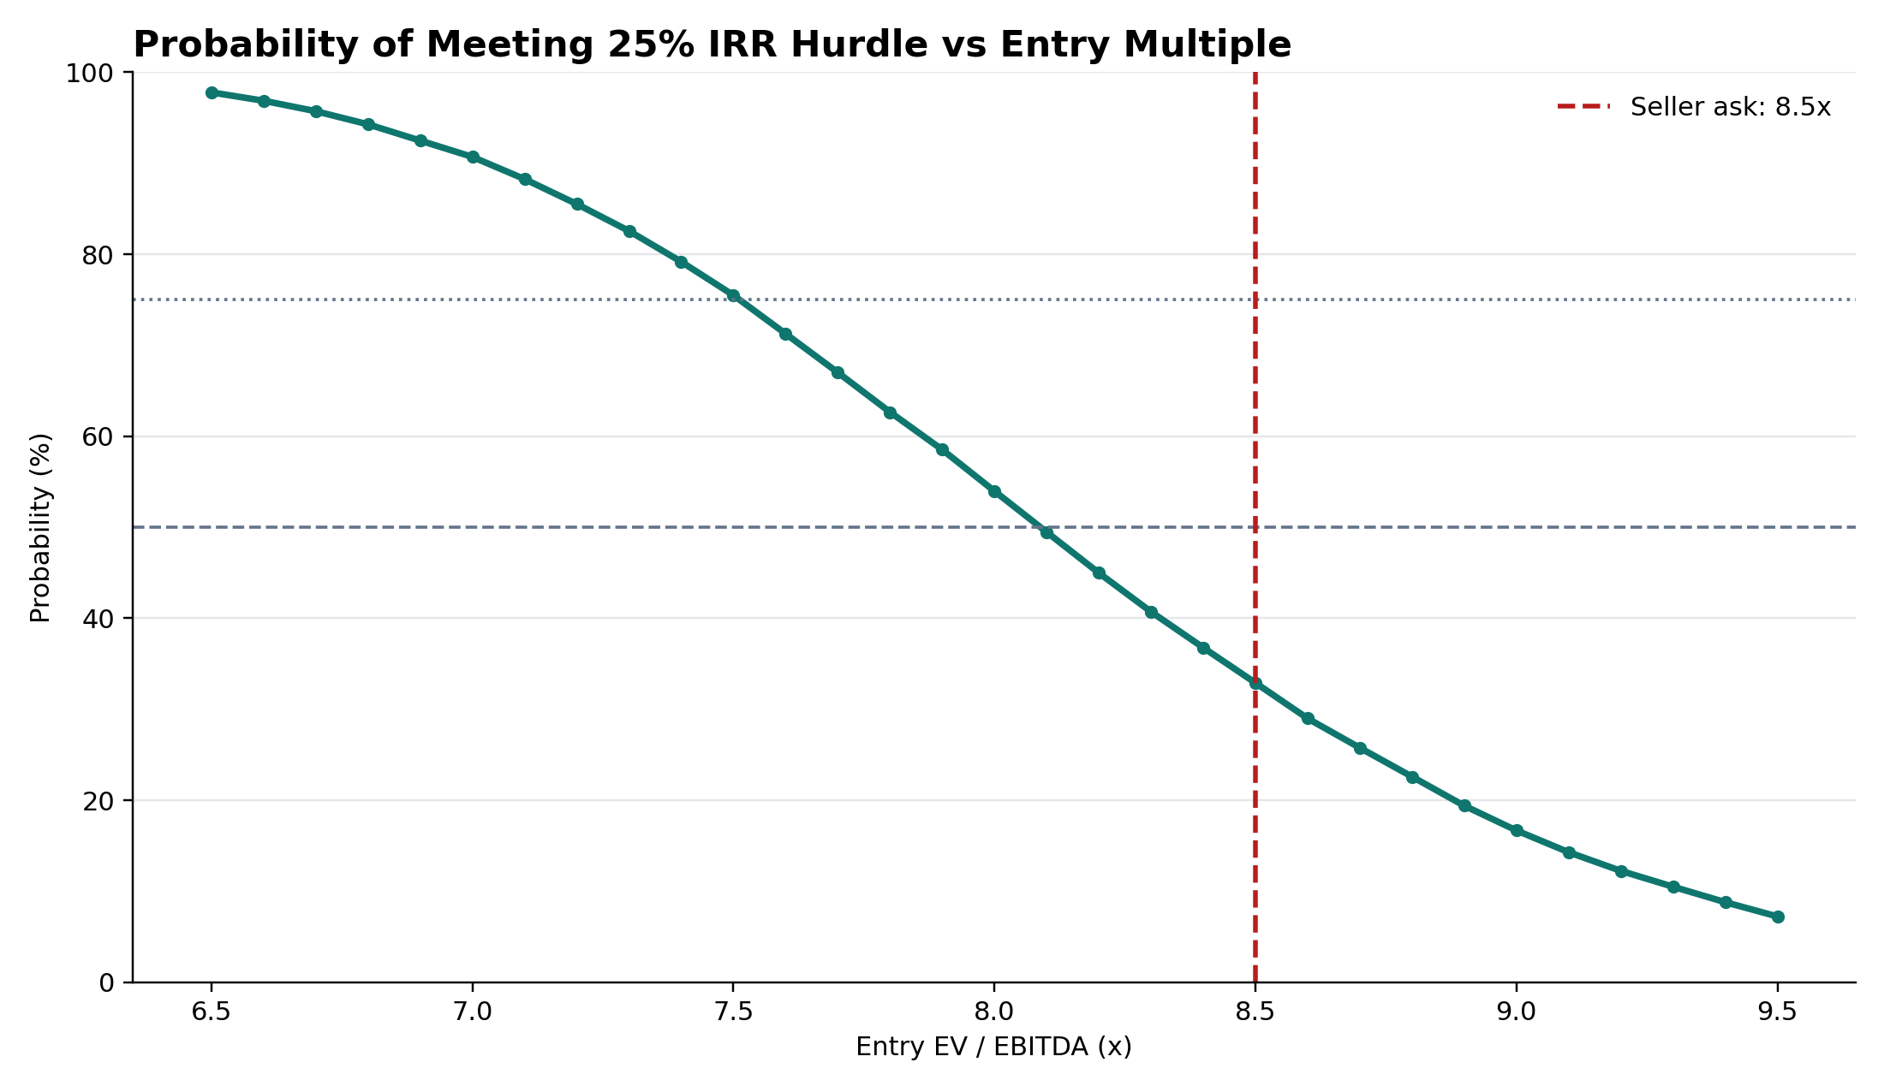
Probabilistic underwriting: one base case is not enough
The Python layer creates a distribution of deal outcomes and converts risk into bid discipline.
Gross IRR distribution across 10,000 paths
Probability of hitting 25% IRR by entry price
32.9%
P(IRR >= 25%) at 8.5x
Only one-third of paths clear hurdle
8.0x
Bid ceiling @ 50% probability
Risk-adjusted price discipline
7.5x
Bid ceiling @ 75% probability
Higher confidence requires lower bid
PROJECT REDWOOD | FICTIONAL EDUCATIONAL CASE STUDY

Slide 6
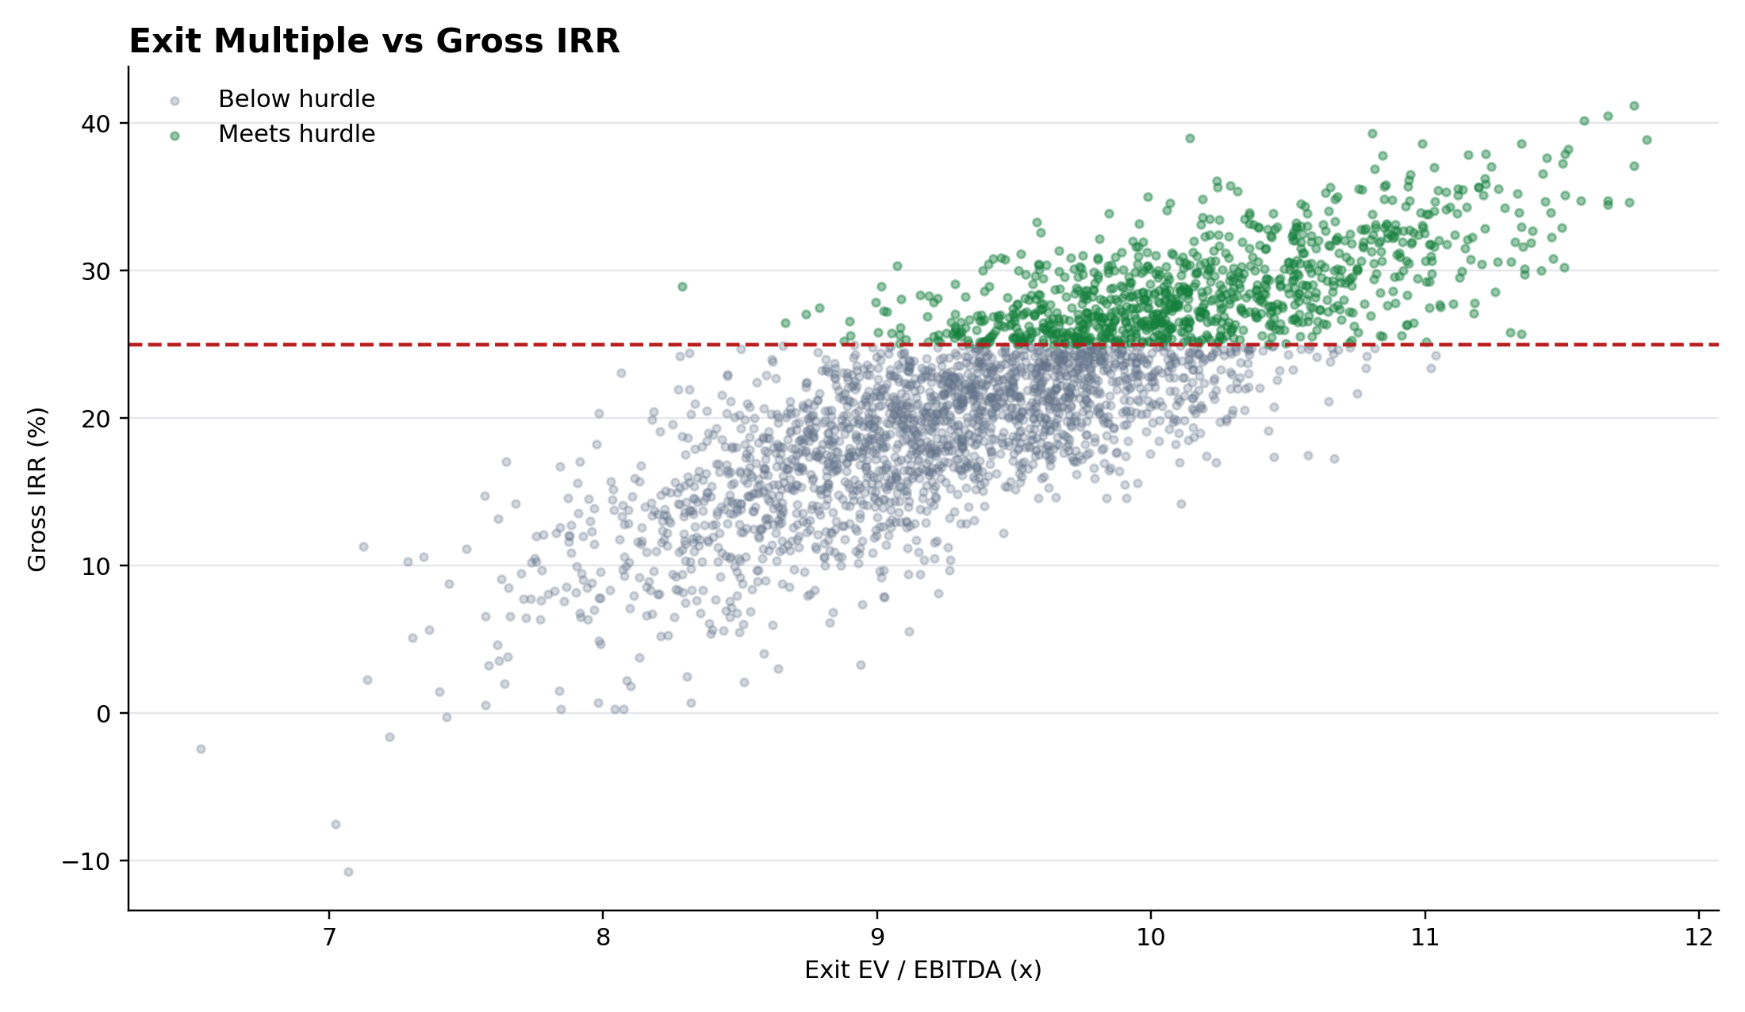
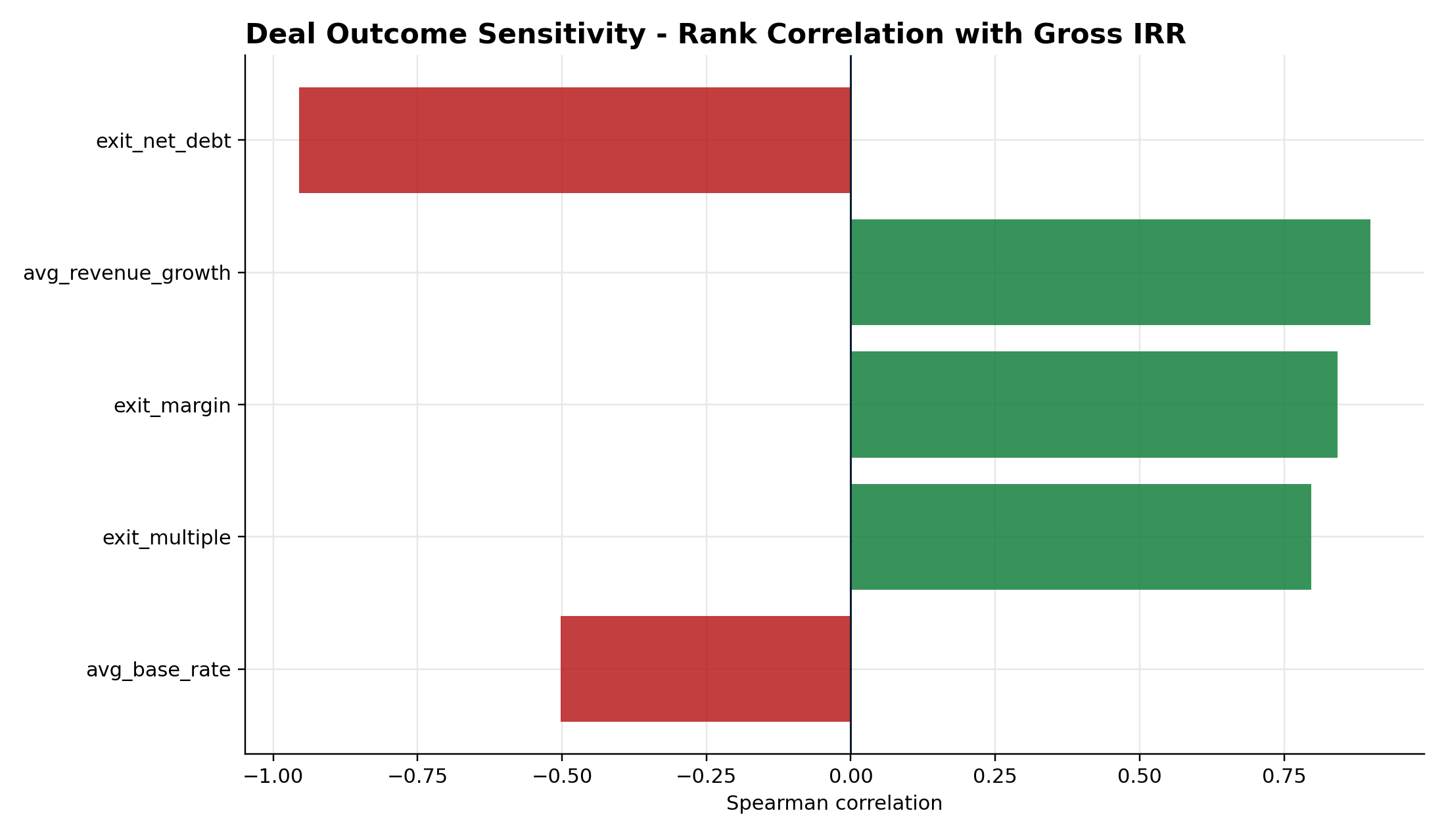
What actually drives returns?
Exit valuation matters, but execution and debt paydown still determine how much of the upside reaches the sponsor.
Exit multiple vs realised gross IRR
Rank correlation of drivers with gross IRR
Interview angle
This is not “we built an LBO and got an IRR”. It is a bid-discipline framework: price, leverage, return hurdle, downside risk and probability of success.
PROJECT REDWOOD | FICTIONAL EDUCATIONAL CASE STUDY

Slide 7
GitHub-ready package
Designed to be reviewed like a small investment committee case study: Excel model, Python risk engine, tests, documentation and visual materials.
Excel model
Take-private model, reverse LBO, hurdle solver, IC summary
Python engine
10,000 synthetic paths, correlated deal shocks, risk-adjusted bid curve
Tests
13 automated checks across returns, debt logic, monotonicity and reproducibility
Docs
Methodology, interview guide, Mac quickstart and LinkedIn copy
Visual assets
Investment committee overview PDF + chart library
Recommended LinkedIn project name
Take-Private Reverse LBO & Probabilistic Underwriting | Project Redwood
PROJECT REDWOOD | FICTIONAL EDUCATIONAL CASE STUDY

