Slide 1
PRIVATE EQUITY
TRANSACTION MODEL
PYTHON RISK
TAKE-PRIVATE REVERSE LBO &
PROBABILISTIC UNDERWRITING
Investment committee snapshot
Seller ask
8.5x EBITDA
Base-case return
22.3% gross IRR
Project Redwood | Fictional Private Equity Case Study
Deterministic max bid
8.1x EBITDA
Core underwriting question
Risk-adjusted bid
8.0x @ 50% probability
What is the highest price a sponsor can pay while preserving return hurdles, debt capacity and downside protection?
Probability at ask
32.9% hit 25% IRR
8.5x
22.3%
8.1x
10,000
Seller ask
Base-case gross IRR
Deterministic max bid
Synthetic deal paths
Entry EV / EBITDA
vs 25.0% hurdle
IRR hurdle is binding
Correlated underwriting scenarios
PROJECT REDWOOD | FICTIONAL EDUCATIONAL CASE STUDY | SYNTHETIC ASSUMPTIONS

Slide 2
The seller ask is a pricing question, not just an LBO output
The model starts with transaction mechanics, then asks whether the capital structure and exit case support the required sponsor return.
Entry
Financing
Hold
Exit
Return
8.5x
5.0x
5 years
9.5x
22.3%
EV / EBITDA
Gross leverage
Operating + debt paydown
EV / EBITDA
Gross IRR
Sources & uses at close
Uses ($mm)
Amount
Sources ($mm)
Amount
Deterministic underwriting readout
Equity purchase price
479.9
Term Loan B
247.0
2.74x
22.3%
Refinance net debt
45.0
Second-lien
61.8
Gross MOIC
Gross IRR
Minimum cash + fees
26.7
Management rollover
19.4
Above 2.5x hurdle
Below 25.0% hurdle
Total uses
551.5
Sponsor equity
223.4
2.7x
$170.5mm
Funding mix
Minimum coverage
Exit net debt
Above 2.0x guardrail
Deleveraging drives equity value
Debt 56%
Equity 44%
Key point: the base case is investable-looking, but the asking price does not clear the sponsor IRR hurdle. That creates a real bid / negotiate / walk-away decision.
PROJECT REDWOOD | FICTIONAL EDUCATIONAL CASE STUDY | SYNTHETIC ASSUMPTIONS

Slide 3
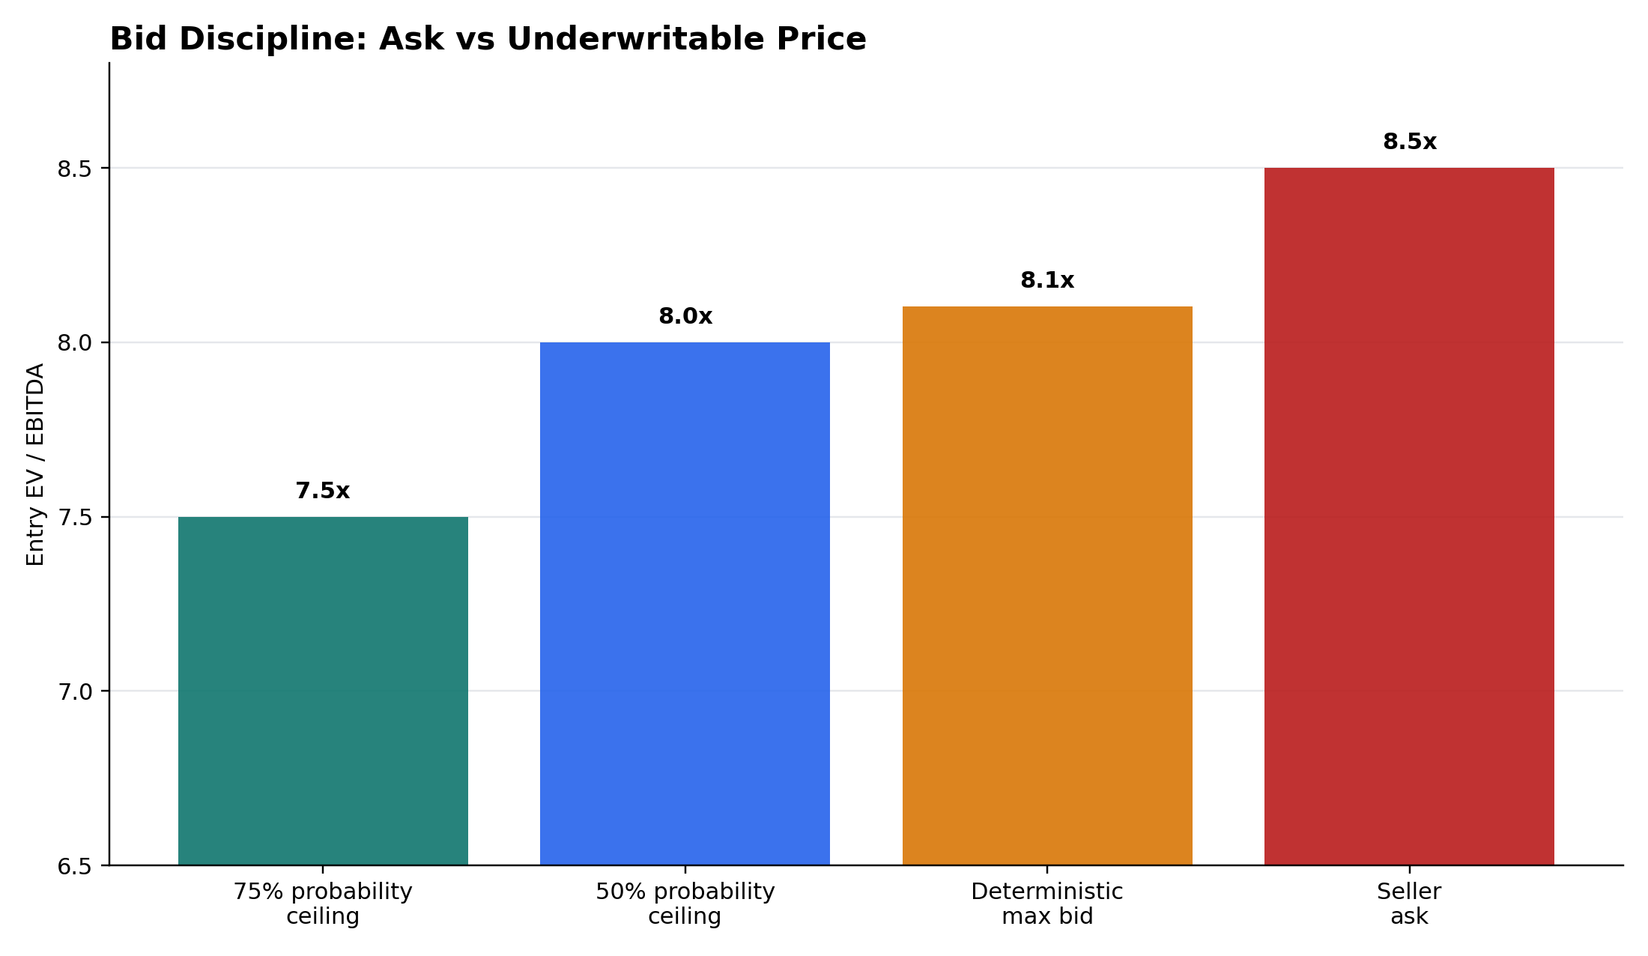
Reverse LBO: solve the price before making the bid
Instead of forcing 8.5x to work, the model backs into the highest price consistent with sponsor return hurdles.
The bid gap
8.1x
vs
8.5x
maximum deterministic entry multiple
seller ask
Implied bid gap
(0.4x) / ($24.5mm EV)
If the sponsor still pays 8.5x, one of these has to improve to reach 25% IRR:
+9.1%
10.4x
$76.3mm
Exit EBITDA
Exit multiple
Additional debt paydown
Bid ceiling under deterministic and probability-based return hurdles
PROJECT REDWOOD | FICTIONAL EDUCATIONAL CASE STUDY | SYNTHETIC ASSUMPTIONS

Slide 4
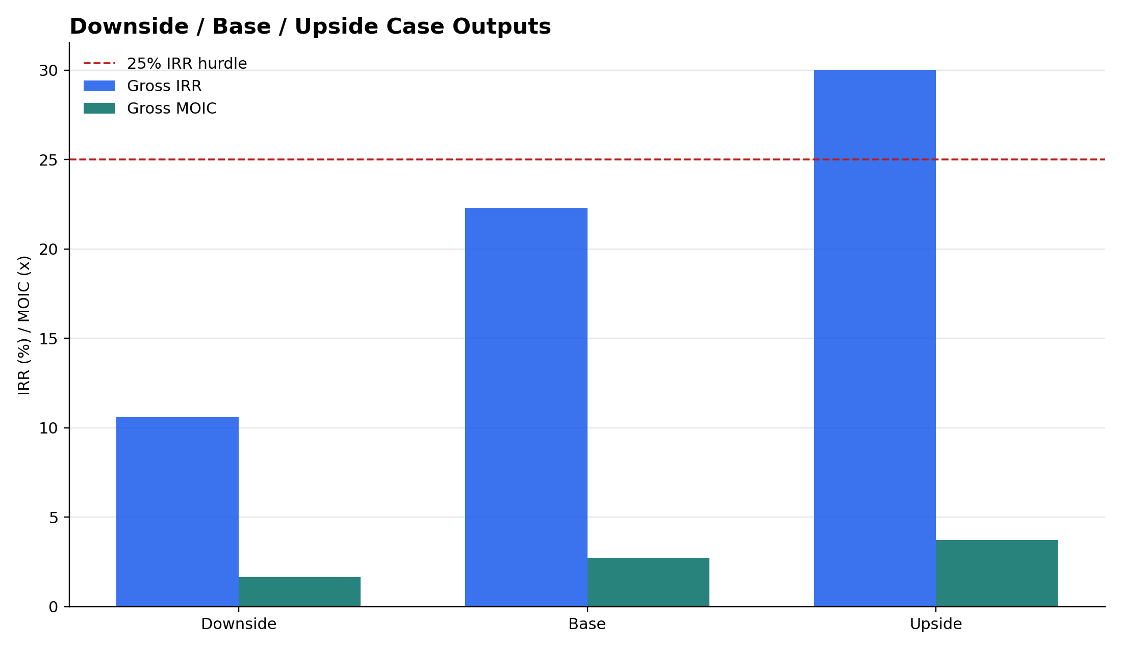
Downside protection matters as much as headline returns
The deal remains serviceable in the deterministic downside case, but returns compress sharply when growth, margins and exit valuation weaken together.
Scenario scorecard
Scenario
IRR
MOIC
Min coverage
Downside
10.6%
1.65x
2.16x
Base
22.3%
2.74x
2.71x
Upside
30.0%
3.72x
3.05x
Credit guardrails in the 10,000-path simulation
0.6%
0.1%
P(coverage < 2.0x)
P(RCF draw)
Synthetic paths
Liquidity backstop used
Downside / base / upside sponsor returns
Interpretation: the capital structure is not the main reason to reject the ask. The bigger issue is price relative to the required equity return.
PROJECT REDWOOD | FICTIONAL EDUCATIONAL CASE STUDY | SYNTHETIC ASSUMPTIONS

Slide 5
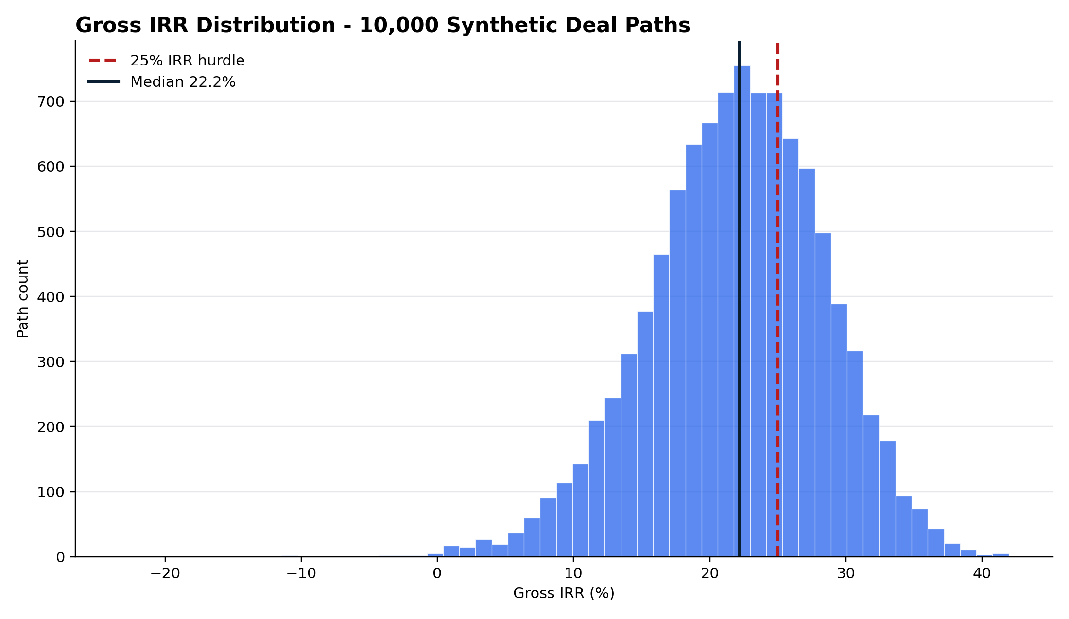
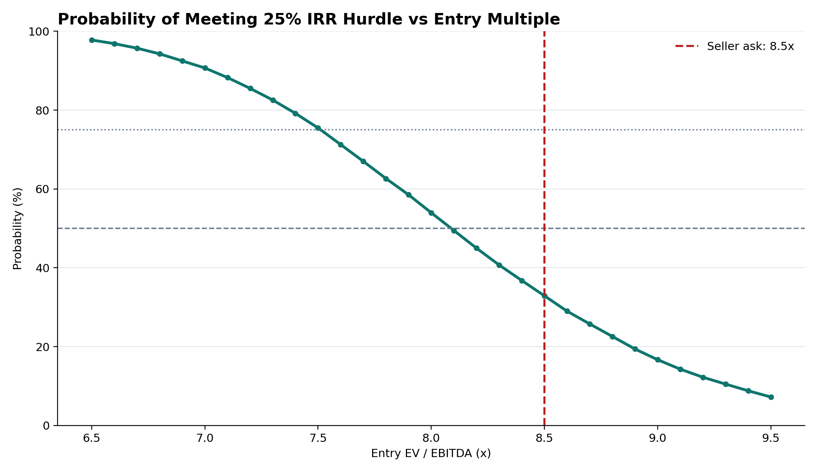
Probabilistic underwriting: one base case is not enough
10,000 correlated synthetic paths vary growth, margins, rates and exit valuation, then pass every outcome through the same LBO debt waterfall.
Distribution of gross IRR across 10,000 paths
Probability of meeting the 25% IRR hurdle by entry multiple
32.9%
8.0x
7.5x
At 8.5x seller ask
50% probability ceiling
75% probability ceiling
of paths clear 25% IRR
Risk-adjusted bid
Higher confidence = lower bid
PROJECT REDWOOD | FICTIONAL EDUCATIONAL CASE STUDY | SYNTHETIC ASSUMPTIONS

Slide 6
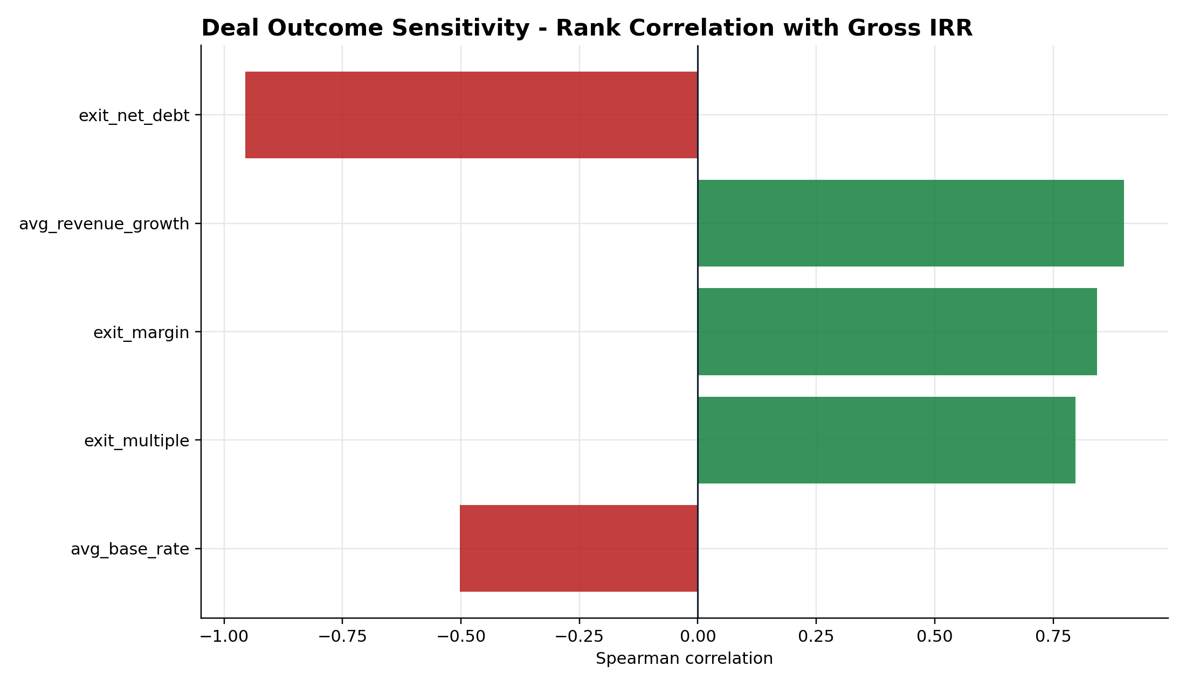
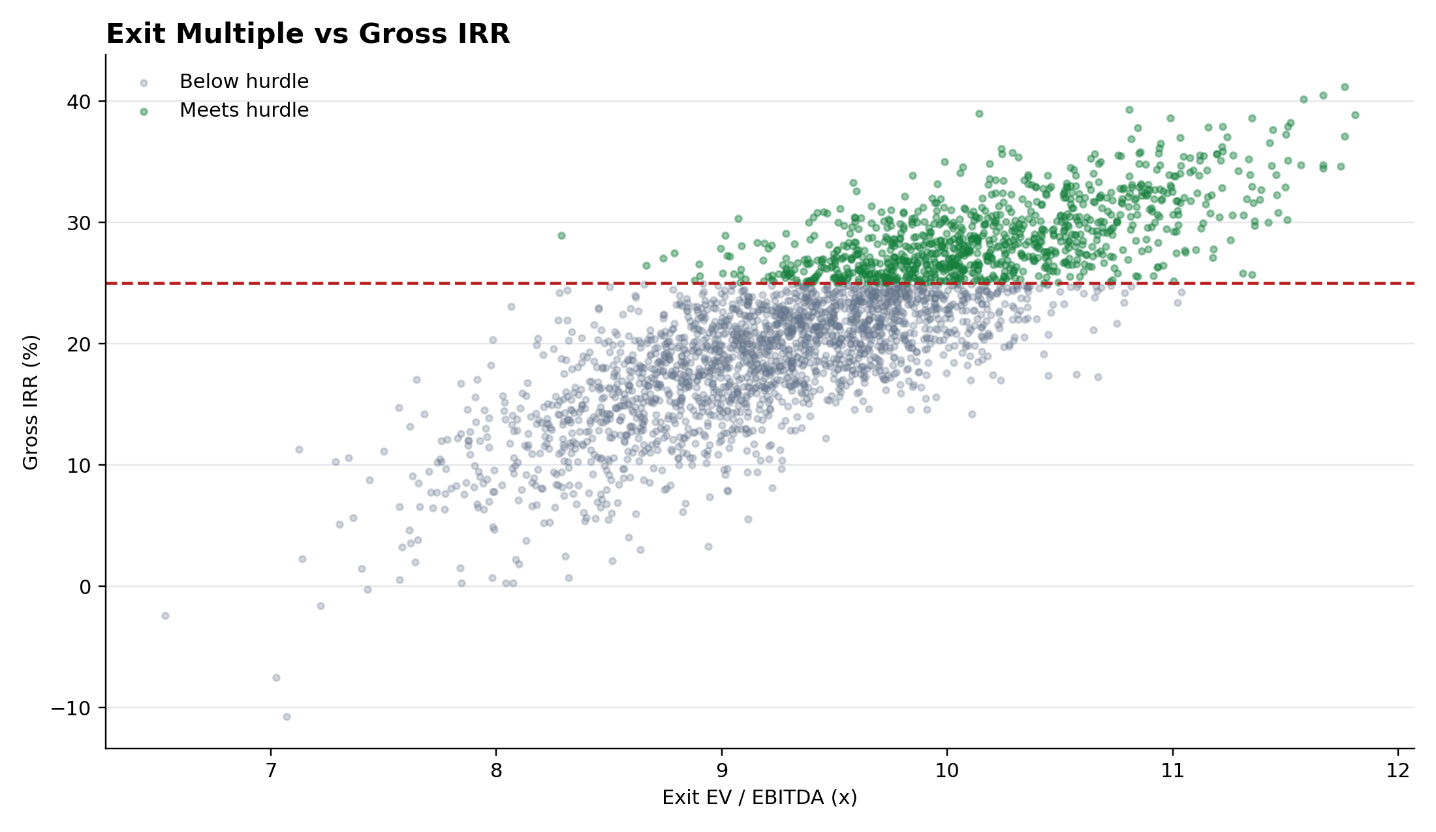
Investment committee conclusion: bid discipline, not model engineering
The framework connects valuation, leverage, operating execution and probability of success into one decision.
Spearman rank correlation with gross IRR
Exit multiple vs realised gross IRR
IC takeaway
The 8.5x ask is possible, but not the most defensible price under the selected 25% IRR hurdle. The model supports ~8.1x deterministically, ~8.0x at a 50% probability threshold, and ~7.5x at 75%.
Deliverables: Excel LBO + Reverse LBO | Python risk engine | 15 automated tests | interactive HTML dashboard | reproducible CSV outputs
PROJECT REDWOOD | FICTIONAL EDUCATIONAL CASE STUDY | SYNTHETIC ASSUMPTIONS

