Slide 1
Chapter 8 – Pipe Flow
CE30460 - Fluid Mechanics
Diogo Bolster

Slide 2
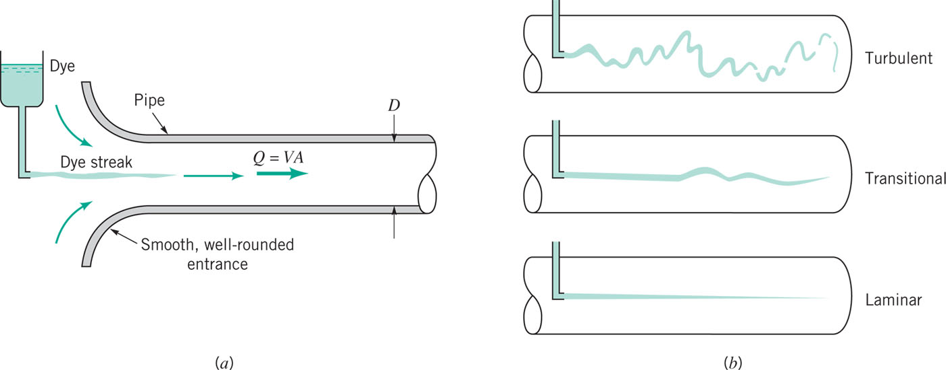
Laminar or Turbulent Flow
Re>4000
Re<1000
Re=UDρ/μ
Laminar Flow http://www.youtube.com/watch?v=KqqtOb30jWs&NR=1
Turbulent Flow http://www.youtube.com/watch?v=NplrDarMDF8

Slide 3
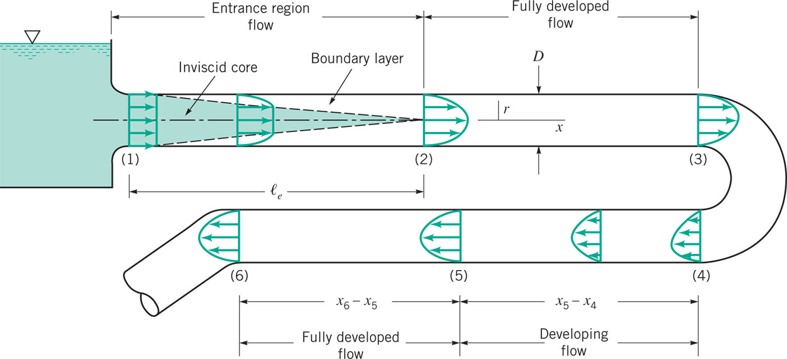


Fully Developed Flow
Entrance length:

Slide 4
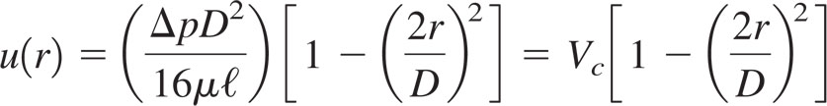
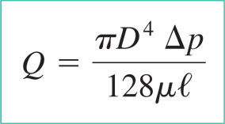
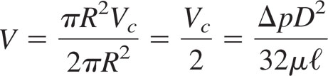
Fully Developed Laminar Flow
We’ve done this one already in chapter 6

Slide 5
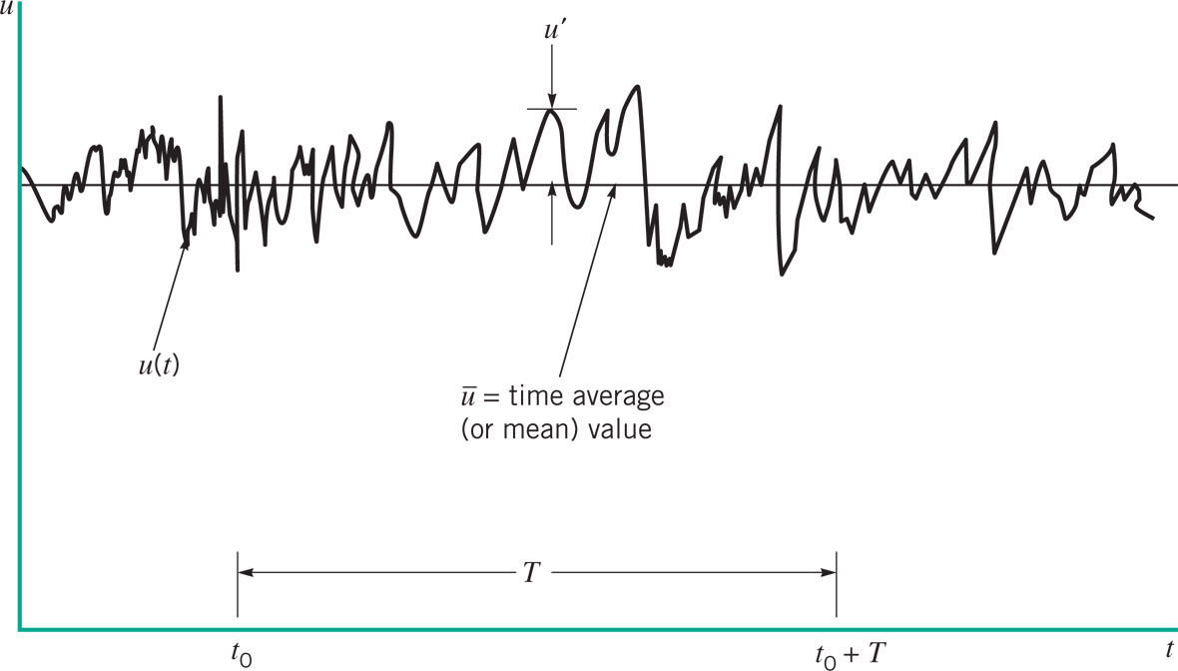
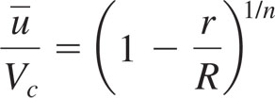
What about Turbulent Flow
Typically:
n is between 6 and 10

Slide 6
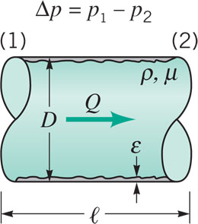

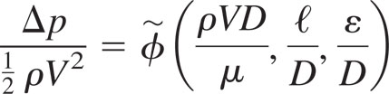
Dimensional Analysis
Pressure Drop depends on
Mean velocity V
Diameter D
Pipe length l
Wall Roughness ε
Viscosity μ
Density ρ
By dimensional Analysis

Slide 7
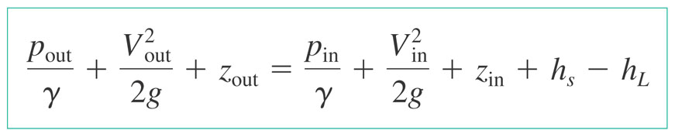
Pressure drop must increase linearly with length of tube
Recall from chapter 5
Therefore we can say that (part of) the loss in a pipe is
Friction factor – look up in table

Slide 8
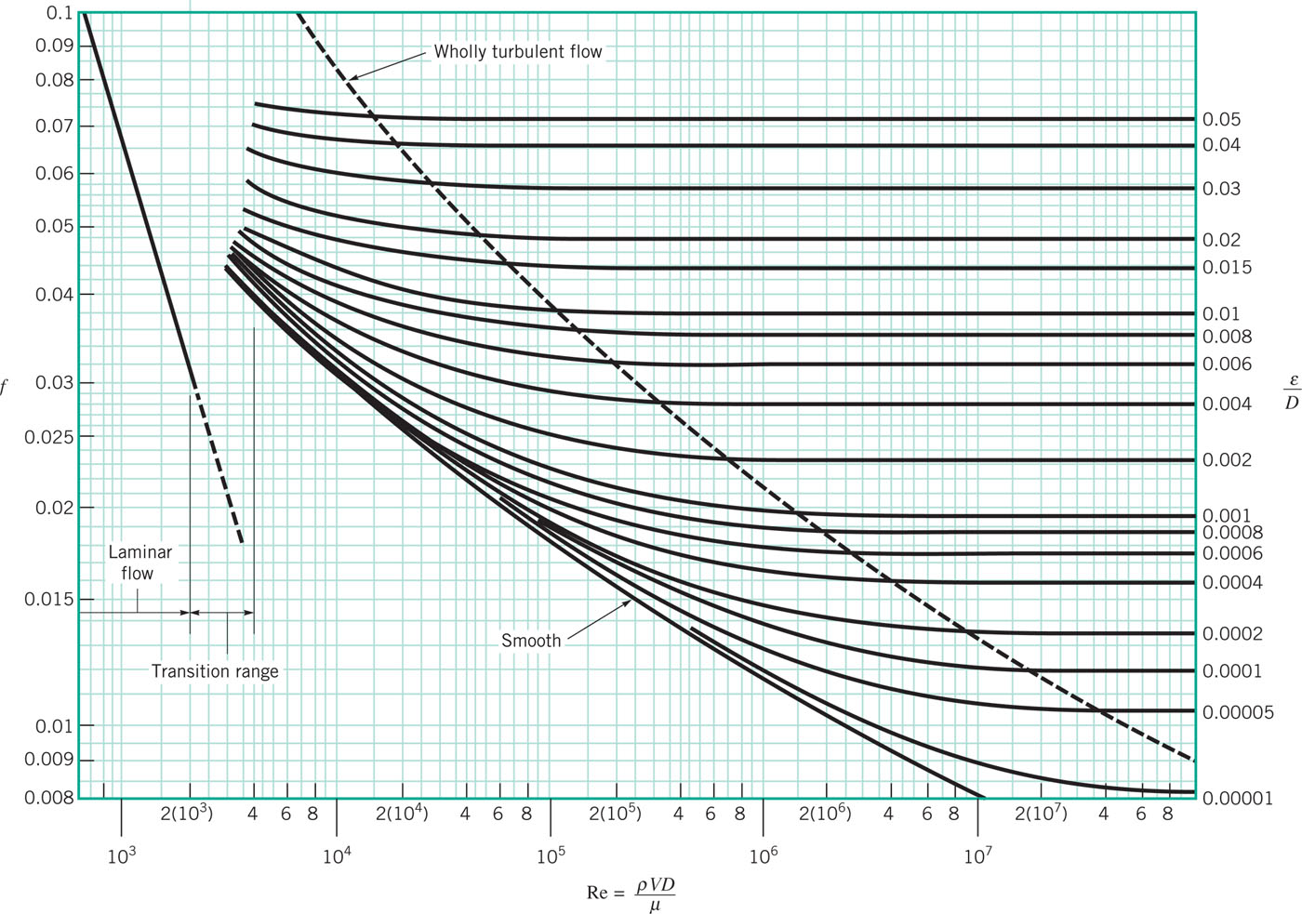
Moody Diagram (Friction Factor)
For laminar
For non-laminar flow approximately true that

Slide 9
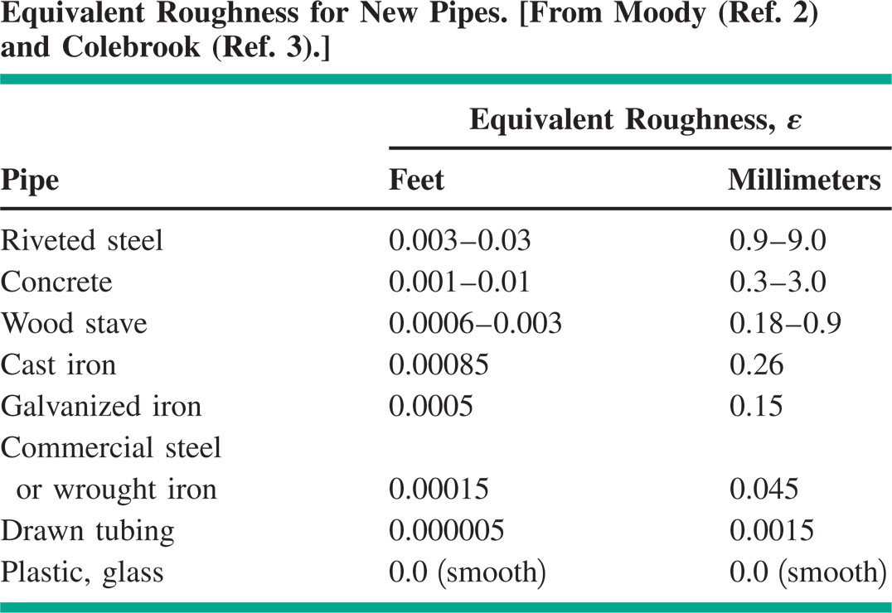
Roughness (Typical)

Slide 10

Minor Losses
K_{L} depends on the flow (expansion, contraction, bend, etc)

Slide 11
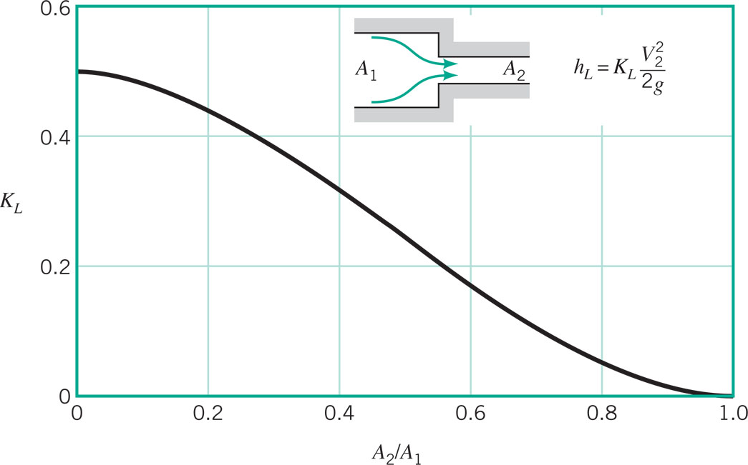
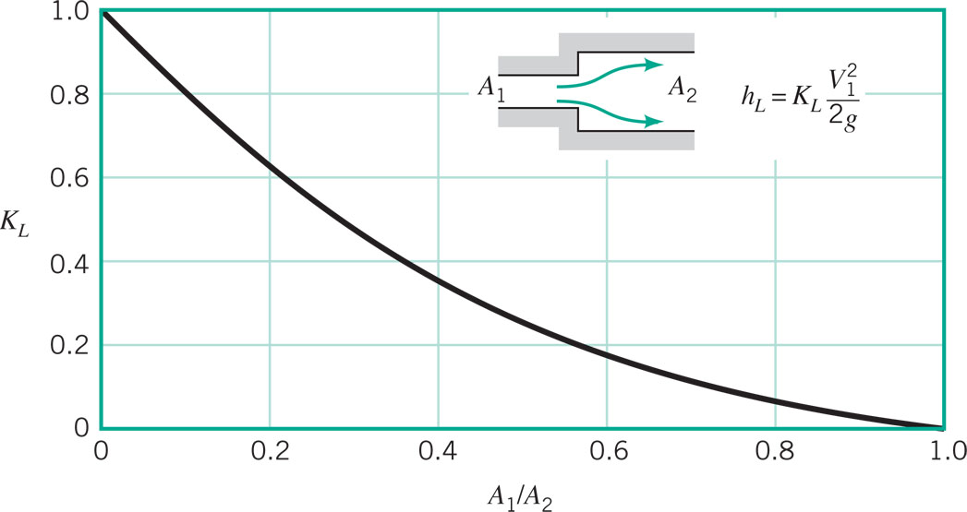
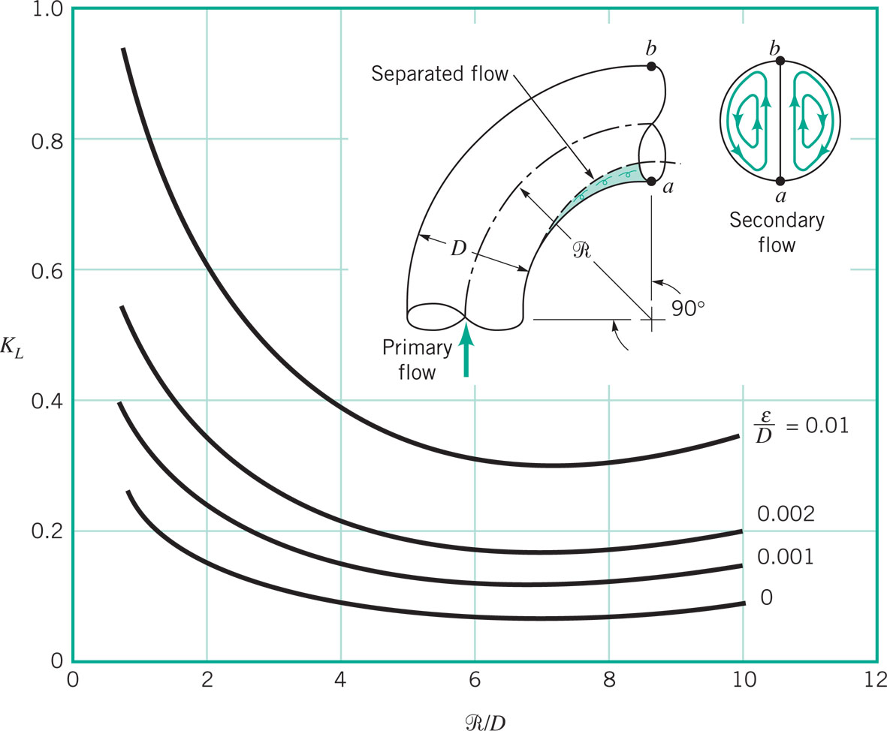
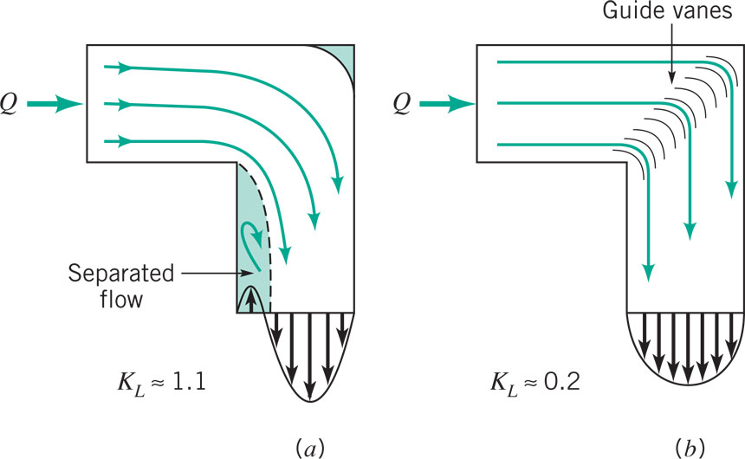
Minor Losses

Slide 12
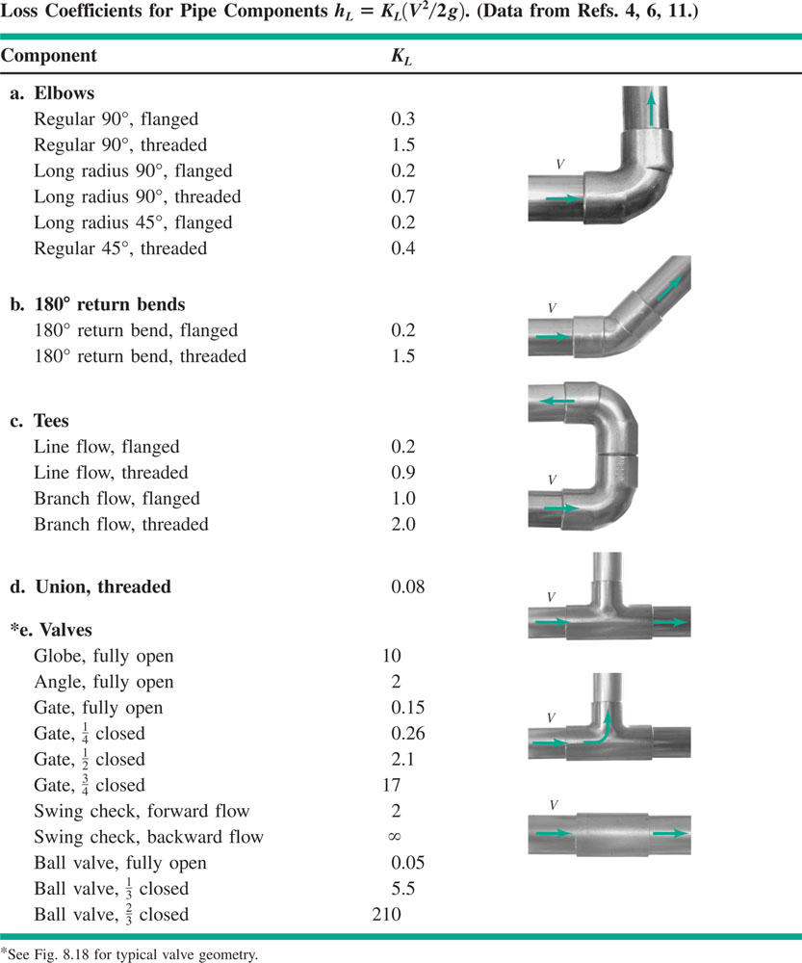
Minor Losses

Slide 13
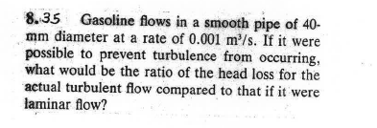
Sample Problem

Slide 14
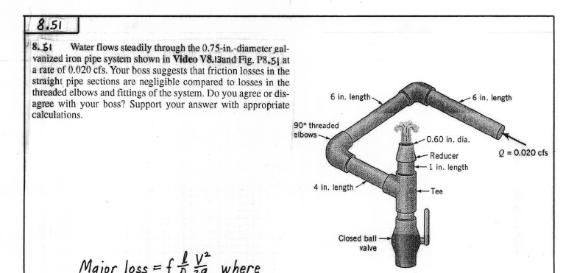
Sample Problem

Slide 15
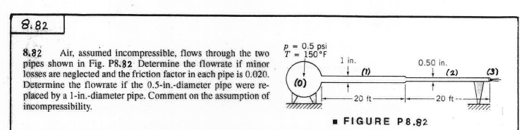
Sample Problem

Slide 16
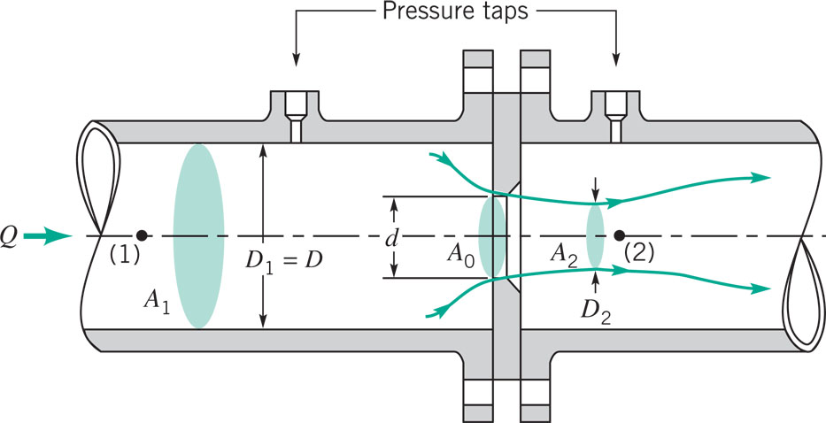
Pipe Flow Measurement
C is a constant that depends on geometry

Slide 17
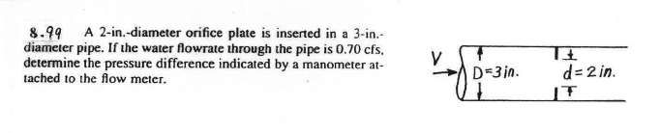
Sample Problem

Slide 18
More Problems

Slide 19
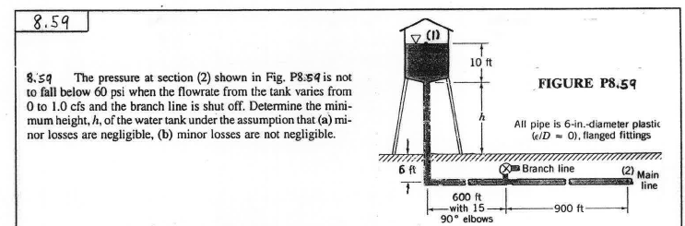
Single Pipe – Determine Pressure Drop

Slide 20
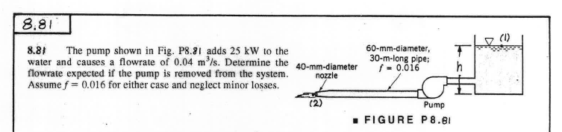
Single Pipe – Determine Flowrate

Slide 21
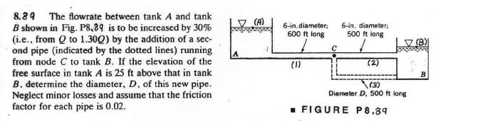
Single Pipe – Determine Diameter

Slide 22
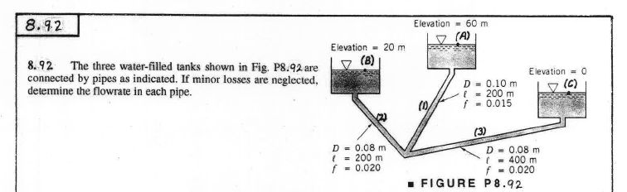
Multiple Pipe Systems

