Slide 1
CE 30460 – Fluid Mechanics
Diogo Bolster
120 c Cushing Hall
dbolster@nd.edu

Slide 2
Course Objectives
Learn the fundamental physics behind fluid flows
Apply these principles to solve engineering problems
Acquire basic knowledge for other courses such as
Hydraulics
Hydrology (Groundwater)

Slide 3
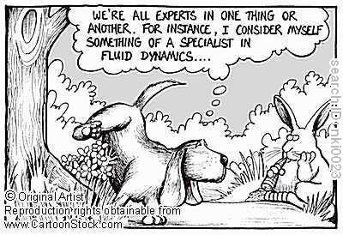
What is Fluid Mechanics

Slide 4
A couple of questions
Why do engineers care about fluid mechanics?
Why do civil engineers care?
Why should you specifically care?
Breakout session (1 minute)

Slide 5

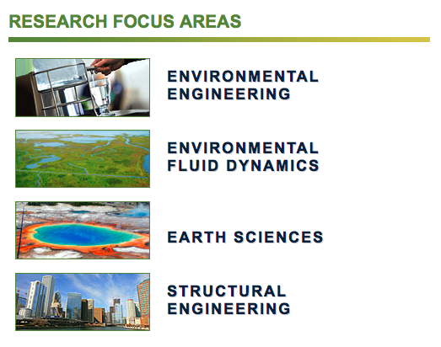
Let’s take a look at our department http://nd.edu/~ceees/

Slide 6
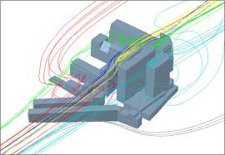
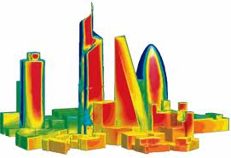
Structural Engineering
Flow around buildings – Forces that must be understood
Take a look at:
http://www.nd.edu/~nathaz/
http://www.nd.edu/~cpssl/

Slide 7
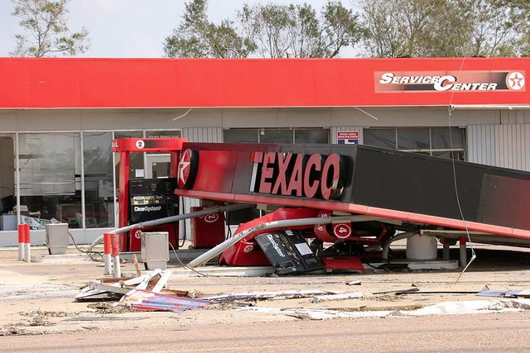

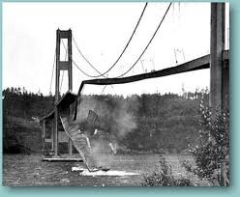
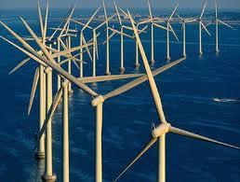
Other Structural Problems

Slide 8
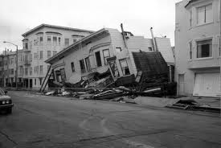
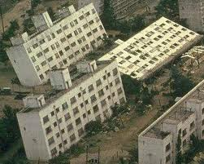
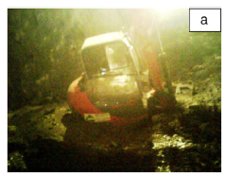
Geotech

Slide 9
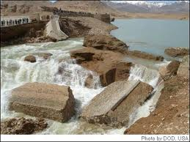
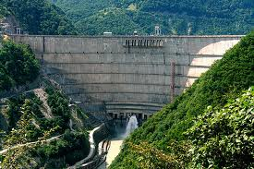
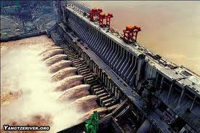
Dams, Hydroelectric Plants, Flood Control

Slide 10
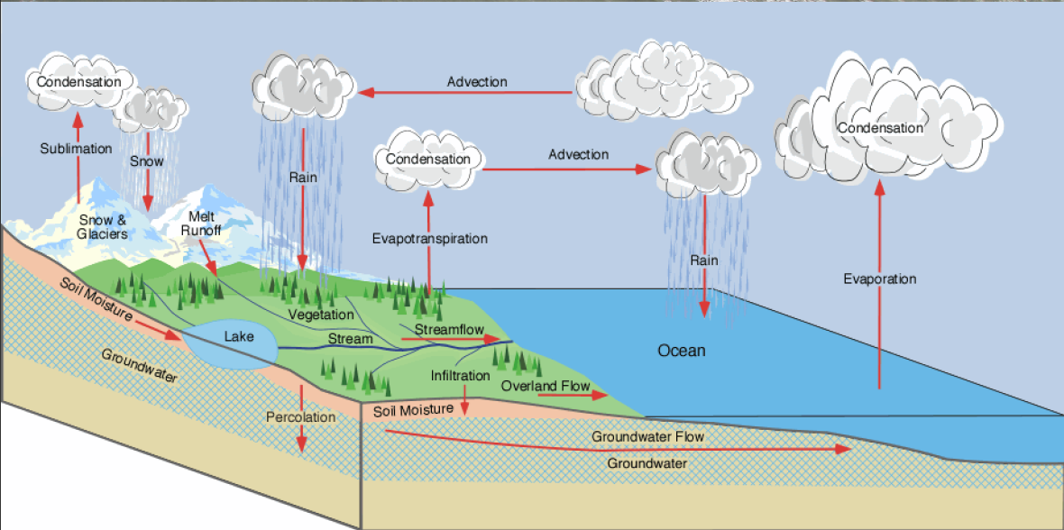
Water Cycle
Environmental Fluid Dynamics

Slide 11
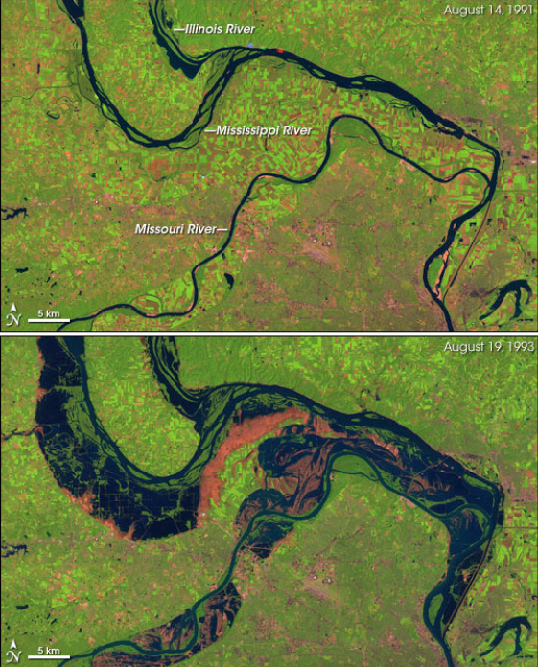
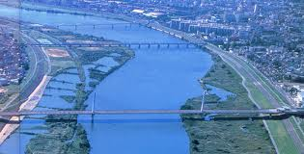
River/Canal Dynamics

Slide 12
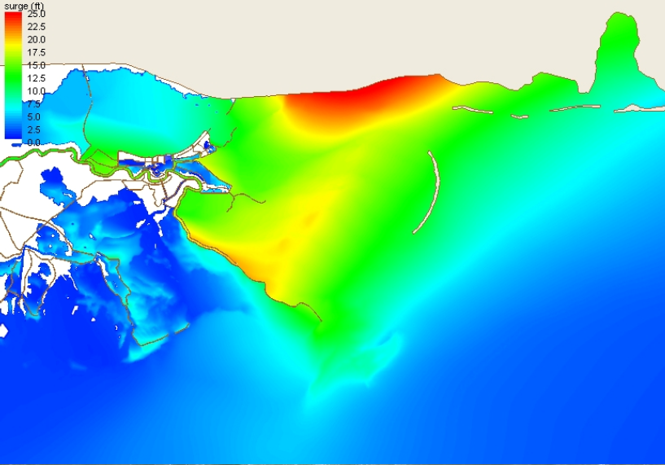
Predicting Hurricanes
http://nd.edu/~coast

Slide 13
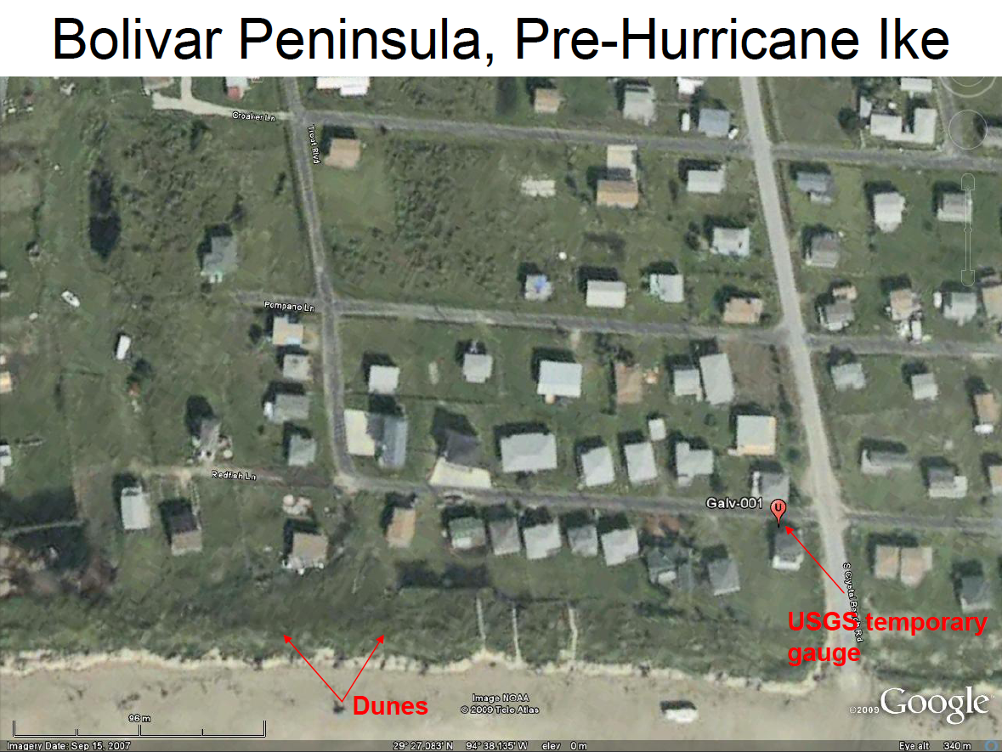
Hurricane Damage

Slide 14
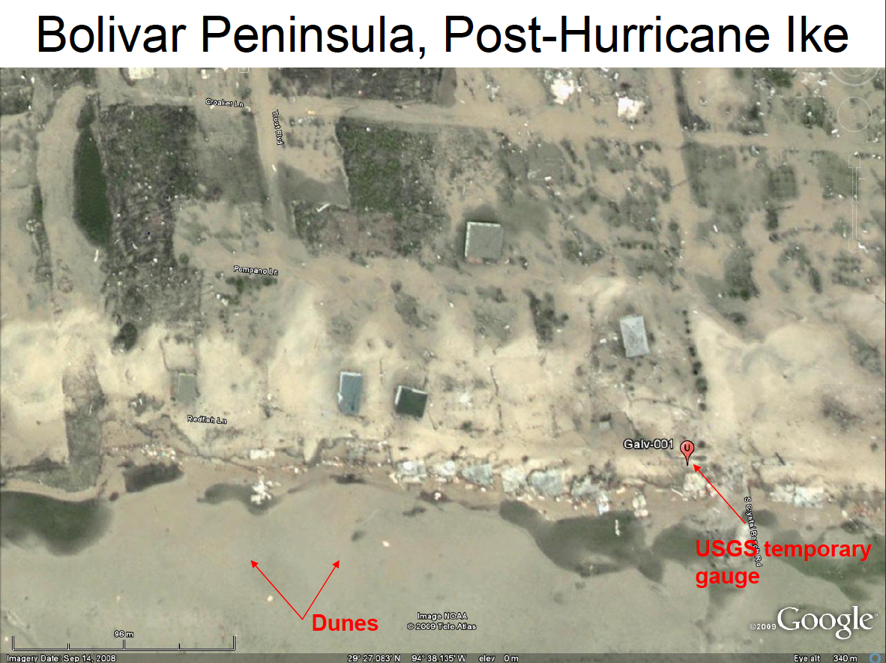
Hurricane Damage

Slide 15
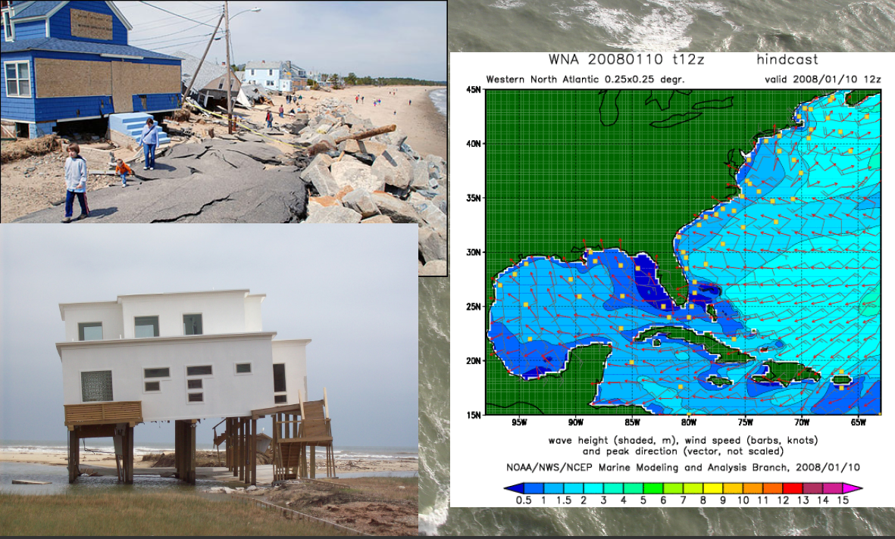
Coastal Erosion (Slower, but Severe)

Slide 16
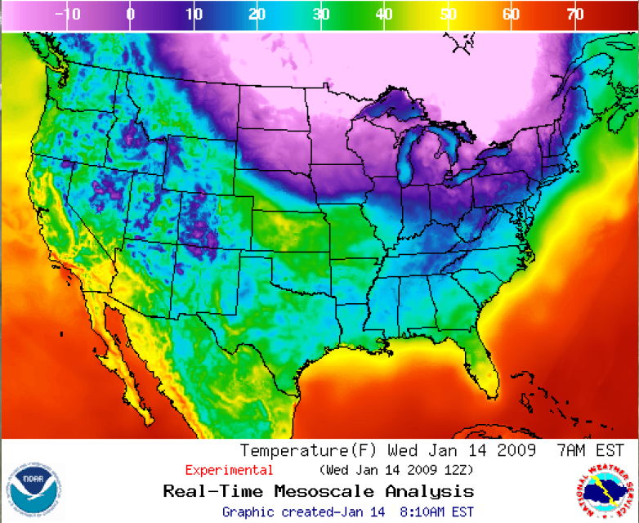
Atmospheric and Ocean Science

Slide 17
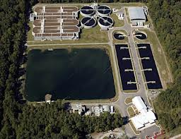
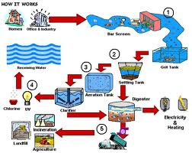
Environmental Engineering
Wastewater Treatment

Slide 18
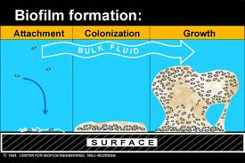
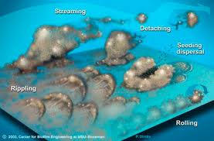
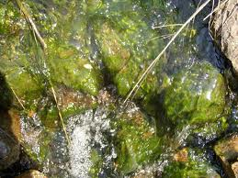
Biofilms

Slide 19
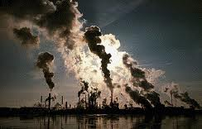
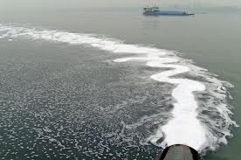

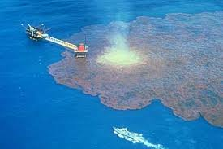
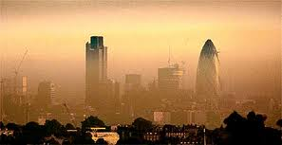
Pollutant Transport

Slide 20
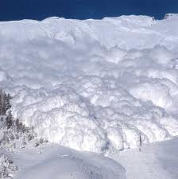
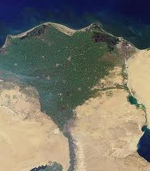
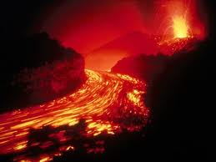
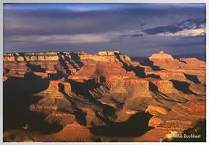

Earth Sciences (most of you are Engineers I know)

Slide 21
General Engineering Applications

Slide 22
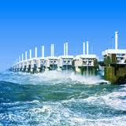
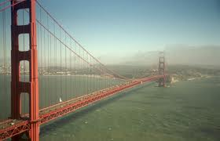
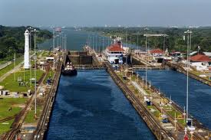
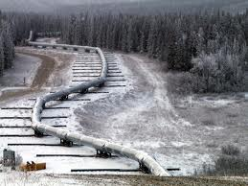
Infrastruture

Slide 23
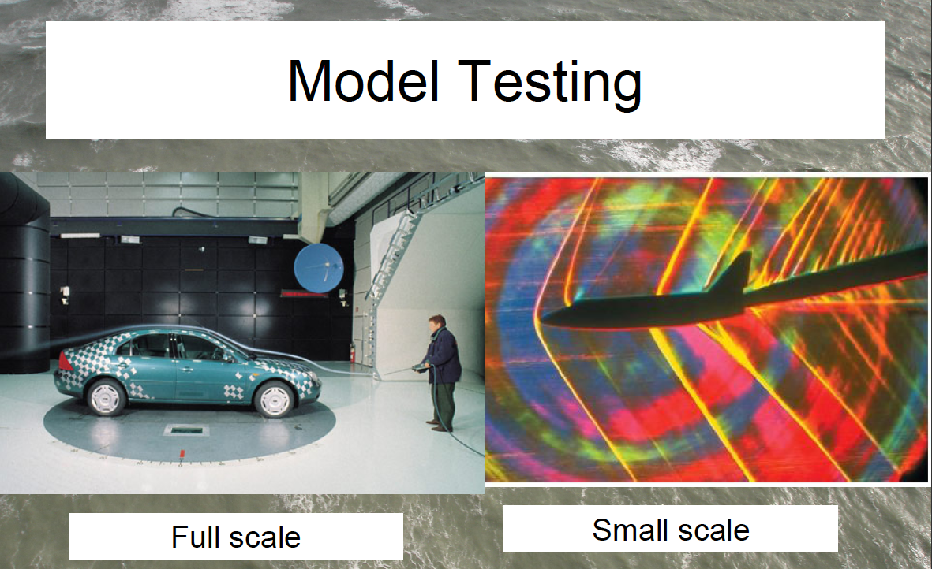

Slide 24
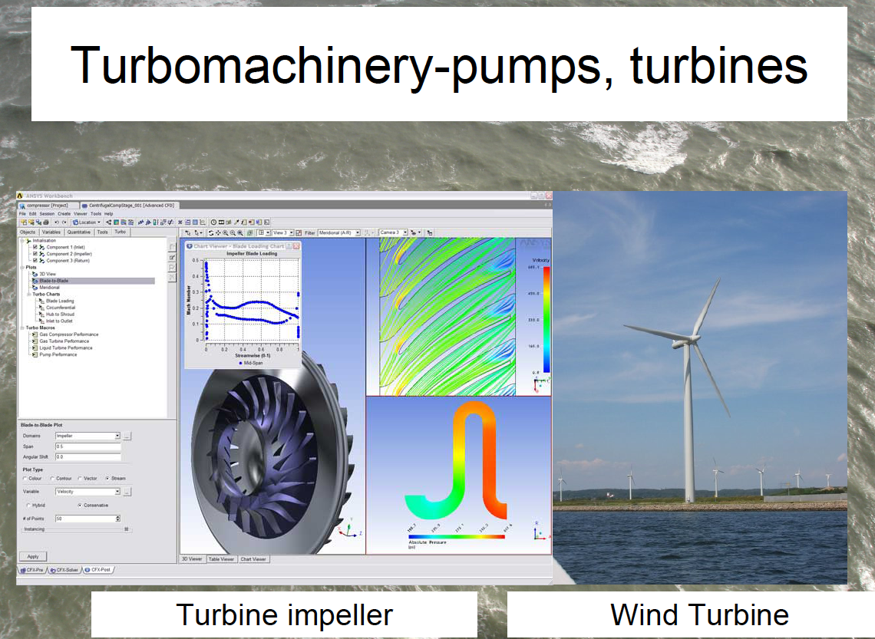

Slide 25
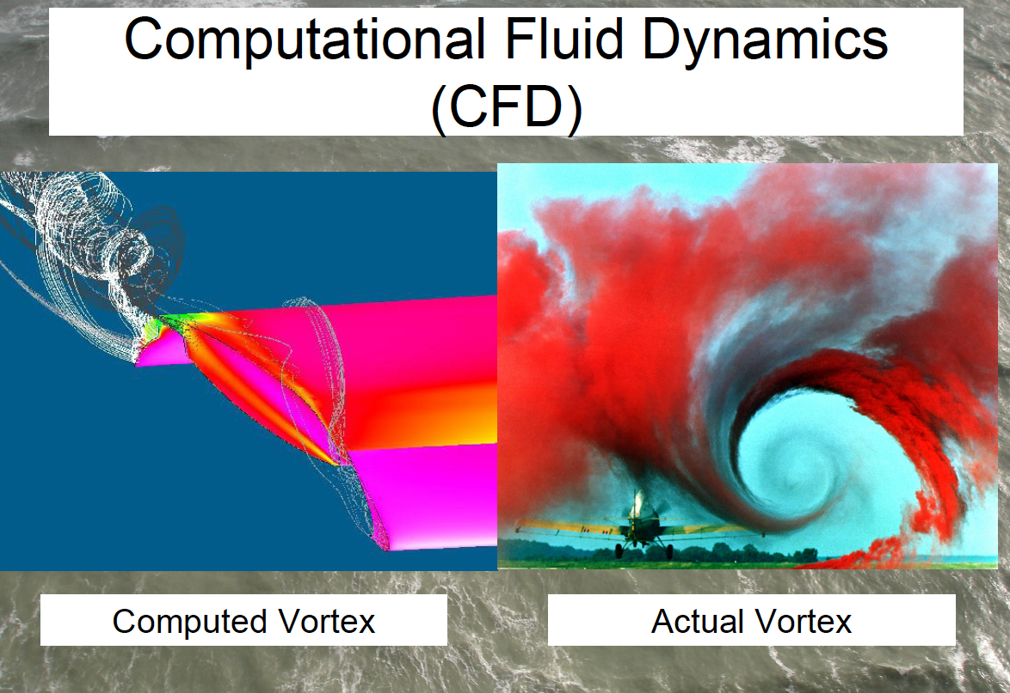

Slide 26
Fluid Dynamics in the News
Kelvin Helmholtz Waves in Alabama:
http://www.alabamawx.com/?p=55225
http://www.youtube.com/watch?v=dcwOn4VeJOE
News stories relating to fluids research
http://www.physorg.com/tags/fluid+mechanics/
Stories about professors in our department:
http://newsinfo.nd.edu/news/22057/
http://newsinfo.nd.edu/news/22131-engineering-professors-receive-muri-grants/
http://newsinfo.nd.edu/for-the-media/nd-experts/faculty/joannes-westerink/
http://newsinfo.nd.edu/news/25718-researcher-ndrew-kennedy-is-observing-hurricane-irene-s-storm-surge/
http://newsinfo.nd.edu/news/16293-silliman-named-darcy-distinguished-lecturer-in-ground-water-science/

Slide 27
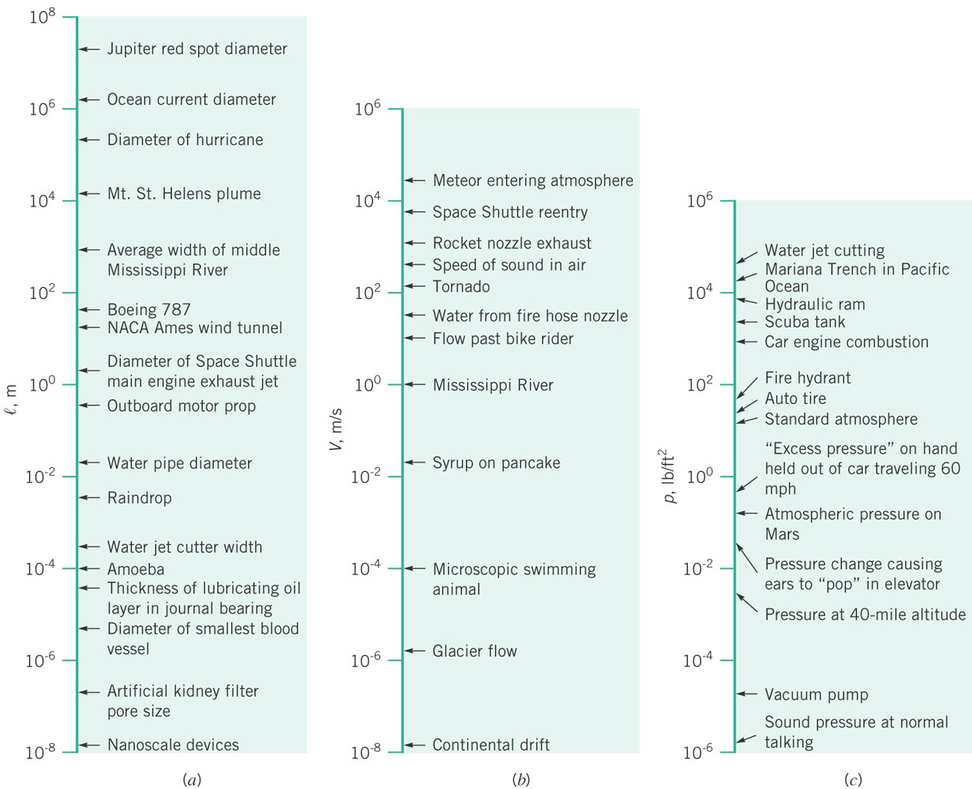
Scales of Interest – HUGE VARIATION very few other subject you study will be this wide

Slide 28
Course Outline
Ch 1: Fluid Properties
Ch 2: Hydrostatics
Ch 3: Bernoulli’s Equation
Ch 4: Kinematics
Ch 5: Control Volumes
Ch 6: Differential Analysis
Ch 7: Similitude and Dimensional Analysis
Ch 8: Pipe Flows

Slide 29

Notes
This is a mechanics (fundamentals) class and one of the last you may have
Be patient – fundamentals are necessary to understand and solve more complicated and interesting problems

Slide 30
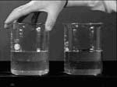
Notes
In class demos will try to illustrate some of the basic physics
You are encouraged to suggest in class demos and topics of discussion that are of interest to you (we will try to oblige).

