Slide 1
Chapter 7
Mixing Driven Reactions

Slide 2
General Principle
Consider a reactive system made up of species A, B and C, where A and B can react to form C at some rate k_{f} and C can degrade back into A and B at some rate k_{b}
If the system is well-mixed (i.e. no spatial variability in concentration, reaction are governed by the law of mass action
k_{f}
k_{b}

Slide 3
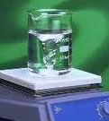
Let’s Start Simple – Recall Chemistry 101
A
C
B

Slide 4
Question
Consider a case where you have equal amounts of A and B initially, that is C_{A}(t=0)=C_{B}(t=0)=C0 and no C_{C}.
What will the system evolve to at very late (steady state) times?
Consider k_{b}=0, i.e. there is no backward reaction. How will the system evolve at all times?
at late times

Slide 5
Question 2
What if you do not have equal amounts of A and B initially, that is C_{A}(t=0)= C_{A,0} C_{B}(t=0)= C_{B,0} and no C_{C}.
What will the system evolve to?
at late times

Slide 6
What if we have transport?
Then
In general there is not much you can do other than solve these systems numerically

Slide 7
Two Limits
Slow Reactions
Fast Reactions
Question: What does this even mean? How do I define something is fast or slow
Let’s start with irreversible reactions only and only consider diffusion in one direction (easy to generalize)

Slide 8
Irreversible reactions
What does it mean for reaction to be fast
Fast means
advection
dispersion
reaction
Reaction>>dispersion
Reaction>>advection
How to quantify this?

Slide 9
Characteristic Dimensionless Numbers
Advection
Dispersion
Reaction
if
C₀ is a characteristic concentration; L is a characteristic length scale

Slide 10
What is a fast or slow reaction
Da -> infinity means an infinitely fast reaction
Da>100 can be large enough to assume infinite
Da-> 0 means an infinitely slow reaction
Da<0.1 can be small enough to treat in this limit

Slide 11
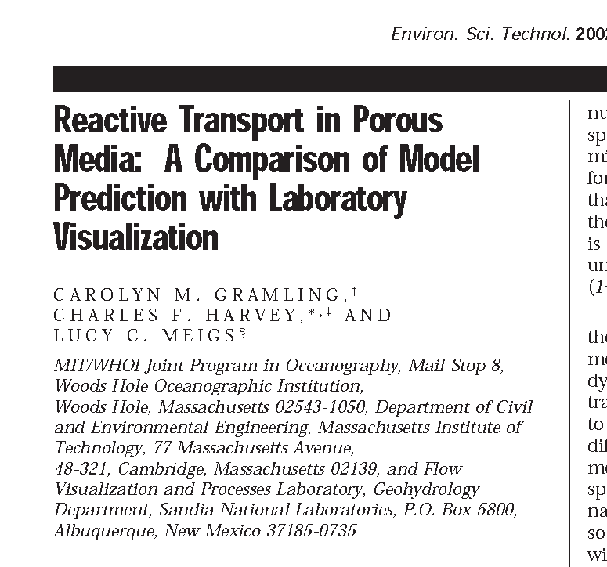
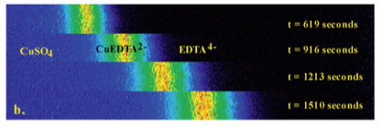
Let’s look at fast reactions first (assume infinitely fast)
In this paper the authors develop the theory we will learn here, which is formally correct. They then study a case where they show that it fails, which we will also explore in a later chapter. While they highlight the failure, there are many instances where the model will work excellently and so should be considered as important.

Slide 12
Consider the Following System
A and B react irreversibly with one another to form some product C
Typically reactions occur at some rate (i.e. A and B have to be in contact for some time to produce C). If this rate is very fast relative to anything else in the system, then we say it can be treated as INSTANTANEOUS – that is any time A and B come into contact they immediately form C – or alternatively A and B cannot coexist at a given point in space and time
Question: How might you determine that this condition of very fast reactions holds?

Slide 13
Consider A and B advecting and diffusing
What happens to
r= k C_{A}C_{B}
when infinitely
fast reaction?
3 equations, 4 unknowns… Problem? Do we have another constraint? Yes – what is it?

Slide 14
Consider A and B advecting and diffusing
What happens to
r= k C_{A}C_{B}
when infinitely
fast reaction?
3 equations, 4 unknowns… Problem? Do we have another constraint? Yes – what is it?
C_{A}C_{B}= 0 everywhere

Slide 15
In general we do not know how to solve ADRE. However can we rewrite our equations in such a way as to write them in a form that we can solve (i.e. can we define some conservative component)
Consider the following three

Slide 16
For each of these three
Conservative ADE equation
Using any of the methods we have learned so far we can solve for any of these under any reasonable initial and boundary conditions – But does this help us at all?

Slide 17
Let’s ignore the first conservative component for this problem (we will find it useful in the next chapter though) and focus on the latter two
As noted, we can solve for both of these using any of the methods we have learned so far.
Now recall, A and B cannot coexist, which means C_{A}=0 or C_{B}=0 everywhere and anywhere in the domain.

Slide 18
Therefore
If u_{A}>u_{B} => C_{B}=0 (or u_{B}=C_{C})
If u_{B}>u_{A} => C_{A}=0 (or u_{A}=C_{C})
Therefore C_{C}=min(u_{A},u_{B})
We can solve for the reactant C using only conservative information!!! And you are all super expert at that by now!

Slide 19
Example - Let’s consider Gramling’s experiment
A column is initially filled with reactant A (EDTA) at a concentration of 1 mol/m³. It is then displaced by another reactant B (CuSO₄) at the same concentration.
The Darcy velocity is 1 cm/s and porosity 0.4; Dispersivity is 0.1 cm.
The two reactants form CuEDTA and the rate for this reaction is k=4.4x10⁵ m³/(mol s).
Predict the evolution of concentration of CuEDTA and total mass of product against time.

Slide 20
Think about it this way..
Assume Infinite Domain
Initial Conditions
Solve for C_{C}

Slide 21
Slow Reactions

