Slide 1
Chapter 9
-
Indoor Air
Quality

Slide 2
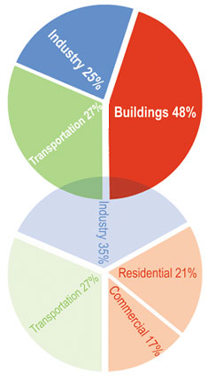



Low Energy Buildings - Who Cares?
+
+
=
Buildings account for 48% of all energy used in USA

Slide 3
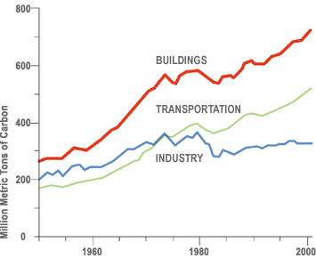
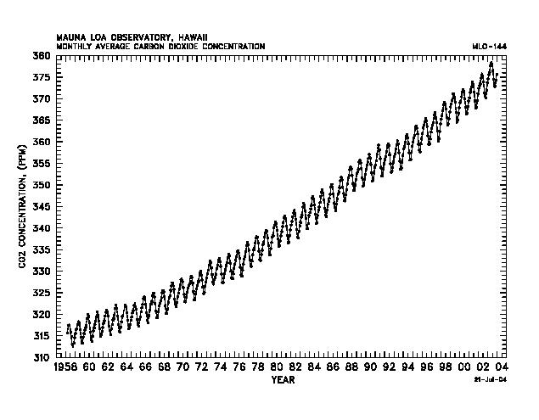
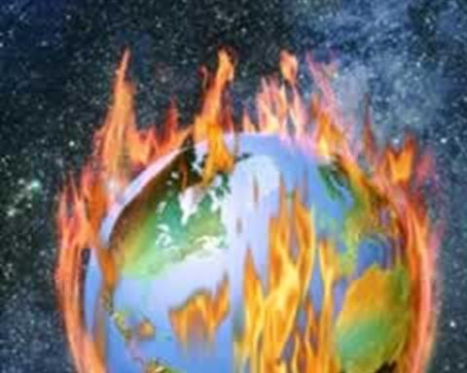
Who cares some more?
+
=
Buildings account for more than 50% of anthropogenic CO2
EIA Report

Slide 4
Air Quality Affects Childhood Development
If it were not for good air quality in Nebraska this would not be possible

Slide 5


Slide 6


Slide 7


Slide 8
Whereas in Ireland with grim smog

Slide 9


Slide 10


Slide 11


Slide 12


Slide 13
Where would you raise your child?

Slide 14

Contaminants and Low Energy - Who cares?
1973 OPEC Oil Crisis
1970s/80s - Sick Building Syndrome
  Bad planning = Many good ideas died
2007 - Can low energy buildings provide adequate indoor air quality?

Slide 15
Contaminants - What do I mean by that?
Passive (Gaseous)
Particulate
(0.01-10 microns)
Radon
Paint Fumes
Gas
Odours
CO2
Viruses
Bacteria
Home Care Products
Combustion
Dust
This is a very short, very incomplete list of examples

Slide 16
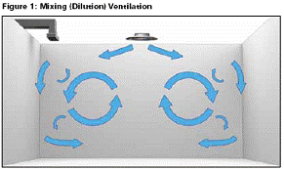
Traditional Ventilation
Tell me what is silly about this

Slide 17
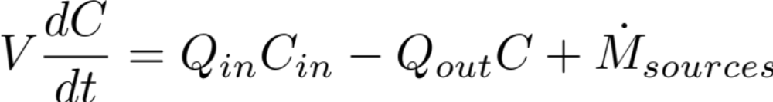
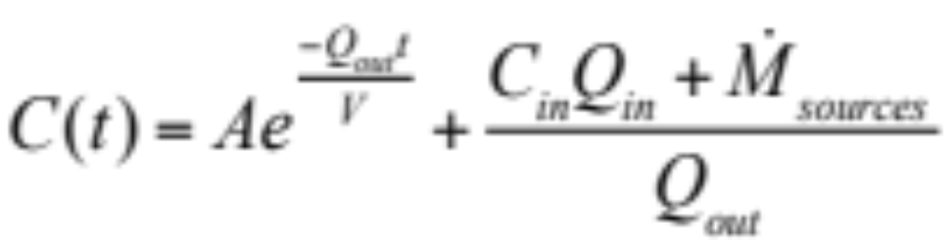
Traditional Model

Slide 18
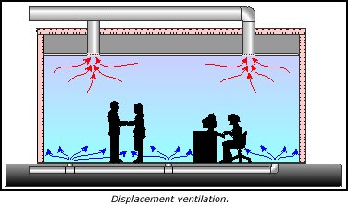
Displacement Ventilation
An air distribution system in which incoming air originates at floor level and rises to exhaust outlets at the ceiling.
“The use of displacement ventilation is increasing, however, as a response to interest in improved indoor air quality.”
www.advancedbuildings.org

Slide 19
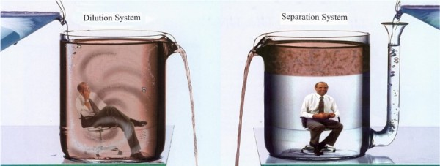
Displacement vs Mixing

Slide 20
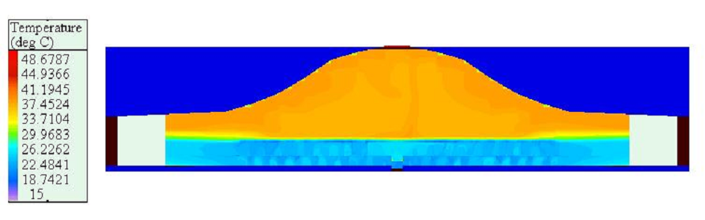
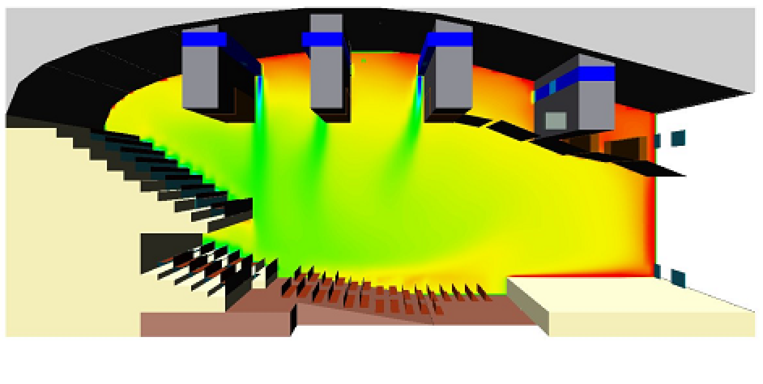
Practical Examples
Displacement
Mixing

Slide 21
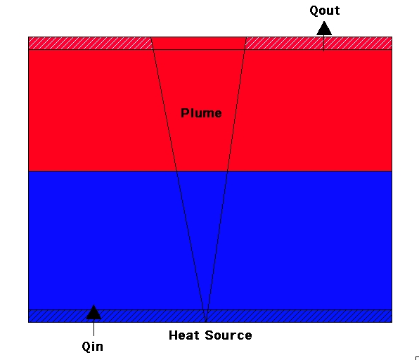
Flow Model Description - “Emptying Filling Box”
1d Model - 2 zones
  Heat Source = Plume
    MTT 1956
  Background - Neglect Diffusion

Slide 22
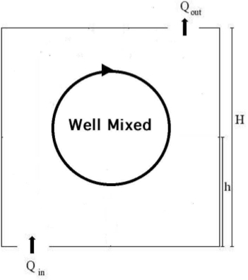
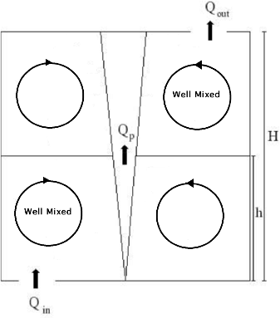
Conceptual Models

Slide 23
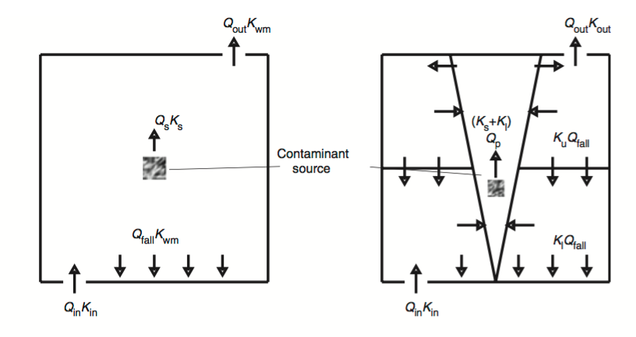
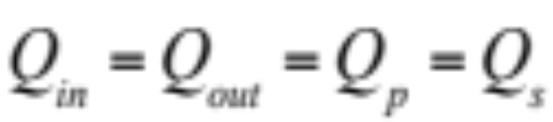
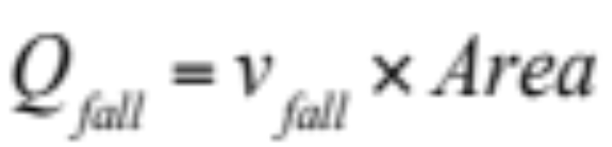
Conceptual Models

Slide 24
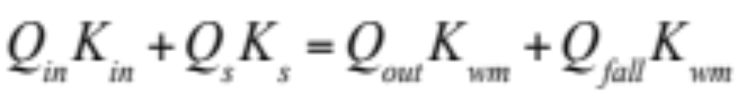
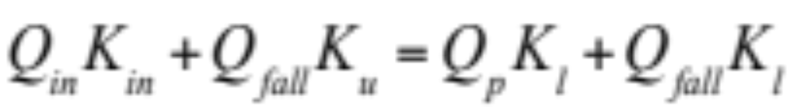
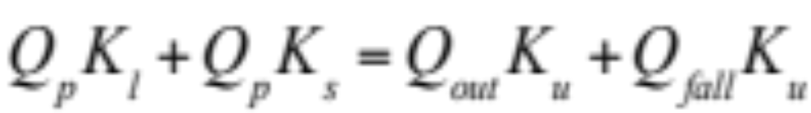
Steady State
Well Mixed
Displacement

Slide 25
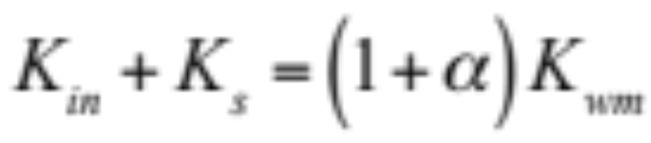
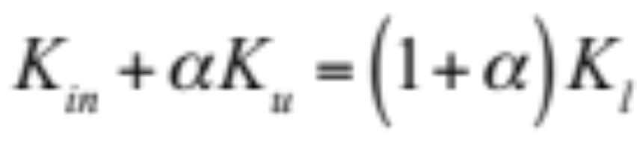
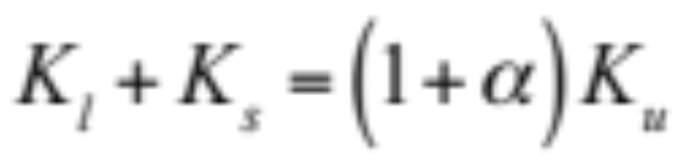
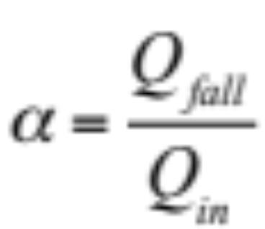
Steady State – Divide by Q_{in}
Well Mixed
Displacement
So which is better?

Slide 26
Contamination Scenarios
Through the ventilation system
  Kin=1; Ks=0
Internal Source
  Kin=0; Ks=1

Slide 27
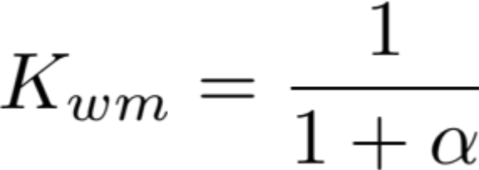
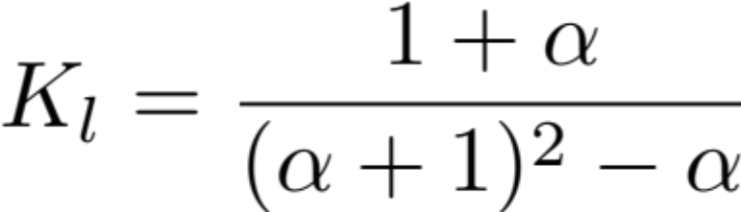
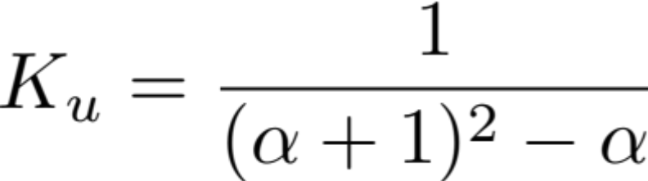

Case 1
  Kin=1; Ks=0
Well Mixed
Displacement
So which is better?

Slide 28
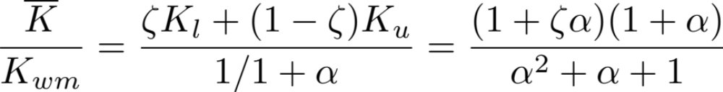
It depends
Lower layer is always worse than upper layer
What about the average concentration?

Slide 29
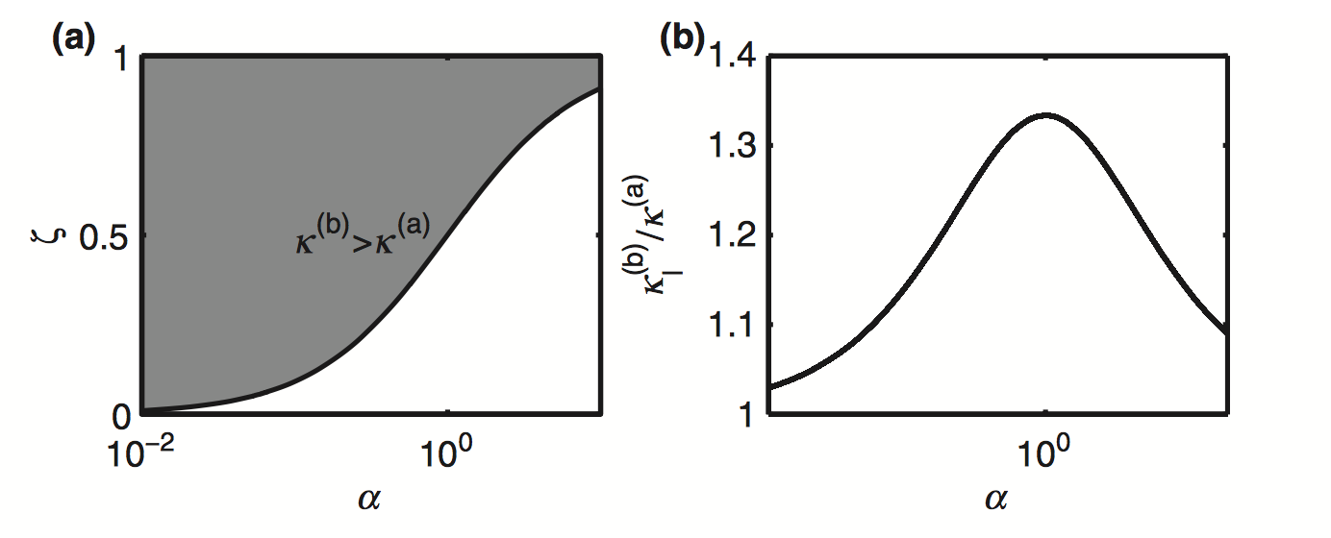

Slide 30
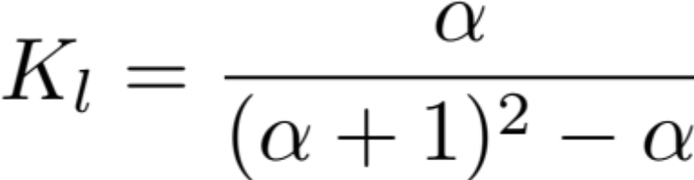
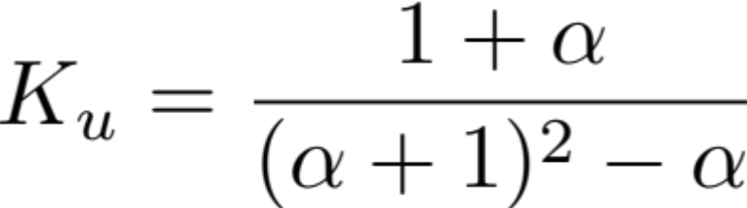
Case 2
  Kin=0; Ks=1
Well Mixed
Displacement
So which is better?

Slide 31
What about non-gravitational settling of particles?

Slide 32



Steady State - Step Up
Well Mixed
Displacement
Implications
Bad News
for Low
Energy!

Slide 33


Steady State - Point
Well Mixed
Displacement
Implications
Good News!

Slide 34
Transients…
This part is what I did my PhD thesis on

Slide 35



Conservation Equations
Lower Layer
Upper Layer
2 dimensionless parameters
Interface
Height
Particle
Settling

Slide 36
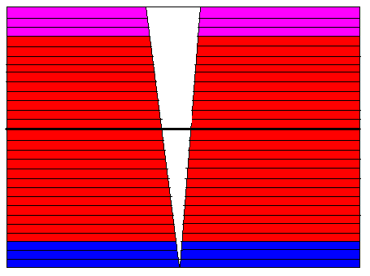
Vertical Distributions 2 - Transient
Germeles Algorithm
Discretize Background
Quasi Steady
  Integrate Plume Eqns
  Update Background
Add 2 new layers
Restart

Slide 37
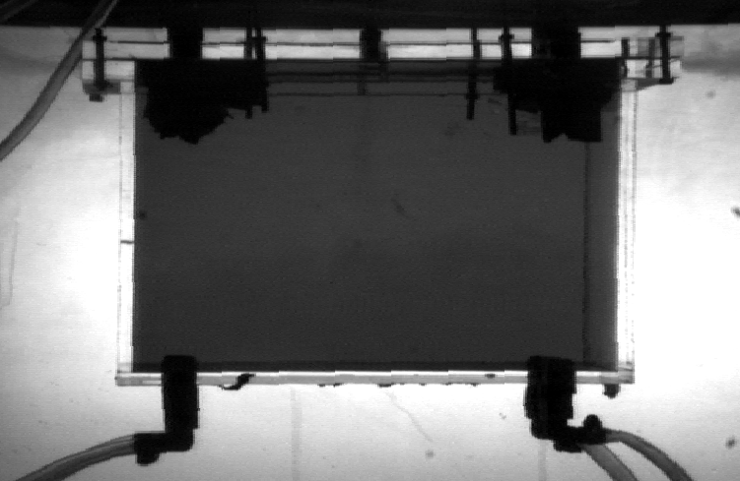
Experiments - Passive

Slide 38
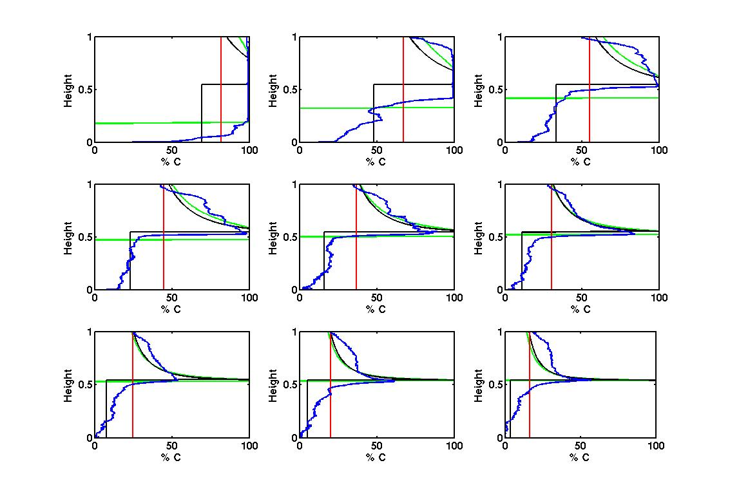

Results (Step Down)

Slide 39
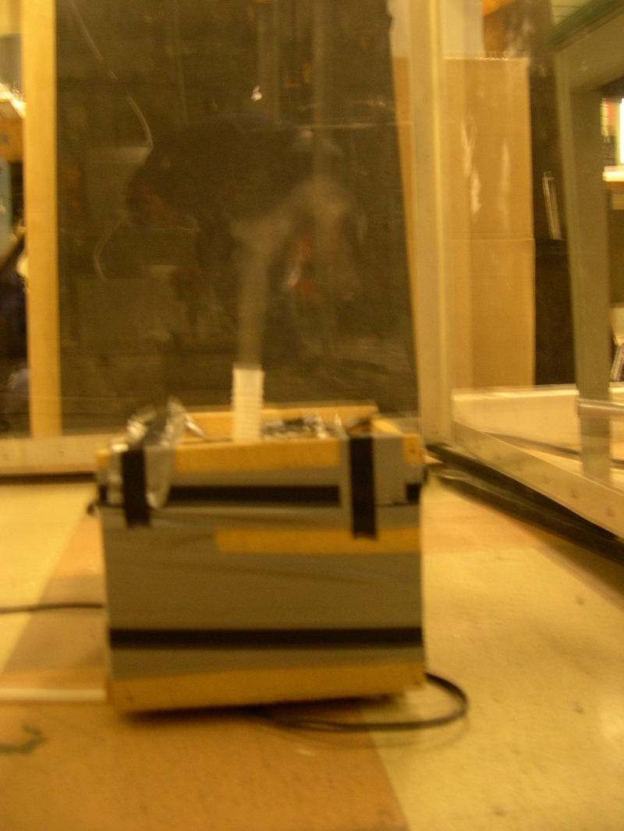
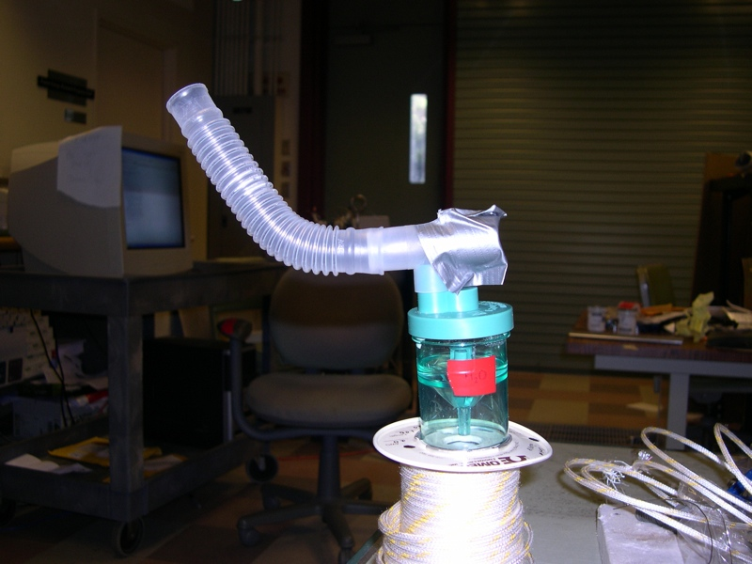
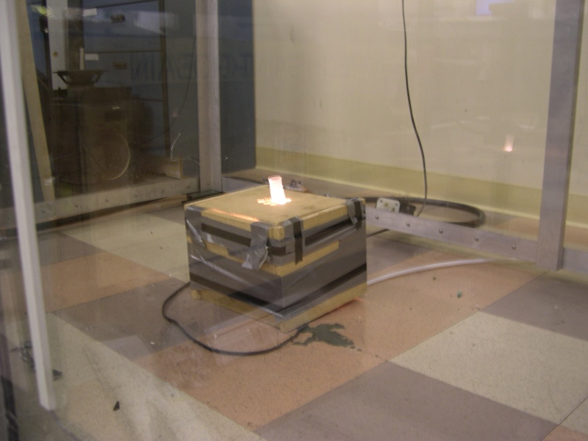
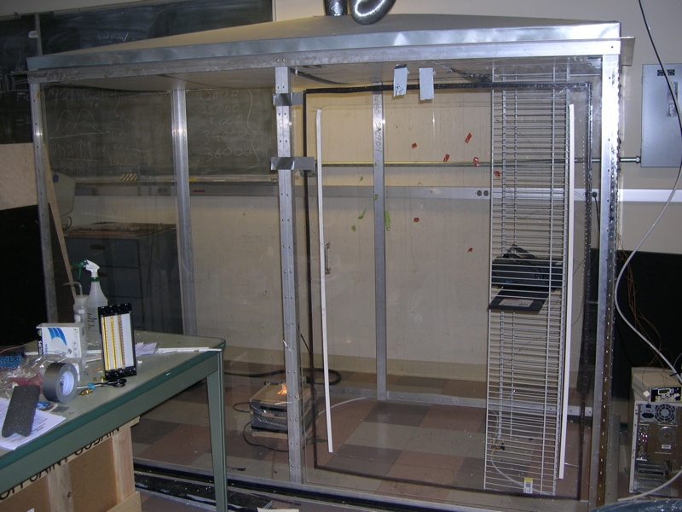
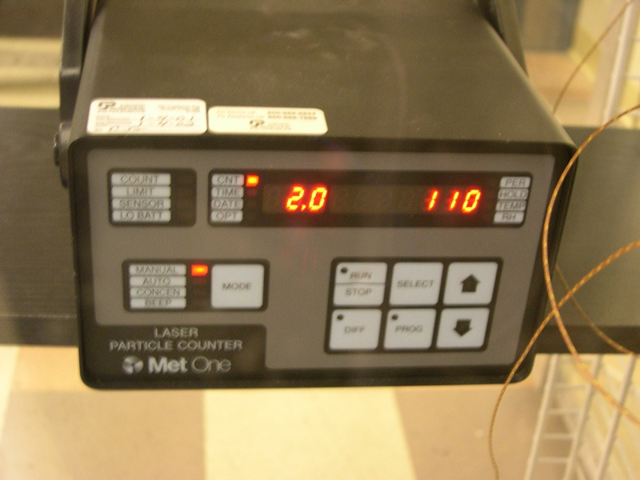
Experiments - Particles

Slide 40

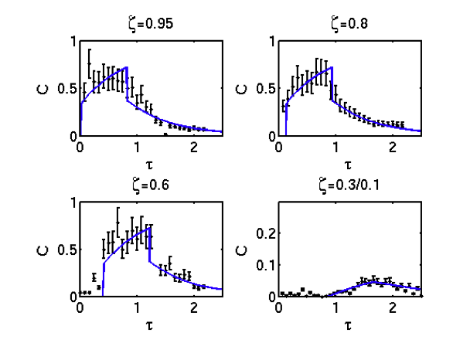
Results
- Not Well Mixed
Upper Layer
-Concentration in
Upper/Lower
Layer very
different

Slide 41
Implications
Displacement Ventilation sometimes better, sometime worse
Different Source Types = Different Behaviour
Averages don’t tell all
Contaminant Removal not Heat Removal

