Slide 1
Flow to Wells

Slide 2
Basic Assumptions
Aquifer bounded on the bottom
Horizontal Geologic Formations (with infinite extent)
The potentiometric surface is horizontal and is steady prior to pumping
Any changes in potentiometric surfaces are due to pumping
Aquifer is homogeneous and isotropic
All flow is radial towards the well
Groundwater flow is horizontal
Darcy’s Law is valid
Water has constant density and viscosity
Wells are fully penetrating
Pumping well has infinitesimal diameter and 100 efficiency

Slide 3
Radial Flow
Two dimensional flow in a confined aquifer
Radial Transform
Axisymmetric
Radial Coords Flow Equations

Slide 4
How about steady state conditions?
We will see how transient tests can be used to assess parameters, but steady state can provide a lot of information
Assumptions
Pumping well is screened in aquifer being test only
Observation wells are also screen in that aquifer only
Both pumping and observation wells are screened throughout the entire aquifer thickness

Slide 5
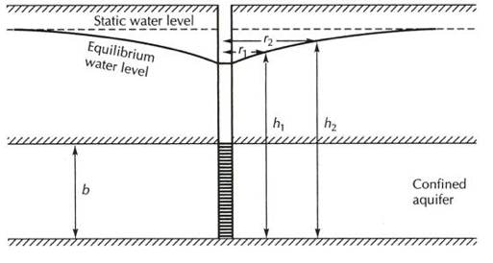
Steady State Confined Aquifer (Thiem solution)

Slide 6
Steady State Confined Aquifer (Thiem solution)
Governing equation
Integrating between two wells at different radii

Slide 7
Example Problem
Two observation wells are placed at a distance on 2 and 10 meters from a well.
The well is pumped at a flow rate of 800 litres/minute
The depth to water is 15m and 12 m for the first and second well respectively.
What is the transmissivity of the well.
If the depth of the aquifer is 10m, what is the hydraulic conductivity

Slide 8
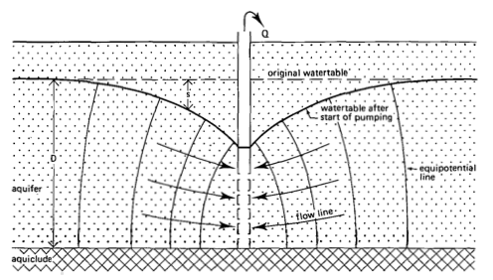
Steady State Unconfined Aquifer

Slide 9
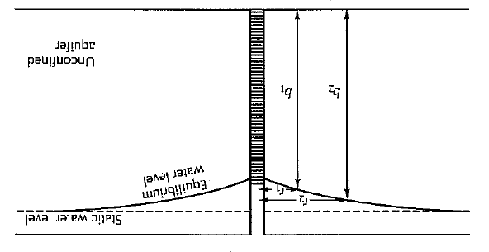
Steady State Unconfined Aquifer

Slide 10
Steady State Unconfined Aquifer (Thiem solution)
Governing equation
Integrating between two wells at different radii

Slide 11
Example Problem
Two observation wells are placed at a distance of 3 and 8 meters from a well in an unconfined aquifer
The well is pumped at a flow rate of 500 litres/minute
The depth to water is 5m and 2 m for the first and second well respectively.
If the depth of the aquifer is 10m, what is the hydraulic conductivity?

Slide 12
Transients
Now we will consider transient (time-varying) solutions.
For some real situations it will simply take too long to reach steady state (equilibrium – let me hear it Brandon) conditions.
We can use transient analysis to infer aquifer properties, including storativity (which is not possible from steady measurements)

Slide 13
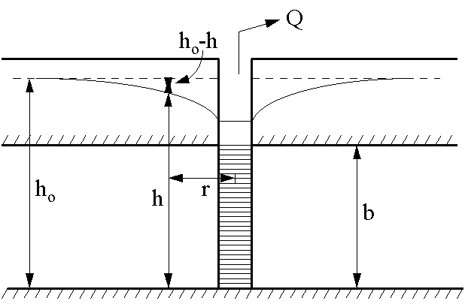
Flow in a Completely Confined Aquifer – Theis’ Solution
Additional Assumptions
Aquifer is confined on top and bottom
No recharge
Aquifer is compressible and water is released instantaneously
Well is pumped at a constant rate

Slide 14
Schematic Setup

Slide 15
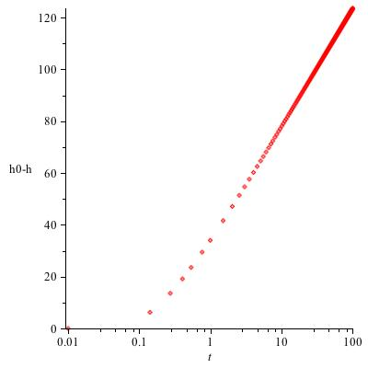
What does data typically look like?

Slide 16
Governing Equations
Flow Equation
Initial Condition
Boundary Conditions

Slide 17
Alternatively
Define drawdown
Flow Equation
Initial Condition
Boundary Conditions

Slide 18
To Solve – Boltzman Transformation
Define
The flow equation and IC/BCs now become

Slide 19
Solution
Let
Our equation becomes
Solution

Slide 20
Solution
Solution
Recall
Therefore
This is called the exponential integral
and can be called from Matlab or any
good maths program

Slide 21
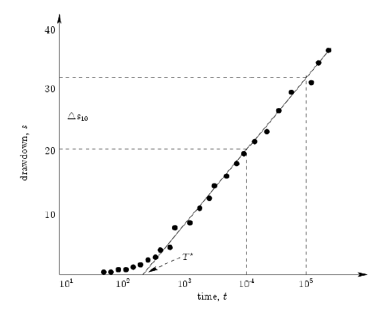
Data from a pumping test
Known Q, known radius

Slide 22
Approximately (for large times)
Using the graph on previous page (two unknowns – straight lines tells all)
Time when line intersects x axis
Change in drawdown over one decade on log scale

Slide 23
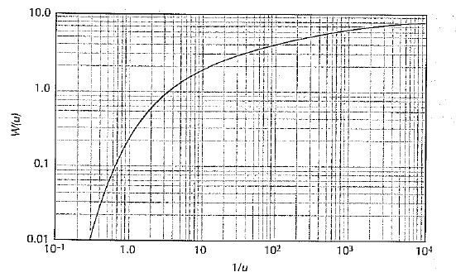
Alternatively
We use the well function (tabulated in appendix 1 of the text by Fetter)

Slide 24
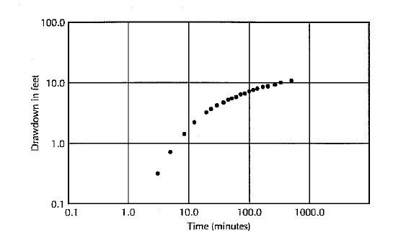
Why use the tabulated function? Plot drawdown vs time in log log

Slide 25
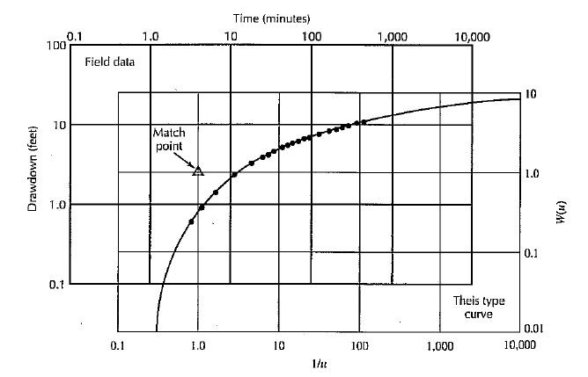
Overlay the Two and pick a match point (does not have to be on the curves – usually 1,1 on well function curve)
Using the match point, apply

Slide 26
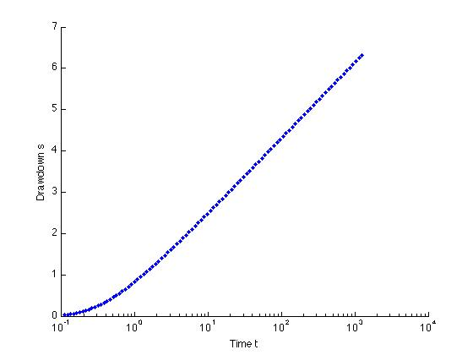
Example Problem (Matlab) Solve Both Ways
You are provided with the following pumping curve
The flowrate is 10m^3/s. The radius of the well is 10m
What is the transmissivity and storativity of the aquifer?

Slide 27
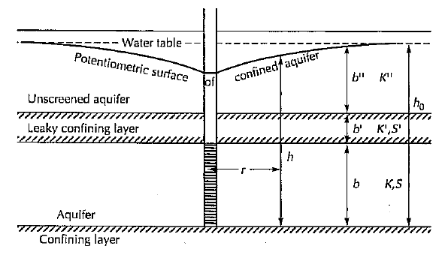
What if the aquifer is leaky?
We include some form of flux from a confining layer
OR

Slide 28
What if the aquifer is leaky?
Solution is given in terms of a tabulated function
where
W(u,r/B) is called the artesian well function and can be looked up
in Appendix 3 of Fetter

Slide 29
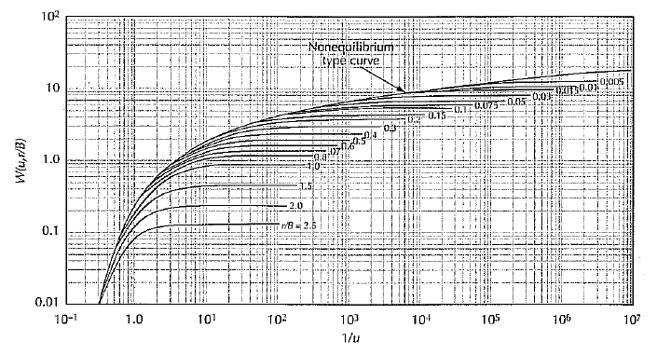
What does the Artesian Well Function look like?

Slide 30
Unconfined Aquifers
Assumptions
Aquifer is unconfined
Vadose zone has no influence on drawdown
Water initially pumped comes from instantaneous release of water from elastic storage
Eventually water from from storage due to gravity drainage
Drawdown is negligible relative to saturated aquifer thickness
The specific yield is at least 10 times the elastic storativity
The aquifer can be anisotropic

Slide 31
Unconfined Aquifers
Again, a tabulated results exists (water table aquifer pumping function - appendix 6)

Slide 32
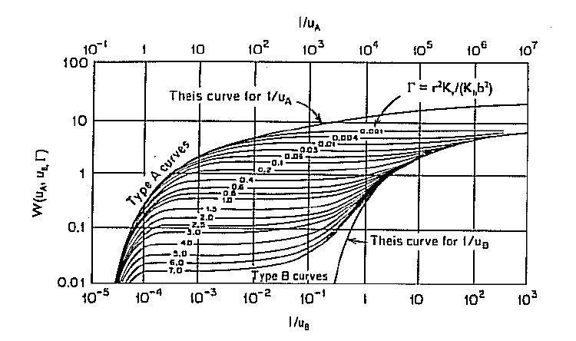
What does this pumping function look like?

Slide 33
Graphical Methods with Match Point discussed in text book. They work just fine and I recommend that those of you who are interested read about them, but they are a little outdated with current computer capabilities.

Slide 34
Slug Tests – The Poor Man’s Alternative
Pumping Tests are expensive for many many reasons (labor costs, well drilling costs, equipment, etc.). Sometime one way also not actually wish to extract water from an aquifer for fear that it may be contaminated.
Slug Tests (or their counterpart bail-down tests) are a cheap and quick alternative
A known quantity of water is quickly added or removed from a well and the response of water level in the well is measured.
Water does not have to be added – instead a slug of known volume can be thrown in, displacing a known volume of water.
Slug test responses can be overdamped or underdamped and different and appropriate methods must be chosen to properly analyse data.

Slide 35
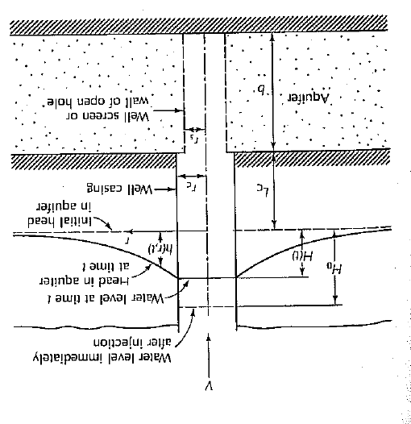
Overdamped Cooper-Bredehoeft-Papadopulos

Slide 36
Overdamped Cooper-Bredehoeft-Papadopulos
We can show that (F is tabulated in appendix 2 of book)
Where
rc – radius of casing rs – radius of screen
Overlay data to identify what values of eta and mu correspond to your setup and
t₁ is the time where on the type curve Tt/r_{c}²=1

Slide 37
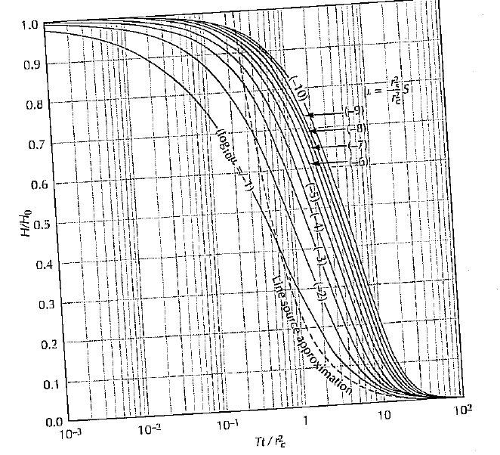
Type Curves for Cooper-Bredehoeft-Papadopulos

Slide 38
Sample Problem (Matlab)
Consider the following dataset and using the CBP method evaluate the Transmissivity and Storativity. Well and screen radius is 5 cm.
T(s) | H | H0 | H/H0
0.01 | 96.5 | 100 | 0.965
0.05 | 86 | 100 | 0.86
0.1 | 74.5 | 100 | 0.745
0.2 | 58 | 100 | 0.58
0.5 | 29 | 100 | 0.29
1 | 10.8 | 100 | 0.108
5 | 6.2 | 100 | 0.062
10 | 2.7 | 100 | 0.027
20 | 1.3 | 100 | 0.013

Slide 39
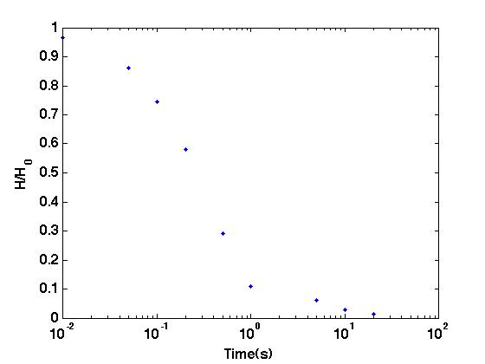
Data from Example

Slide 40
Overlay Graphics

Slide 41
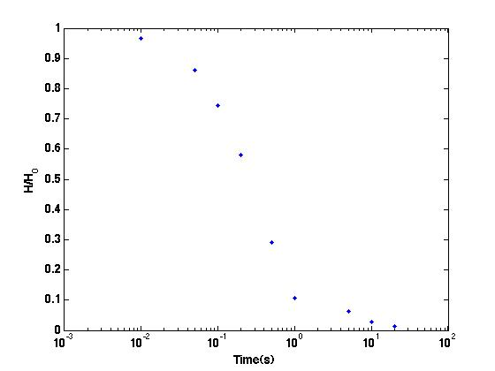
Overlay Graphics

Slide 42
Overlay Graphics

Slide 43
Overlay Graphics
Tt/r_{c}²=1 on type curve plot

Slide 44
Remove the Type Curve, but keep vertical line
When overlaid on Figure 5.19
We identify mu=1e-6 (see figure below)
t₁=0.1
t₁=0.1

Slide 45
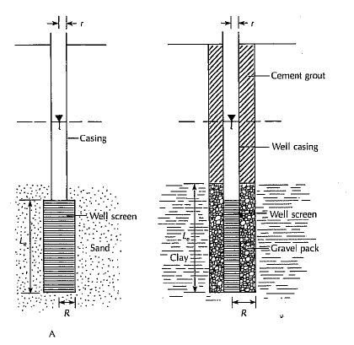
Overdamped Hvorslev Method

Slide 46
Overdamped Hvorslev Method Interpretation
If the length of the piezometer is more than 8 times the radius of the well screen, i.e. L_{c}/R>8 then
K – hydraulic conductivity r – radius of the well casing R – radius of the well screen L_{e} – length of the well screen t37 – time it take for the water level to rise or fall to 37% of the initial change.

Slide 47
Example Problem
t(s) | H | H0 (cm) | H/H0
0.5 |  | 100 | 0.9
1 |  | 100 | 0.82
2 |  | 100 | 0.67
4 |  | 100 | 0.37
5 |  | 100 | 0.25
7 |  | 100 | 0.2
8 |  | 100 | 0.165
9 |  | 100 | 0.135
R=0.1m (radius of screen)
r=0.1m (radius of casing
L=5m (length of well screen)

Slide 48
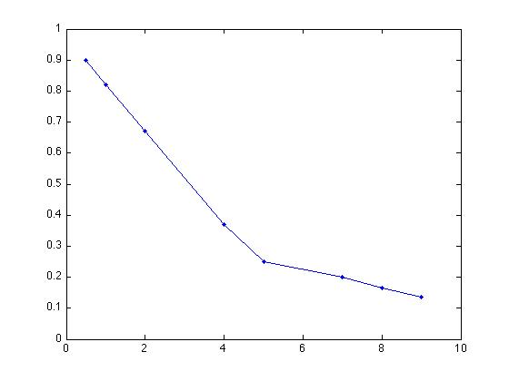
Data

Slide 49
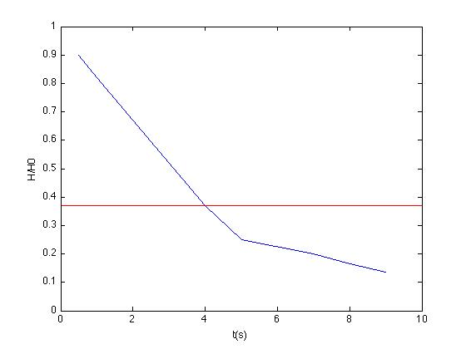

Slide 50
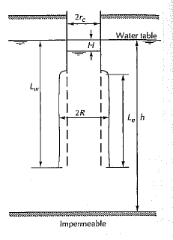
Overdamped Bouwer and Rice Method

Slide 51
Overdamped Bouwer and Rice Interpretation
K – hydraulic conductivity rc – radius of the well casing R – radius of the gravel envelope Re – effective radius over which hear is disipated Le – length of screen over which water can enter H0 – drawdown at time 0 Ht – drawdown at time t t – time Lw – distance from water table to the bottom of the bore hole A,B – constants on figure 5.25
Valid for Lw<h (the saturated thickness of the aquifer)

Slide 52
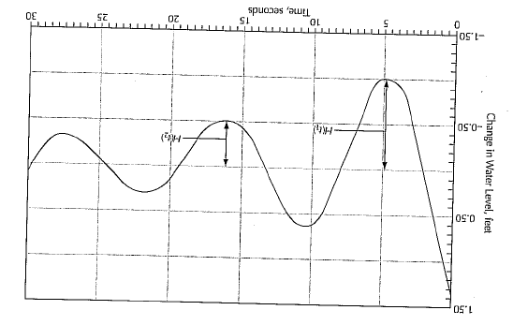
Underdamped Van der Kamp

Slide 53
Underdamped Van der Kamp
Consider the following decay formula
Transmissivity given by
T – transmissivity rc – radius of well casing rs – radius of well screen S – storage coefficient L – effective length of the water column g – gravity ω – angular frequency

Slide 54
Steps in Van der Kamp
Calculate angular frequency w Δτ – time between succesive peaks
Calculate damping factor
Solve implicit equation (iteratively)
Continue until converged

Slide 55
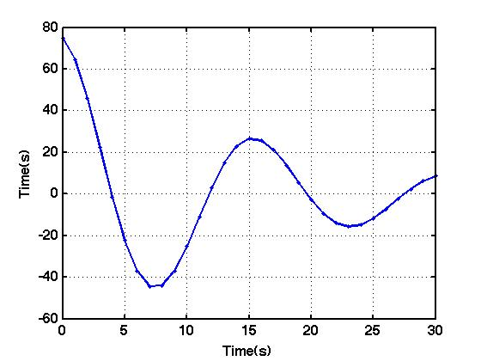
Example Problem
Interpret the following curve
rc=0.5 m and rs=0.5m

Slide 56
Cautions and Guidelines for Slug Tests
Skin Effects can yield underpredictions
Geological Survey Guidelines
Three or more slug tests should be performed on a given well
Two or more different initial displacement should be used
The slug should be introduced as instantaneously as possible
Good data acquisition equipment should be used
An observation well should be employed for storage estimation
Analysis method should be consistent with site
Study results carefully and reassess analysis method if necessary
Appropriate well construction parameters should be used

Slide 57
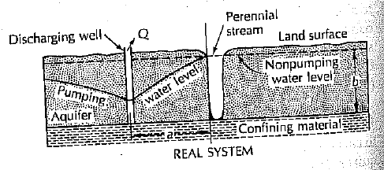
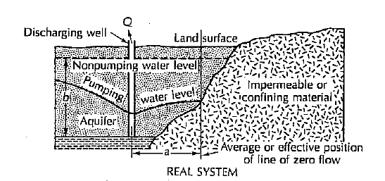
Effects of Hydrogeologic Boundaries

