Slide 1
Multiphase Flows The Vadose Zone

Slide 2
Common Examples of Multiphase Flows
Vadose Zone (Air and Water)
Oil Reservoir (oil and water (saline/fresh) and maybe air/gas)
Gas Reservoirs
Geologic Carbon Sequestration
NAPL contamination

Slide 3
Definitions
Saturation (component dependent)
Wettability – The tendency for one fluid to be attracted to a surface in preference to another
Immiscible – when a fluid-fluid interface separates two fluids that cannot mix

Slide 4
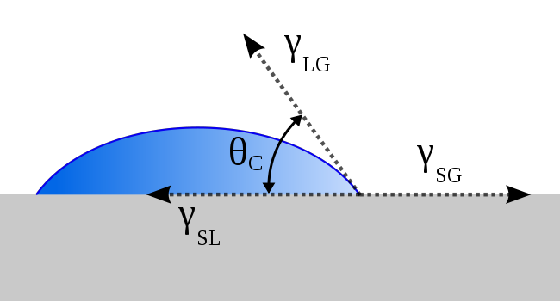
Wettability
The tendency for one fluid to be attracted to a surface in preference to another
The only direct measure of wetting is a contact angle
theta<90º – fluid is wetting
Theta>90º – fluid is nonwetting

Slide 5
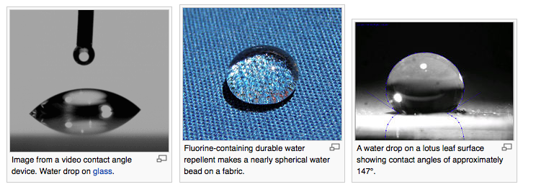
Examples

Slide 6
Wettability
Wettability if unique for a given solid and fluids. However a few generalizations hold
Water is always wetting with respect to oil or air on rock-forming minerals
Oil is a wetting fluid when combined with air, but nonwetting when combined with water
Oil is wetting on organic matter in relation to either water or air
Wetting character of organic contaminants is highly uncertain an variable

Slide 7
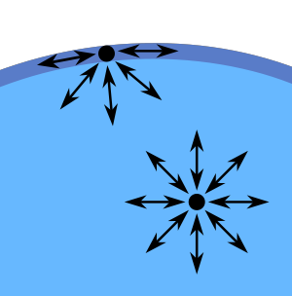
Surface Tension
Surface tension is a property of fluid that is important at interfaces between different fluids. The different molecular dynamics on each side of the interface lead to surface tension
How insects walk on water; how droplets form in a specific shape
Sensitive to changes in chemical composition (i.e. you can change surface tension easily by dissolving a solute in a fluid)
Notes:
Derive on blackboard

Slide 8
Capillarity
When a fluid is in contact with another substance there is an interfacial free energy between them.
Nature tries to minimize this energy
We can define a capillary pressure, which can be related to surface tension
Capillary pressure is a common measure is multiphase flows through porous media, because it can be linked to saturation

Slide 9
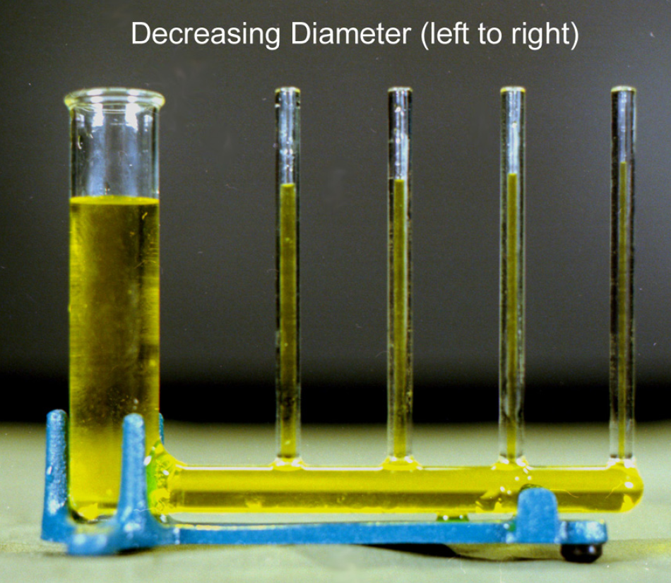
Capillarity
For a capillary rise

Slide 10
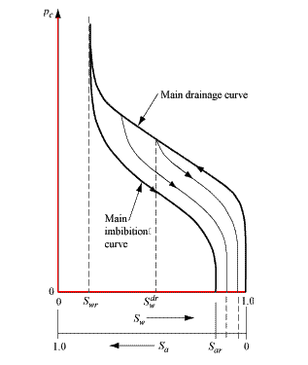
Capillary Pressure vs Saturation
Wetting (Imbibition) and Drying (drainage)
Helps identify thresholds

Slide 11
We would like to keep using Darcy’s Law
Recall
Let us introduce the idea of relative permeability
What would this relative permeability look like?

Slide 12
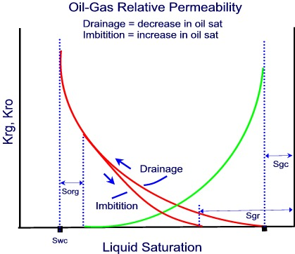
Relative Permeability

Slide 13
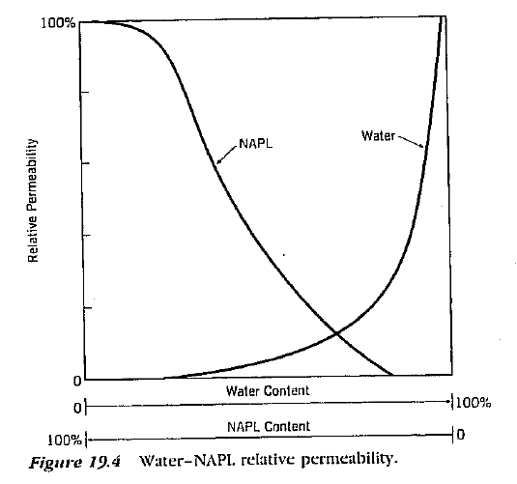
Water NAPL relative Permability

Slide 14
Common Approximation
Polynomial
Ignores irreducible saturations, but good insight

Slide 15
Example Problem
Consider a multiphase with the following 2 fluid components of identical viscosity and the following relationships
Assume a constant capillary pressure (Buckley-Leverett approximation)
The pressure gradient in fluid 1 is -10 Pa/m
What is the pressure gradient in fluid 2
For saturation =0, 0.25, 0.5, 0.75 and 1 calculate the flow speeds of each phase and the sum of the two. Compare and discuss
Take intrinsic permeability ki=0.001m^2. Fluid 1 is water; Fluid 2 is oil

Slide 16
Models
There are many models for multiphase flow to relate capillary pressure to saturation and saturation to relative permeability
If you are interested:
Brooks Corey
Van Genuchten
Gardner Model

Slide 17
Example Problem
Consider a 2 phase system of water and air. Assume air pressure is the same as atmospheric
Assume capillary pressure-saturation relationship
At a given point it is measured that saturation varies linearly with depth from 0.5 to 1 over a range of 10 m. How does capillary pressure vary?
Is there a flow of water in this system? If you assume a quadratic relative permeability saturation relationship can you say anything about it?

Slide 18
Governing Equations of Multiphase Flow
Combining Conservation of Mass for Both phases
We then have a variety of relationships to close all of this (saturation, relative permeability, capillary pressure)

Slide 19
Vadose Zone – Richards Equations
Assumptions
Air is immobile (attains equilibrium much faster than water) – p_{a}=constant
Air pressure is at equilibrium with the atmosphere, which mean constant=0
Water is incompressible and of constant density
Recall

Slide 20
Combining Assumptions
Richard’s Equation
Needs to be supplemented by equations that relate saturation to tension and relative permeability/hydraulic conductivity
Source
Tension/suction
Related to capillary pressure

Slide 21
Richards Equation
Tension Based Version
Saturation Based Version

Slide 22
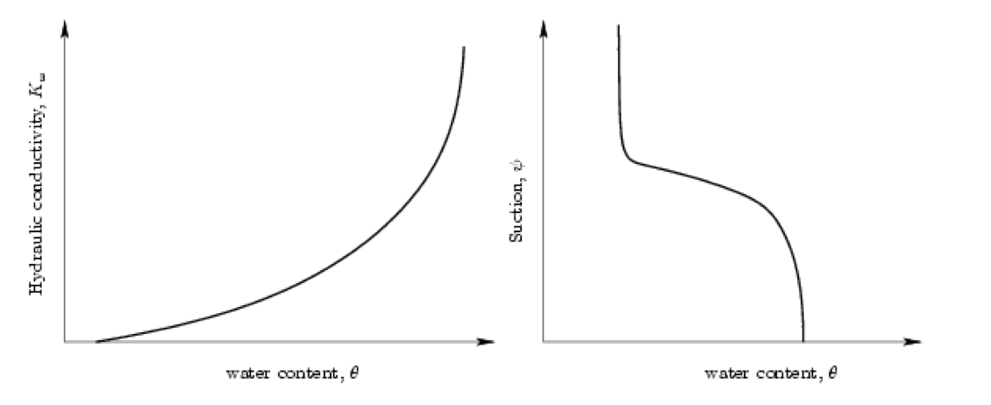
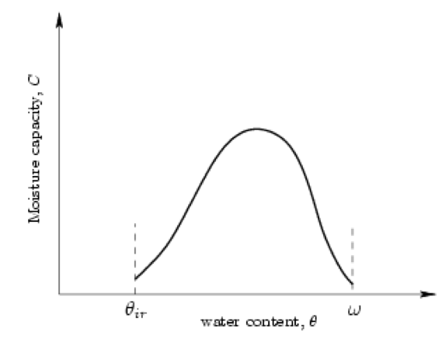
Richards Equation
Tension Based Version

Slide 23
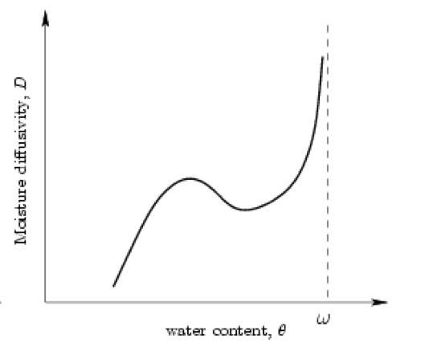
Richards Equation
Saturation Based Version

Slide 24
Pros and Cons of Richards Equation Forms
Psi based form
Since the equation can transition naturally between unsaturated and saturated there is no need to use different models between vadose and saturated zone
Numerically conducive
Nonlinear, which is bad
The saturation based form
partially linear (LHS)
D(theta) is singular in certain regions making it difficult/impossible to connect zones
Problematic for layered heterogeneous systems

Slide 25
Methods of Characterization -Saturation
Laboratory Drying
Electrical Resistance
Neutron Scattering
Gamma-ray absorption

Slide 26
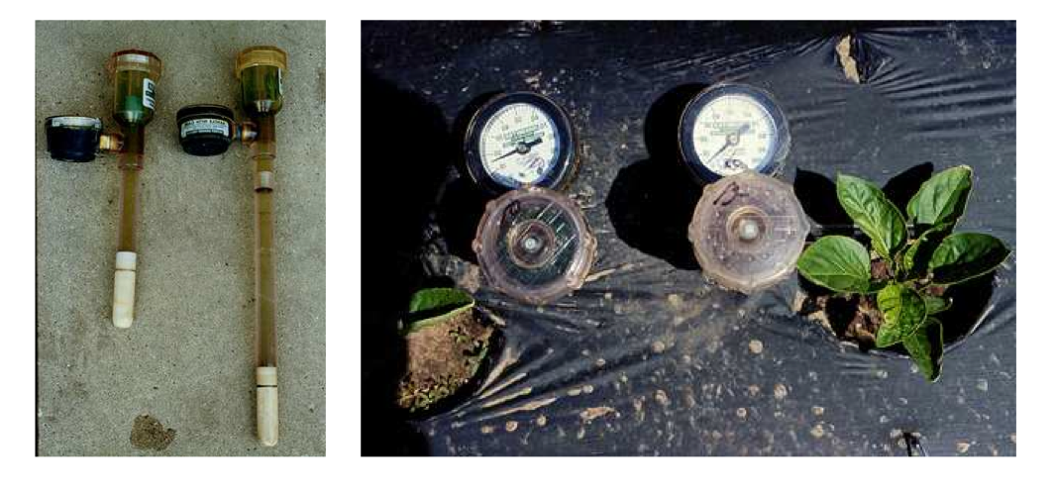
Methods of Characterization -Suction
Tensiometers
A porous cup that is connected to a tube fully filled with water and a vacuum gauge attached

Slide 27
Horizontal Wetting Problem
Steady State – Consider a horizontal column of an unsaturated soil. It is contact with water at x=0 and dry at the other end where x=L. What is the distribution of water in the soil?
Horizontal
Steady State
No sources

Slide 28
Horizontal Wetting Problem
Steady State – Consider a horizontal column of an unsaturated soil. It is contact with water at x=0 and dry at the other end where x=L. What is the distribution of water in the soil?
Horizontal
Steady State
No sources

Slide 29
Horizontal Wetting Problem
It is common to approximate D(θ) as exp(θ). Doing this the solution is
In the notes you will find how to deal with a transient problem and vertical infiltration

Slide 30
Green-Ampt Model for Infiltration
Approximate the shape of the wetting front with a step function
Let z_{f}(t) be the position of the wetting front at time t
h_{f}=ψ_{f}+z_{f} – hydraulic head on the wetting front
h₀=ψ₀ – hydraulic head on the soil surface (z=0)
Infiltration rate
Velocity of wetting front

Slide 31
Green-Ampt Model for Infiltration
Equating these

Slide 32
Green-Ampt Model for Infiltration
Equating these
where

