Slide 1
Principles of Groundwater Flow

Slide 2
Hydraulic Head
Bernoulli’s Equation
Hydrostatic Pressure

Slide 3
Hydraulic Head
Bernoulli’s Equation
Hydrostatic Pressure

Slide 4
Hydraulic Head
Total Hydraulic Head (drop velocity – why?)
Or
Force Potential (driver)
Bernoulli’s equation suggests this should be constant, but clearly it is not – what’s going on?

Slide 5
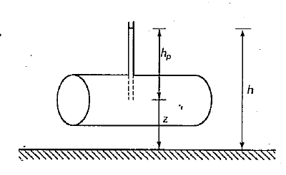
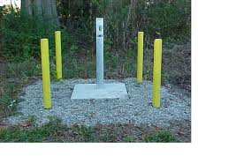
How to measure it?
Piezometer

Slide 6
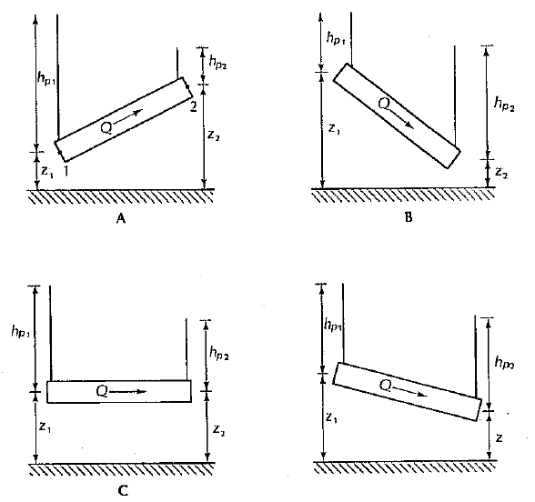

Slide 7
Validity and Applicability of Darcy’s Law
Reynolds Number
Re = (ρvd/μ)
ρ – density
v – velocity
d – characteristic distance
μ- viscosity

Slide 8
Equations of Flow – Confined Aquifers
Combine Darcy’s Law and Conservation of Mass
(Derivation on Pages 126-128 of Fetter)
Governing Equation
Transmissivity (average over z direction)

Slide 9
Unconfined Aquifers
Without a confining upper layer the governing equation changes a little
Boussinesq Equation
What makes this equation so difficult to deal with?

Slide 10
Direction of Groundwater Flow
Potential and Equipotential Lines
What direction is the flow in

Slide 11
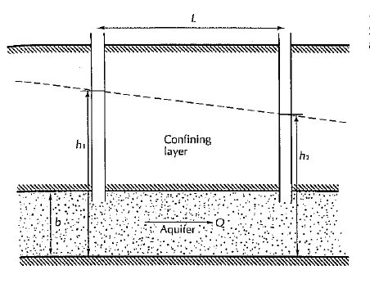
Steady Flow in Confined Aquifer

Slide 12
Steady Flow in Confined Aquifer

Slide 13
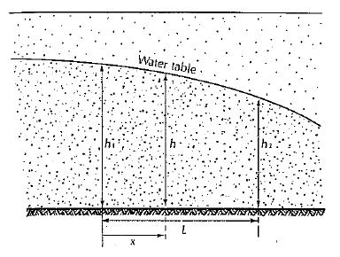
Steady Flow in an Unconfined A quifer

Slide 14
Steady Flow in an Unconfined A quifer

Slide 15
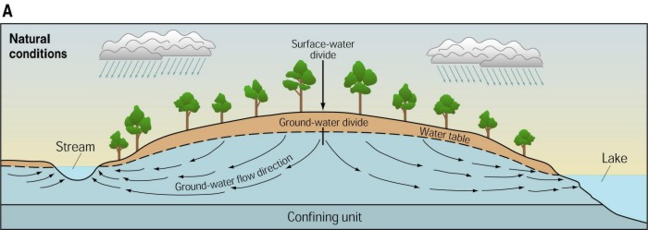
Groundwater Divides
Can our equations predict these?
Source or sink

Slide 16
Groundwater Divides
Can our equations predict these?

Slide 17
Groundwater Divides
If h=h1 at x=0 and h =h2 at x=L

Slide 18
Groundwater Divides
Discharge per unit width

Slide 19
Groundwater Divides
Location of GW Divide is where q’=0

Slide 20
What about 2-d steady state
Confined
Unconfined

Slide 21
What about 2-d steady state
Confined
Unconfined

Slide 22
Sample Problem
Wells are located at locations (x,y)=(0,0), (15,20) and (10,10) and the respective head at each well is 15,140 and 8 5. All units are in meters.
Calculate the head distribution assuming a confined aquifer.
Calculate the head distribution assuming an unconfined aquifer.
You obtain a fourth measurement at (x,y)=(5,5) where the head is approximately 50. Is the aquifer confined or unconfined?

Slide 23
Final Test
You are performing a study of fluid flow through the groundwater system underlying a very large lake. As shown on the next page, you have been provided with five wells which penetrate into the underlying geology. You have determined previously that the flow through this system occurs as follows:
Water moves from west to east in the lower confined aquifer with essentially no flow between the lower aquifer and the middle aquifer.
Flow in the middle aquifer has components both in the northeast direction AND vertically into the upper confining layer (upper aquitard).
Flow in the upper aquifer is vertically upward from the upper aquitard and into the lake with no noticeable horizontal components to flow.
The rate of flow into the lake is 0.05 meters per day. The hydraulic conductivity of the upper aquifer is 0.01 cm/sec. The conductivity of both confining layers is 3 x 10-5 cm/s. The conductivity of the middle aquifer is 0.06 cm/s. The conductivity of the lower confined aquifer is unknown.

Slide 24
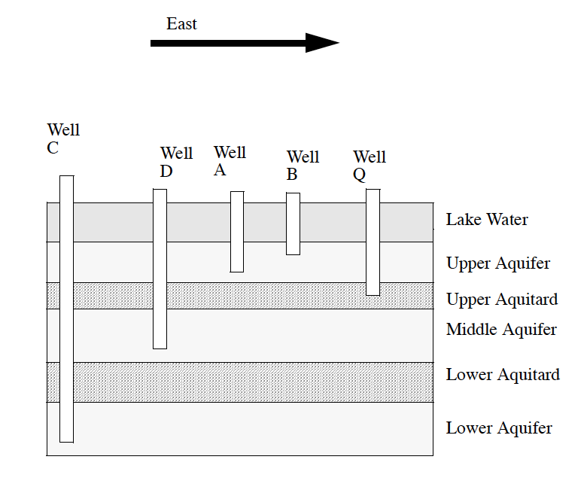
Final Test
If you were to compare the water levels in wells A and B, which well would have the higher water level?
How would you calculate the water level difference between A and B?
Which well has the higher water level, well A or Well Q?

Slide 25
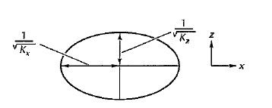
Direction of Groundwater Flow
What if anisotropic?? Kx is not the same as Ky (Kz)
Transform in to equivalent isotropic case

Slide 26
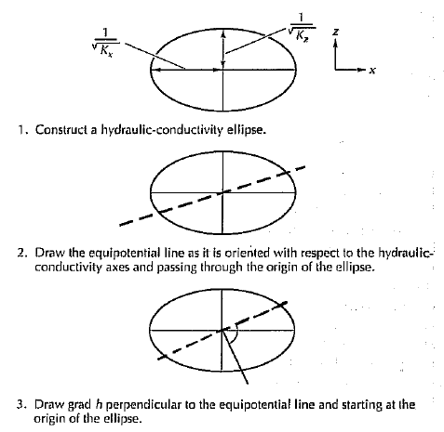
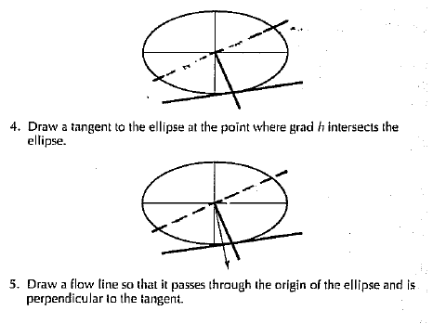
Direction of Groundwater Flow
What if anisotropic?? Procedure

