Slide 1
Properties of Aquifers

Slide 2
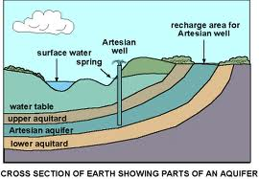
Aquifer
An aquifer is a wet underground layer of water-bearing permeable rock or unconsolidated materials from which groundwater can be usefully extracted using a water well.

Slide 3
Useful Definitions
Confining Layer – geologic unit with little or no intrinsic permeability
Aquifuge – Absolutely impermeable unit that will not transfer water
Aquitard – a layer of low permeability that can store ground water and transmit it slowly from one aquifer to another
Unconfined/Confined Aquifer – an aquifer without/with a confining layer on top.
Leaky Confined Aquifer – a confined aquifer with an aquitard as one of its boundaries
Perched Aquifer – a layer of saturated water that forms due to accumulation above an impermeable lens (e.g. clay)
Water Table – depth where the soil becomes completely saturated

Slide 4
Topics
Aquifers are essentially porous media and so the properties relate to the properties of porous media:
Porosity
Grain Size Distribution
Specific Yield
Hydraulic Conductivity and Permeability
Compressibility

Slide 5
Porosity
Porosity is the ratio of the volume of voids to the total volume
0<n<1, although sometimes we express it as a percentage by multiplying by 100
Question: How would you measure this?

Slide 6
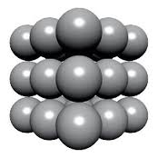
What does porosity depend on
Packing
Cubic Packing – Calculate the porosity….

Slide 7
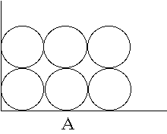
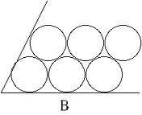
What does porosity depend on
Packing – what is we switch it up
VS.
Cubic vs Hexagonal vs Rhombohedral
(47.65%) (39.5%) (25.95%)

Slide 8
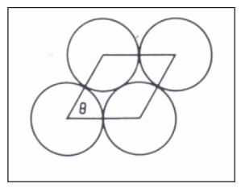
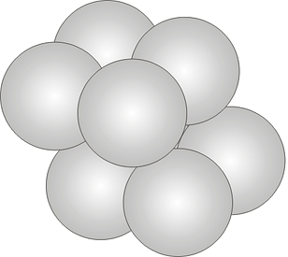
Hexagonal Packing
Shift All Spheres on top layer one radius to the right

Slide 9
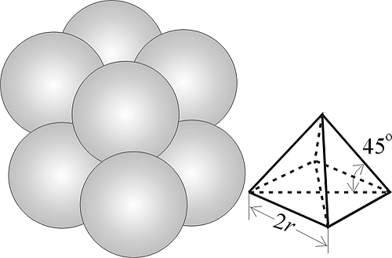
Rhombohedral-Packed Spheres
Shift All Spheres on top layer one radius to the right and the shift forward one radius also
Estimation of porosity accounting to this model:

Slide 10
Key Central Point
Porosity does not depend on the diameter of your grains!!!

Slide 11
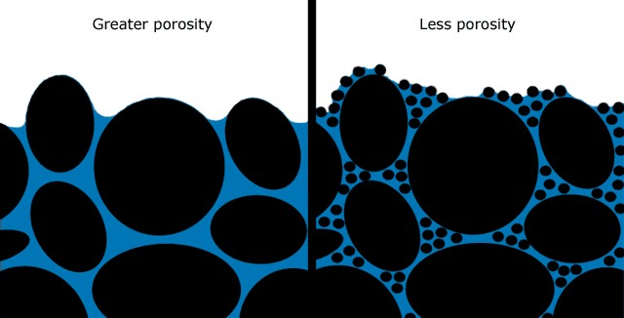
Heterogeneous Particle Sizes
Size and Shape of Grains makes a difference

Slide 12
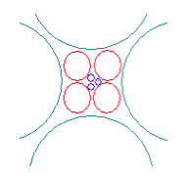
Example
Porous medium blended with three types of sediment fractions:
Fine pebble gravel
with porosity (φ_{pebble}=0,30)
Sand (φ_{sand}=0,38)
Fine sand (φ_{f.sand}=0,33)

Slide 13
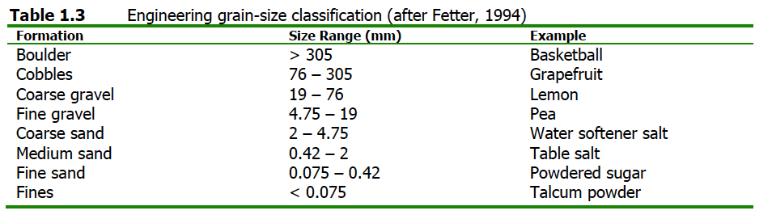
Classification of Sediments
Engineering ASTM D2488 (Amer. Soc Testing Materials)

Slide 14
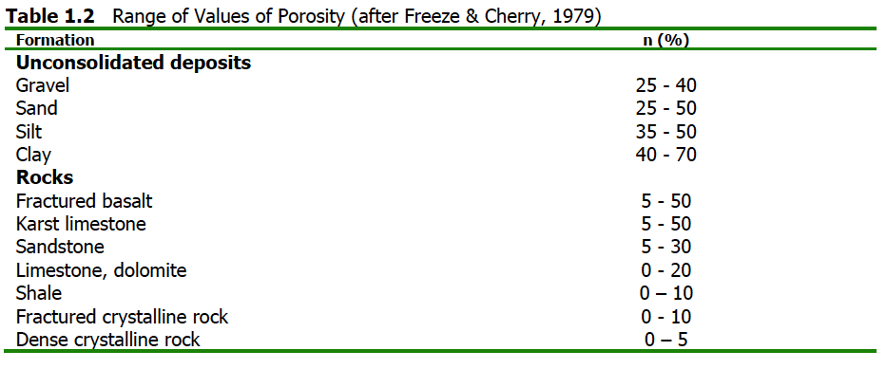
Typical Porosity Ranges

Slide 15
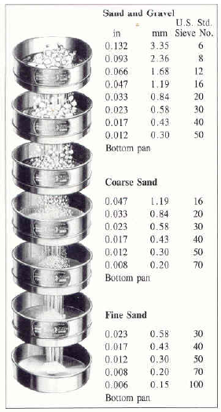
Grain Size Distribution
Very few materials have uniform grain sizes.
In order to measure the distribution of grains successively sieve materials through sieves of different size and build grain size distribution
Metrics – d₁₀ and d₆₀ (ten and sixty percentile diameters)
C_{U}=d₆₀/d₁₀ – coeff of uniformity
C_{U}<4 well sorted
C_{U}>6 poorly sorted
d10 is called effective grain size

Slide 16
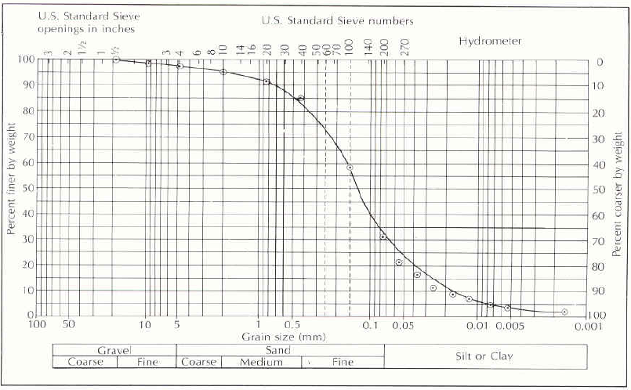
Typical GSD
GSD of silty fine to medium sand – What is C_{U}

Slide 17
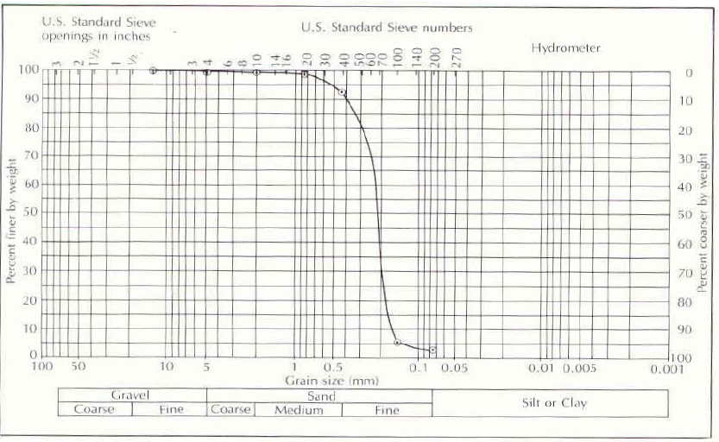
Typical GSD
GSD of fine sand – What is C_{U}

Slide 18
Specific Yield
Specific yield (Sy) is the ratio of the volume of water that drains from a saturated rock owing to the attraction of gravity to the total volume of the saturated aquifer.
Specific retention (Sr) is the rest of the water that is retained
Question: You have two materials with cubic packing; one is made up of small spheres, the other of larger ones; which has the larger specific retention? Think about the physics of what is retaining the water?

Slide 19
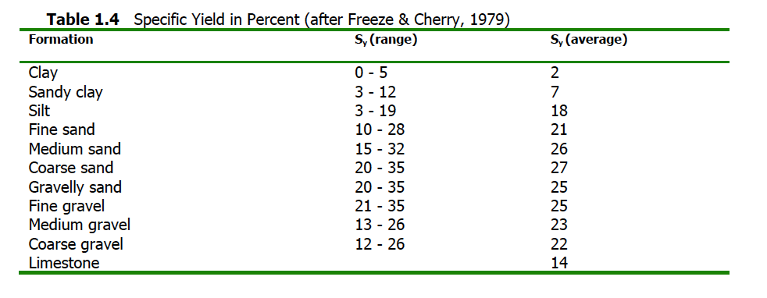
Typical Specific Yields

Slide 20
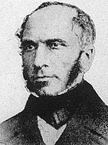
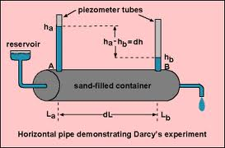
Hydraulic Conductivity
Henry Darcy – the father of groundwater hydrology

Slide 21
Hydraulic Conductivity
Measure flowrate Q to estimate specific discharge (velocity)
q=Q/Area
Observations

Slide 22
Darcy’s Law
Hydraulic Conductivity
Hydraulic Conductivity depends on both the
fluid and the porous medium

Slide 23
Further Observations
In a bed of packed beads the flow rate is proportional to the diameter squared
The flow rate is proportional to the specific weight of the fluid
The flow rate is inversely proportional to the viscosity of the fluid

Slide 24
Therefore
Property of the porous medium
only called intrinsic permeability
Denoted k_{i} with units m² (or Darcy’s)
1 Darcy=1x10⁻⁸cm²
What drives the flow
Property of the fluid only

Slide 25
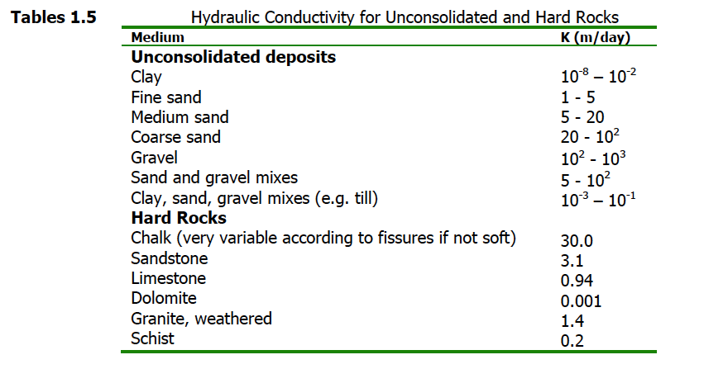
Typical Hydraulic Conductivities (for water)

Slide 26
Hazen Formula for Hydraulic Conductivity
Recall from our classification of soils
Effective diameter d₁₀
Hazen proposed that hydraulic conductivity is given by
K=C (d₁₀)²
This is for water!!!!
C – shape factor (see adjacent table)
d₁₀ in cm
K is given in cm/s
C shape factor
Very fine sand: C=40-80
Fine sand: C=40-80
Medium sand: C=80-120
Coarse sand: C=80-120 (poorly sorted)
Coarse sand: C=120-50 (well sorted, clean)

Slide 27
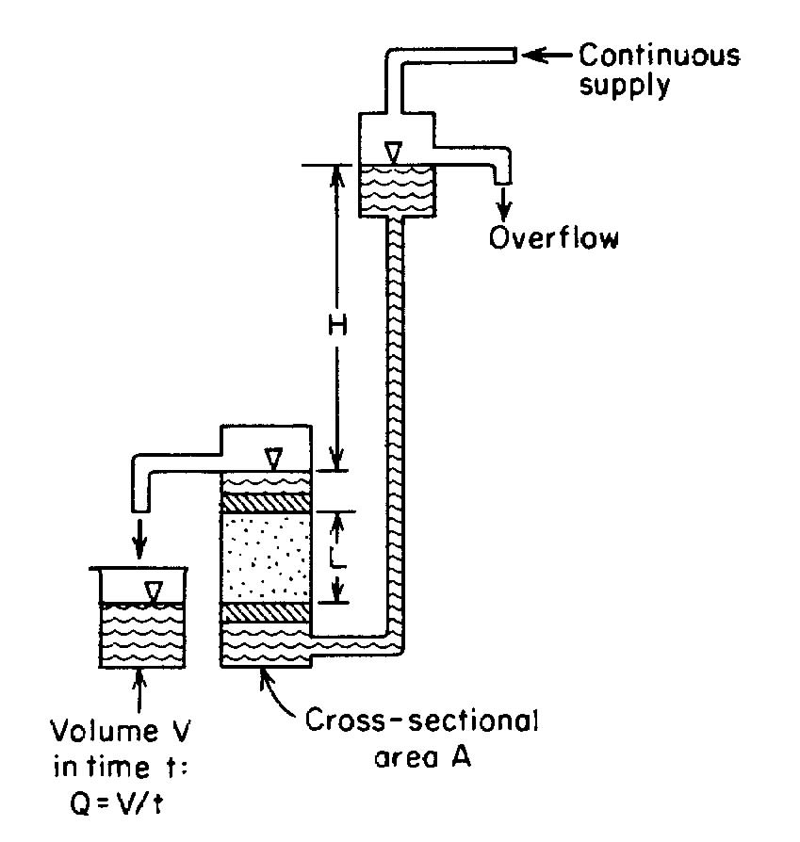
How to Measure Permeability
Measure Volume V over time t
Hydraulic Conductivity is given by

Slide 28
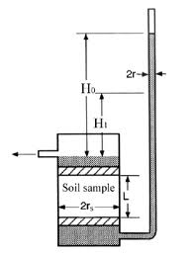
Falling Head Permeameter
Measure the drop in H over a time t

Slide 29
Transmissivity
We like to think about groundwater in 2-dimensions (like a map).
Therefore we like to define the permeability over the depth of the aquifer (depth b)
Tranmissivity
T=bK

Slide 30
Heterogeneity
Effective Hydraulic Conductivity – We like to replace heterogeneous blocks with analogous homogeneous ones
Replace with
Are they the same for the two – how would you do it?
K₁
K₁
K₂
VS.
K₂
K_{eff}

Slide 31
Heterogeneity
Effective Hydraulic Conductivity – We like to replace heterogeneous blocks with analogous homogeneous ones
K₁
K₁
K₂
K₂
K_{eff}
K_{eff}

Slide 32
More Generally
N parallel layers, each with conductivity K_{i} of thickness b_{i}
N perpendicular to flow layers, each with conductivity K_{i} of thickness b_{i}
K₁
K₁
K₂
K₃
K₄
K₂
K₃
K_{N}

Slide 33
Anisotropy
VS.
We therefore usually define a horizontal and vertical hydraulic conductivity
K_{h} and K_{v}
Coefficient of Anisotropy K_{v}/K_{h} - typically less than 1

Slide 34
Formally
Darcy’s Law
where
q is a vector
K is a symmetric tensor (matrix) K_{xy}=K_{yx}
is a vector

Slide 35
Sample Problem
You are provided with the following tensor for the hydraulic conductivity and the following hydraulic gradient. Determine the magnitude and direction of the resulting Darcy velocity. Units on the conductivity tensor are meters/second. Provide the final magnitude in meter per year.
dh/dx = 0.0013
dh/dy = -0.0021

Slide 36
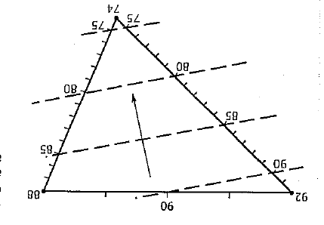
Hydraulic Gradient and Potentiometric Surface
3 well setup
Draw lines connecting wells
Note elevation at each well
Map distances between wells
Note difference in elevations
Find distance for unit head drop between wells
Mark even increments
Repeat for all well pairs
Create Contour Lines
Gradient normal to these lines

Slide 37
Hydraulic Gradient and Potentiometric Surface
Right Angled Triangle

