Slide 1
Chapter 10
Quantifying Dilution & Mixing

Slide 2
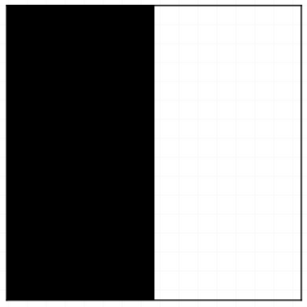
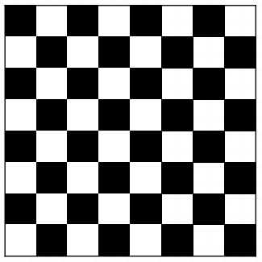

Consider the Following Cases
vs
vs
Each box contains the same mass, just spread in different ways. Which is the most dilute? Which is best for mixing?
How might we quantify this?
First let’s normalize concentration such that

Slide 3
What should a metric like this look like? For Dilution
It should correspond to our own intuition of what is to be more dilute (i.e. so one can actually compare two different cases – say A and B)
It should be proportional to the volume occupied by the fluid to compare A or B to C).
The maximum should correspond to the most dilute case possible.

Slide 4
Let’s break our box into n boxes
1 | 2 | 3 | 4
5
 |  |  | n
k=1,2,3,….,n
Kitanidis proposes the following index

Slide 5
The Dilution Index
Imagine m cells all have equal mass such that
for m of n cells
for other (n-m) cells
Therefore
Therefore
Does this meet our requirements?

Slide 6
Generally
In the continuous limit
If this looks familiar to you at all that might be because ln(E) is a very common measure called the entropy, which is used across a diverse range of fields to quantify the disorder of a system.

Slide 7
Let’s consider and ADE system
Just to put you at ease, what does this look like in 1d, 2d and 3d?
Let’s start by calculating p(x,t).

Slide 8
Recall
What we want to calculate is
Let’s start in 1d (others are easy once you know this)

Slide 9
Therefore

Slide 10
For general dimensionality

Slide 11
How About Mixing? Scalar Dissipation Rate
As we did before let’s break concentration into a mean and a fluctuation
By definition
However
Except when C’(x,t)=0

Slide 12
Back to the Broken Box
1 | 2 | 3 | 4
5
 |  |  | n
k=1,2,3,….,n
Again
for m of n cells
for m of n cells
for other (n-m) cells
for other (n-m) cells

Slide 13
Define
Which we can calculate as
As
Smaller χ means more dilute/mixed

Slide 14
Therefore in continuous form
In continuous form (n->infinity)
When C and its average are the same this is zero
-1/2 the time derivative of this is called the scalar dissipation rate
Why??

Slide 15
Consider the 1d ADE
Multiply it by C
And rearrange

Slide 16
Now Integrate over space

Slide 17
In Multiple Dimensions
The scalar dissipation rate in multiple dimensions is given by

