Slide 1
Reaction-Diffusion Systems - Continued
Reactive Random Walks

Slide 2
The grand question
How do you code what we described in our last lecture?
Here we focus on how to implement it, but do not worry about doing it efficiently

Slide 3
Consider the following problem (somewhat analogous to the beaker experiment from Chem 101)
We have a one dimensional domain of size L that is randomly filled with an equal mass of A and B.
A and B can only move by diffusion and react at some rate k
Because of the finite size of our domain we impose boundary conditions. For the sake of simplicity we assume periodicity (although results are virtually identical for any bounded setu – e.g. no flux)
Periodicity means that a particle that exist the right boundary enters through the left and vice versa (i.e. you have a sequence of identical domains next to one another). Note that this also means that particles close to one boundary can interact with particles close to the other

Slide 4
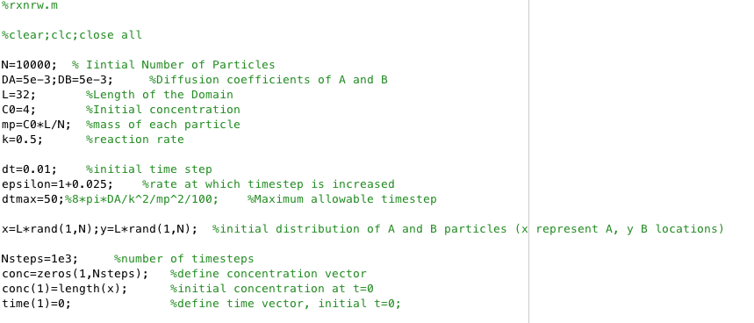
First we set up the general conditions (Matlab code below)

Slide 5
Now we enter a loop that marches over time
for kk=1:Nsteps
dt=min(dt*epsilon,dtmax); %define timestep allowing it to increase to a maximum
Pr=k*mp*dt; %probability of reaction

Slide 6
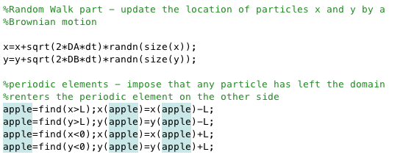
Update particle positions by a Brownian random walk
With this we are done with the motion part of the algorithm

Slide 7
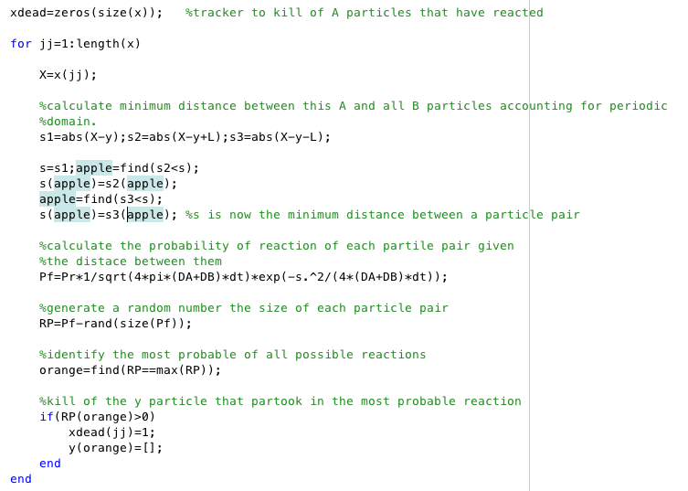
Now enter the reaction loop

Slide 8
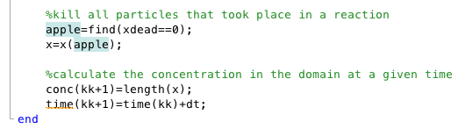
Update your x field to kill reacted particles and calculate your domina concentration
End here means loop jumps back to start the next time step and process is repeated until desired number of time steps is completed

Slide 9
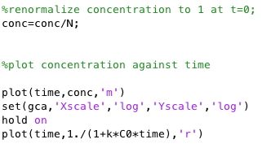
Plot desired results

Slide 10
Statistical method
Note that this is a stochastic method and it means that each time you run the code you will get slightly different results, relating to the specific random initial condition you run.
For cases likes these it makes sense to think about the ensemble result (i.e. the average over several realizations) to physically understand what is going on)

Slide 11
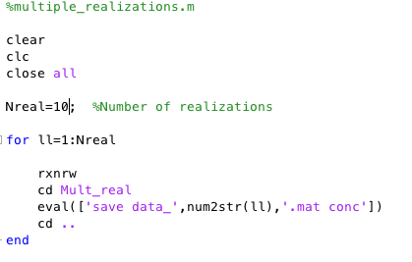
Example 10 realizations

Slide 12
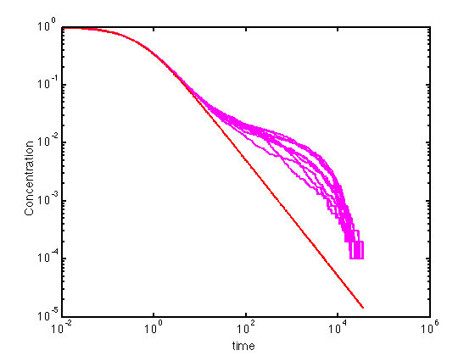
Example 10 realizations - plots

Slide 13
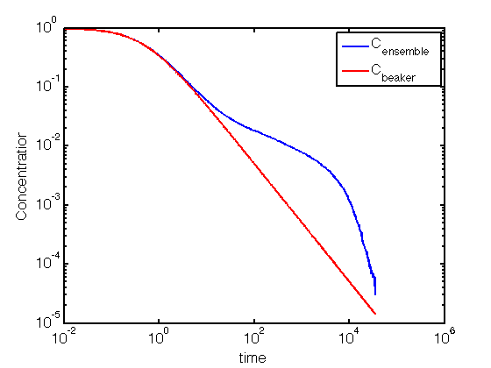
Ensemble average

Slide 14
What???
Great , we appear to have a numerical method that works well at early times where blue and red match perfectly, but diverges at late times in a way that other methods will not
First impression – USELESS tool
But let’s look at this more closely

Slide 15
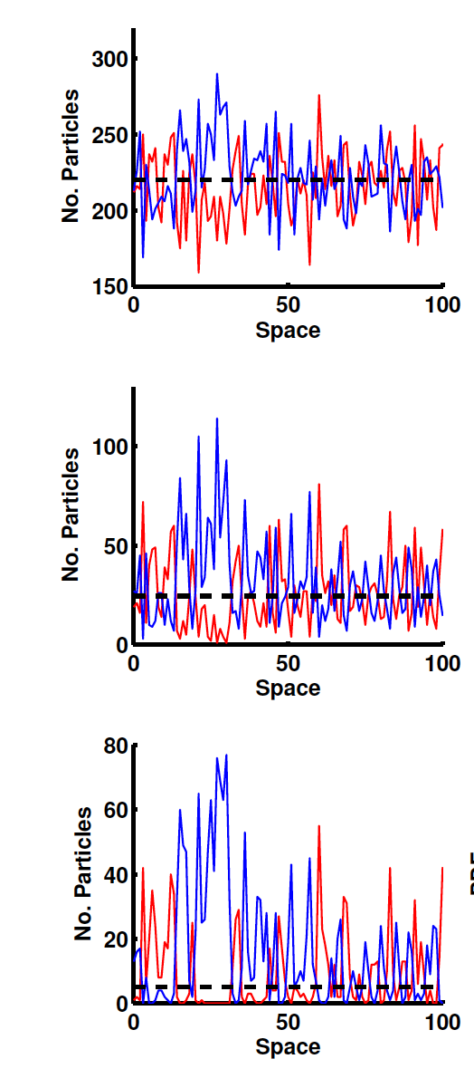
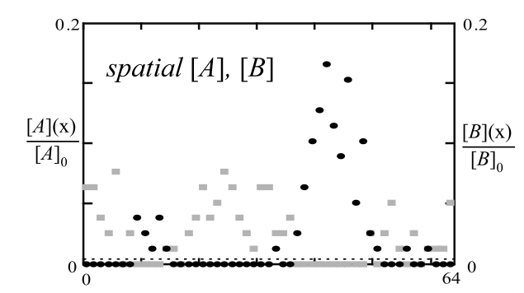
What’s going on… Let’s take a look at concentrations in 1d
Early
Benson & Meerschaert 2008, WRR
Intermediate
Late

Slide 16
What’s going on… Let’s take a look at concentrations in 1d
Early
Benson & Meerschaert 2008, WRR
Intermediate
Late
Isolated Islands of A and B form
limiting reaction by how quickly
A and B diffuse into one another
Incomplete
Mixing

Slide 17
Is our method actually capturing some real?
Remember we are interested in calculating <C>, the average concentration in the domain, but what happens when <C> is not a good measure of the actual concentration field. Let’s go back to our governing equations
Let’s as before break concentrations into mea and fluctuations

Slide 18
The governing equation for <C_{A}> or <C_{B}> is now
New term due the fluctuations that did not exist when we solved for <C_{A}> in the beaker – i.e. we assumed the new term was small
At early times it is small – so the well mixed solution works great, but at late time it is not and so it takes over
If we assume a structure for <C’_{A}C’_{B}> (called invoking a closure argument and next week you will learn the physical basis for it) then we may be able to solve this equation.
Let’s assume <C’_{A}C’_{B}> =χt^{-1/2}
For now you may consider χ a constant, but next week you will learn what this constant is

Slide 19
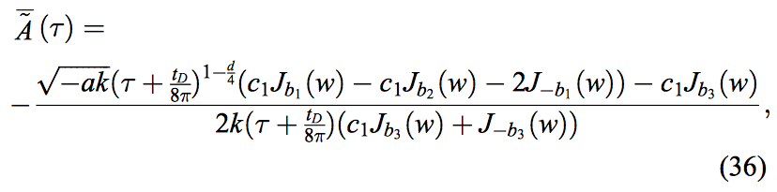
Our closed equation is
This type of equation is called a Riccati equation and you can generally solve it. The solution is an ugly combination of Bessel functions and it is difficult to see anything useful from it’s general form
Don’t worry if this is meaningless to you – it’s just to show that it can be done

Slide 20
However
If we take the solution from the earlier page and do a small time expansion it becomes
And at late times it looks like

Slide 21
Can be understood, using what is called a dominant balance argument
At early times
Perturbation term in negligible and so you recover the solution we derived in the last class – explains why models match well at early times
At late times
May seem confusing, but at late time the balance is between both terms on the RHS, which means
Or

