Slide 1
Chapter 13 - 2
MIMs - Mobile Immobile Models
Diffusive Mobile Regions

Slide 2
So why am I teaching you this…
Let’s stay wit this case – a flow channel and an immobile region next to it that can exchange mass. However our mobile domain diffuses and send mass both ways
What equations should we use here??

Slide 3
What about just diffusion
Now our equations are
First Laplace Transform
Again, we can combine these into a single ODE that can be solved

Slide 4
Again, we use Mathematica and Matlab to solve the problem
In fact just going into Laplace space is not quite enough as we the derivate in space causes some problems so we Fourier Transform also
Now we go to Mathematica to solve and invert these. We can only invert back to Laplace space and then invert numerically to real space with Matlab as before

Slide 5
Now, many of you have said you struggle with what LT and FT mean so let’s take a step back
Here are the equations
These may or may not help, but let’s see if we can understand them….

Slide 6
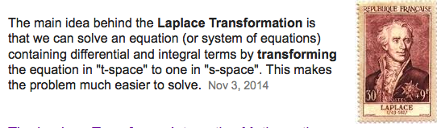
If nothing else
Well, the same can be said of the Fourier transform in taking x to k
Not very satisfying so let’s look at the physical interpretation of the mathematics
Let’s start with Laplace Transform

Slide 7
Laplace Transform
The formula says you are multiplying your function by an exponential in time that decays at a rate s (s can take any value for 0 to infinity)
When you integrate you are basically asking how much of the function is captured by tempering it with that exponential…. As s approaches 0 you get more and more and as s goes to infinity you get less and less
It tells you in some sense how you could reconstruct your function by adding together lots and lots of exponentials
These are very subtle ideas that even experts struggle with so don’t worry if you don’t get it immediately – practice makes perfect

Slide 8
Example
Consider the function f(t)=1
Calculate and think about what the following mean (draw a picture)
Do you see what is happening? Well the Laplace transform does this for all s
for any function

Slide 9
Fourier Transform
First you need to recognize exp(ikx)=cos(kx)+i sin(kx).
Well if you look now it’s just the same as what we saw except that we are seeing how much of the function is captured by waves of different wavelenght.

Slide 10
Again
I cannot emphasize this enough
These are very subtle ideas that even experts struggle with so don’t worry if you don’t get it immediately – practice makes perfect
But the key here is that they are really really important to a lot of systems and so it is practice worth putting in.

Slide 11
Back to our problem
In fact just going into Laplace space is not quite enough as we the derivate in space causes some problems so we Fourier Transform also
Now we go to Mathematica to solve and invert these. We can only invert back to Laplace space and then invert numerically to real space with Matlab as before

Slide 12
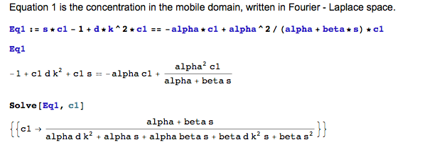
See code Chapter13-MIMDE
First we combine our two equations into one for c1 in Fourier-Laplace Space

Slide 13
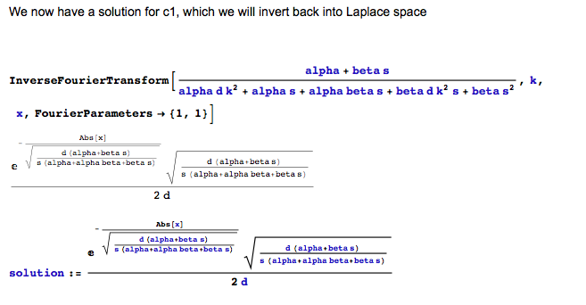
Next

Slide 14
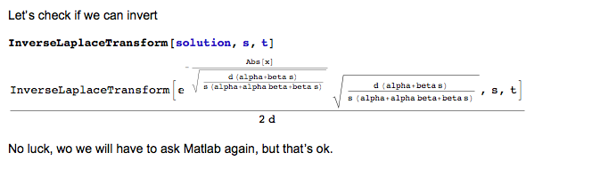
And

Slide 15
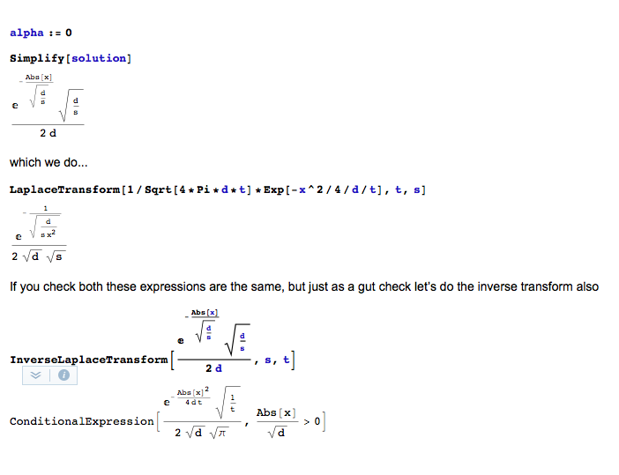
Before we solve – gut check

Slide 16
Solution Method
In Fourier-Laplace Space we have
In Laplace space from Mathematica we have
Let’s do some gut checks to make sure these make sense and then go to Matlab

Slide 17
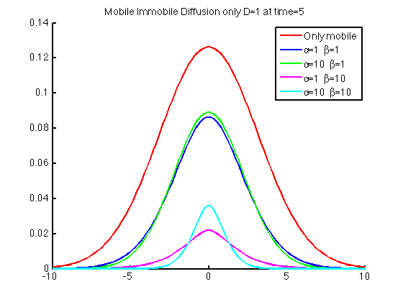
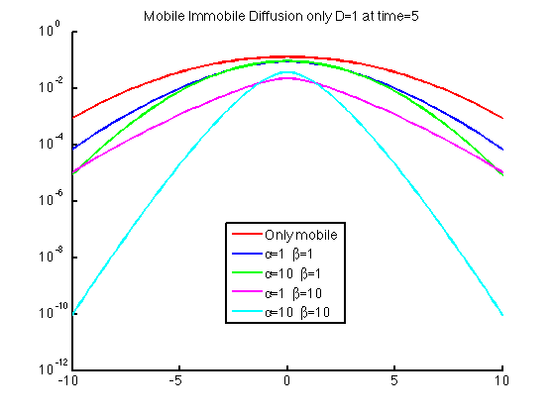
Sample Results

