Slide 1
Chapter 13
MIMs - Mobile Immobile Models

Slide 2
Consider the Following Case
You have two connected domains that can exchange mass
1
2

Slide 3
We can write something like this
If we assume that each reservoir is well mixed and looses mass to the other at a rate α, then we can write the following equations
Note that this like assuming a diffusive transfer between the two across
some finite transition region
Most importantly β is the ratio of volumes

Slide 4
What can we say about this system
What happens at steady state (equilibrium)?
How about if want to include an initial condition, say
What can we do?

Slide 5
Hmmmmm?
This poses a challenge, because we may not be able to use standard methods
However, can we change a differential equation into an algebraic one?
In previous cases we have used the Fourier Transform, but now we are dealing with time for which it is not reasonable to say -infinity<t<infinity…. But rather 0 to infinity..
Good news – there’s a thing called the Laplace Transform

Slide 6
Laplace Transform
The Laplace transform of a function f(t) is defined by
It converts t->s, like FT does x->k
It is similar to the Fourier transform and has all sort of useful and similar to FT properties, including a particularly useful one
f₀ is initial condition of f(t)

Slide 7
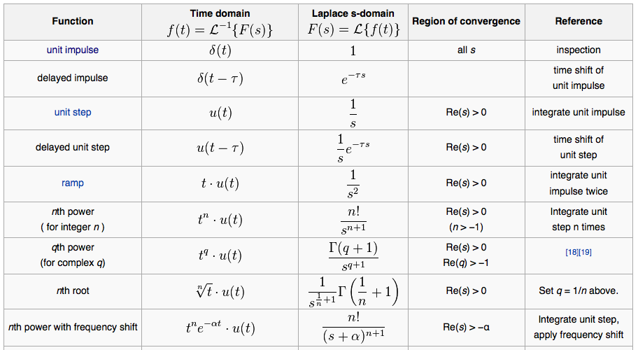
LT of Common Functions
See Wikipedia for more and you can always try to rely on Mathematica for help too

Slide 8

Like for FT there is an inverse
It’s pretty horrible to try and calculate
Use tables, Mathematica and in some cases numerical inversion methods in Matlab (only option in some cases)

Slide 9
Back to our System
Laplace Transform
Algebraic equations we can solve

Slide 10
Solving the equations in Laplace Space
We now have an explicit solution for both concentrations that we can inverse transform to get the solutions in time
Pain to do – BUT – Mathematica comes to the rescue

Slide 11
In real space
Check the asymptotic t-> infinity…
What do these look like?

Slide 12
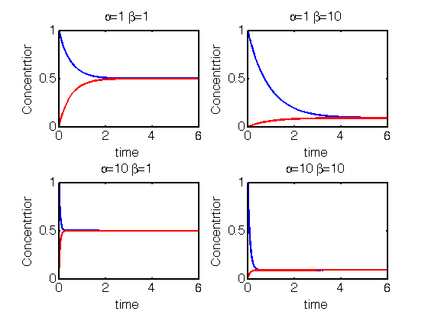
A couple of examples..

Slide 13
So why am I teaching you this…
Consider the following – a flow channel and an immobile region next to it that can exchange mass
What equations should we use here??

Slide 14
How about these?
If we add these two equation together we get something resembling a conservative equation

Slide 15
Total Concentration
First, let’s consider an interesting case
α -> infinity (i.e. mass is exchanged really really quickly between the two domains)
What does this condition mean in terms of C₁ and C₂?
It means that they equilibrate instantaneously
C1=C2

Slide 16
Does this resemble something we have seen before??
Under the assumption of instant equilibrium
Look familiar??? What if I called R=1+β
Retardation Coefficient – The MIM is a more general model than ADE with retardation

Slide 17
Ok, let’s go back to these
Let’s not worry about diffusion in the mobile channel just yet – i.e. D=0
And let’s try and solve this for
C₂(t=0)=0 and C₁(t=0)=δ(x)
What can we do??

Slide 18
Yup; Laplace Transform
Ok – no longer algebraic, but we can combine into a single ODE that can be solved

Slide 19
Recognizing
We can write an equation for concentration 1 only
Which we can solve with Mathematica

Slide 20
Solution
See the Mathematica code to see how we got this.
Now, first let’s check the consistency of this result. Is it correct when α=0

Slide 21
Solution
Inverse Laplace
Good it’s consistent so now let’s look at the full solution
Too hard to do by hand, even with Mathematica – numerical solution only (Matlab)

Slide 22
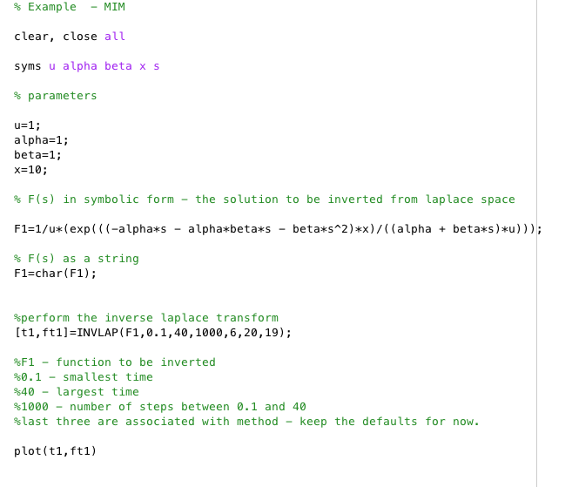
Matlab Code

Slide 23
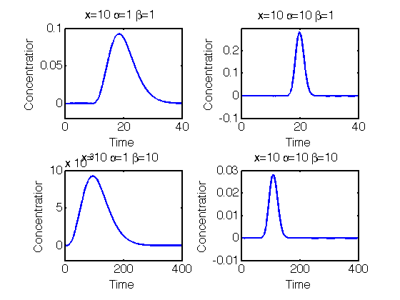
A couple of Results – Breakthrough Curves at x=10

Slide 24
What about just diffusion
Now our equations are
Again, we can combine these into a single ODE that can be solved

Slide 25
Again, we use Mathematica and Matlab to solve the problem
In fact just going into Laplace space is not quite enough as we the derivate in space causes some problems so we Fourier Transform also
Now we go to Mathematica to solve and invert these. We can only invert back to Laplace space and then invert numerically to real space with Matlab as before

Slide 26
Solution Method
In Fourier-Laplace Space we have
In Laplace space from Mathematica we have
Let’s do some gut checks to make sure these make sense and then go to Matlab

Slide 27
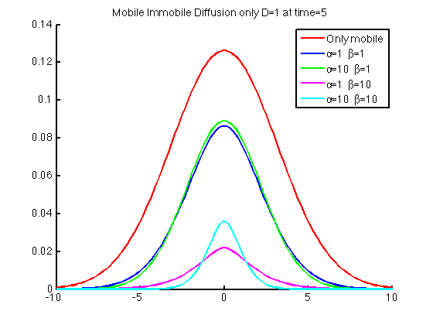
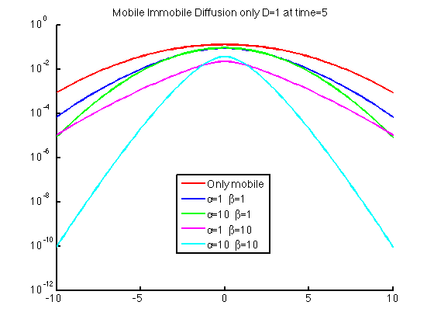
Sample Results

Slide 28
In many instances reactions only happen in one region
Can you think of any?
In this case let’s focus on first order degradation in the immobile region and not worry about diffusion in the mobile region.
Reaction term
Degradation at rate γ
THIS IS VERY SIMILAR TO THE PROBLEM WE STUDIED BEFORE BUT ONE
ADDITIONAL TERM – SAME METHODS APPLY

Slide 29
Solution Method
In Laplace space
Solve, as before with Mathematica
Check – if g=0, we recover case with no reaction
And then invert numerically with Matlab

Slide 30
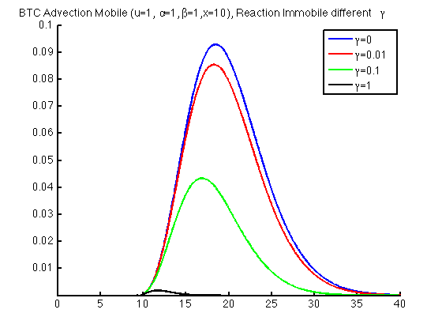
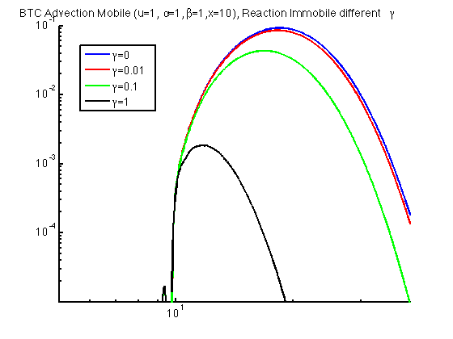
Some example results

Slide 31
However
In real field settings for a reactive tracer it can be difficult to actually measure the details of such a breakthrough curve and a common thing to d is run the system to plateau (Steady State with a constant concentration input at an upstream position)
At x=0

Slide 32
A common thing you might do
Measure α from a conservative tracer release
Then measure γ from a reactive steady state experiment
From equation for C2
At x=0

Slide 33
Solve
How does this compare to just advection with reaction
This means that the reaction rate you would measure by not accounting for exchange
Is not a real reaction rate, but an effective one

