Slide 1
Fractional Dispersion
Chapter 14

Slide 2
Let us begin by revisiting random walks
The location of a single particle is given by
Where x is the location of the particle
t is time and dt a finite small time increment
D is the diffusion/dispersion coefficient
ξ is a random number – what distribution and properties does it have?

Slide 3
Let’s test different distributions of ξ
Consider the following problem: An initial condition C=δ(x), where all particles start at x=0 and the diffuse with diffusion coefficient D=1.
Consider x as a random number distributed with the following distributions:
Normally distributed
Uniformly distributed
Delta distributed
Exponentially distributed (one and two sided)
The only thing we impose is that the distributions have zero mean and unit variance

Slide 4
What do these look like?
Normal
Uniform
Delta
Exponential (2 sided)
Exponential (1 sided)

Slide 5
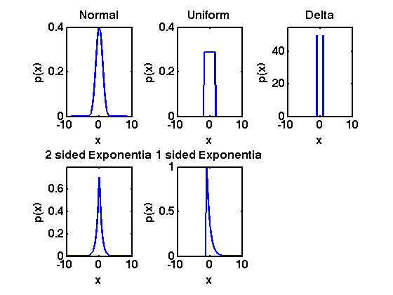
Graphically

Slide 6
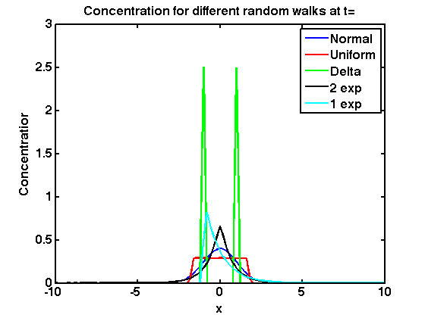
What if we run rw sampling from these (rw_distributions.m)
At t=1

Slide 7
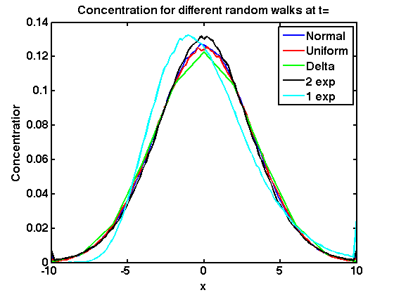
At t=10

Slide 8
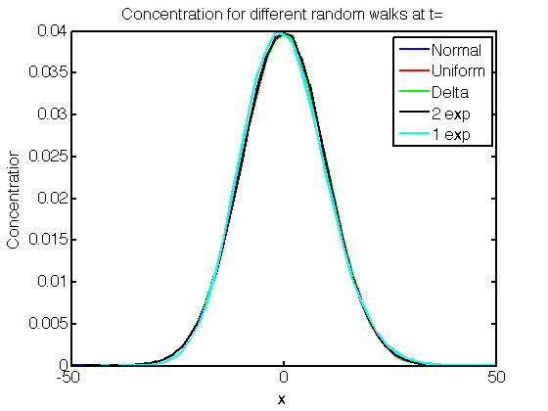
At t=100

Slide 9
What?
Look at those distributions carefully. I hope you agree they all look pretty different from one another and only have one thing in common (zero mean and unit variance by design)
Yet given enough time the random walks for all of them look virtually identical
Why?

Slide 10
Central Limit Theorem
From Wikipedia
In probability theory, the central limit theorem states, that given certain conditions, the arithmetic mean of a sufficiently large number of iterates of independent random variables, each with a well defined mean and variance, will be approximately normally distributed regardless of the underlying distribution.
For X_{i} random and conditions above,
when n big S is normally distributed

Slide 11
Truly Amazing
The central limit theorem is why we say that the Gaussian distribution is the normal distribution and it is observed (or nearly observed) almost everywhere in statistics.
However, it has some critical assumptions
Increments must be independent
Increments must be identically distributed
Increment distributions must have a well defined mean and variance
When might these not hold?

Slide 12
Let’s look at the last assumption
Do distributions have to have a well defined and finite variance or for that matter a finite mean?
Consider the following distribution, called a Pareto distribution
Calculate it’s mean and variance

Slide 13
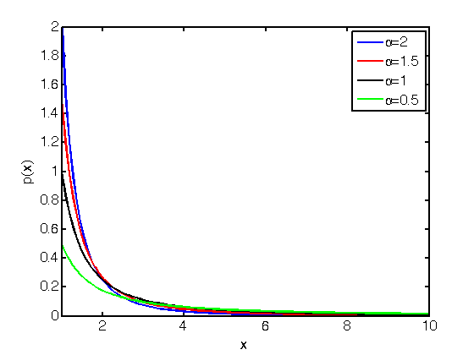
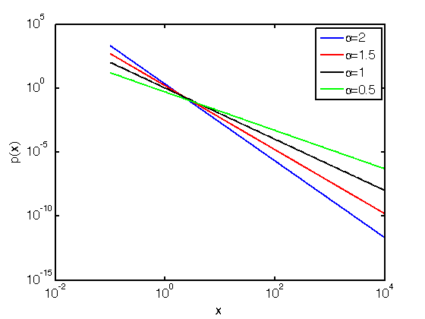
First – what do these look like
In all cases here χ=1

Slide 14
Mass, Mean and Variance
Can you see the problem??

Slide 15
For α<2 Var -> Infinity (undefined)
For α<1 not even a well defined mean exists.
Can you physically reconcile this?
So who cares
Go back to central limit theorem
This distribution potentially has neither and so the central limit theorem will not hold and you will not converge to a Gaussian
each with a well defined mean and variance

Slide 16
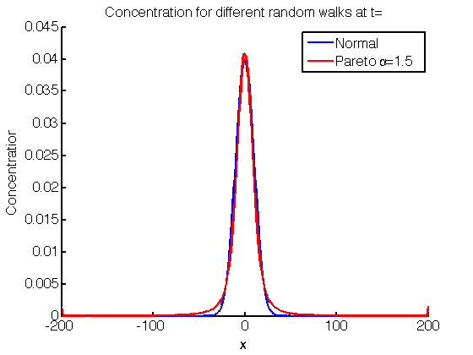
Let’s test this
Here’s a random walk where particle sample the distribution and can jump left or right (symmetric)

Slide 17
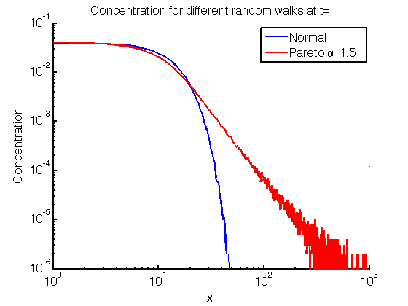
What about on a log scale
Heavy tail
Exponential tail

Slide 18
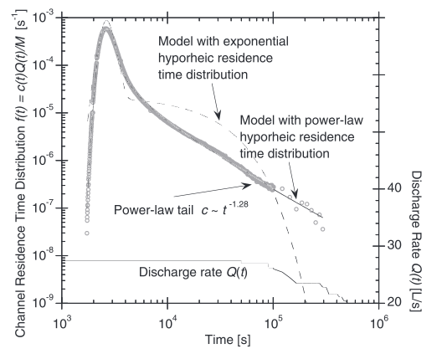
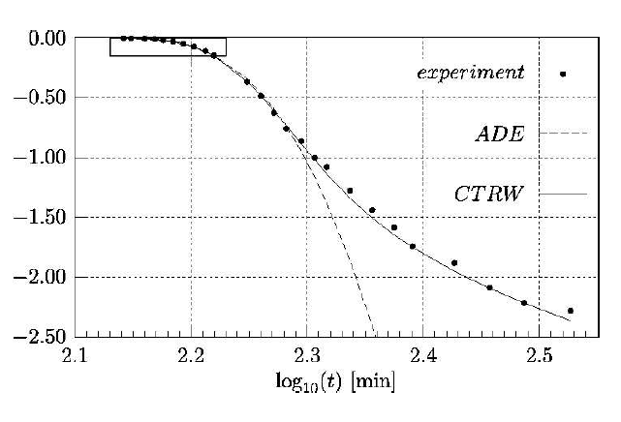
Remember – we see tails in the environment all the time
Our assumptions behind the ADE and Brownian random walks
are flawed

Slide 19
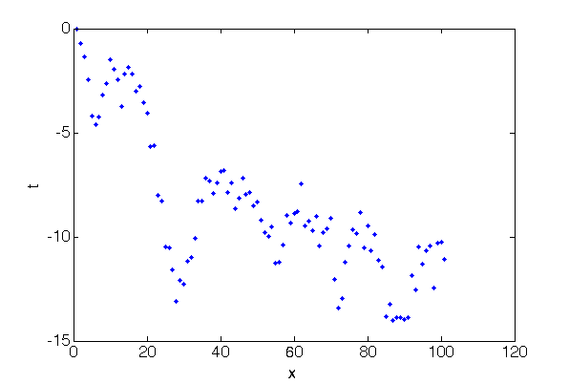
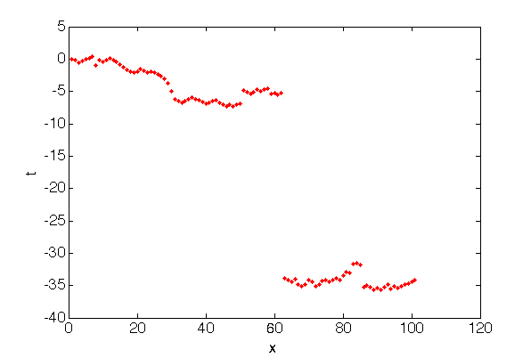
Let’s look at single particle’s trajectory
Do you see the difference?

Slide 20
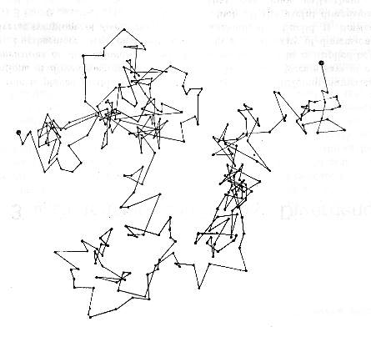
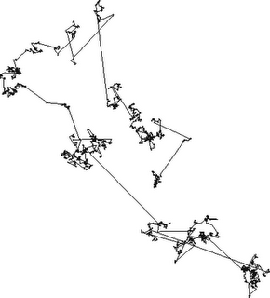
I personally find it easier to see in 2d
Brownian Motion
Levy Flight – α<2
Can you think of some physical systems where this might make sense and don’t restrict your thinking to flows

Slide 21
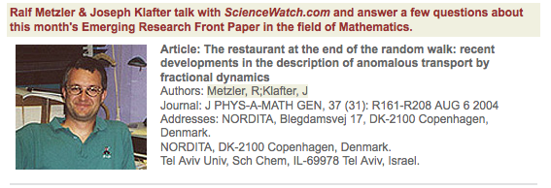

Anyway,….
There are many features that conventional models cannot capture so there is a need for better theories and models

Slide 22
So what does this mean?
Well we can’t use the central limit theorem, which means we don’t expect Gaussians, which means we cannot use the Diffusion Equation.
Are we screwed??
Well, no – there is a thing called the Generalized Central Limit Theorem…. Which basically says that even heavy tailed variable converge to certain distributions, just not Gaussian ones. These distributions are called stable distributions (and the Gaussian is just one of them)

Slide 23
What do they look like
Well, for one we can only define them formally in Fourier space (or as the inverse of a Fourier).
φ(x) is called the characteristic equation
Let’s go to Wikipedia for some details
http://en.wikipedia.org/wiki/Stable_distribution

Slide 24
And
In the same way as we can show that the Brownian motion random walk represents the diffusion equation we can show that a Levy flight is equivalent to what is called a fractional dispersion.
1<α<2
If you’re wondering what a derivative to power a is – that’s an excellent question
And there are a few ways of interpreting it – I want you to think about it for next class

Slide 25
Fractional Derivatives
There are a variety of ways in which fractional derivatives can be interpreted and if we have time we will later come back and discuss them, but to start with let’s look at Fourier Transforms. First recall that for integer n:
i.e.
And so on…

Slide 26
Well in the same way we can still say
For non integer n, 1<α<2
But note from the fADE we wrote that we must also deal with (-x), i.e.
This is important – positive and negative x need not behave the same – i.e. fractional dispersion need not be symmetric

Slide 27
Ok, let’s go back to our fractional diffusion equation and do what we always do
Solve the following equation subject to a pulse initial condition , i.e. C(x,t=0)=δ(x).
Does this still provide all the information we need as it did for the standard diffusion equation?
How do we solve this? By the way what to the different D’s represent do you think?

Slide 28
Fourier Transform
Our equation becomes:
Solution
Do some gut checks to make sure this is correct – find 3…

Slide 29
Let’s look at some solutions
First, let’s consider a fully symmetric system at t=1, where
D₊=D₋=1. Our solution is
We can invert this (numerically with Matlab)
FourierTransform_Symmetric.m

Slide 30
What about these cases
D+=1, D-=0
D+=0, D-=1
What do you think these results will look like?
Again, let’s go to Matlab
FourierTransform_Positive.m
FourierTransform_Nagative.m

Slide 31
Now, what if we mix them?
D+=1, D-=0
D+=0.9, D-=0.1
D+=0.8, D-=0.2
D+=0.7, D-=0.3
D+=0.6, D-=0.4
D+=0.5, D-=0.5
And so on.. The point is we have a great deal of flexibility with this model that we do not have in the ADE – we can heavy tails in both directions, one direction, different levels of skewness, etc. (unlike pure diffusion we now have three degrees of freedom, which makes the system much more flexible)
Use Matlab code
FourierTransform_mixed.m

Slide 32
Recall that for diffusion we calculated spatial moments as a useful tool for analysis.. What happens here?
What are the zeroth and first moment. Recall
What is the second centered moment of these solutions? Think hard about this.
What if truncate them? (as a computer naturally does)
When kappa₁₁~t^{n} n>1 this is called superdiffusion

Slide 33
Moments
Zeroth Moment
First Moment
Integration
by parts

Slide 34
Second Moment
Infinity by definition, but consider this

Slide 35
What happens if you include advection?
I.e. Our governing equation becomes:
Do we need to do anything fundamentally different?
Can we solve by the same ways as before?
How about?
And you get one more constant to fiddle with

Slide 36
So, how would you apply these to real data?
First question – how might you know that a fractional model is needed?
How might you then pick alpha?
And after that how would you pick the combination of D+ and D-?
Finally, how might you check that this model makes sense and works for the system that you wish to model? (BIG BIG QUESTION – AND NOT SURE I HAVE AN ANSWER FOR YOU)

Slide 37
What about mixing or reactions?
Chapter 10 – Dilution Index or Scalar Dissipation Rate?
Is fractional dispersion a faster or slower mixer than diffusion
Chapters 8 and 9 – How does fractional dispersion influence of chemical reactions?
Instantaneous Equilibrium Reactions
Instantaneous Reactions (of type C_{A}C_{B}=0)
Incomplete Mixing Phenomena

