Slide 1
Chapter 15 – CTRW
Continuous Time Random Walks

Slide 2
Random Walks
So far we have been looking at random walks with the following Langevin equation
ξ is a random spatial jump, which can have finite mean and variance (diffusion) or infinite variance (fractional dispersion)

Slide 3
But is this the only thing that can be random?
Might be less intuitive, but why not say that time is random, instead of the spatial jump
τ is now the random number, while Δx is fixed, (which could also be random, but let’s keep it simple for now).
Why would you want to do this and can you think of a context where it might make sense?

Slide 4
Let’s consider a symmetric case for comparison
Consider Random Walk
Δx can be plus or minus 1 with equal probability
τ is sampled from a probability density function p(τ) – let’s consider a few different ones

Slide 5
Let’s consider a few different p(τ)
Exponential
Power Law
Infinite variance, finite mean
Infinite mean

Slide 6
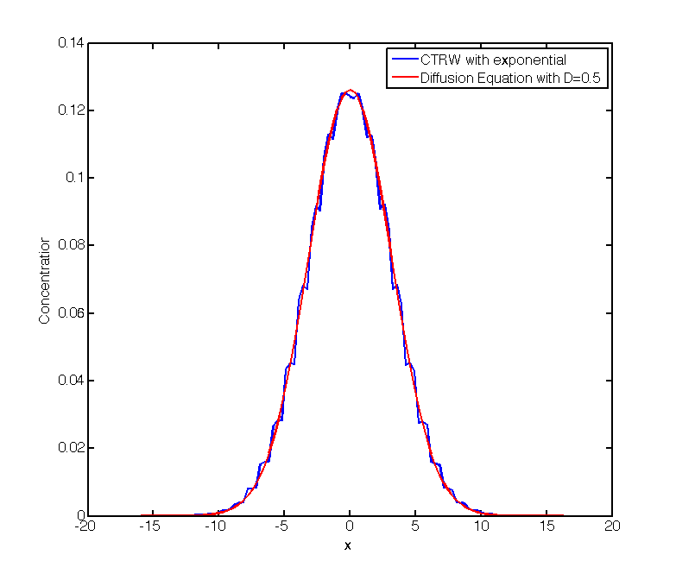
Ctrw_exponential.m
Solution with λ=1 at t=10
Looks just like a diffusion equation solution with D=0.5

Slide 7
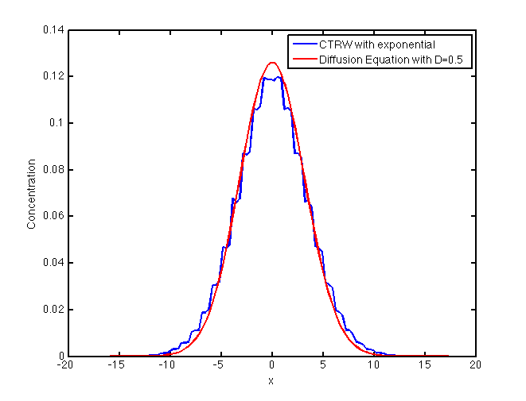
Ctrw_Pow_inf_var.m
Solution with α=1.5 at t=10
Looks a lot like a diffusion equation solution with D=0.5 (maybe slightly different D would be better)

Slide 8
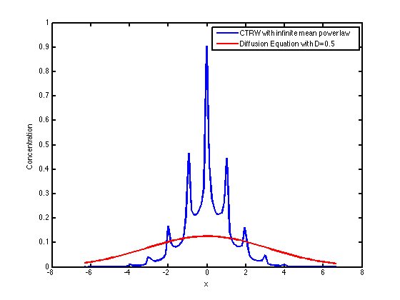
Ctrw_Pow_inf_mean.m
Solution with α=0.5 at t=10
Looks very distinct – let’s run to later times
By the way peaks could be a weird interpolation effect only – see code.

Slide 9
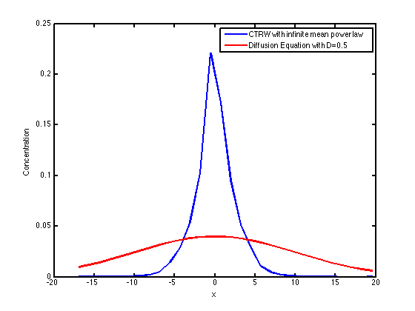
Ctrw_Pow_inf_mean.m
Solution with α=0.5 at t=100
Looks very distinct – let’s run to later times
What stands out?

Slide 10
The point is the following
For exponential and finite variance power law the behavior looks familiar and in space we converge to something that looks Gaussian
For the infinite mean we do not – what is going on there?

Slide 11
Now let’s consider unidirectional equal jumps
Δx=1 (like a river or some system with a mean flow in one direction). All we care about is how long it takes a particle to jump some distance downstream, not the specific path it has taken…

Slide 12
In systems with preferential drift (velocity) we have focused on BTCs
Let’s look at them here
CTRW is a particularly easy framework for looking at BTCs, because it basically tells us the times at which a plume will arrive at a give distance
If you are interested in a downstream BTC at distance NΔx you just at N random time steps sampled from p(τ)

Slide 13
Again let’s look at the three different distributions
Consider BTC at x=100 with Δx=1
Exponential
Power Law
Infinite variance, finite mean
Infinite mean

Slide 14
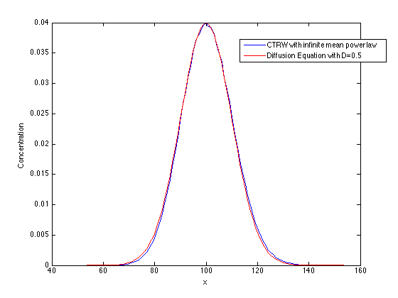
Ctrw_exponential.m
Δx=1
λ=1
t=100
Again matches perfectly with u=1 and D=0.5 ADE

Slide 15
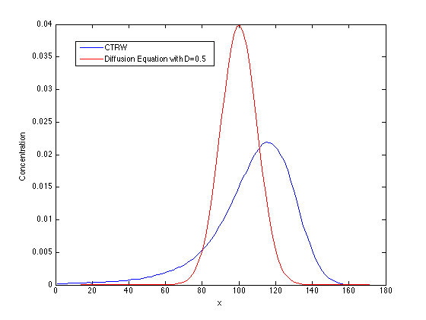
Ctrw_pow_inf_var
α=1.5
Δx=1
No longer looks like a diffusion system
Heavy backward tail

Slide 16
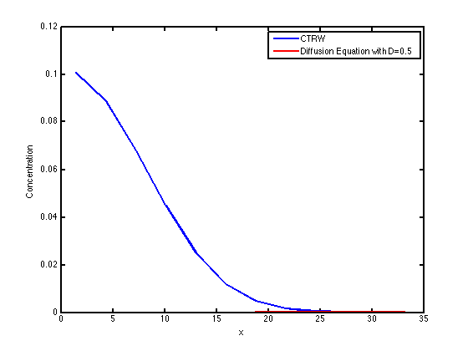
Ctrw_pow_inf_mean.m
Δx=1
α=0.5
Looks absolutely nothing like an ADE
Later times

Slide 17
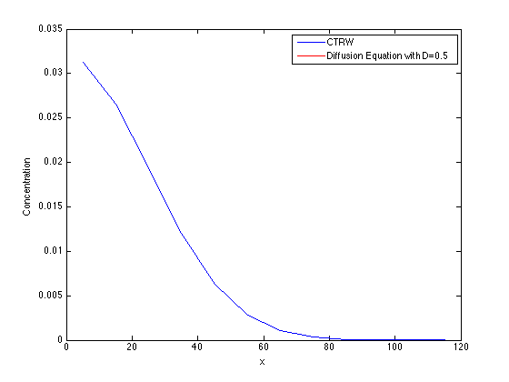
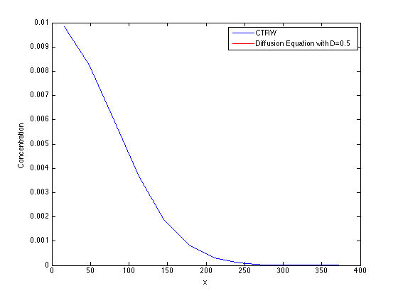
T=1000 and 10000

Slide 18
Interim Conclusions
In the absence of drift we only get anomalous transport for α<1
With drift we get anomalous transport for α<2, but it is quite different for the range 1<α<2 and 0<α<1.
Can you explain these differences?

Slide 19
Let’s take a step back and make sure we understand random walks
Basic idea – random walks track a particle’s location in space and time.
In 1-d we can represent this on a 2d plot so let’s do that and compare the different random walks as well as variants of CTRW we have considered so far.
All plots are time on x –axis and position on y-axis

Slide 20
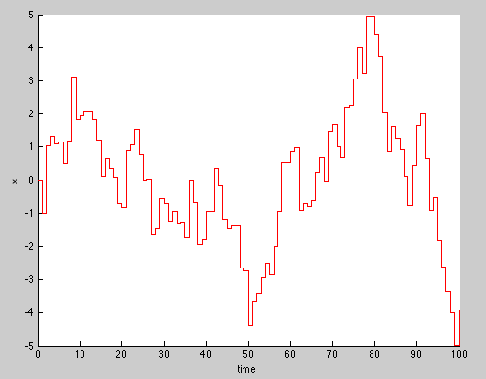
Single Brownian Particle

Slide 21
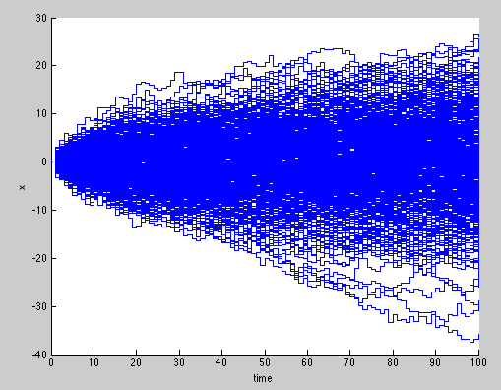
Multiple Brownian Particles
If I take a transect at a fixed time say t=50, the distribution of particles will be Gaussian (as the solution of the diffusion equation)

Slide 22
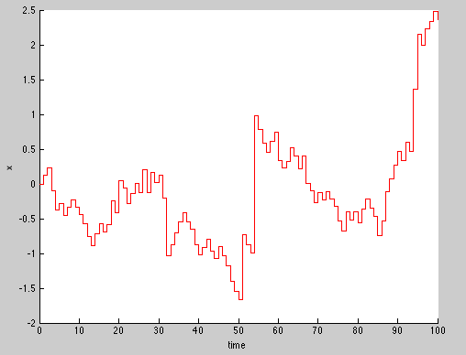
Levy Flight - Single

Slide 23
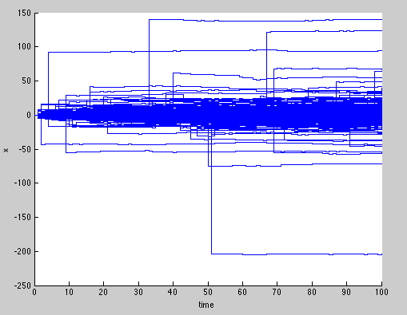
Multiple Levy
Vs Brownian
Clearly heavy tails in space

Slide 24
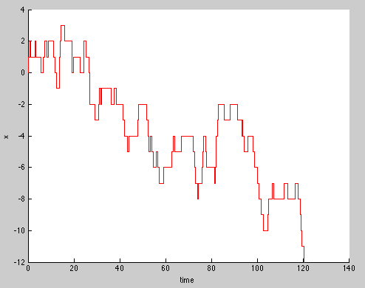
CTRW – Exponential p(τ), Symmetric no drift

Slide 25
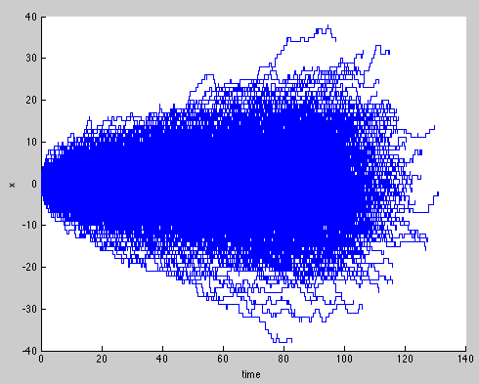
Multiple
Vs Brownian
Look similar at a fixed time

Slide 26
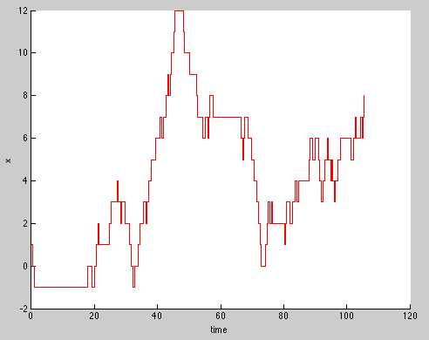
CTRW – Inf variance p(τ), Symmetric no drift
You can see long time jumps relative to exponential

Slide 27
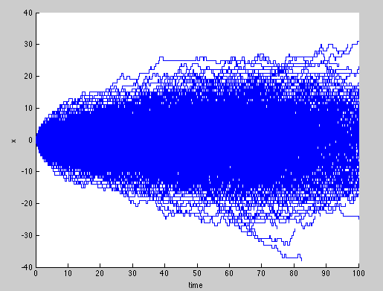
Multiple
Vs Brownian
Look similar at a fixed time

Slide 28
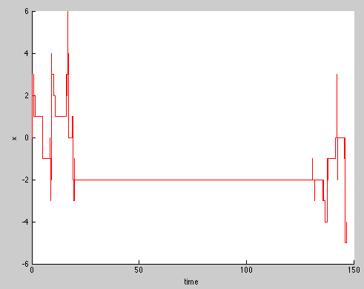
CTRW – Inf mean p(τ), Symmetric no drift
You can see even longer time jumps relative to exponential or infinite variance

Slide 29
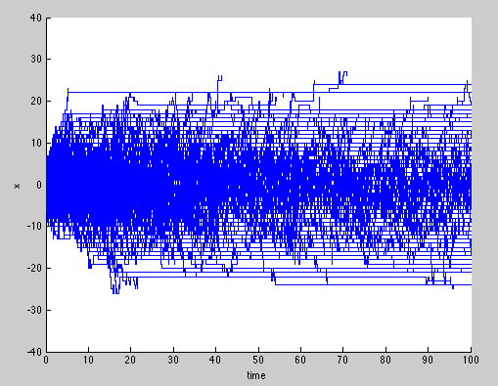
Multiple
Vs Brownian
Look different with more mass held close to x=0

Slide 30
How about with fixed Δx
We can do the exact same thing including a fixed spatial jump during each step

Slide 31
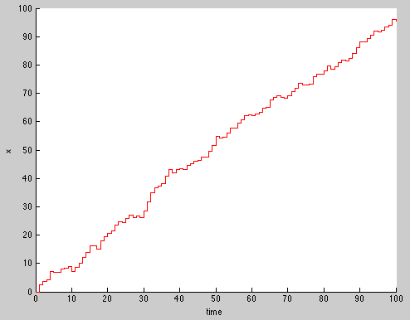
Single Brownian Particle

Slide 32
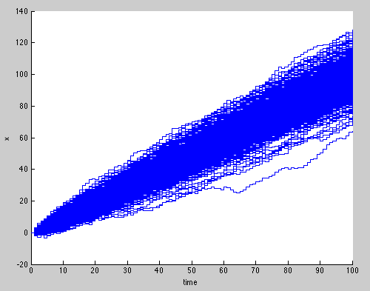
Multiple Brownian Particles
If I take a transect at a fixed time say t=50, the distribution of particles will be Gaussian (as the solution of the advection diffusion equation)
i.e. the mean is just shifted over time

Slide 33
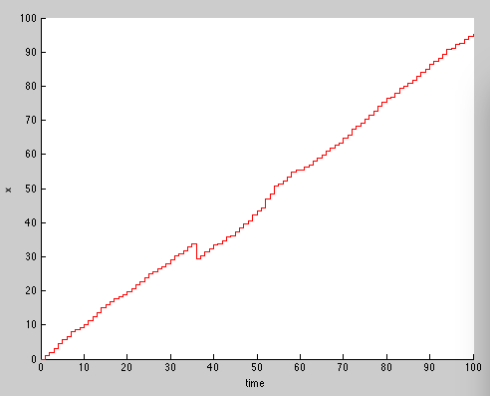
Levy Flight - Single

Slide 34
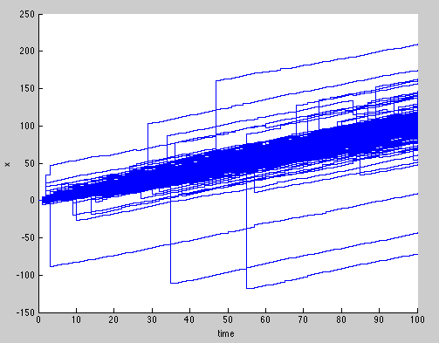
Multiple Levy
Vs Brownian
Clearly heavy tails in space

Slide 35
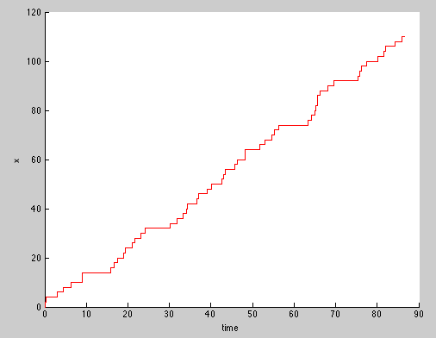
CTRW – Exponential p(τ), Symmetric no drift

Slide 36
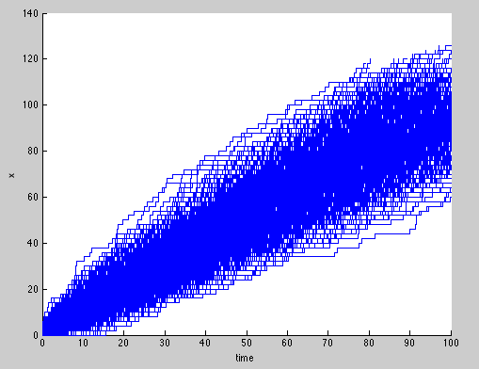
Multiple
Vs Brownian
Look similar at a fixed time

Slide 37
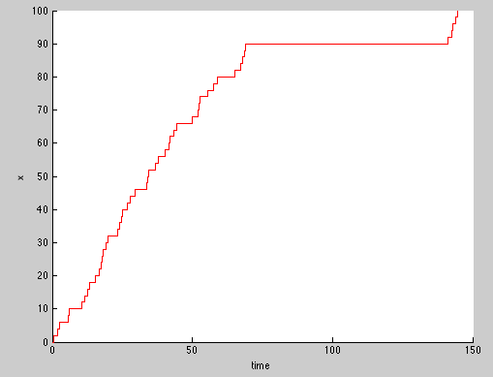
CTRW – Inf variance p(τ), Symmetric no drift
You can see long time jumps relative to exponential

Slide 38
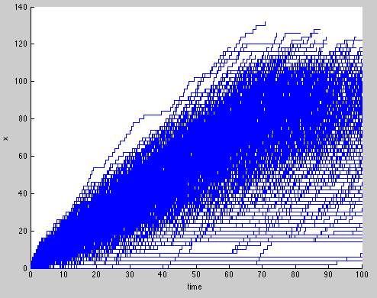
Multiple
Vs Brownian
Clearly mass is being held back – why was there no deviation for symmetric?

Slide 39
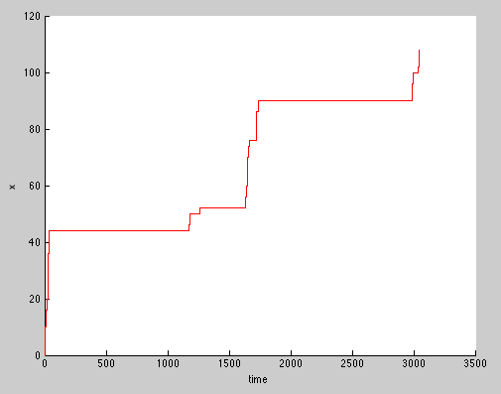
CTRW – Inf mean p(τ), Symmetric no drift
You can see even longer time jumps relative to exponential or infinite variance

Slide 40
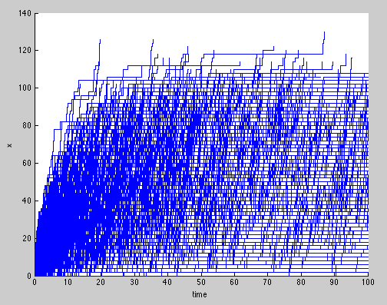
Multiple
Vs Brownian
Look different with more mass held close to x=0

Slide 41
Can we write continuum equations for these
In the same way as we did for the last chapter where we translated Levy flights into fractional dispersion equations, can we do the same for the CTRW framework where time steps rather than spatial jumps are random?

Slide 42
Can we write continuum equations for these
When diffusion is symmetric and you have infinite mean waiting time distribution you get a fractional diffusion equation, but with fractional diffusion in time
You have to be careful how you define fractional derivative in time. In Laplace space

Slide 43
Moments
Recall
Integrate above equation

Slide 44
In Laplace Space
Moment Equations
Subdiffusion for α<1

Slide 45
What about the other case with fixed Δx
Complicated, but yes
M is called a memory function and in Laplace space
Where ψ is the waiting time distribution

Slide 46
For 1<α<2
Moments
This is much harder to show than one would think – if you are interested see paper by Margolin & Berkowitz, PRE 2002 (appendix B)

Slide 47
For 0<α<1
Moments
For this case you can actually use
Note that even your first moment
does not grow linearly in time

Slide 48
Ok – so how might you apply this to real data?
Well – usually we solve in Laplace space and do the same kinds of things we did for the Mobile-Immobile Model
However, Andrea Cortis and Brian Berkowitz were kind enough to write software that does it for us called the CTRW Toolbox, written in Matlab. We’ll run through a few examples now..

Slide 49
Before we do this, note the types of travel time distributions allowed
ADE
Modified Exponential
Truncated Power Law
You can also define your own, but the above are fairly flexible.

Slide 50
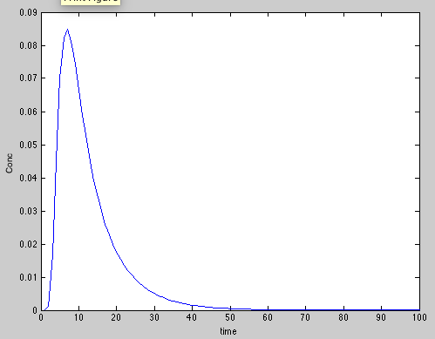
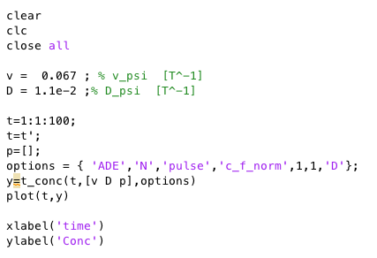
Here are some examples
ADE
As you would expect

Slide 51
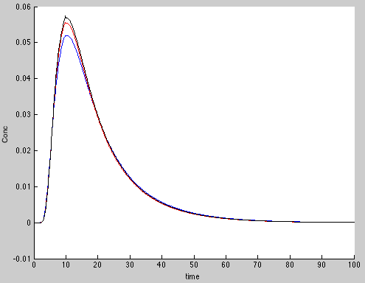
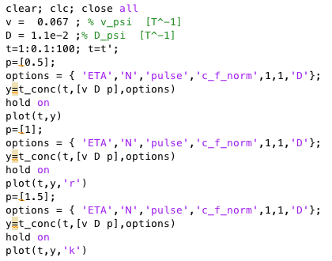
Modified Exponential
Would not worry too much about this one

Slide 52

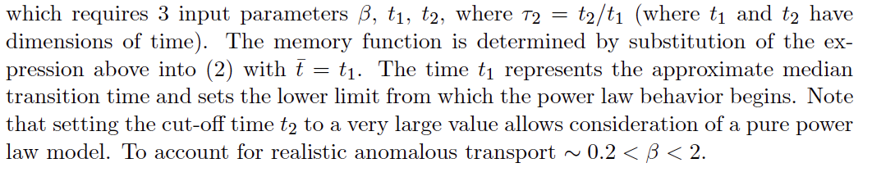
Let’s focus on this one
Truncated Power Law

Slide 53
The truncated power law
Recognizes that infinite mean and variances likely do not exist, because at some finite scale it will be cutoff (and so have finite mean and variance)
If that cutoff is really really big it behaves as if it had infinite mean or variance
After the cutoff the central limit theorem holds and you revert to standard diffusion system (Brownian)

Slide 54
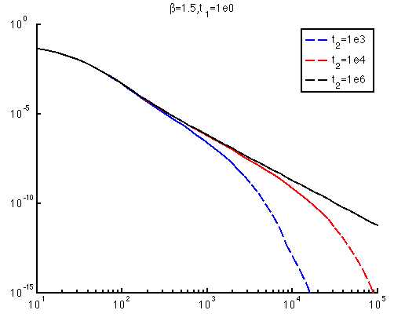
Examples – beta=1.5; t_1=1

Slide 55
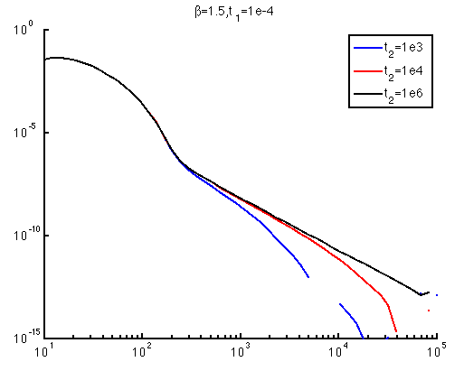
Change t_1=1e-4;

Slide 56
A few things to note about CTRW toolbox
It always assumes that the distance of the total domain is 1. So if you have a problem where you measure a breakthrough curve at distance 40, you have to rescale. Velocities and Dispersion coefficients scale as L and L^2 also.
You want your concentration normalized also

Slide 57
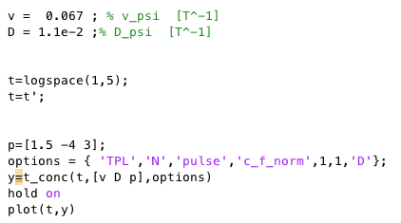
Options and p
What are options
and p?

Slide 58
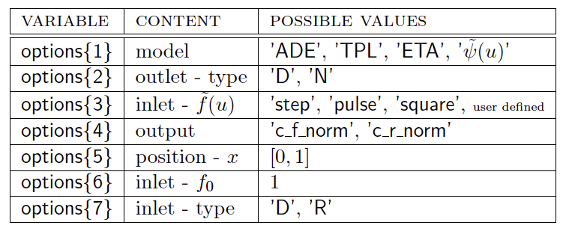
Options

Slide 59
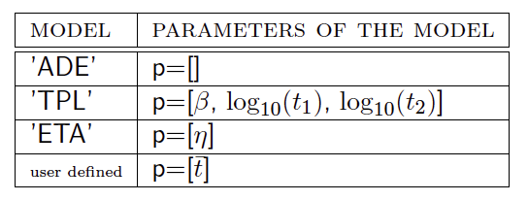
p

Slide 60
But the real winner is:
Being able to plot these things is great, but the strength of the toolbox is in matching data. Let’s look at an example.
You are provided with the data on the following page and asked to match it with a model. Use the CTRW toolbox to get the best fit with an ADE and TPL model. The data is from a porous column that is 40 cm long where the concentration is monitored and you use a step input of concentration. to observe transport.

Slide 61
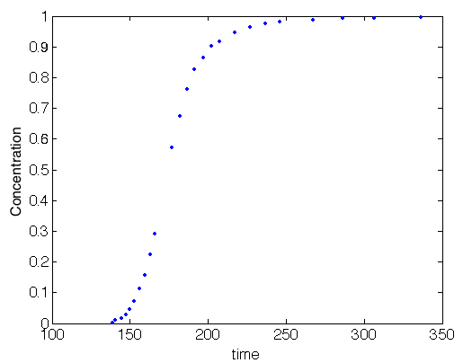
Data to be fit
How can you tell if there is a tail in data for a step input like this one?

Slide 62
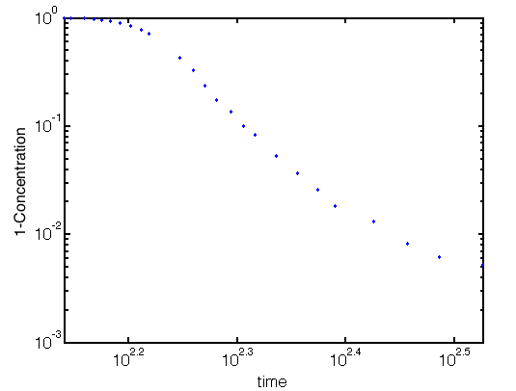
Plot(t,1-conc) on log log

Slide 63
OK – let’s fit ADE
Run code ADE_fit_class.m
What do you see?
Do you consider this a good fit?
Could you do better?

Slide 64
OK – now TPL
Run TPL_fit_class.m
Is this a better fit?
Is it worth the extra effort?
Could it be even better?

