Slide 1
Chapter 16 – Markov Chain Random Walks
McCTRWs – the fast food of random walks

Slide 2
Overview
We are in the home stretch now and this last topic is one that is very dear to my heart as it is something that I worked very actively on myself.
One of my close friends who was a postdoc in Spain at the same time as me actually ‘invented’ this method and he and I have continued to work on it a lot (including that this is a core part of Nikki’s PhD thesis).
We have run this model in many many different problems and so far it has proven itself robust to almost any challenge we have thrown its way…. What we still do not know how to do is how to parameterize it for real data from real systems.. But we’re getting there.

Slide 3
Basic Premise of Most Random walk Models
Our particle position and time equations are given by
ξ and τ are random numbers. We have considered them with finite mean and variance, infinite variance and infinite mean and shown all sorts of behaviors, but we have still always assumed one thing
I.I.D (Independent and Identically Distributed)

Slide 4
IID
Identically Distributed – this means that the random number is always drawn from the same distribution.
How might you relax this?
Do you think it’s important?
In what context?
Independent
What do you mean by independent?
Does this make sense to you
How might we relax this assumption and when is it important?

Slide 5
Consider the following classical problem
Flow between two flat plates
We already know from our work on Taylor dispersion how this system will behave at late times (t>L^2/D)
But what about at earlier times than this? Can we use some of the CTRW ideas we have discussed to date?
y
x

Slide 6
How about this?
Define some distance Δx
I can measure how much time it takes particles to move this distance, right?
Therefore I can say ξ=0, Δx is fixed, Δt=0 and τ is random
y
x
Δx
And now I just run my CTRW, right? And because p(t) has finite mean and variance it will converge to Fickian Dispersion (which I expect from Taylor’s theory) – Foresee any issues?

Slide 7
Let’s test it
Consider the following case
U=3/2 (1-y^2) -1<y<1 (parabolic flow between two plates)
Let’s consider Δx=10 (you can pick whatever you want – within limits as Nikki has discovered, but lets not get sidetracked by that)
Test our idea for D=0.1,0.01 and 0.001
Basically, I run a particle tracking simulation with a pulse initial condition at x=0 (represented by N particles) and then measure how long it takes each particle to travel a distance of Δx=10. This then gives me a vector of N travel times that I can sample from to make the next jump over Δx=10 (i.e. to 20)
Let’s test this model’s ability to predict breakthrough at x=20, 40 and 100

Slide 8
Step 1 – Measure travel time distribution
Run the code rw_ptau.m
Note here that we use what is called a flux weighted initial condition (just for ease)
This code runs a random walk that resolves the velocity field, i.e.
In this code we store the vector, called timer, that measures the amount of time it takes each particle to cross a distance Δx=10.
Save timer

Slide 9
Step 2 – Generate data for comparison
Run the same random walk code that models everything too Measure BTCs at further distances – rw_btcs.m
Measure the amount of time it takes particles to travel a distance of 20, 40 and 100, which allows us to build brreakthrough curves btc20, btc40 and btc100.

Slide 10
Step 3 - Run our “Upscaled” Model
We now run a code that implements a CTRW and no longer resolves the velocity field, but aims to capture the different speeds of each particle by saying it takes a random time to cross a distance Δx. That random time is chosen from the vector timer.
Run this code to generate arrival times/BTCs for x=20,40, 100
Sampled randomly from timer

Slide 11
Step 4 – Compare the model outputs
Run the code compare.m
The code plot the BTCs at x=20,40 and 100 for both the fully resolved and upscaled CTRW model.

Slide 12
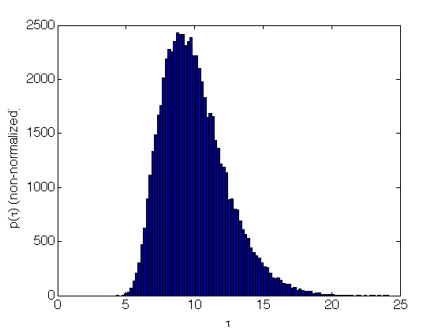
For D=0.1 Step 1 – Generate Timer

Slide 13
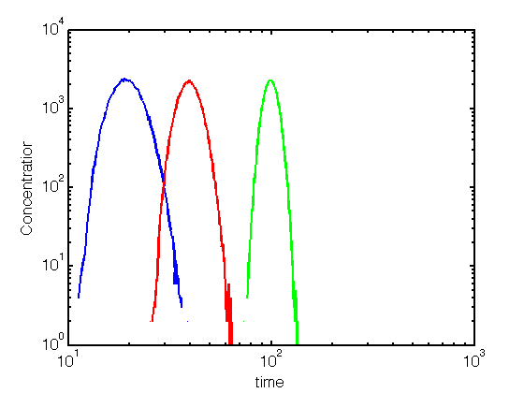
For D=0.1 Step 2– Generate BTCs

Slide 14
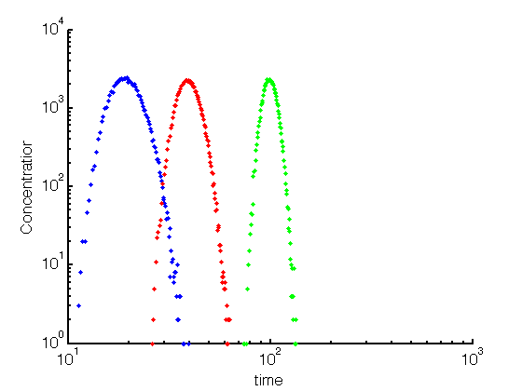
For D=0.1 Step 3 – Run CTRW

Slide 15
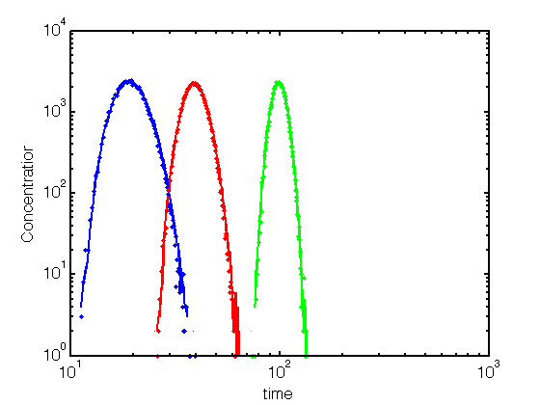
For D=0.1 Step 4 – Compares
Virtually Indistinguishable

Slide 16
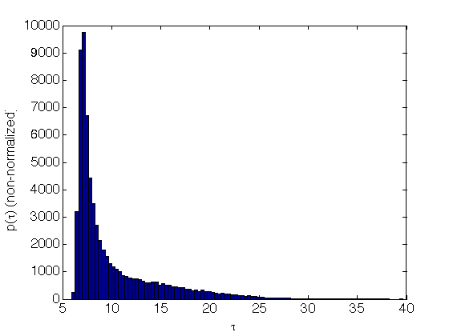
For D=0.01 Step 1 – Generate Timer

Slide 17
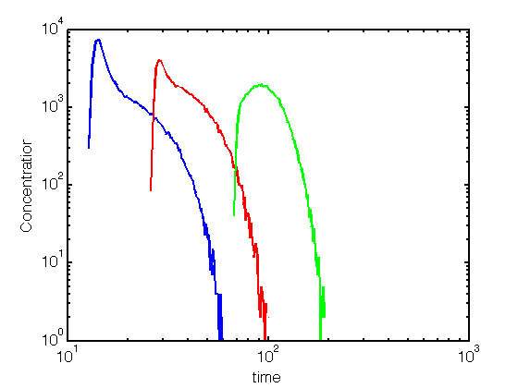
For D=0.01 Step 2– Generate BTCs

Slide 18
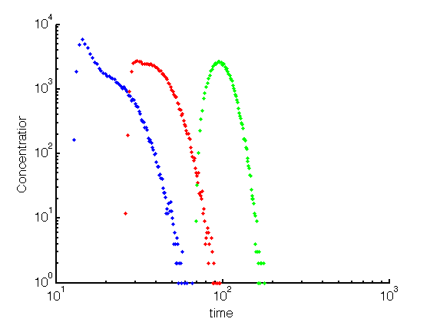
For D=0.01 Step 3 – Run CTRW

Slide 19
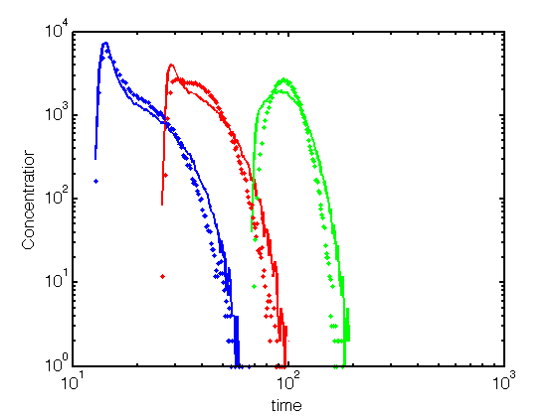
For D=0.01 Step 4 – Compares
Not terrible
But certainly
Not Indistinguishable

Slide 20
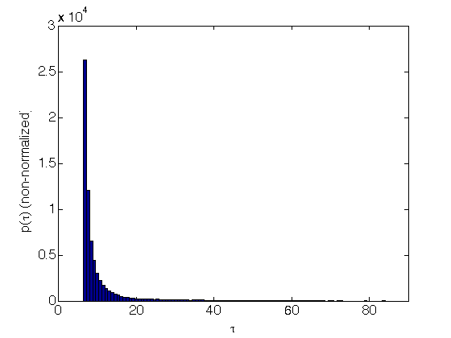
For D=0.001 Step 1 – Generate Timer

Slide 21
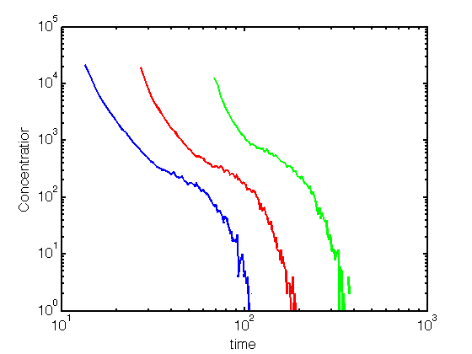
For D=0.001 Step 2– Generate BTCs

Slide 22
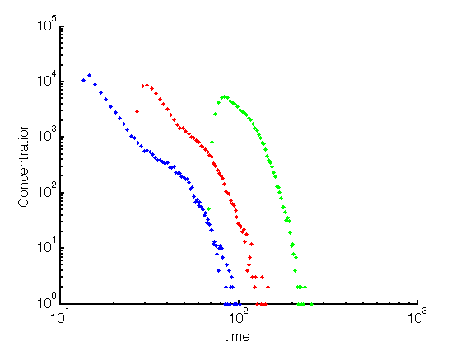
For D=0.001 Step 3 – Run CTRW

Slide 23
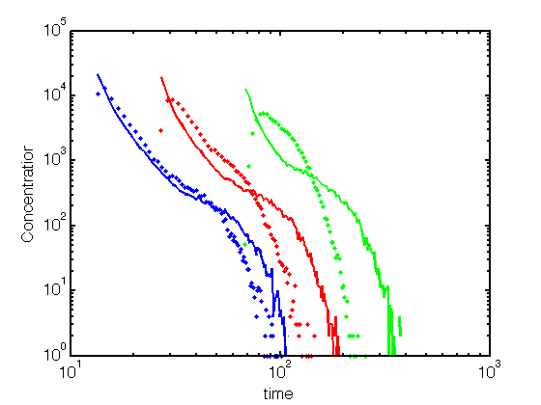
For D=0.001 Step 4 – Compares
Seems to be getting even worse

Slide 24
So what is going on?
For large D the proposed CTRW model looks pretty good…
As D gets smaller the match between model and measured gets worse and worse – WHY?
What is different from the perspective of the CTRW model as D get smaller and smaller?
How might you address this? And thereby improve our model so that we can match predicted and observed consistently across a range of values of D?

Slide 25
What is missing?
The CTRW as we have defined it assumes that successive jumps in time are completely uncorrelated and independent of one another.
Our simulations suggest that this may only be true for large diffusion coefficients – does this align with your intuition?
As D gets smaller particles are likely to stay on similar streamlines and so it is likely that successive τs will not be independent.
How can mea measure and thus impose such correlation

Slide 26
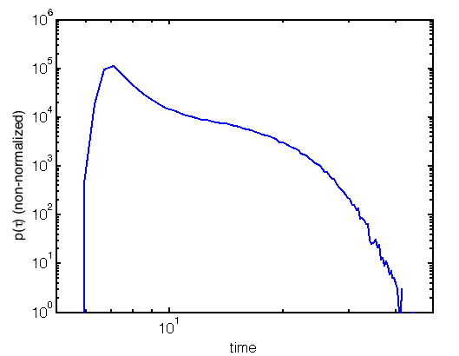
Travel Time Distribution
Δx₁
τ₁
Δx₂
τ₂
If uncorrelated I just sample arbitrarily from p(τ)

Slide 27
Travel Time Distribution
Δx₁
τ₁
Δx₂
τ₂
Imagine I pick a specific value of τ₁ as shown. Now because of correlation τ₂ is restricted where it can come from

Slide 28
Let’s break p(τ) into bins – for sake of depiction say 4
Δx₁
τ₁
Δx₂
τ₂
1
2
3
4
What correlation is saying is that τ₂ can only come from bin 2 or 3 now and we can measure the probability that it comes from bin 2 or bin 3.

Slide 29
What we have to measure
Δx₁
τ₁
Δx₂
τ₂
Run a simulation with N particles (say N=one million) and for each particle measure how long it takes to cross Δx₁ and how long it takes to cross Δx₂
The distribution of the two should be the same
Now break p(t) into M bins and attribute each particles τ₁ to one bin and each particles τ₂ to a bin.
Measure how likely it is that a particle with τ₁ from one bin has a τ₁ from another one and represent it as a matrix

Slide 30
Let’s break p(τ) into bins – for sake of depiction say 4
Δx₁
τ₁
Δx₂
τ₂
1
2
1
2
3
4
3
4
What correlation is saying is that τ₂ can only come from bin 2 or 3 now and we can measure the probability that it comes from bin 2 or bin 3.

Slide 31
Transition Matrix
1 2 3 4 (Next Bin)
1
2
3
4
0.8 | 0.2 | 0 | 0
0.1 | 0.7 | 0.2 | 0
0 | 0.15 | 0.75 | 0.1
0 | 0 | 0.3 | 0.7
How to read this
If τ₁ comes from bin 1 then it has an 80% chance that τ₂ will be from bin 1 and 20% that it will be from bin 2 and 0% chance from bins 3 or 4
If τ₁ comes from bin 3 then it has an 0% chance that τ₂ will be from bin 1 and 15% that it will be from bin 2, 75% from bin 3 and and 10% chance from bin 4
(Initial Bin)
Thus, I randomly generate τ₁ from p(τ). Then I generate another random number to assess where τ₂ will come from and then only sample from that bin.
I generate a new number to assess where τ₃ will come from based on τ₂ and so on until I have jumped my desired number of steps

Slide 32
Example – same case as before with D=0.001 (where CTRW did not work)
Recall this is what p(τ) looked like
If will break this into 25 bins
The higher the number of bins the better you resolve correlation – typically 25-50 is good.

Slide 33
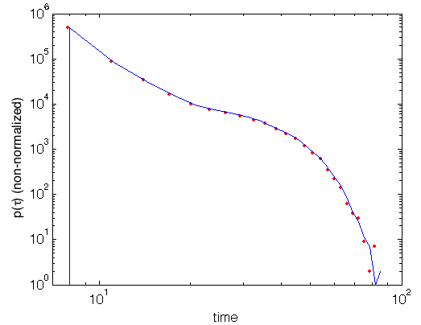
Check that indeed p(τ) is the same for τ₁ and τ₂
Run code rw_ptau_2dx.m

Slide 34
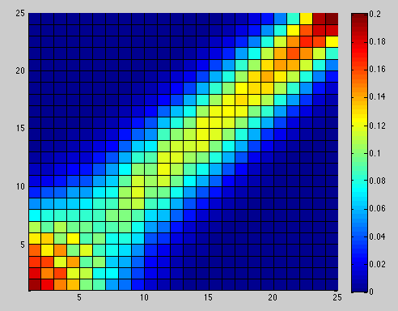
Measure the transition matrix
Run code transition_matrix.m
Bin 1 is the smallest travel times (i.e. fastest particles). Bin 25 is the largest travel times (slowest particles)
τ₁
τ₂

Slide 35
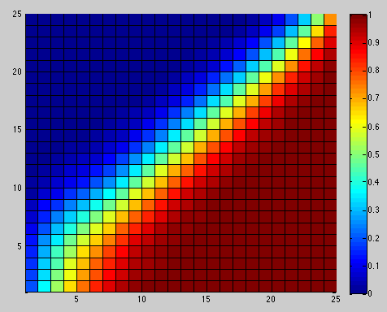
Cumulative Transition Matrix
This Matrix adds columns together… last column has to be 1
Why would I do this?
Easier for coding…
You know τ₁, which means you know which row you are in. To determine next bin generate a random number U=[0,1]
This determines your next bin by looking along the columns..

Slide 36
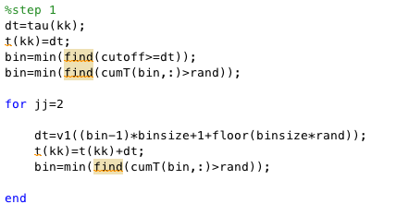
Now use this transition matrix to enforce correlations in a CTRW code
See code mcctrw.m (sample below)

Slide 37
How does this compare…
Recall this is what we want to reproduce…

Slide 38
This is what the CTRW without correlation gave us
Not a good match

Slide 39
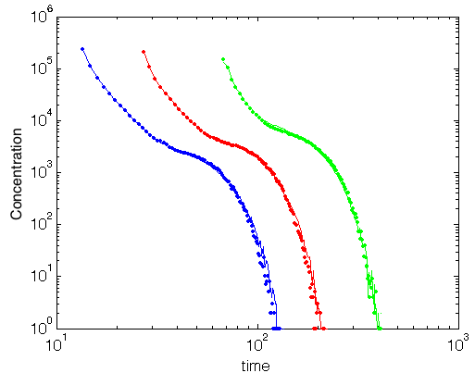
How about our new algorithm…
Almost perfect..
Including correlation the way we have seems to fix the issues
What about larger D?

Slide 40
For D=0.01
What uncorrelated model gave us
Better than smaller D
But not Perfect

Slide 41
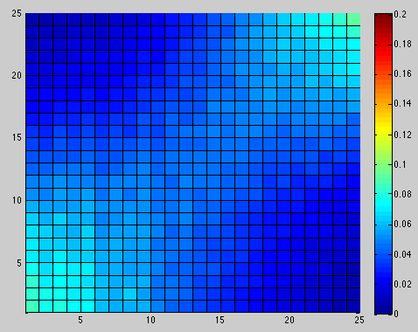
What does transition matrix look like for our new model?
Compare to smaller D

Slide 42
What does transition matrix look like for our new model?
D=0.01
D=0.001
What’s different – Does it make sense to you?

Slide 43
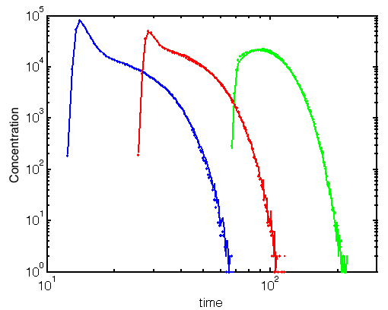
How about our new algorithm…
Almost perfect..
Including correlation the way we have seems to fix the issues
What about larger D?

Slide 44
Finally for largest D=0.1
What uncorrelated model gave us
Virtually Indistinguishable

Slide 45
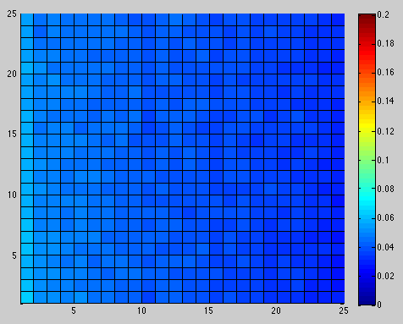
Transition Matrix for this Case
Again, compare to before and does it make sense?

Slide 46
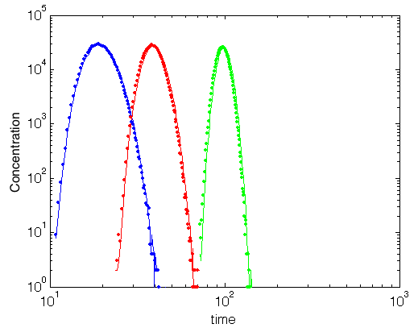
Comparison
Again, virtually perfect (but unnecessary to include correlations)

Slide 47
Summary of Algorithm for McCTRW
Step 1 – Generate a random number τ₁ from p(τ)
Step 2 – Determine what bin is τ₁in
Step 3 – Generate a random number and use transition matrix to assess what the next bin will be
Step 4 – Generate τ₂ from the new bin
Step 5 - Generate a random number and use transition matrix to assess what the next bin will be
Step 6 – Generate τ₃ from the new bin
And so on until the desired number of jumps have passed.

Slide 48
Ok – it works for flow between two plates – does it work in other flows?
For this let’s dig in the litterature… Thursday

