Slide 1
Fate & Transport of Contaminants in Environmental Flows
2015

Slide 2
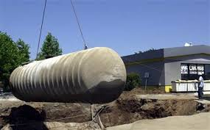
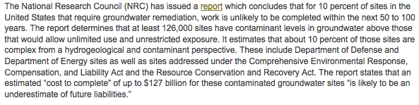
Motivation

Slide 3
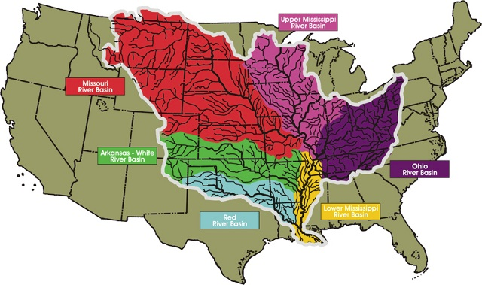
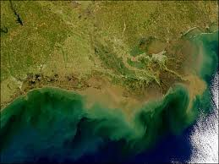
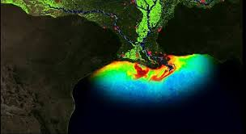
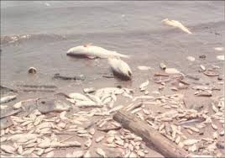
Motivation

Slide 4
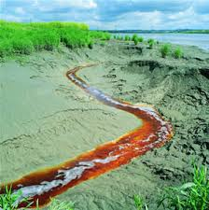
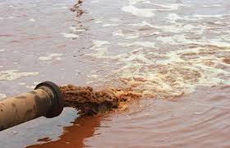
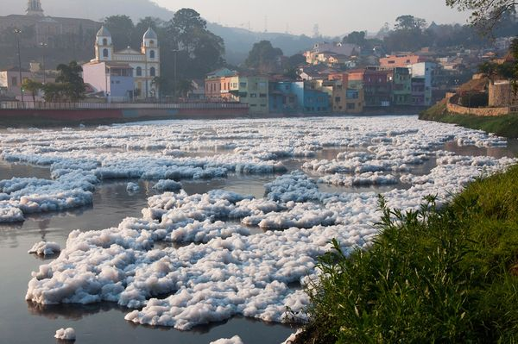
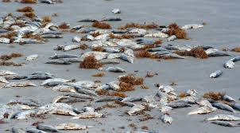
Motivation

Slide 5
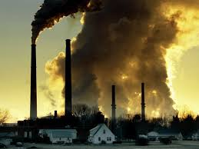
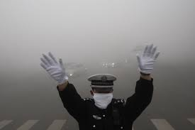
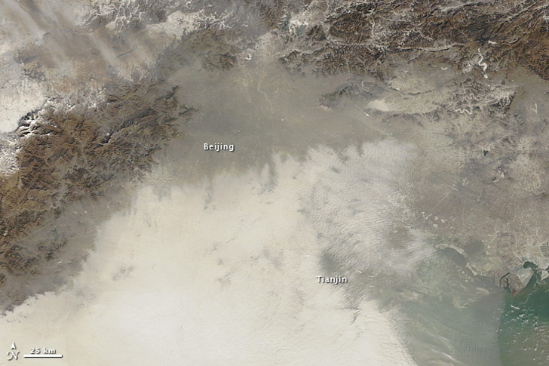
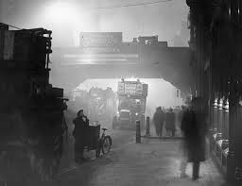
Motivation

Slide 6
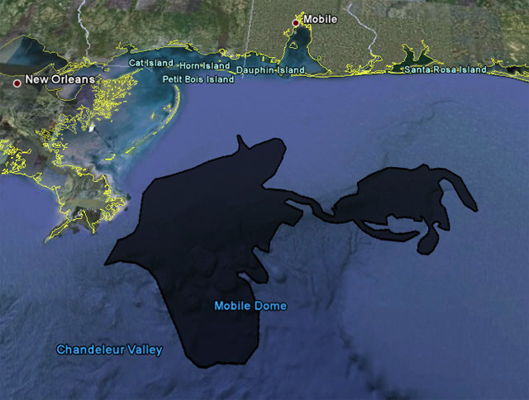
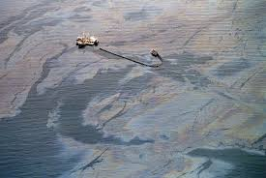
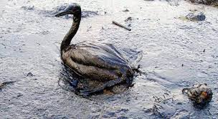
Motivation
Deepwater Horizon
Valdez Exxon

Slide 7
Basics on Contaminant Transport
What processes do we usually consider?

Slide 8
Basics on Contaminant Transport
What processes do we usually consider?
Advection – the solute simply moves with the velocity of the surrounding fluid

Slide 9
Basics on Contaminant Transport
What processes do we usually consider?
Diffusion – Because molecules bounce around randomly and off one another they also spread randomly (usually a slow process)
Cause solute to dilute, because it spreads over a greater area/volume

Slide 10
Basics on Contaminant Transport
What processes do we usually consider?
Dispersion – Because of random fluctuations in the flow (because of turbulence or boundaries) solute molecules spread over a greater area/volume (usually much faster than diffusion)
Cause solute to dilute, because it spreads over a greater area/volume

Slide 11
Basics on Contaminant Transport
What processes do we usually consider?
Trapping – Solute can get trapped in immobile regions of flow (pockets, or for example by sorption to boundaries)
Causes solute to move more slowly than the mean flow

Slide 12
How do we model these classically?
Define concentration
C=Mass/Volume
In 1d [C]=ML⁻¹
In 2d [C]=ML⁻²
In 3d [C]=ML⁻³

Slide 13
Advection
Advection simply moves the solute with the speed of the flow
In 1d
velocity of the flow
In general

Slide 14
Diffusion
Diffusion describes the spread of particles through random motion from regions of higher concentration to regions of lower concentration.
Fick’s Law - diffusive flux
The diffusion coefficient depends on the materials, temperature, electrical fields, etc.
Measured in the Lab

Slide 15
Dispersion
Dispersion describes the spread of particles through random motion of the fluid velocity.
Fick’s Law can also be shown to work - dispersive flux
The dispersion coefficient depends on the properties of the flow and solute (Dmech=f(Dmol,v))
Usually empirical

Slide 16
We can throw all these together
Advection Dispersion Equation (ADE)
In general

Slide 17
Trapping
Often represented by a retardation coefficient, which merely means it takes the solute longer to get from A to B…
This implicitly assumes equilibrium (i.e. mobile and immobile solutes instantly adjust to some fixed relationship).
Retardation term

Slide 18
In General
ADE in general Dimensions
In 3d (for constant D and incompressible flow)

Slide 19
This is great – we have a governing equation for transport that we can in general solve (we will learn how to to do so in the first part of this course)
So why bother with an advanced course on transport?
Well there are lots and lots of instances where this model does not work in many applications relevant to environmental flows, because the assumption behind the ADE do not always hold.
This is gives rise to anomalous transport models (anomalous meaning any system that cannot be described by the ADE).

Slide 20
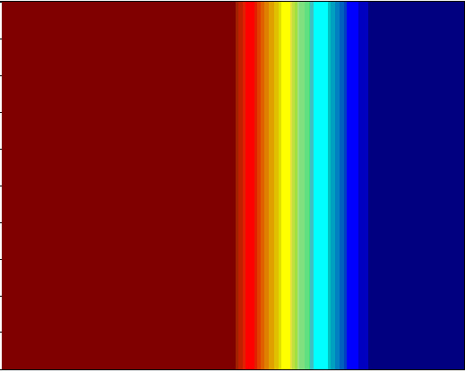
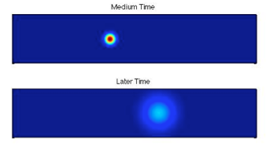
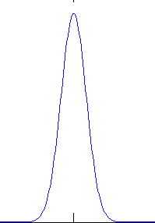
Typical Homogeneous Observation for Transport of Solutes
Continuous
Injection
Nice Clean Smooth Transition
Between Red to Blue
Dispersive Mixing Zone
Point Injection
Mean Flow
Gaussian Plumes
Gaussian Plumes

Slide 21
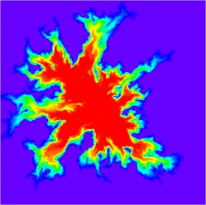
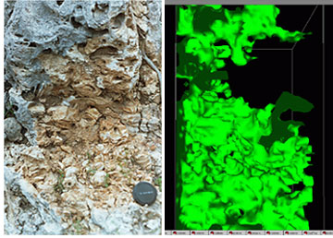
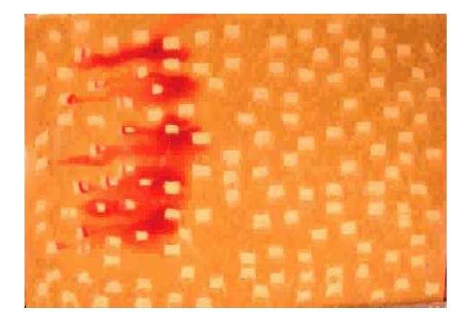
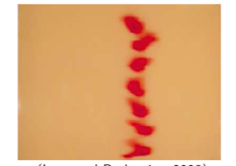
What does the real world look like?

Slide 22
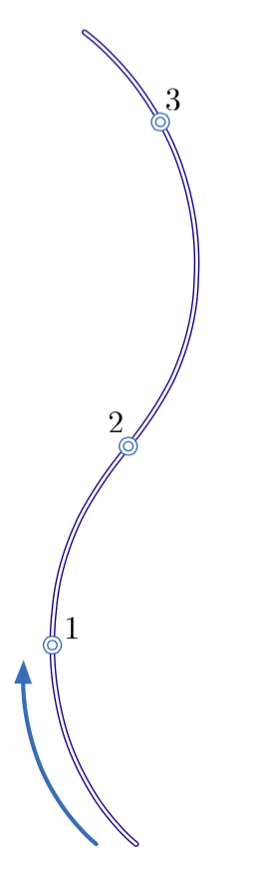
How do we measure solute transport?
One of the most common experiments for solute transport is to measure a breakthrough curve
Inject a solute here
Measure concentrations over time here
Breakthrough Curves (BTCs)

Slide 23
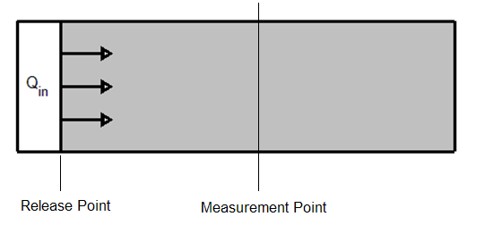
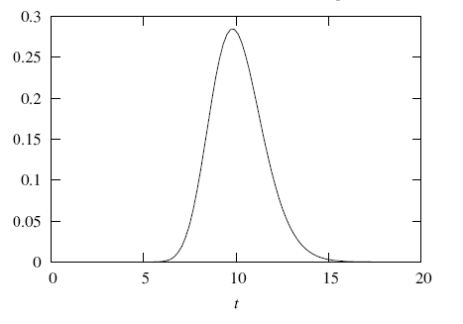
Homogenous Breakthrough
Instantaneous Pulse Release
Fickian Breakthrough

Slide 24
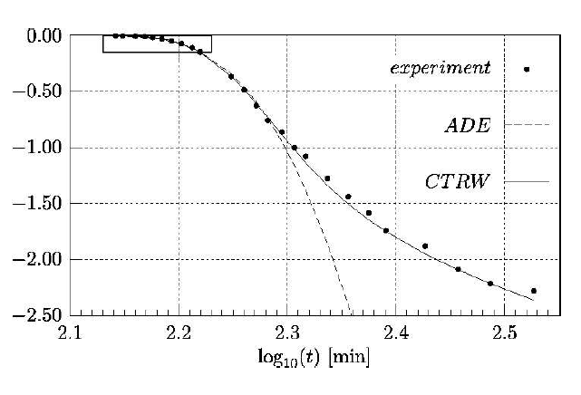
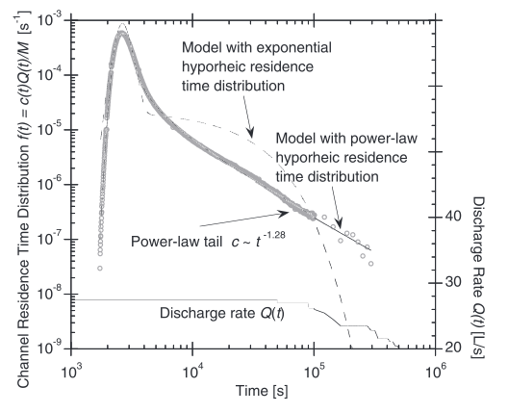
What do real BTCs look like?

Slide 25
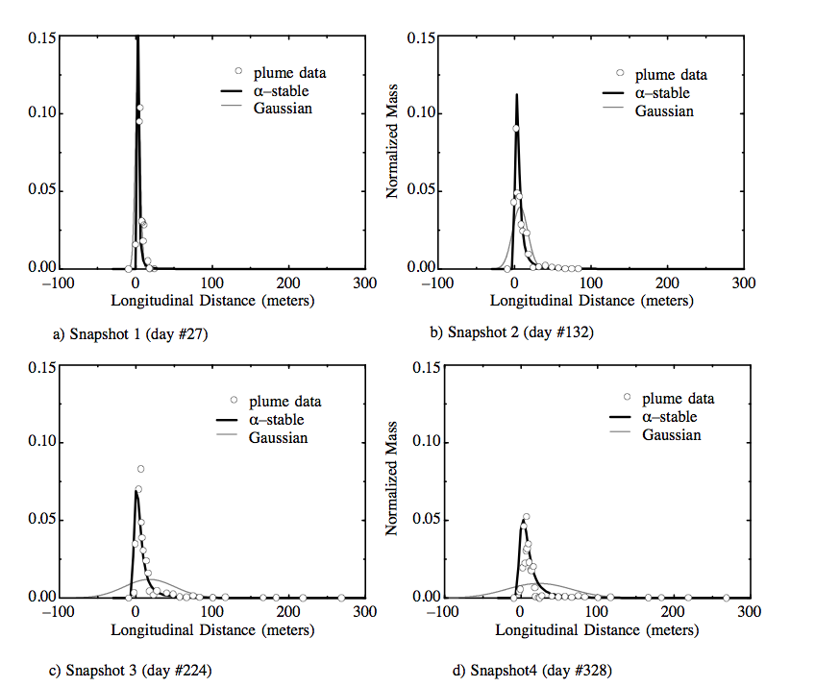
The MADE Experiment

Slide 26
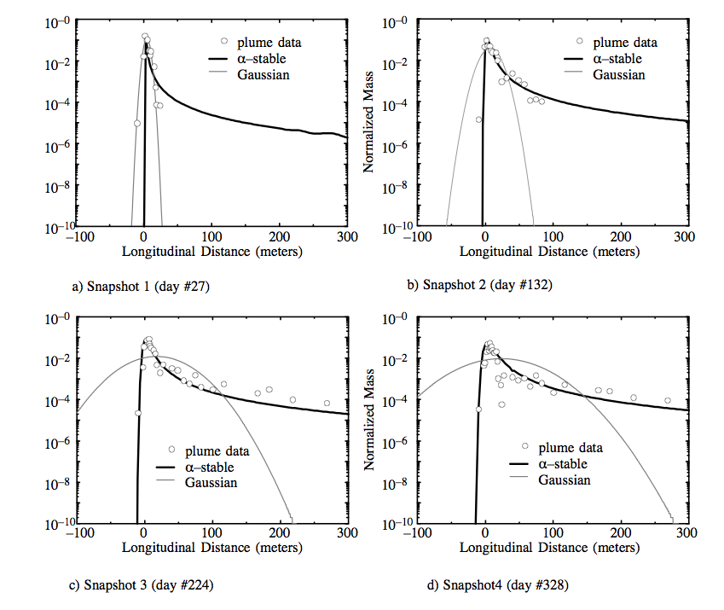
The MADE Experiment

Slide 27
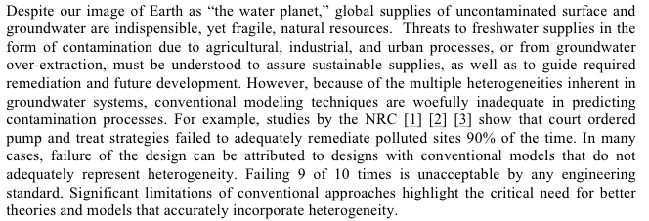
Why is this a problem?

Slide 28
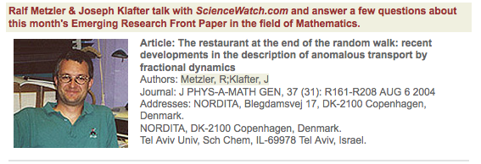

Conclusion
There are many features that conventional models cannot capture so there is a need for better theories and models

Slide 29
None The Less
The ADE model is widely used and, while it has its flaws it also has its strengths in that it is simple, well understood and readily applicable compared to some more advanced theories. It also, even when it fails, provides a lot of useful information, particularly about the largest concentrations in a system. Thus we will focus our attention initially on it.

Slide 30
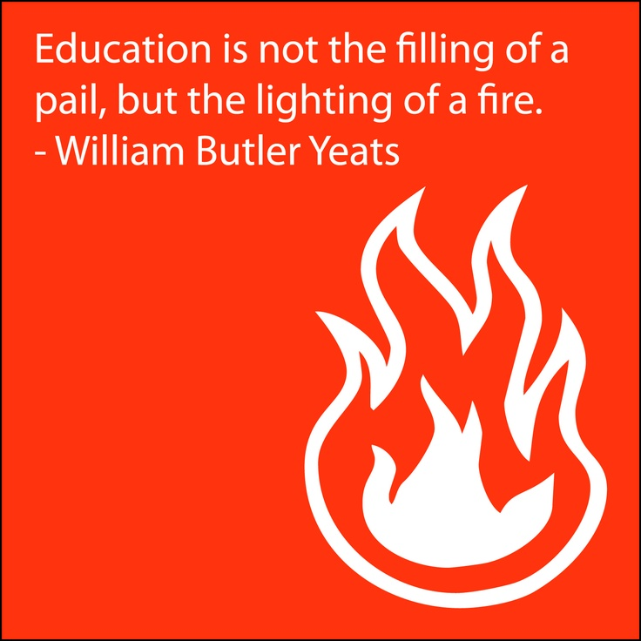
Goal of This Course
The nature of this course will be very mathematical. For some of you the maths may be easy, for some of you very hard. I promise to always be there to help you with it and teach it to you in as many different ways as needed and I can, so that you will succeed! My office is always open to you – I mean it when I say that the most satisfying part of my job is to have students come and chat with me – it brightens my day (even just to chat) and nothing is more satisfying than seeing the switch go ‘Click’ when a student gets it.
I am not interested in testing your mathematical skills, nor am I really interested in testing you at all. A grad class in my view is about exposing you to new ideas and details you are not aware of and as Yeats said best ‘igniting a fire’.
My goal is to expose you to what I think are extremely elegant and beautiful methods for understanding very complex phenomena.
Struggle with me, work hard and be patient and you will find it very rewarding as you will start to see the equations and processes everywhere you look around you (as I do and know my grad students begin to also). I expect you to work hard and put in the hours needed to learn this, but that also means that you should expect me to work hard for you – hold me to the highest standard and expect nothing less than that from me – if I am failing you – let me know and I will do my best to rise to the occasion.
If it’s easy for you – push yourself harder and try to take these concepts a level further by implementing more elegant approaches and solutions than those I teach you – I am happy to provide more challenging and interesting problems!
Once you get these things, as hard as they may seem right now, they become ‘SIMPLE’ and I believe that Simplicity is the root of Elegance in problem solving for Scientists and Engineers

