Slide 1
Fourier Transforms - Solving the Diffusion Equation

Slide 2
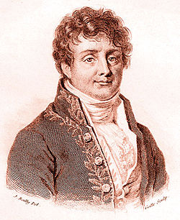
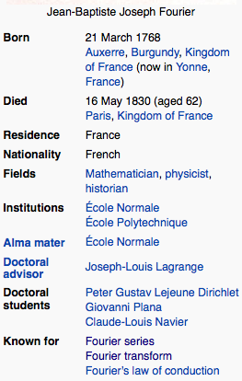
Joseph Fourier

Slide 3
The Heat Equation
Fourier, Joseph (1822). Théorie analytique de la chaleur
The heat equation is for temperature what the diffusion equation is for solutes
Fourier developed the Fourier transform and Fourier series as tools to solve this equation

Slide 4
The Fourier Transform
Take a function f(x), where x is space and we want to transform it to wave space k
where

Slide 5
The Inverse Fourier Transform
To invert from Fourier space to real space
Where the inverse transform is given by

Slide 6
Aside
Note that there are several alternative definitions of the Fourier transform (see for example Wikipedia page). They are all equivalent, but once you choose one convention you must stay with that convention. In this class we will take the definition as given on previous page (which is typical in Physics)
Just be careful if looking up references to make sure that you are being consistent.

Slide 7
So who cares and why on earth would you ever do this?
The Fourier transform decomposes a function/ signal into the various waves (of wavelength k) that make it up (useful for example in noise signal processing)
Many times it is easier to solve an equation in Fourier space than in real space (what we will do here).

Slide 8
Properties of Fourier Transform
Linearity
Translation
Modulation

Slide 9
Properties of Fourier Transform
Scaling
Convolution
where

Slide 10
Properties of Fourier Transform
Derivatives
For more details and properties please see
http://en.wikipedia.org/wiki/Fourier_transform
(again, be careful that you are using the correct form of FT)

Slide 11
Some useful Fourier Transforms (of many – again see Wikipedia for more)

Slide 12
Again, who cares?
Take the Diffusion Equation (1d)
Fourier Transform this equation
We have reduced a PDE in t and x to an ODE in t

Slide 13
Solution
Solve the ODE
And now in real space
And we have our solution (as ugly as it may be – it is a correct solution)

Slide 14
Consider the following simple example
A delta pulse initial condition (i.e. a small localized spill of mass 1)
Then
Any ideas what to do? Hint:
Let

Slide 15
What is the integral?
Hint: Let

Slide 16
And rearrange
Recall
What is this?

Slide 17
Any of you who have taken a basic intro to contaminant transport should recognize this as the fundamental solution to the diffusion equation
What if?
Well then

Slide 18
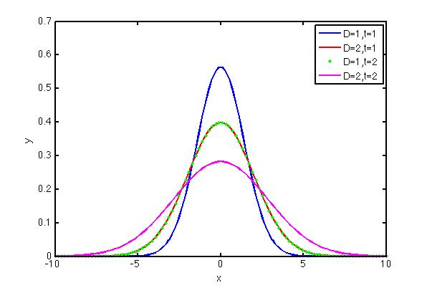
What does this solution look like?
Pay attention to two things:
Peak concentration
Width of distribution

Slide 19
What about more complex initial condition
Not always so easy to invert
But we can use Greens functions (next chapter)

Slide 20
Take Away Message
The Fourier transform allows us to convert a PDE in space and time into an ODE in wavenumber and time, which is in general much easier to solve.
Once we have the solution in wave space we have to be able to invert.
Aside – sometimes the solution in Fourier space, even is we cannot invert provides a lot of useful information (we will see this later on in particular).

