Slide 1
Greens Functions - Solving the Diffusion Equation with Complex initial Conditions and Boundaries

Slide 2
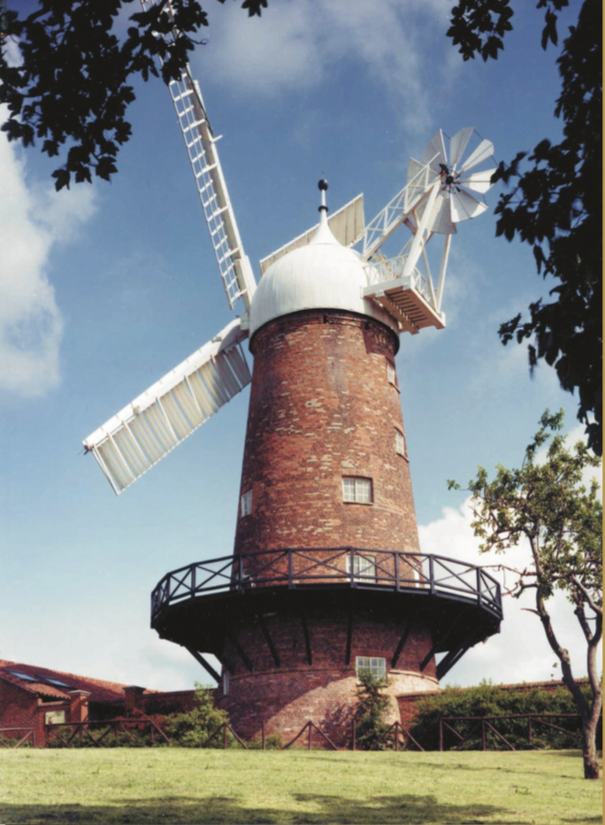
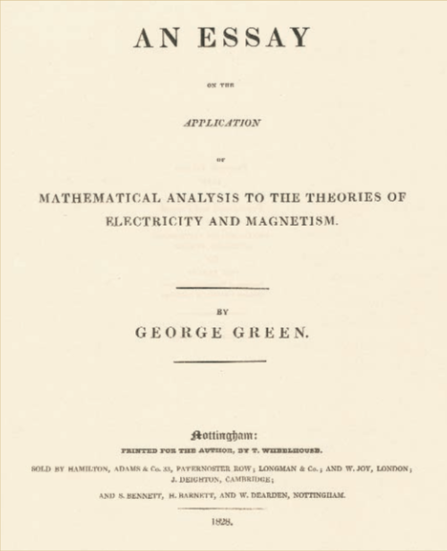
George Green
George Green (14 July 1793 – 31 May 1841) was a British mathematical physicist who wrote: An Essay on the Application of Mathematical Analysis to the Theories of Electricity and Magnetism (Green, 1828). The essay introduced several important concepts, among them a theorem similar to the modern Green's theorem, the idea of potential functions as currently used in physics, and the concept of what are now called Green's functions. Green was the first person to create a mathematical theory of electricity and magnetism and his theory formed the foundation for the work of other scientists such as James Clerk Maxwell, William Thomson, and others. His work on potential theory ran parallel to that of Carl Friedrich Gauss.
Green's life story is remarkable in that he was almost entirely self-taught. He received only about one year of formal schooling as a child, between the ages of 8 and 9

Slide 3
The Diffusion Equation
Consider the Following Problem
Two point spills of mass M₁ and M₂ occur at two different locations x₁ and x₂.
Describe how the concentration field evolves.

Slide 4
Hopefully you gut said
This is absolutely correct – but the question is why?
Here’s a question for you:
Is the ADE a linear or a nonlinear equation?

Slide 5
Linear Superposition
Answer:
The ADE is a linear equation, which means we can add solutions together (principle of linear superposition), i.e.
where
We can use this same idea for any initial condition, no matter how complex

Slide 6
One step back What is the delta function?
An infinitely narrow, infinitely tall pulse
Which integrates to unity
It also acts as a filter with the following
useful property
i.e. it picks out the value of f(x) and x=x₀

Slide 7
Arbitrary Initial Condition
How do we represent this as the sum of several point spills? Which will allow us to solve in the same way as before.
Well by definition we can always write:
That is we can represent any initial condition as the sum (integral) of infinitely many delta functions weighted by C₀. Each delta evolves with the fundamental solution of the diffusion equation

Slide 8
This is pretty amazing….
Each evolves as
Therefore
We call the fundamental solution for initial condition
the Greens function
We can do this for any linear equation!!

Slide 9
More Generally for the ADE
Consider the diffusion equation with an additional source term
The solution of which is given by the general expression
Where for the diffusion equation

Slide 10
Example 1
Consider the diffusion equation with a more complex initial condition
H(x) is the Heaviside step function where
H(x)=1 for x>0 =0 for x <0
This is a step initial condition where C=1 for x<0 and 0 for x>0

Slide 11
Example 2 This problem is a lot harder than it seems it should be…
Consider the diffusion equation with an additional source term
We have a domain that is initially empty of contaminant and there is a source located at x=0, which is continuously injecting mass in at x=0.

Slide 12
Finite Domains
So far we have only considered infinite domains, which of course is an idealization of reality. What about when the domains are finite and have boundary conditions?
Amazingly we can still use the Greens function approach – the form of the Greens function just changes to reflect the domain of interest.
See handout with notes from Polyanin’s book.

