Slide 1
Chapter 4
Numerical Solutions to the Diffusion Equation

Slide 2
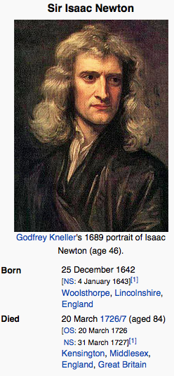
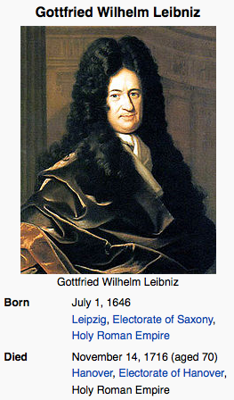
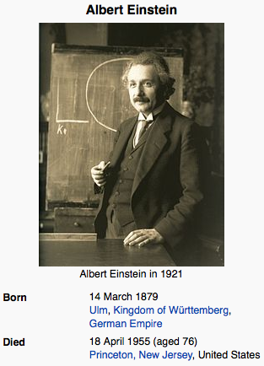
This chapter is inspired by

Slide 3
The Diffusion Equation
There are many instances where it may be necessary or preferable to solve the diffusion equation numerically. Here we will explore two different approaches, one based on finite differences and one based on particle tracking methods.
Many other methods exist, and if you want to know more I recommend a numerical methods class

Slide 4
Finite Differences
Here we will explore one of the simplest finite-difference schemes out there.
The basic idea is that we represent derivatives by a discrete approximation (we will use the following – again there are many possibilities)

Slide 5
Now Discretize your domain
1
2
n
N
X=0
X=L
We break our domain of length L into N points, each separated by distance Δx
Now consider a point n and call the concentration there
where j denotes time step j and n denotes space point n
The discrete version of our diffusion equation for the concentration at point n is now given by

Slide 6
Now Discretize your domain
1
2
n
N
X=0
X=L
Rearranging
Thus if we know the concentration at every point at time equal zero (initial condition) we can advance the concentration at every point by implementing the above expression in a code.
Note that for n=1 and n=N we typically impose values based on boundary conditions
Also note that making Δx and Δt smaller makes the approximation better so you want to pick them small enough to be reasonable, but large enough that it works quickly. However there are stability criteria that must be met (i.e. you cannot choose any combination of spatial and temporal discretization – Δx<sqrt(DΔt) at least).

Slide 7
Now Discretize your domain
1
2
n
N
X=0
X=L
Rearranging
This implementation is called explicit in time forward differences and central in space. It may not always be the best choice (but we do not have time to cover many more cases – again if you need them I encourage you to look into other options on your own or in another course).
It is however straightforward to implement in any language of your choice (e.g. Matlab or even Excel – although I do not encourage you to do this in Excel)

Slide 8
Example
Consider a domain of size 10. Numerically solve the following equation.
Compare your numerical results to a Greens function solution. For small times assume that the x=10 boundary plays no role and take a semi-infinite domain. At late times it may be important so check the finite domain solution too. Test different choices of spatial and temporal discretizations.
What is the steady state solution to this problem?

Slide 9
Great
The finite difference methodology is great and widely used, but has some problems, particularly when you look at systems that include more processes such as advection (in which case you can get what is called numerical diffusion whereby the numerical method artificially imposes a diffusion that is larger than the desired actual value).
What else can we do?

Slide 10
Now let’s consider a different Approach
Let’s pretend that we can break our solute plume into a large number of discrete particles, N.
Each particle represents some mass of solute m. If the total mas of the system is M and all particles carry equal mass then the mass a particle m=M/N.
Now the question is, how do we move particles in such a way that will faithfully represent the process of diffusion.
This is a problem that Einstein considered when studying Brownian motion and led to much of our current understanding of diffusion and the existence of molecules so let’s look at what he did first and then come back to our problem

Slide 11
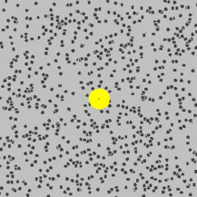
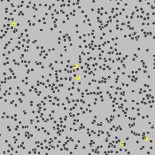
Brownian Motion
Robert Brown in 1827 observed that pollen particles in completely quiescent water executed what appeared to be a random motion. He observed the same for inorganic particles, eliminating the hypothesis that it was some life-based motion.
The hypothesis was that molecules of water were randomly bombarding the bigger particle and inducing the random motion

Slide 12
The way Einstein saw it
Consider a small particle in a fluid that is continuously being bombarded by lots and lots of molecules.
Apply F=ma
Friction due to viscosity
Random force due to molecular bombardment

Slide 13
Brownian Motion
Consider the case of an infinitesimally small particle (m->0) – i.e. there will be a balance between the friction force and the random molecular forces. Then
Now let’s think about the random force term ξ(t)
What characteristics should it have?

Slide 14
Brownian Motion
On average the force should be zero, because an equal bombardment should occur statistically from all sides.
The force should act over a short time and not have long time correlation.
The average of the force at time t and t’ is zero, but at t=t’ a force of strength 2D applies

Slide 15
Mean location of a particle
Integrating the equation of motion
Because <ξ>=0 => <x>=0 – on average a particle’s mean location is 0

Slide 16
Variance of Particle Location
Let’s look at the variance of the particle position <x²>
Therefore the mean particle position is zero and the variance is 2Dt
–
remind you of anything?

Slide 17
How to Implement
We can implement the governing equation with the following Langevin equation
A random number with zero mean and unit variance
(use for example randn in matlab)

Slide 18
In arbitrary dimensions
Random numbers with zero mean and unit variance
(different)
Loop over as many steps as desired
By the way – why will the above converge to a Guassian? (as it should given the solution of the diffusion equation)
Also – we need not implement that the random number be normally distributed, but in the long run the distribution of particles will converge to a Gaussian – WHY?

