Slide 1
Chapter 5 – Advection and Retardation

Slide 2
Let’s take everything we have learned so far and now add in the two other processes discussed in the introduction chapter – advection and retardation

Slide 3
Solve any way you want

Slide 4
What does advection do?
Solve
Shifts the location of the peak

Slide 5
What does retardation do?
Solve
Slows down time

Slide 6
Can we still use a Greens function?
As long as our governing equation is linear, yes – you can always do it for a linear equation!
And – yes the ADE is linear. For the infinite domain the Greens function is given by

Slide 7
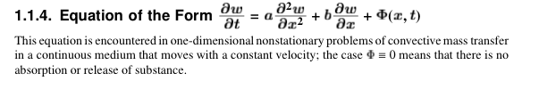
Can we solve on a general domain?
What if our domain is not infinite (like in the problems in HW2)?
Well Polyanin’s book has an entire section with Greens functions for those problems too

Slide 8
Can we use the same numerical methods?
Finite Differences
Random Walk

Slide 9
Spatial Moments of a Plume
One of the features that is often used to characterize the nature of transport is the evolution of a plume’s spatial moments.
The n^{th} moment of the plume is defined as
What does this represent?

Slide 10
Centered Moments
It is usually useful to measure moments centered about the center of mass of the plume

Slide 11
Moments
Zeroth (measures mass of system)
Should be equal to 1 when normalized
First
Tells you the location of the center of mass of the plume
Second
Provides information about how wide the plume is (variance of the distribution)
Third
Provides information on how skewed a plume is .

Slide 12
So for ADE?

Slide 13
Use these to classify models.
When second centered moment scales linearly in time
=> Fickian Dispersion
Anomalous/
Non-Fickian
Dispersion
Superdiffusion
Subdiffusion

Slide 14
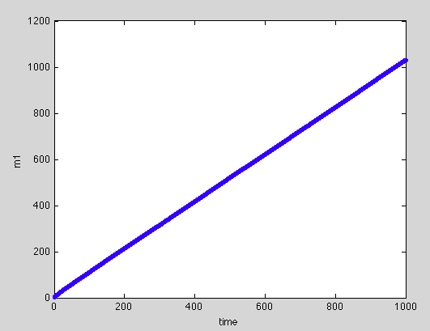
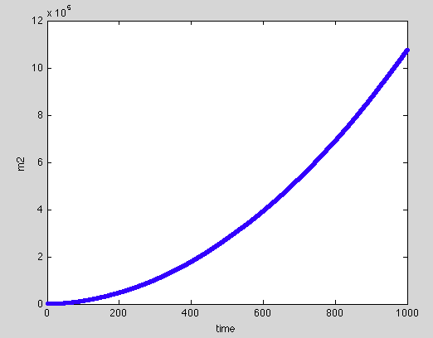
Sample Question
A geophysicist has provided you with the following plots of the first and second moment of a plume. Can you infer the advection speed and the dispersion coefficient?

Slide 15
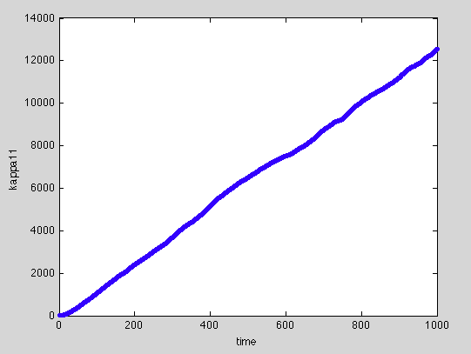

Slide 16
Temporal Moments of Breakthrough Curves
Another, less common, but increasingly popular method is to look at temporal moments of breakthrough curves (i.e. you have a concentration measurement at a fixed distance x and integrate over time)
It is often easier to measure breakthrough curves than spatial distribution of solutes and this information can also be used to infer parameters (such as v and D in the ADE).

Slide 17
Evaluating these for ADE
For

Slide 18
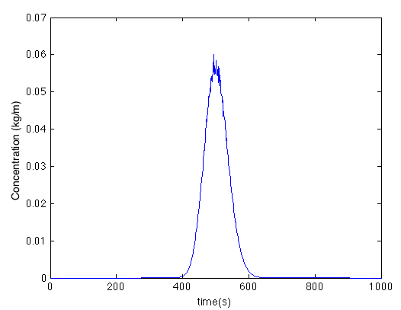
Example Problem
The following breakthrough curve is measured in a stream 100 meters downstream of a location where you injected a pulse of a conservative solute. The mass you threw in is 1 kg. The data associated with this curve in available for download. From this breakthrough curve can you infer the velocity of the water in the stream is and what the dispersion coefficient for the solute is?

