Slide 1
Chapter 6
Taylor Dispersion

Slide 2
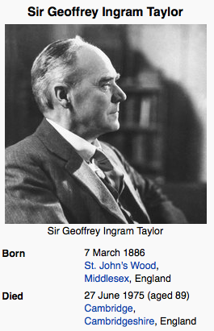
Sir Geoffrey Ingram Taylor
Sir Geoffrey Ingram Taylor OM (7 March 1886 – 27 June 1975) was a British physicist and mathematician, and a major figure in fluid dynamics and wave theory. His biographer and one-time student, George Batchelor, described him as "one of the most notable scientists of this (the 20th) century”
He also generalized random walks to include persistence (a topic we will come back to later on in this course)

Slide 3
Taylor’s Genius Idea
Solute Transport in a Tube with a Flow in it is governed by an advection diffusion equation in 3 dimensions. Assuming radial symmetry we can reduce to 2 dimensions, but can we reduce it even further to a 1 dimensional equation that can still accurately capture the way concentration in the tube evolves?
Turns out Yes – We just have to adjust the diffusion terms to include mechanical dispersion (but have to be careful)

Slide 4
Flow and Transport in a Pipe
r
a (radius of pipe)
z
v(r)
(1)

Slide 5
If we want a 1d equation we must define a 1d concentration. Let’s decompose concentration into an average and a fluctuation
Where the average (overbar) is defined as the average across the cross section of the tube

Slide 6
Subbing into my ADE
(2)
Note that I have decomposed velocity into its mean and fluctuation also
Now we can take the average of the above equation (term by term)
Note : Terms with primes have zero average by definition, but be careful with terms with products of primes

Slide 7
Averaging equation (2)
(3)
Except for this term this looks like a perfect one-dimensional ADE
-
What can we do with this term?
And what does it mean…
It is called the dispersion term

Slide 8
We still have some information left – subtract (3) from (2)
And this is where the genius comes…..
Taylor, based on physical intuition assumed
Horizontal gradients in the mean are larger than horizontal gradients in fluctuations
Fluctuations evolve slowly in time
Gradients of fluctuations in radial direction are larger than in longitudinal direction
But when or why are these reasonable?

Slide 9
Only at times larger than the diffusion time scale
What does this time represent???? Think hard about this, because this is the key to understanding Taylor dispersion and why this is so elegant….

Slide 10
Implementing our assumptions
Or written more neatly, recalling the form of v(r)
Which we can solve for C’ analytically – How?

Slide 11
Rearranging
Integrate both sides w.r.t. r

Slide 12
Rearrange
Integrate w.r.t. to r again
Two constants of integration – what now?

Slide 13
C₁ = 0 - Why?
What else do we know about C’ to constrain C₂?
It’s average must be equal to zero
Or more simply
Which enforces

Slide 14
THEREFORE
where
We know v’(r) so therefore can completely calculate the desired term

Slide 15
Recall
Therefore
Mission
Accomplished !

Slide 16
Recall
Equation (3)
Well we now know
Therefore

Slide 17
Or
where
Thus, the effect of the velocity field is to enhance dispersive spreading, but it too can adequately be described by a diffusion type term, called a dispersion term.
Note a few things – as a increases D_{Taylor} increases,
as mean v increases D_{Taylor} increases,
as D increases D_{Taylor} decreases Does this make sense to you?

