Slide 1
Chapter 8
Mixing Driven Instantaneous Equilibrium Reactions

Slide 2
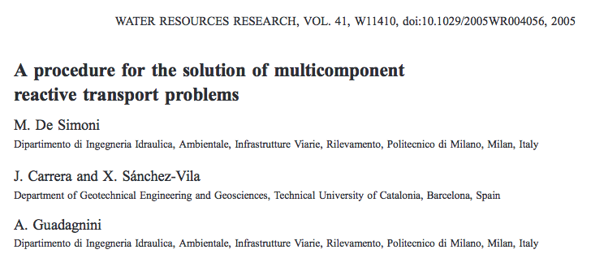
Where these ideas come from

Slide 3
Equilibrium
There are many instances in which two substances dissolved in a fluid maintain an equilibrium relationship such that the product of their concentrations is a constant
When this equilibrium is not satisfied they produce some product CC to return to equilibrium

Slide 4
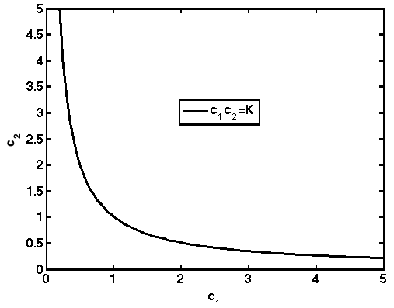
Graphically
C₁C₂ must sit on this line

Slide 5
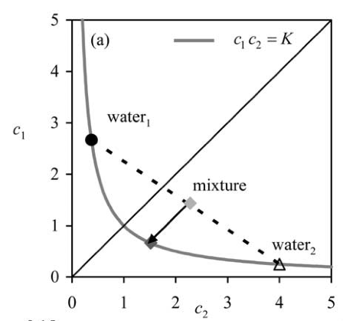
Consider the Following?
Take two waters, each in equilibrium

Slide 6
Mix them together
The mixture is no longer in equilibrium

Slide 7
Therefore we must produce product C_{C} to return to equilibrium

Slide 8
Therefore we must produce product C_{C} to return to equilibrium
Once reaction occurs new water is in equilibrium again. Happens very quickly

Slide 9
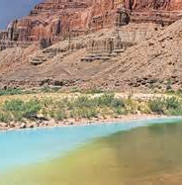
Example
Confluence of Little Colorado (Alkaline) and Colorado River.
At interface precipitates of carbonates and sulfates form

Slide 10
What about in dynamic systems where water and solutes move
Often we consider C immobile, but don’t have to
By the way – while this is different from last chapter K=0 is like last chapter, but it is an odd mathematical limit so be careful…

Slide 11
Again we have a nonlinear complex reaction system, but can we relate it to things we understand?
Let’s go back and try to define conserved quantities (i.e. quantities that satisfy ADE with no r term).
Because C immobile the trick last time does not work, except for
Who’s governing equation is
By now we can solve this type of equation no problem
But does this help us?

Slide 12
Let’s say our main interest is in calculating r – the rate at which C is produced
Can we write this in terms of u?
Well

Slide 13
Substituting
But this is zero by definition!!!
Therefore
If we can calculate u, which we can, we can calculate this no problem
What about this guy?
Some people take as constant (not always valid)

Slide 14
What can we do with
Let’s look back
We need a relationship between C_{A} and u. Can we remove C_{B}?
This is a quadratic – so no problem
Rearranging

Slide 15
Only one physical root
Differentiating twice
It may be ugly, but we know K and we know u so therefore we know it all

Slide 16
Back to key result
This is called the mixing term (depends only on transport)
This is called the stochiometric term (depends on chemistry)
ONCE AGAIN WE CAN SOLVE THE REACTIVE PROBLEM BY UNDERSTANDING THE CONSERVATIVE ONE ONLY
-
AMAZING!!

Slide 17
In General – if in multiple Dimensions
Dot product
Still just product of mixing and chemistry terms

Slide 18
Example
Consider a case where initially c1=1 and c2=1 everywhere for x>0 and c1=1.618 and c2=0.618 everywhere for x<0
The system has no advection and D=10
Calculate an expression for the reaction rate r
Calculate r at t=10 and plot it.

