Slide 1
Chapter
Fluctuation Kinetics of Reactions

Slide 2
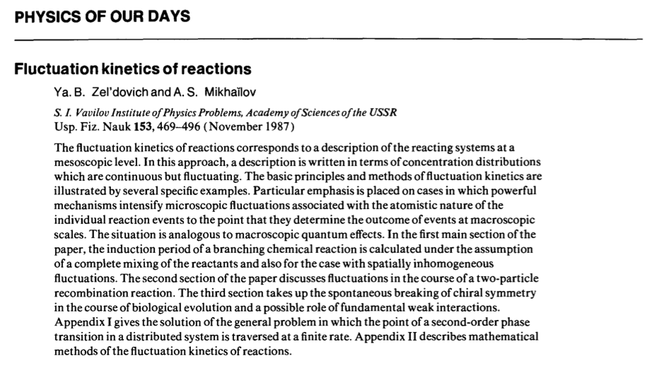
Fluctuation Kinetics of Reactions
Based on Zel'dovich and Mikhallov (1987):

Slide 3
Recall Well-Mixed Situation…
If reactants can come together efficiently (reaction-limited case):

Slide 4
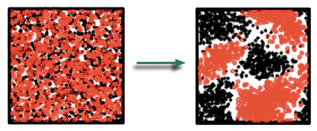
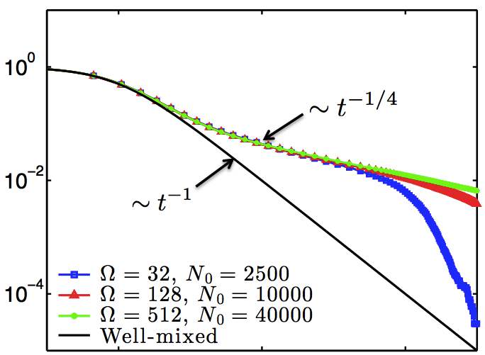

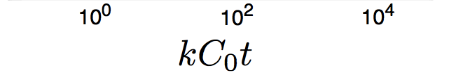
…But in many situations
Incomplete mixing ➝ Segregation
“Anomalous” scaling
Finite size effects

Slide 5
The Zel’dovich Argument
How do we capture this new scaling?
Ingredients
Purely diffusive transport
Instantaneous reaction
Flat initial spectrum (uncorrelated fluctuations)

Slide 6
Diffusive Transport (RADE)
Conservative component
Solve in Fourier space:

Slide 7
Instantaneous Reaction
No coexistence:
From Plancherel’s Theorem:

Slide 8
Flat spectrum
Split average and fluctuations:
Initially uncorrelated fluctuations (t=0):

Slide 9
Put it all together
And so at late times:

Slide 10
Generalizations
We get the same scaling if:
The reaction is not instantaneous but is fast.
The fluctuations have short-range (exponential) correlations.
We get a different scaling if:
The fluctuations have long range (power law) correlations.
The transport is not by pure diffusion (e.g. nontrivial background flow, non-diffusive jumps).
We will not look at these in detail but will investigate the effect of background flows using a different approach in the next class.

