Slide 1
Chapter
Mixing in a Shear Flow

Slide 2
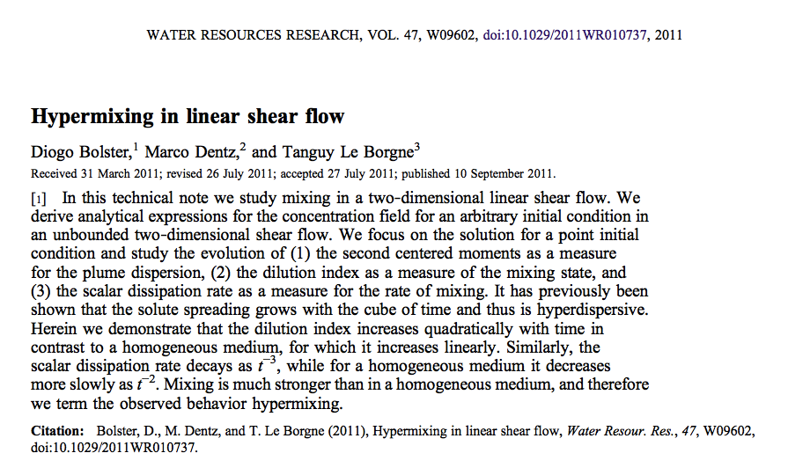
Mixing in a Shear Flow
Based on Bolster 2011

Slide 3
Up until now…
We have only studied the ADE with homogeneous advection, which has no effect on mixing (Galilean invariance)

Slide 4
Inhomogeneous flows
But what if v depends on x?
We can’t use simple Galilean invariance anymore. Now the plume can be stretched and compressed, and this can enhance mixing.

Slide 5


Shear Flow (2d)
Let’s look at a very simple flow:
Shear rate
ADE:
Green’s function:

Slide 6
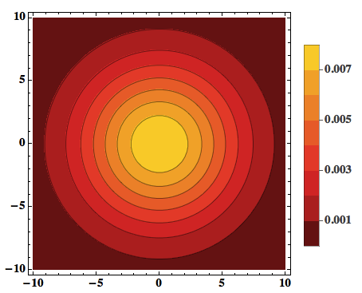
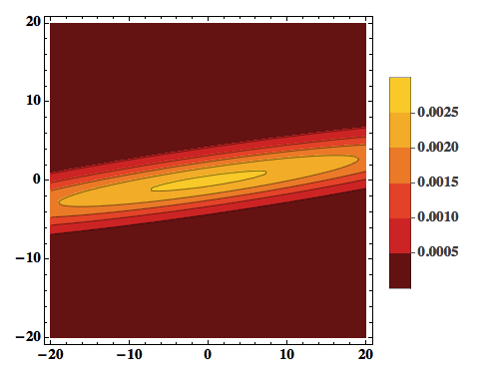
Pure diffusion vs Shear
The green’s function is now stretched and compressed:
Pure diffusion
Shear

Slide 7
Mixing
Let’s try to quantify mixing using the Dilution Index and the Scalar Dissipation Rate:
Pure diffusion (d dimensions)
Shear
Shear in d=2 mixes like pure diffusion in d=4!

Slide 8
And what about reactions?
Mixing enhances reactions. Use dominant balance in the RADE:
So at late times shear makes the system behave as well-mixed!

