Slide 1
FL110 – Investigating Sampling Probabilities
Using protein abundance (copies per cell) in Beck et al 2011 (https://doi.org/10.1038/msb.2011.82)
  U2OS cells. (bone cancer)
  Mass spec method.
  7309 proteins detected in the study.
  Proteins outside detectable dynamic range set to either 2*10⁷ (upper bound) or 500 (lower bound) copies per cell.
Directional guidance given here, as numbers presented here are approximations.
  1 read = 1 full protein through nanopore.
  Full proteome not taken into account.
  Copies per cell for highest abundance and lowest abundance proteins outside detectable dynamic range are not quantitatively correct.
  All calculations done assume sampling with replacement, as opposed to the real scenario of sampling without replacement.
    “With replacement” = independent samples from an unchanging pool; “without replacement” = once sample is taken, it is removed from the pool.
      Nanopore scenario is sampling without replacement because once a protein runs through the pore, it doesn’t go back to the milieu.
    This is a fair approximation due to the small to tiny probabilities.
    Sampling with replacement calculations are extremely cumbersome beyond small problems.

Slide 2
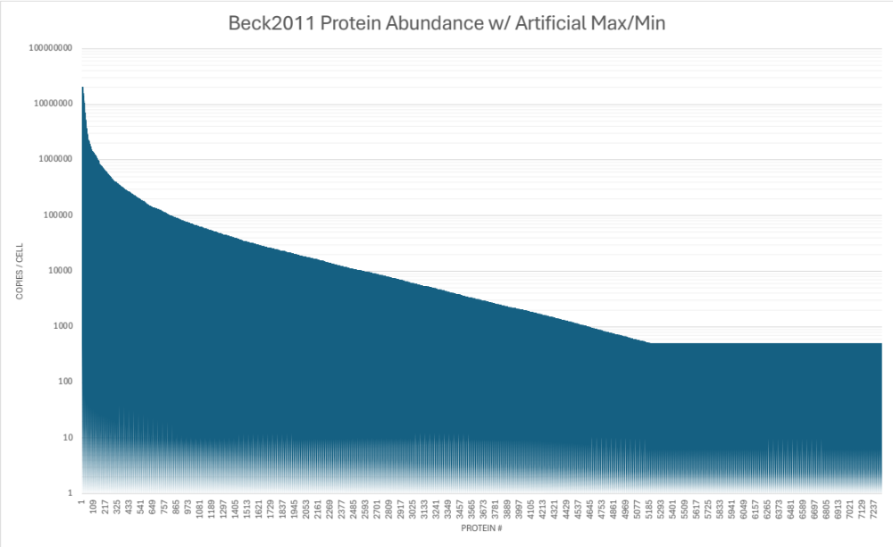
Beck2011: 7309 total proteins
Proteins outside detectable dynamic range set to either 2*10⁷ (upper bound) or 500 (lower bound) copies per cell.

Slide 3
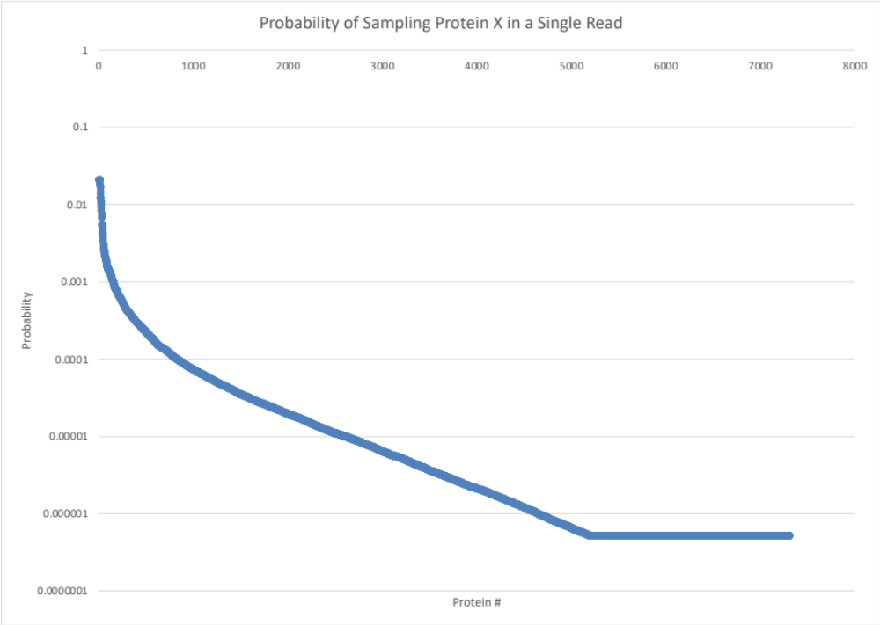
Probabilities Using Beck2011
954,999,300 proteins / cell
across 7309 proteins
0.02094
(e.g. Glyceraldehyde-3-phosphate dehydrogenase)
99.99966% chance of seeing at least once requires 595 reads
99.7% chance of seeing at least once requires 275 reads
5.2356 * 10⁻⁷
(e.g. Nebulin)
99.99966% chance of seeing at least once requires 24,050,191 reads
99.7% chance of seeing at least once requires 11,095,452 reads

Slide 4
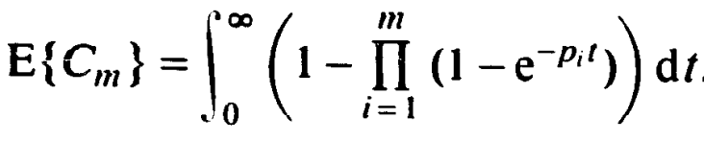
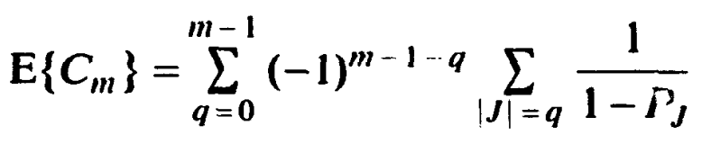
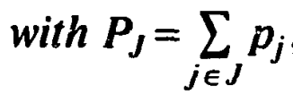
Expected reads required to see every protein at least once?
Assuming sampling with replacement, this is known as the coupon collector’s problem with non-uniform probability distribution.
The summation is computationally intractable for the numbers represented in Beck2011 due to the combinatorics involved, at least if computing in a naïve fashion.
  There are 2⁷³⁰⁹ reciprocals.
Instead we can approximate the integral, which leads to ~15.8M expected reads required to see each protein at least once.
from Flajolet, Gardy, Thimonier, Discrete and Applied Mathematics 39 (1992) 207-229

Slide 5
Expected reads required to see every protein at least once?
Beck2011: ~15.8M expected reads required to see each protein at least once.
Blood: ~12.86B expected reads required to see each protein at least once.
The large difference is due to the arbitrary lower bound we set of 500 copies per cell of the lowest detectable proteins for Beck2011.

Slide 6
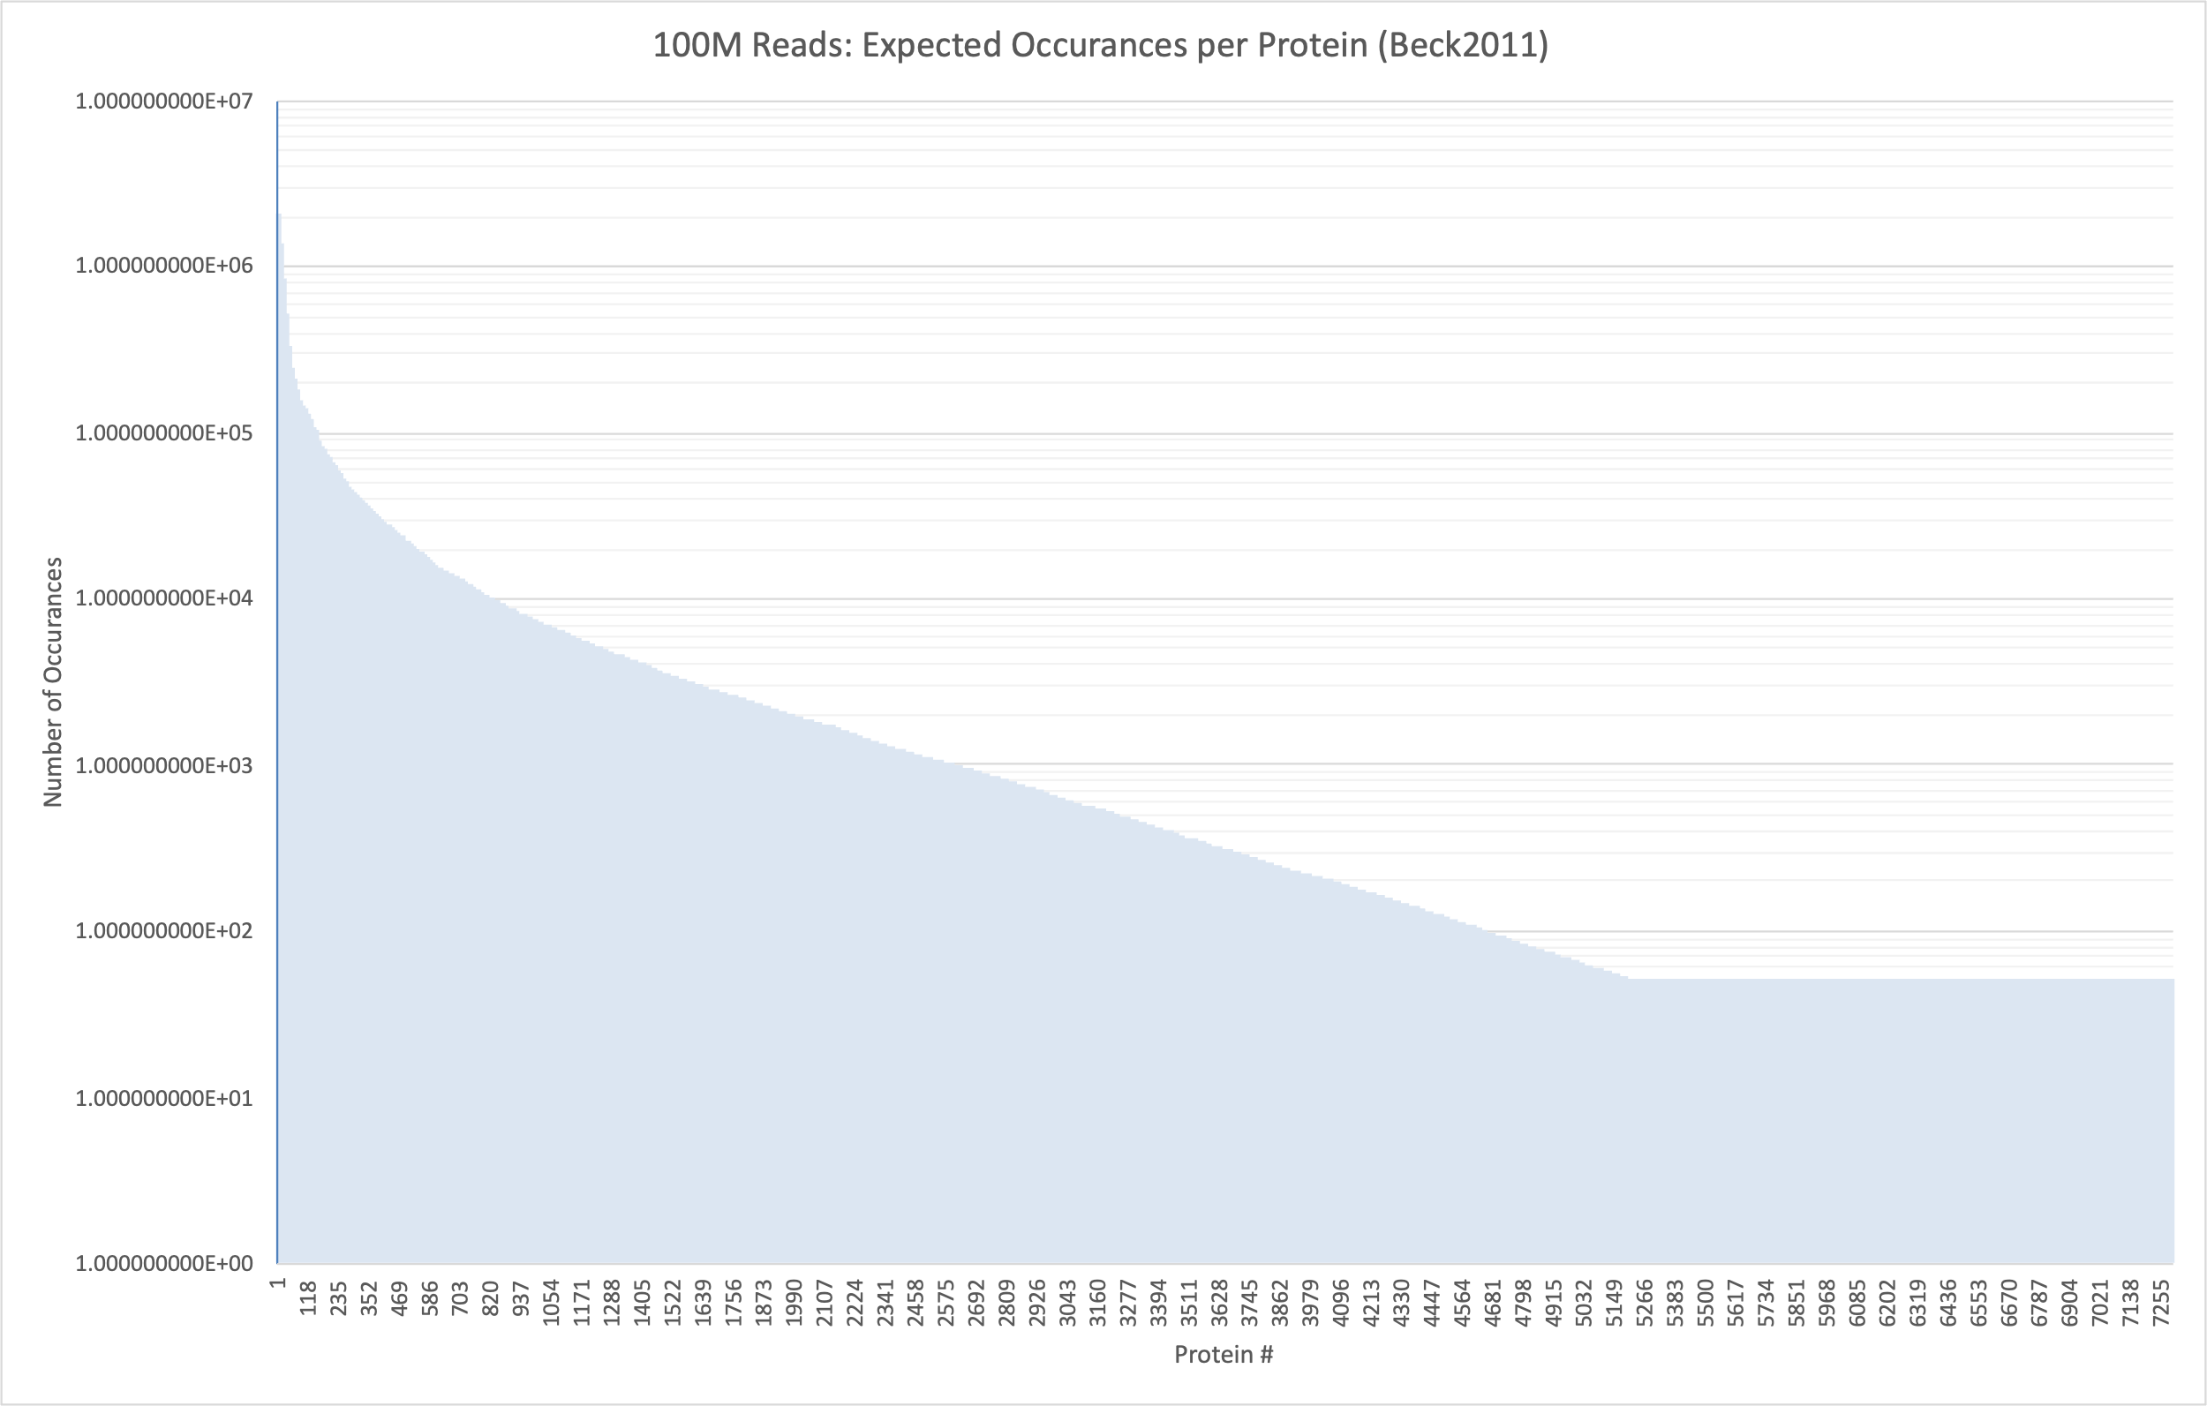
Beck2011: How many of each protein seen given 100M reads?
Proteins outside detectable dynamic range set to either 2*10⁷ (upper bound) or 500 (lower bound) copies per cell.
Largest = 2M times
Smallest = 52 times

Slide 7
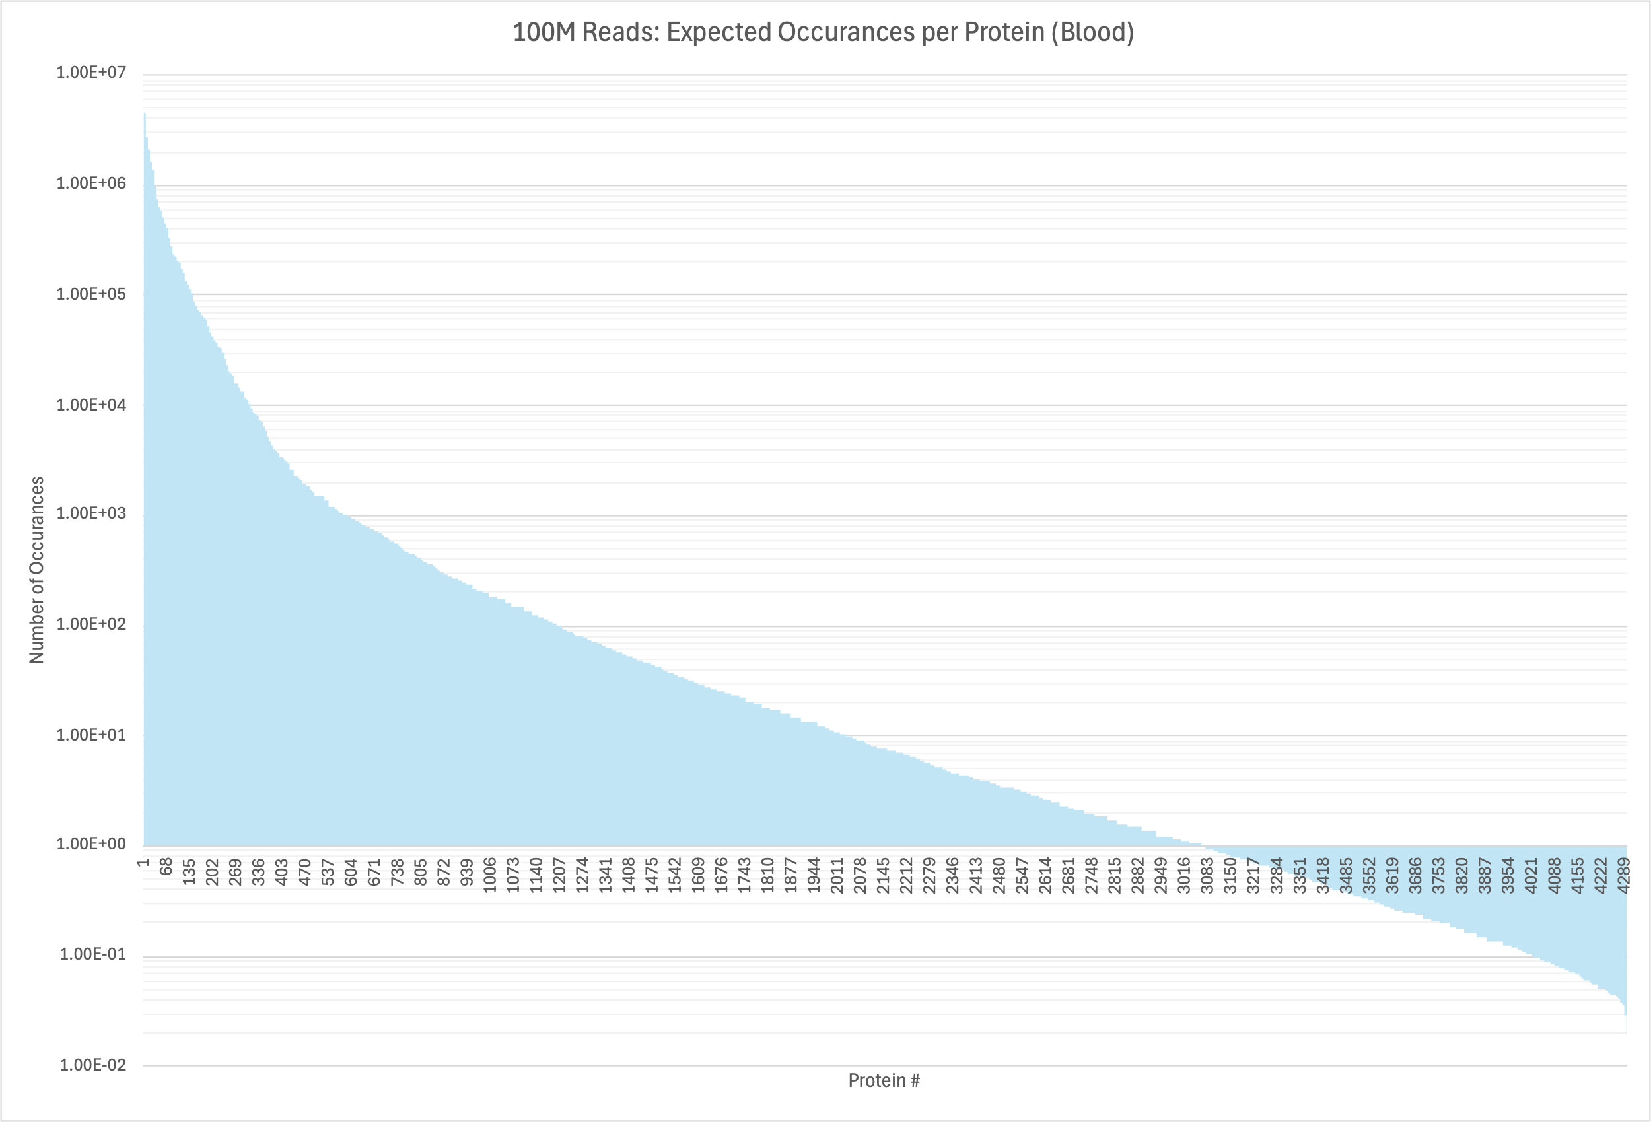
Blood: How many of each protein seen given 100M reads?
Largest = 4.54M times
After this point unable to see at 100M reads; expected to see less than once.
Smallest = 0.0196 times

Slide 8
Old Slides

Slide 9
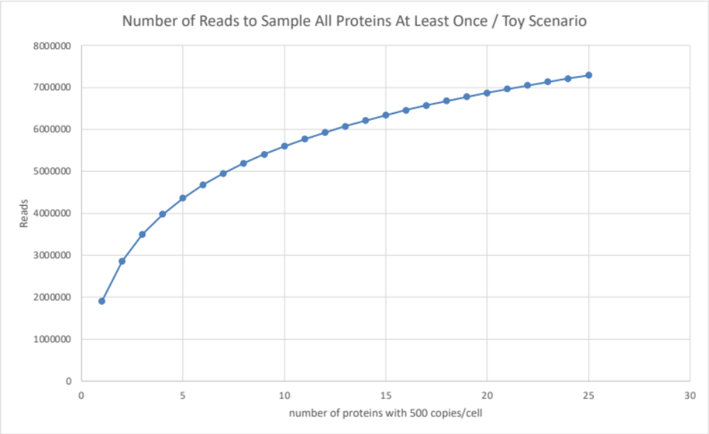
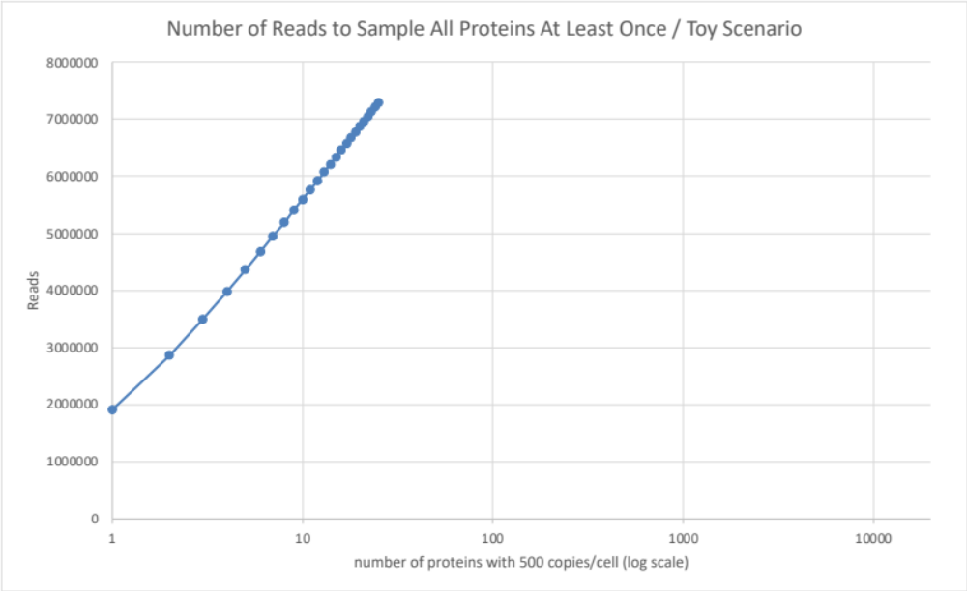
Expected reads required to see each protein at least once?
Toy scenario inspired from Beck2011
Assume total = 954,999,300 proteins / cell.
Construct the set of unique proteins to be n proteins with 500 copies/cell, and the rest to belong to a single protein with (total - 500n) copies/cell.

