Slide 1
RAM, PRAM, and LogP models

Slide 2
Why models?
What is a machine model?
  A abstraction describes the operation of a machine.
  Allowing to associate a value (cost) to each machine operation.
Why do we need models?
  Make it easy to reason algorithms
  Hide the machine implementation details so that general results that apply to a broad class of machines to be obtained.
  Analyze the achievable complexity (time, space, etc) bounds
  Analyze maximum parallelism
  Models are directly related to algorithms.

Slide 3
RAM (random access machine) model
Memory consists of infinite array (memory cells).
Instructions executed sequentially one at a time
All instructions take unit time
  Load/store
  Arithmetic
  Logic
Running time of an algorithm is the number of instructions executed.
Memory requirement is the number of memory cells used in the algorithm.

Slide 4
RAM (random access machine) model
The RAM model is the base of algorithm analysis for sequential algorithms although it is not perfect.
  Memory not infinite
  Not all memory access take the same time
  Not all arithmetic operations take the same time
  Instruction pipelining is not taken into consideration.
The RAM model (with asymptotic analysis) often gives relatively realistic results.

Slide 5
PRAM (Parallel RAM)
A unbounded collection of processors
Each process has infinite number of registers
A unbounded collection of shared memory cells.
All processors can access all memory cells in unit time (when there is no memory conflict).
All processors execute PRAM instructions synchronously (some processors may idle).
Each PRAM instruction executes in 3-phase cycles
  Read from a share memory cell (if needed)
  Computation
  Write to a share memory cell (if needed)

Slide 6
PRAM (Parallel RAM)
The only way processors exchange data is through the shared memory.
Parallel time complexity: the number of synchronous steps in the algorithm
Space complexity: the number of share memory
Parallelism: the number of processors used

Slide 7
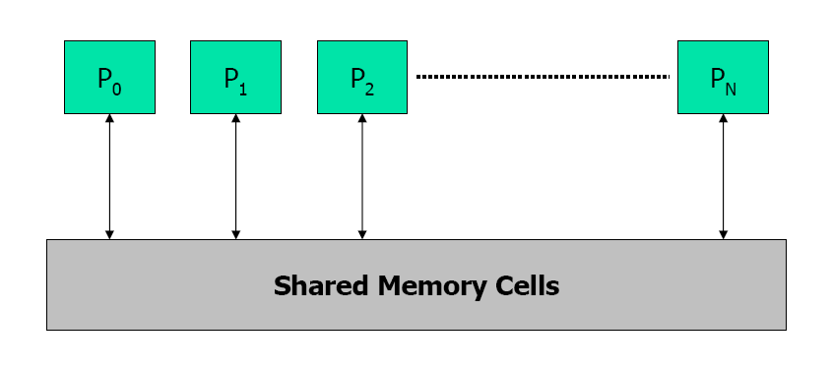
PRAM
All processors can do things in a synchronous manner (with infinite shared Memory and infinite local memory), how many steps do it take to complete the task?

Slide 8
PRAM – further refinement
PRAMs are further classifed based on how the memory conflicts are resolved.
  Read
    Exclusive Read (ER) – all processors can only simultaneously read from distinct memory location (but not the same location).
      What if two processors want to read from the same location?
    Concurrent Read (CR) – all processors can simultaneously read from all memory locations.

Slide 9
PRAM – further refinement
PRAMs are further classifed based on how the memory conflicts are resolved.
  Write
    Exclusive Write (EW) – all processors can only simultaneously write to distinct memory location (but not the same location).
    Concurrent Write (CR) – all processors can simultaneously write to all memory locations.
      Common CW: only allow same value to be written to the same location simultaneously.
      Random CW: randomly pick a value
      Priority CW: processors have priority, the value in the highest priority processor wins.

Slide 10
PRAM model variations
EREW, CREW, CRCW (common), CRCW (random), CRCW (Priority)
  Which model is closer to the practical SMP machines?
Model A is computationally stronger than model B if and only if any algorithm written in B will run unchange in A.
  EREW <= CREW <= CRCW (common) <= CRCW (random)

Slide 11
PRAM algorithm example
SUM: Add N numbers in memory M[0, 1, …, N-1]
Sequential SUM algorithm (O(N) complexity)
    for (i=0; i<N; i++) sum = sum + M[i];
PRAM SUM algorithm?

Slide 12
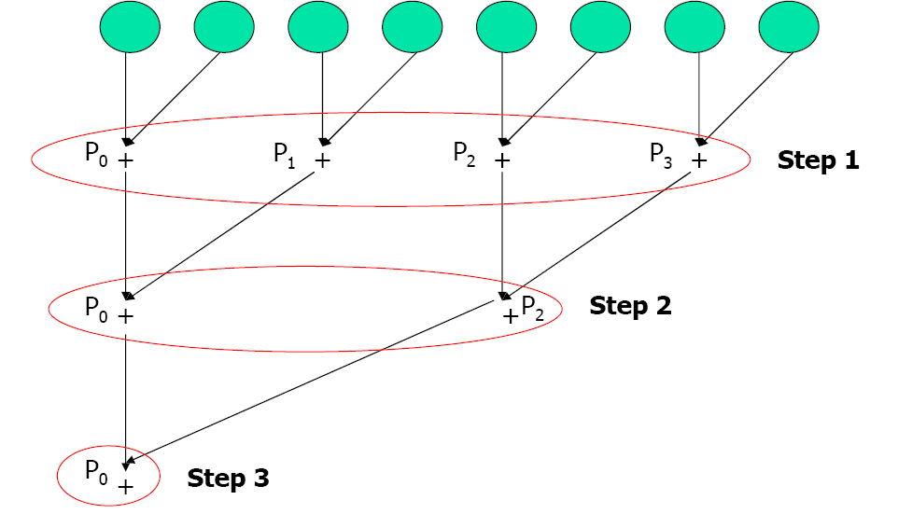
PRAM SUM algorithm
Which mo
Which PRAM model?

Slide 13
PRAM SUM algorithm complexity
Time complexity?
Number of processors needed?
Speedup (vs. sequential program):

Slide 14
Parallel search algorithm
P processors PRAM with unsorted N numbers (P<=N)
Does x exist in the N numbers?
p_0 has x initially, p_0 must know the answer at the end.
PRAM Algorithm:
  Step 1: Inform everyone what x is
  Step 2: every processor checks N/P numbers and sets a flag
  Step 3: Check if any flag is set to 1.

Slide 15
Parallel search algorithm
PRAM Algorithm:
  Step 1: Inform everyone what x is
  Step 2: every processor checks N/P numbers and sets a flag
  Step 3: Check if any flag is set to 1.
EREW: O(log(p)) step 1, O(N/P) step 2, and O(log(p)) step 3.
CREW: O(1) step 1, O(N/P) step 2, and O(log(p)) step 3.
CRCW (common): O(1) step 1, O(N/P) step 2, and O(1) step 3.

Slide 16
PRAM strengths
Natural extension of RAM
It is simple and easy to understand
  Communication and synchronization issues are hided.
Can be used as a benchmarks
  If an algorithm performs badly in the PRAM model, it will perform badly in reality.
  A good PRAM program may not be practical though.
It is useful to reason threaded algorithms for SMP/multicore machines.

Slide 17
PRAM weaknesses
Model inaccuracies
  Unbounded local memory (register)
  All operations take unit time
  Processors run in lock steps
Unaccounted costs
  Non-local memory access
  Latency
  Bandwidth
  Memory access contention

Slide 18
PRAM variations
Bounded memory PRAM, PRAM(m)
  In a given step, only m memory accesses can be serviced.
Bounded number of processors PRAM
  Any problem that can be solved by a p processor PRAM in t steps can be solved by a p’ processor PRAM in t = O(tp/p’) steps.
LPRAM
  L units to access global memory
  Any algorithm that runs in a p processor PRAM can run in LPRAM with a loss of a factor of L.
BPRAM
  L units for the first message
  B units for subsequent messages

Slide 19
PRAM summary
The RAM model is widely used.
PRAM is simple and easy to understand
  This model never reachs beyond the algorithm community.
  It is getting more important as threaded programming becomes more popular.
The BSP (bulk synchronous parallel) model is another try after PRAM.
  Asynchronously progress
  Model latency and limited bandwidth

Slide 20
LogP model
PRAM model: shared memory
M
M
M
Common MPP organization: complete machine connected by a network.
LogP attempts to capture the characteristics of such organization.
°°°
P
P
P
network

Slide 21
Deriving LogP model
° Processing
– powerful microprocessor, large DRAM, cache => P
° Communication
+ significant latency => L
+ limited bandwidth => g
+ significant overhead => o
  - on both ends
  – no consensus on topology
  => should not exploit structure
+ limited capacity
  – no consensus on programming model
  => should not enforce one

Slide 22
LogP
P ( processors )
P
M
P
M
P
M
° ° °
o (overhead)
o
g (gap)
L (latency)
Limited Volume
Interconnection Network
(
L/ g
to or from
a proc)
Latency in sending a (small) mesage between modules
overhead felt by the processor on sending or receiving msg
gap between successive sends or receives (1/BW)
Processors

Slide 23
Using the model
o
L
o
o
L
o
g
time
° Send n messages from proc to proc in time 2o + L + g(n-1)
– each processor does o n cycles of overhead
– has (g-o)(n-1) + L available compute cycles
° Send n messages from one to many
in same time
° Send n messages from many to one
in same time
– all but L/g processors block
so fewer available cycles
P
P

Slide 24
Using the model
Two processors send n words to each other:
  2o + L + g(n-1)
Assumes no network contention
Can under-estimate the communication time.

Slide 25
LogP philosophy
Think about:
– mapping of a task onto P processors
– computation within a processor, its cost, and balance
– communication between processors, its cost, and balance
given a charaterization of processor and network performance
Do not think about what happens within the network

Slide 26
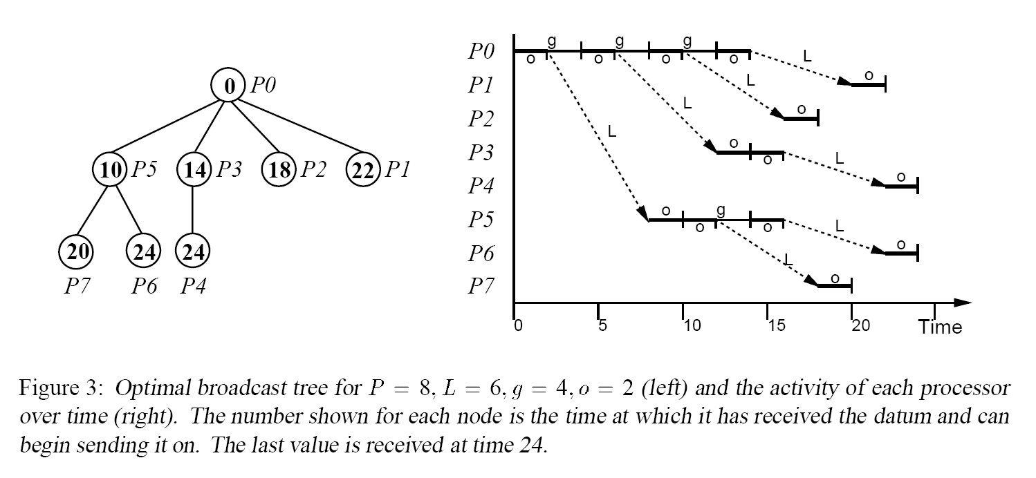
Develop optimal broadcast algorithm based on the LogP model
Broadcast a single datum to P-1 processors

Slide 27
Strengths of the LogP model
Simple, 4 parameters
Can easily be used to guide the algorithm development, especially algorithms for communication routines.
  This model has been used to analyze many collective communication algorithms.

Slide 28
Weaknesses of the LogP model
Accurate only at the very low level (machine instruction level)
  Inaccurate for more practical communication systems with layers of protocols (e.g. TCP/IP)
  Many variations.
  LogP family models: LogGP, logGPC, pLogP, etc
    Making the model more accurate and more complex

