Slide 1
Computing Unified Device Architecture (CUDA)
A Mass-Produced High Performance Parallel Programming Platform
  Prof. Alberto Ferreira De Souza
  alberto@lcad.inf.ufes.br

Slide 2
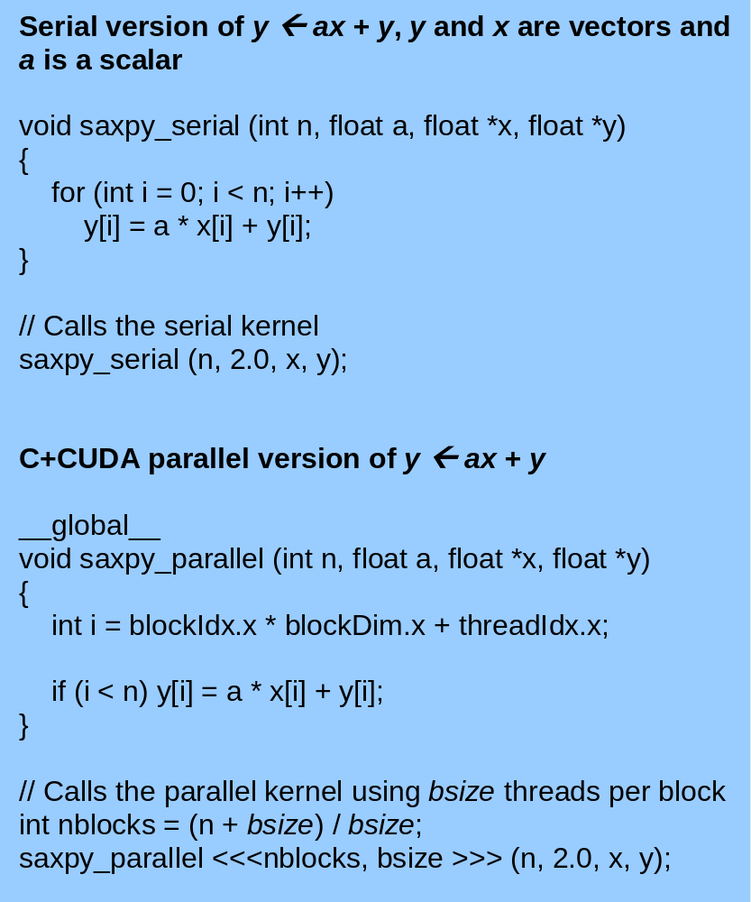
Overview
The Compute Unified Device Architecture (CUDA) is a new parallel programming model that allows general purpose high performance parallel programming through a small extension of the C programming language

Slide 3
Overview
The 8800 has 128 processors
GeForce 8800 block diagram

Slide 4
Overview
The Single Instruction Multiple Thread (SIMT) architecture of CUDA enabled GPUs allows the implementation of scalable massively multithreaded general purpose code

Slide 5
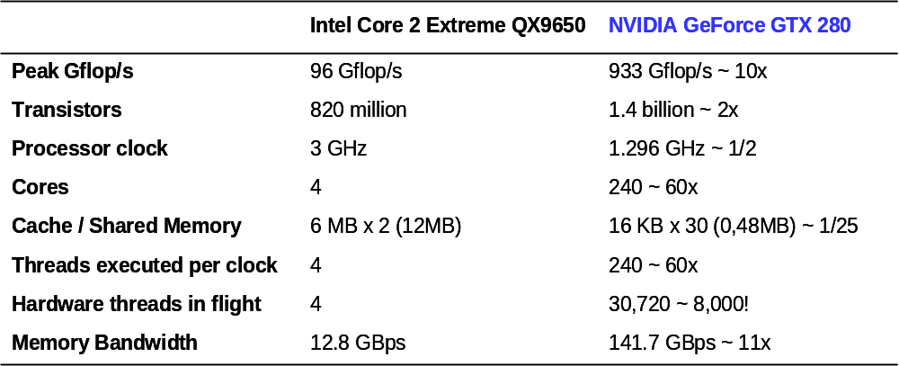
Overview
Currently, CUDA GPUs possess arrays of hundreds of processors and peak performance approaching 1 Tflop/s

Slide 6
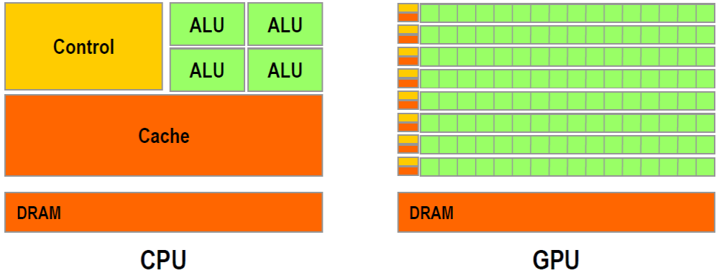
Overview
Where all this performance comes from?
  More transistors are devoted to data processing rather than data caching and ILP exploitation support
The computer gamming industry provides economies of scale
Competition fuels innovation

Slide 7
Overview
More than 100 million CUDA enabled GPUs have already been sold
This makes it the most successful high performance parallel computing platform in computing history and, perhaps, one of the most disruptive computing technologies of this decade
Many relevant programs have been ported to C+CUDA and run orders of magnitude faster in CUDA enabled GPUs than in multi-core CPUs

Slide 8
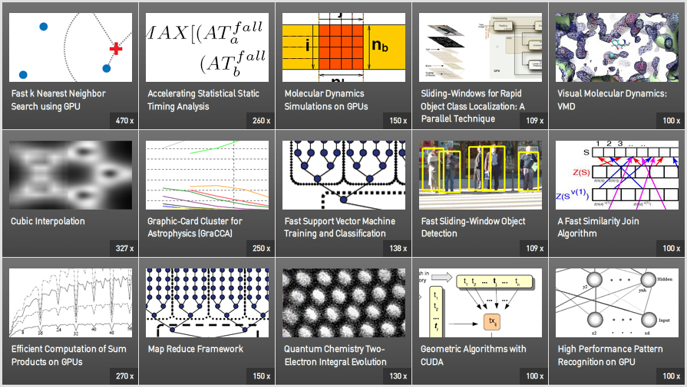
Overview
http://www.nvidia.com/object/cuda_home.html

Slide 9
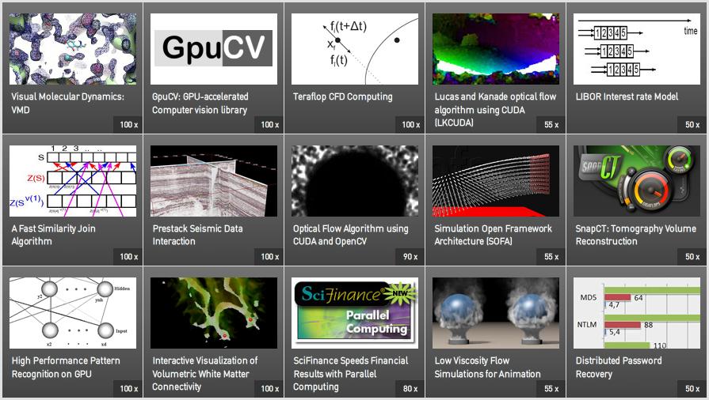
Overview
http://www.nvidia.com/object/cuda_home.html

Slide 10
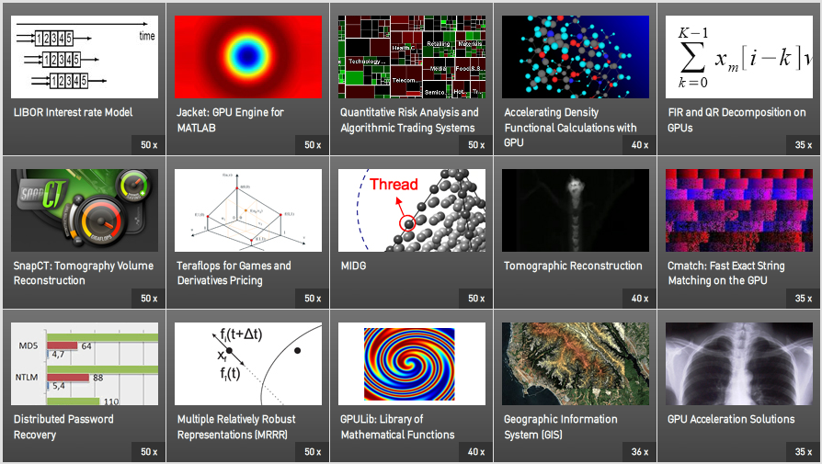
Overview
http://www.nvidia.com/object/cuda_home.html

Slide 11
Overview
In this tutorial we will:
  Discuss the scientific, technological and market forces that led to the emergence of CUDA
  Examine the architecture of CUDA GPUs
  Show how to program and execute parallel C+CUDA code

Slide 12
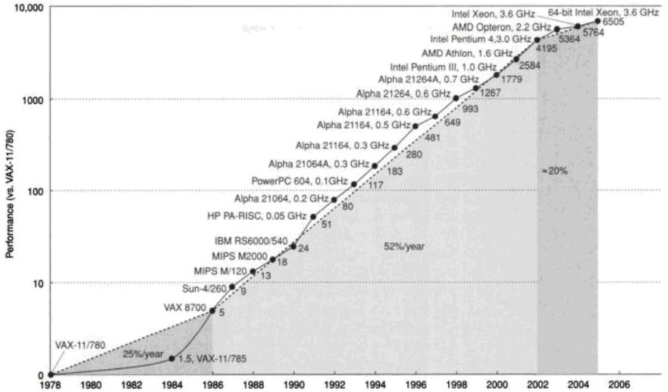
Forces that Led to the Emergence of CUDA
Scientific advances and innovations in hardware and software have enabled exponential increase in the performance of computer systems over the past 40 years
J. L. Hennessy, D. A. Patterson, “Computer Architecture: A Quantitative Approach, Fourth Edition”, Morgan Kaufmann Publishers, Inc., 2006.

Slide 13
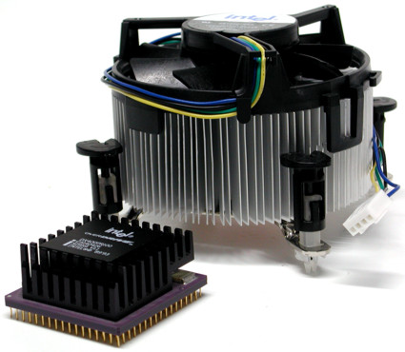
Forces that Led to the Emergence of CUDA
Moore's law allowed manufacturers to increase processors’ clock frequency by about 1,000 times in the past 25 years
But the ability of dissipating the heat generated by these processors reached physical limits
Significant increase in the clock frequency is now impossible without huge efforts in the cooling of ICs
This problem is known as
the Power Wall and has prevented the increase in the performance of single-processor systems
Front: Pentium Overdrive (1993) completed with its cooler
Back: Pentium 4 (2005) cooler.

Slide 14
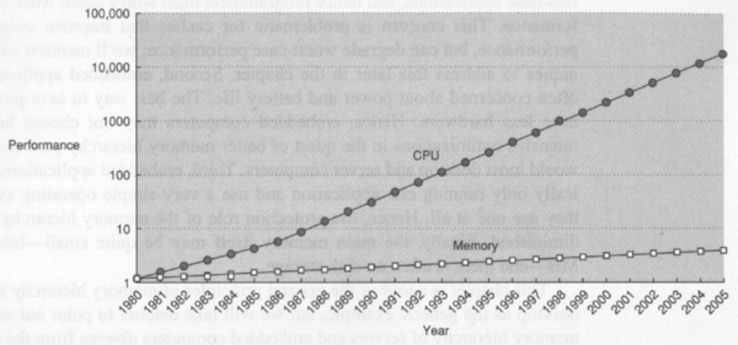
Forces that Led to the Emergence of CUDA
For decades the performance of the memory hierarchy has grown less than the performance of processors
Today, the latency of memory access is hundreds of times larger than the cycle time of processors
J. L. Hennessy, D. A. Patterson, “Computer Architecture: A Quantitative Approach, Third Edition”, Morgan Kaufmann Publishers, Inc., 2003.

Slide 15
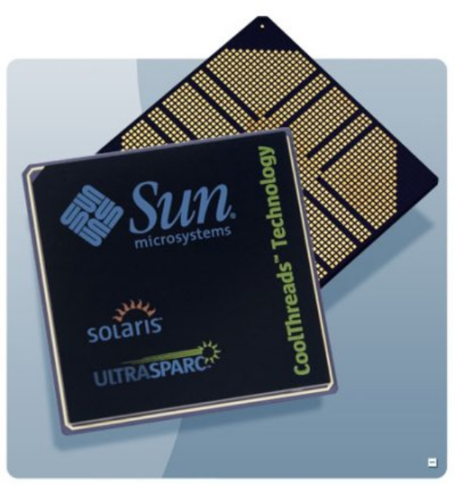
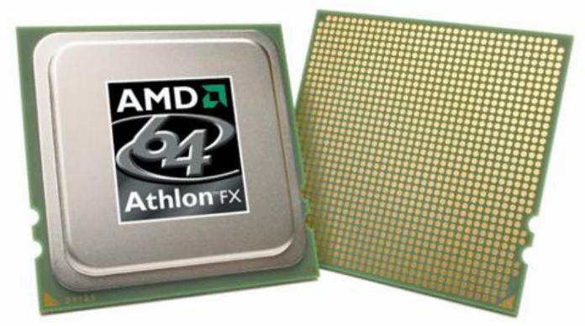
Forces that Led to the Emergence of CUDA
With more processors on a single IC, the need for memory bandwidth is growing larger
But the number of pins of ICs is limited…
This latency + bandwidth problem is known as
the Memory Wall
The Athlon 64 FX-70, launched in 2006, has two processing cores that can run only one thread at a time, while the UltraSPARC T1, launched in 2005, has 8 cores that can run 4 threads simultaneously each (32 threads in total). The Athlon 64 FX-70 has 1207 pins, while the UltraSPARC T1, 1933 pins

Slide 16
Forces that Led to the Emergence of CUDA
Processor architectures capable of executing multiple instructions in parallel, out of order and speculatively also contributed significantly to the increase in processors’ performance
However, employing more transistors in the processors’ implementation has not resulted in greater exploitation of ILP
This problem is known as the ILP Wall

Slide 17
Forces that Led to the Emergence of CUDA
David Patterson summarized:
  the Power Wall + The Memory Wall + ILP the Wall = the Brick Wall for serial performance
All evidences points to the continued validity of Moore's Law (at least for the next 13 years, according with ITRS06)
However, without visible progress in overcoming the obstacles, the only alternative left to the industry was to implement an increasing number of processors on a single IC

Slide 18
Forces that Led to the Emergence of CUDA
The computer industry changed its course in 2005, when Intel, following the example of IBM (POWER4) and Sun (Niagara), announced it would develop multi-core x86 systems
Multi-core processors take advantage of the available number of transistors to exploit large grain parallelism
Systems with multiple processors are among us since the 1960s, but efficient mechanisms for taking advantage large and fine grain parallelism of applications until recently did not exist
In this context appears CUDA

Slide 19
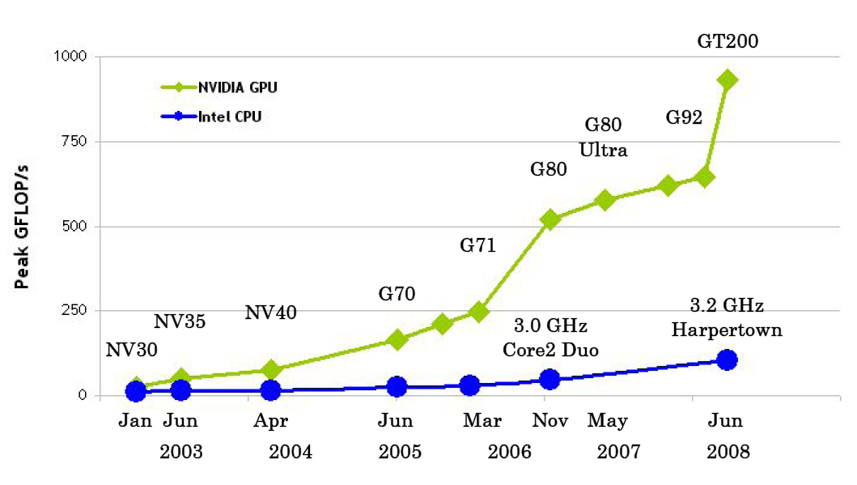
Forces that Led to the Emergence of CUDA
Fuelled by demand in the gaming industry, GPUs’ performance increased strongly
Also, the larger number of transistors available allowed advances in GPUs’ architecture, which lead to Tesla, which supports CUDA
NVIDIA, “NVIDIA CUDA Programming Guide 2.0”, NVIDIA, 2008.

Slide 20
Forces that Led to the Emergence of CUDA
Where the name “Compute Unified Device Architecture (CUDA)” comes from?
  Traditional graphics pipelines consist of separate programmable stages:
    Vertex processors, which execute vertex shader programs
    And pixel fragment processors, which execute pixel shader programs
  CUDA enabled GPUs unify the vertex and pixel processors and extend them, enabling high-performance parallel computing applications written in the C+CUDA

Slide 21
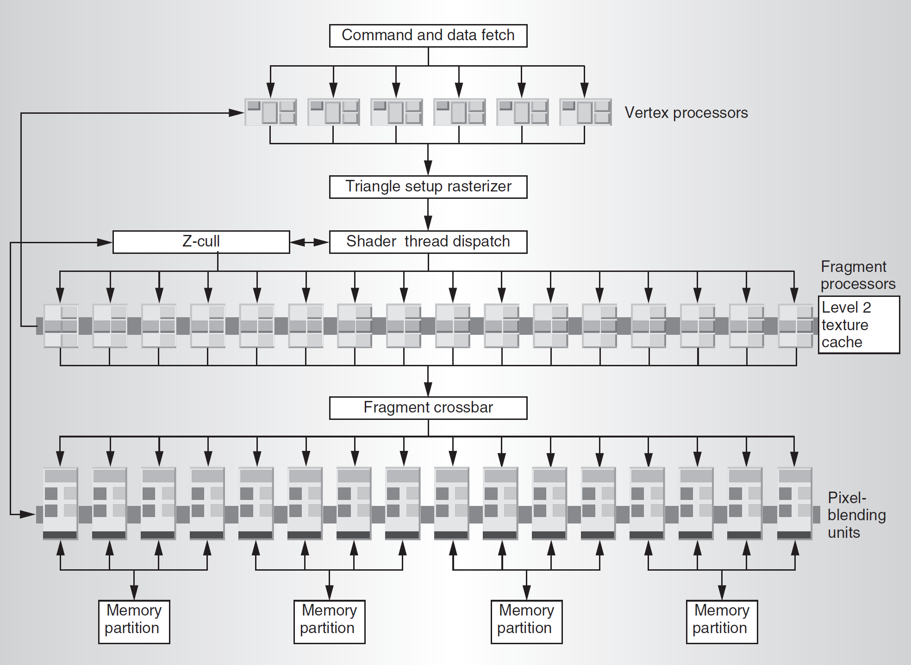
Forces that Led to the Emergence of CUDA
A GPU performs image synthesis in three steps
  Processes triangles’ vertices, computing screen positions and attributes such as color and surface orientation
  Sample each triangle to identify fully and partially covered pixels, called fragments
  Processes the fragments using texture sampling, color calculation, visibility, and blending
Previous GPUs → specific hardware for each one
GeForce 6800 block diagram

Slide 22
Forces that Led to the Emergence of CUDA
Pixel-fragment processors traditionally outnumber vertex processors
However, workloads are not well balanced, leading to inefficiency
Unification enables dynamic load balancing of varying vertex- and pixel-processing workloads and permit easy introduction of new capabilities by software
The generality required of a unified processor allowed the addition of the new GPU parallel-computing capability
GeForce 6800 block diagram

Slide 23
Forces that Led to the Emergence of CUDA
GPGPU → general-purpose computing by casting problems as graphics rendering
  Turn data into images (“texture maps”)
  Turn algorithms into image synthesis (“rendering passes”)
C+CUDA → true parallel programming
  Hardware: fully general data-parallel architecture
  Software: C with minimal yet powerful extensions

Slide 24
The Tesla Architecture
GeForce 8800 block diagram

Slide 25
The Tesla Architecture
The GeForce 8800 GPU scalable Streaming Processor array (SPA):
  Has 8 independent processing units called Texture/Processor Clusters (TPC)
  Each TPC has 2 Streaming Multiprocessors (SM)
  Each SM has 8 Streaming-Processor (SP) cores (128 total)
The SPA performs all the GPU’s programmable calculations
  Its scalable memory system includes a L2 and external DRAM
  An interconnection network carries data from/to SPA to/from L2 and external DRAM
GeForce 8800 block diagram

Slide 26
The Tesla Architecture
Some GPU blocks are dedicated to graphics processing
The Compute Work Distribution (CWD) block dispatches Blocks of Threads to the SPA
The SPA provides Thread control and management, and processes work from multiple logical streams simultaneously
The number of TPCs determines a GPU’s programmable processing performance
It scales from one TPC in a small GPU to eight or more TPCs in high performance GPUs
GeForce 8800 block diagram

Slide 27
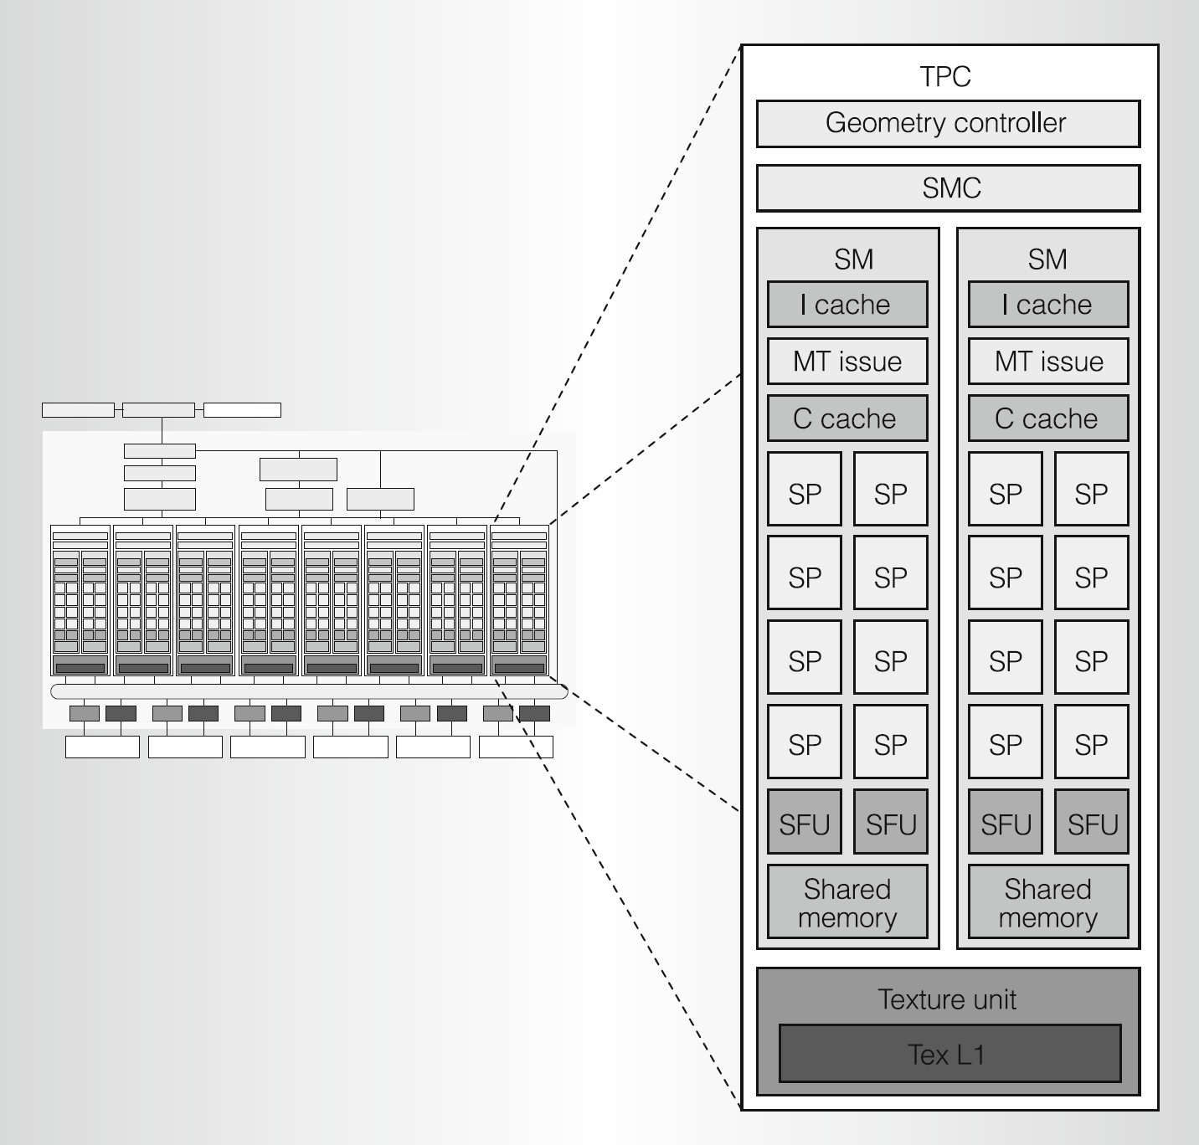
The Tesla Architecture
Each TPC contains:
  1 Geometry Controller
  1 Streaming Multiprocessors Controller (SMC)
  2 Streaming Multiprocessors (SM),
  1 Texture Unit
The SMC unit implements external memory load/store, and atomic accesses
The SMC controls the SMs, and arbitrates the load/store path and the I/O path
Texture/Processor Clusters (TPC)

Slide 28
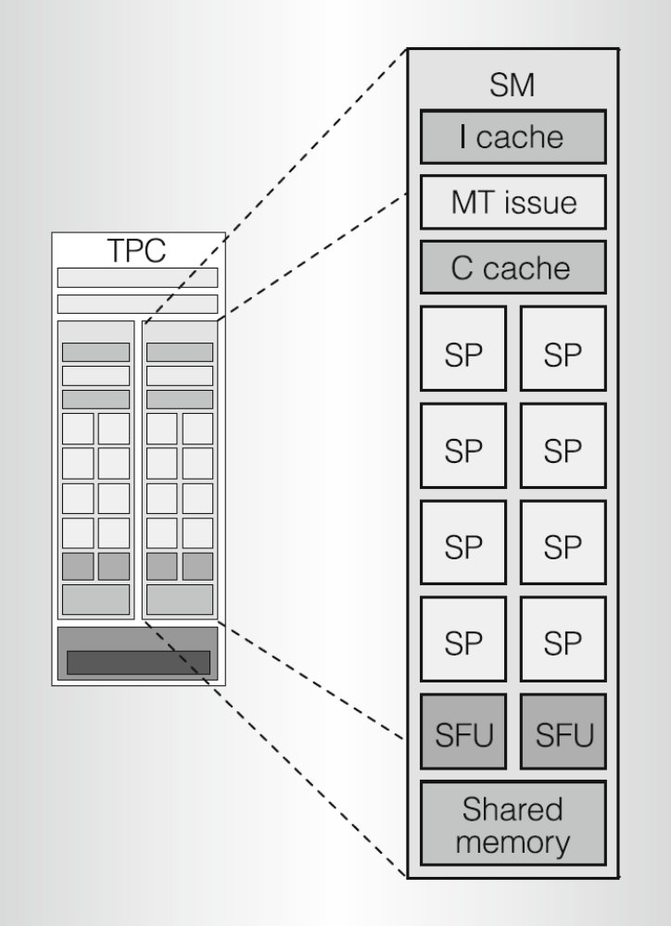
The Tesla Architecture
Each TPC has two Streaming Multiprocessors (SM)
Each SM consists of:
  8 Streaming Processor (SP) cores
  2 Special Function Units (SFU)
  1 Instruction Cache
  (I cache)
  1 read-only Constant Cache (C cache)
  1 16-Kbyte read/write
  Shared Memory
  1 Multithreaded Instruction Fetch and Issue Unit (MT Issue)
Streaming Multiprocessors (SM)

Slide 29
The Tesla Architecture
The Streaming Processor (SP) cores and the Special Function Units (SFU) have a register-based instruction set and executes float, int, and transcendental operations (SFU):
  add, multiply, multiply-add, minimum, maximum, compare, set predicate, and conversions between int and FP numbers
  shift left, shift right, and logic operations
  branch, call, return, trap, and barrier synchronization
  cosine, sine, binary exp., binary log., reciprocal, and reciprocal square root
Streaming Multiprocessors (SM)

Slide 30
The Tesla Architecture
The Streaming Multiprocessor SP cores and SFUs can access three memory spaces:
  Registers
  Shared memory for low-latency access to data shared by cooperating Threads in a Block
  Local and Global memory for per-Thread private, or all-Threads shared data (implemented in external DRAM, not cached)
  Constant and Texture memory for constant data and textures shared by all Threads (implemented in external DRAM, cached)
Streaming Multiprocessors (SM)

Slide 31
The Tesla Architecture
The SM’s MT Issue block issues SIMT Warp instructions
  A Warp consists of 32 Threads of the same type
The SM schedules and executes multiple Warps of multiple types concurrently
The MT Issue Scheduler operates at half clock rate
  At each issue cycle, it selects one of 24 Warps (each SM can manage 24x32=768 Threads)
  An issued Warp executes as 2 sets of 16 Threads over 4 cycles
  SP cores and SFU units execute instructions independently; the Scheduler can keep both fully occupied
Streaming Multiprocessors (SM)

Slide 32
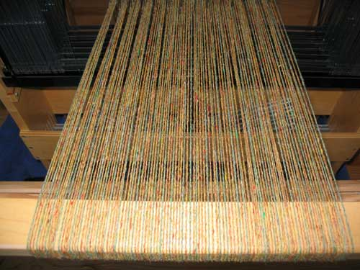
The Tesla Architecture
Since a Warp takes 4 cycles to execute, and the Scheduler can issue a Warp every 2 cycles, the Scheduler has spare time to operate
→ SM hardware implements zero-overhead Warp scheduling
  Warps whose next instruction has its operands ready are eligible for execution
  Eligible Warps are selected for execution on a prioritized scheduling policy
All Threads in a Warp execute the same instruction when selected
  But all Threads of a Warp are independent…
SM multithreaded
Warp scheduler
time
warp 8 instruction 11
warp 1 instruction 42
warp 3 instruction 95
.
.
.
warp 8 instruction 12
warp 3 instruction 96

Slide 33
The Tesla Architecture
SM achieves full efficiency when all 32 Threads of a Warp follow the same path
If Threads of a Warp diverge due to conditional branches:
  The Warp serially executes each branch path taken
  Threads that are not on the path are disabled
  When all paths complete, the Threads reconverge
The SM uses a branch synchronization stack to manage independent Threads that diverge and converge
Branch divergence only occurs within a Warp
  Warps execute independently, whether they are executing common or disjoint code paths
A Scoreboard gives support all that
SM multithreaded
Warp scheduler
time
warp 8 instruction 11
warp 1 instruction 42
warp 3 instruction 95
.
.
.
warp 8 instruction 12
warp 3 instruction 96

Slide 34
The Tesla Architecture
Going back to the top → C+CUDA parallel program
  Has serial parts that execute on CPU
  And Parallel CUDA Kernels that execute on GPU
  (Grids of Blocks of Threads)
Grid: 1D, 2D, or 3D group of Blocks
Block: 1D, 2D, or 3D group of Threads
CPU Serial Code
Grid 0
GPU Parallel Kernel
KernelA<<< nBlk, nThr >>>(args);
. . .
. . .
CPU Serial Code
Grid 1
GPU Parallel Kernel
KernelB<<< nBlk, nThr >>>(args);
. . .

Slide 35
The Tesla Architecture
A Kernel is executed as a Grid of Blocks
A Block is a group of Threads that can cooperate with each other by:
  Efficiently sharing data through the low latency shared memory
  Synchronizing their execution for hazard-free shared memory accesses
Two Threads from two different Blocks cannot directly cooperate
Host
Device
Grid 1
Kernel 1
Block
(0, 0)
Block
(1, 0)
Block
(2, 0)
Block
(0, 1)
Block
(1, 1)
Block
(2, 1)
Grid 2
Kernel 2
Block (1, 1)
Thread
(0, 0)
Thread
(1, 0)
Thread
(2, 0)
Thread
(3, 0)
Thread
(4, 0)
Thread
(0, 1)
Thread
(1, 1)
Thread
(2, 1)
Thread
(3, 1)
Thread
(4, 1)
Thread
(0, 2)
Thread
(1, 2)
Thread
(2, 2)
Thread
(3, 2)
Thread
(4, 2)

Slide 36
The Tesla Architecture
The programmer declares Blocks:
  of 1, 2, or 3 dimensions
  containing 1 to 512 Threads in total
All Threads in a Block execute the same Thread Program
Each threads have a Thread Id within a Block
Threads share data and synchronize while doing their share of the work
The Thread Program uses the Thread Id to select work and to address shared data
CUDA Thread Block
Thread Id #:
0 1 2 3 … m
Thread Program

Slide 37
The Tesla Architecture
Based on Kernel calls, enumerate the Blocks of the Grids and distribute them to the SMs of the SPA
Calls GPU’s Kernels
GeForce 8800 block diagram

Slide 38
The Tesla Architecture
Blocks are serially distributed to all SMs
  Typically more than 1 Block per SM
Each SM launches Warps of Threads
  2 levels of parallelism
The SMs schedule and execute Warps that are ready to run
As Warps and Blocks complete, resources are freed
  So, the SPA can distribute more Blocks
GeForce 8800 block diagram

Slide 39
The Tesla Architecture
The GeForce 8800 in numbers:
  8 Texture/Processor Clusters (TPC)
  16 Streaming Multiprocessors (SM)
  128 Streaming-Processor (SP) cores
  Each SM can handle 8 Blocks simultaneously
  Each SM can schedule 24 Warps simultaneously
  Each Warp can have up to 32 active Threads
  So, each SM can manage 24x32=768 simultaneous Threads
  The GeForce can execute 768x16=12,288 Threads concurrently!
GeForce 8800 block diagram

Slide 40
The Tesla Architecture
Intel Core 2 Extreme QX9650 versus NVIDIA GeForce GTX 280
 | Intel Core 2 Extreme QX9650 | NVIDIA GeForce GTX 280
Peak Gflop/s | 96 Gflop/s | 933 Gflop/s ~ 10x
Transistors | 820 million | 1.4 billion ~ 2x
Processor clock | 3 GHz | 1.296 GHz ~ 1/2
Cores | 4 | 240 ~ 60x
Cache / Shared Memory | 6 MB x 2 (12MB) | 16 KB x 30 (0,48MB) ~ 1/25
Threads executed per clock | 4 | 240 ~ 60x
Hardware threads in flight | 4 | 30,720 ~ 8,000!
Memory Bandwidth | 12.8 GBps | 141.7 GBps ~ 11x
To compensate for that
Use this

Slide 41
The Tesla Architecture
Memory Hierarchy (hardware)
  Registers: dedicated HW - single cycle
  Shared Memory: dedicated HW - single cycle
  Constant Cache: dedicated HW - single cycle
  Texture Cache: dedicated HW - single cycle
  Device Memory – DRAM, 100s of cycles

Slide 42
The Tesla Architecture
Each GeForce 8800 SM has 8192 32-bit registers
  This is an implementation decision, not part of CUDA
  Registers are dynamically partitioned across all Blocks assigned to the SM
  Once assigned to a Block, the register is NOT accessible by Threads in other Blocks
  Each Thread in the same Block only accesses registers assigned to itself

Slide 43
The Tesla Architecture
The number of registers constrains applications
For example, if each Block has 16X16 Threads and each Thread uses 10 registers, how many Blocks can run on each SM?
  Each Block requires 10*256 = 2560 registers
  8192 > 2560 * 3
  So, three Blocks can run on an SM as far as registers are concerned
How about if each Thread increases the use of registers by 1?
  Each Block now requires 11*256 = 2816 registers
  8192 < 2816 * 3
  Now only two Blocks can run on an SM

Slide 44
The Tesla Architecture
Each GeForce 8800 SM has 16 KB of Shared Memory
  Divided in 16 banks of 32bit words
CUDA uses Shared Memory as shared storage visible to all Threads in a Block
  Read and write access
Each bank has a bandwidth of 32 bits per clock cycle
Successive 32-bit words are assigned to successive banks
Multiple simultaneous accesses to a bank
result in a bank conflict
  Conflicting accesses are serialized

Slide 45
The Tesla Architecture
Linear addressing
stride == 1
  No Bank Conflicts
Random 1:1 Permutation
  No Bank Conflicts
Thread 0
Bank 0
Thread 0
Bank 0
Thread 1
Bank 1
Thread 1
Bank 1
Thread 2
Bank 2
Thread 2
Bank 2
Thread 3
Bank 3
Thread 3
Bank 3
Thread 4
Bank 4
Thread 4
Bank 4
Thread 5
Bank 5
Thread 5
Bank 5
Thread 6
Bank 6
Thread 6
Bank 6
Thread 7
Bank 7
Thread 7
Bank 7
Thread 15
Bank 15
Thread 15
Bank 15

Slide 46
Bank Addressing Examples
Linear addressing
stride == 2
  2-way Bank Conflicts
Linear addressing
stride == 8
  8-way Bank Conflicts
Thread 0
Bank 0
Thread 0
x8
Bank 0
Thread 1
Bank 1
Thread 1
Bank 1
Thread 2
Bank 2
Thread 2
Bank 2
Thread 3
Bank 3
Thread 3
Thread 4
Bank 4
Thread 4
Bank 5
Thread 5
Bank 7
Bank 6
Thread 6
Bank 8
Bank 7
Thread 7
Bank 9
Thread 8
x8
Thread 9
Thread 10
Thread 11
Bank 15
Thread 15
Bank 15

Slide 47
The Tesla Architecture
Each GeForce 8800 SM has 64 KB of Constant Cache
Constants are stored in DRAM and cached on chip
A constant value can be broadcast to all threads in a Warp
  Extremely efficient way of accessing a value that is common for all threads in a Block
  Accesses in a Block to different addresses are serialized

Slide 48
The Tesla Architecture
The GeForce 8800 SMs have also a Texture Cache
Textures are stored in DRAM and cached on chip
Special hardware speeds up reads from the texture memory space
  This hardware implements the various addressing modes and data filtering suitable to this graphics data type

Slide 49
The Tesla Architecture
The GeForce 8800 has 6 64-bit memory ports
  86.4 GB/s bandwidth
  But this limits code that does a single operation in DRAM data to 21.6 GFlop/s
To get closer to the peak 346.5 GFlop/s you have to access data more then once and take advantage of the memory hierarchy
  L2, Texture Cache, Constant Cache, Shared Memory, and Registers
GeForce 8800 block diagram

Slide 50
The Tesla Architecture
The host accesses the device memory via PCI Express bus
The bandwidth of PCI Express is ~8 GB/s (~2 GWord/s)
So, if go through your data only once, you actually can have only ~2 Gflop/s…
Grid
Block (0, 0)
Block (1, 0)
Shared Memory
Shared Memory
Registers
Registers
Registers
Registers
Thread (0, 0)
Thread (1, 0)
Thread (0, 0)
Thread (1, 0)
Local
Memory
Local
Memory
Local
Memory
Local
Memory
Host
Global
Memory
Constant
Memory
Texture
Memory

Slide 51
The Tesla Architecture
M.H. (Software)
Each Thread can:
  Read/write per-Thread Registers
  Read/write per-Thread Local Memory
  (not cached)
  Read/write per-Block Shared Memory
  Read/write per-Grid Global Memory
  (not cached)
  Read only per-Grid Constant Memory (cached)
  Read only per-Grid Texture Memory (cached)
The host can read/write Global, Constant, and Texture memory
Grid
Block (0, 0)
Block (1, 0)
Shared Memory
Shared Memory
Registers
Registers
Registers
Registers
Thread (0, 0)
Thread (1, 0)
Thread (0, 0)
Thread (1, 0)
Local
Memory
Local
Memory
Local
Memory
Local
Memory
Host
Global
Memory
Constant
Memory
Texture
Memory

Slide 52
The Tesla Architecture
Thread
Local Memory: per-Thread
  Private per Thread
Shared Memory: per-Block
  Shared by Threads of the same Block
  Inter-Thread communication
Global Memory: per-Application
  Shared by all Threads
  Inter-Grid communication
Local Memory
Block
Shared
Memory
Grid 0
Global
Memory
(Global,
Constant,
and Texture)
. . .
Sequential
Grids
in Time
Grid 1
. . .

Slide 53
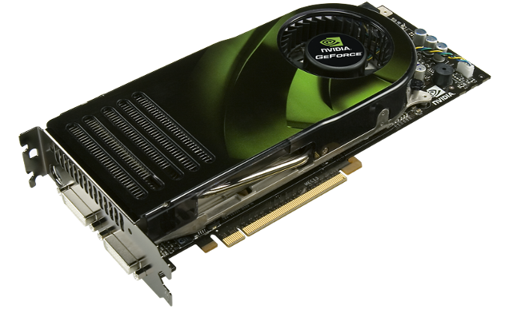
Parallel Programming in C+CUDA
How to start?
  Install your CUDA enabled board
  Install the CUDA Toolkit
  Install the CUDA SDK
  Change some environment variables
The SDK comes with several examples
GeForce 8800

Slide 54
Parallel Programming in C+CUDA
Function Type Qualifiers
__device__
The __device__ qualifier declares a function that is:
  Executed on the device
  Callable from the device only
__global__
__global__ qualifier declares a function as being a kernel. Such a function is:
  Executed on the device,
  Callable from the host only

Slide 55
Overview
Function Type Qualifiers are added before functions
The __global__ functions are always called with a configuration
The __device__ functions are called by __global__ functions

Slide 56
Parallel Programming in C+CUDA
Restrictions
__device__ and __global__ functions do not support recursion
__device__ and __global__ functions cannot declare static variables inside their body
__device__ and __global__ functions cannot have a variable number of arguments
__device__ functions cannot have their address taken
__global__ functions must have void return type
A call to a __global__ function is asynchronous
__global__ function parameters are currently passed via shared memory to the device and are limited to 256 bytes

Slide 57
Parallel Programming in C+CUDA
Variable Type Qualifiers
__device__
Declares a variable that resides on the device
  Resides in global memory space
  Has the lifetime of an application
  Is accessible from all the threads within the grid and from the host

Slide 58
Parallel Programming in C+CUDA
__constant__
Declares a variable that
  Resides in constant memory space
  Has the lifetime of an application
  Is accessible from all the threads within the grid and from the host
__shared__
Declares a variable that
  Resides in shared memory space of a Block
  Has the lifetime of a Block
  Is only accessible from all threads within a Block

Slide 59
Parallel Programming in C+CUDA
Restrictions
These qualifiers are not allowed on struct and union members, or on function parameters
__shared__ and __constant__ variables have implied static storage
__device__, __shared__ and __constant__ variables cannot be defined as external using the extern keyword
__constant__ variables cannot be assigned to from the device, only from the host
__shared__ variables cannot have an initialization as part of their declaration
An automatic variable, declared in device code without any of these qualifiers, generally resides in a register

Slide 60
Parallel Programming in C+CUDA
Built-in Variables
gridDim
This variable contains the dimensions of the grid
blockIdx
This variable contains the block index within the grid

Slide 61
Parallel Programming in C+CUDA
blockDim
This variable contains the dimensions of the block
threadIdx
This variable contains the thread index within the block
warpSize
This variable contains the warp size in threads

Slide 62
Parallel Programming in C+CUDA
Restrictions
It is not allowed to take the address of any of the built-in variables
It is not allowed to assign values to any of the built-in variables

Slide 63
Parallel Programming in C+CUDA
Important Functions
cudaGetDeviceProperties()
Retrieve device properties
__syncthreads()
Used to coordinate communication between the threads of a same block
atomicAdd()
This and other atomic functions perform a read-modify-write operations
cuMemAlloc(), cuMemFree(), cuMemcpy()
This and other memory functions allows allocating, freeing and copying memory to/from the device

Slide 64
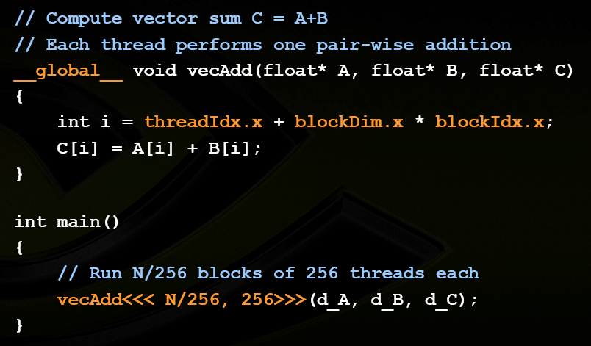
Parallel Programming in C+CUDA

Slide 65
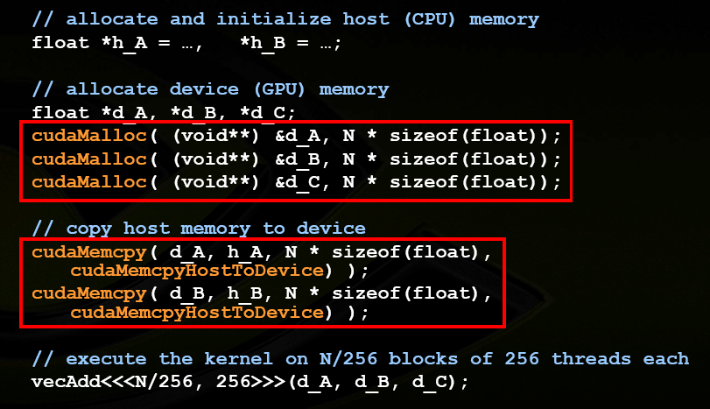
Parallel Programming in C+CUDA

Slide 66
Conclusion
1980s, early `90s: a golden age for parallel computing
  Particularly data-parallel computing
Machines
  Connection Machine, Cray X-MP/Y-MP
  True supercomputers: exotic, powerful, expensive
Algorithms, languages, & programming models
  Solved a wide variety of problems
  Various parallel algorithmic models developed
  P-RAM, V-RAM, hypercube, etc.

Slide 67
Conclusion
But…impact of data-parallel computing limited
  Thinking Machines sold 7 CM-1s
Commercial and research activity largely subsides
  Massively-parallel machines replaced by clusters
  of ever-more powerful commodity microprocessors
  Beowulf, Legion, grid computing, …
Enter the era of distributed computing
  Massively parallel computing loses momentum to inexorable advance of commodity technology

Slide 68
Conclusion
GPU Computing with CUDA brings data-parallel computing to the masses
  A 500 GFLOPS “developer kit” costs $200
Data-parallel supercomputers are everywhere
  CUDA makes it even more accessible
Parallel computing is now a commodity technology

Slide 69
Conclusion
Computers no longer get faster, just wider
  Many people (outside this room) have not gotten this memo
You must re-think your algorithms to be aggressively parallel
  Not just a good idea – the only way to gain performance
  Otherwise: if its not fast enough now, it never will be
  Data-parallel computing offers the most scalable solution
GPU computing with CUDA provides a scalable data-parallel platform in a familiar environment - C

Slide 70
References
Cuda Zone, www.nvidia.com/cuda
K. Asanovic, R. Bodik, B. C. Catanzaro, J. J. Gebis, P. Husbands, K. Keutzer, D. A. Patterson, W. L. Plishker, J. Shalf, S. W. Williams, K. A. Yelick, “The Landscape of Parallel Computing Research: A View from Berkeley”, Technical Report No. UCB/EECS-2006-183, Department of Electrical Engineering and Computer Sciences, University of California at Berkeley, 2006.
R. Farber, “CUDA, Supercomputing for the Masses: Part 1-9”, Dr. Dobb’s, 2008, Avaliable at www.ddj.com/architect/207200659
E. S. T. Fernandes, V. C. Barbosa, F. Ramos, “Instruction Usage and the Memory Gap Problem”, Proceedings of the 14th SBC/IEEE Symposium on Computer Architecture and High Performance Computing, Los Alamitos - CA - USA: IEEE Computer Society, pp. 169-175, 2002.
J. L. Hennessy, D. A. Patterson, “Computer Architecture: A Quantitative Approach, Fourth Edition”, Morgan Kaufmann Publishers, Inc., 2006.
M. J. Irwin, J. P. Shen, “Revitalizing Computer Architecture Research”, Third in a Series of CRA Conferences on Grand Research Challenges in Computer Science and Engineering, December 4-7, 2005, Computing Research Association (CRA), 2007.
P. Kongetira, K. Aingaran, K. Olukotun, “Niagara: A 32-Way Multithreaded Sparc Processor”, IEEE Micro, Vol. 25, No. 2, pp. 21-29, 2005.
E. Lindholm, J. Nickolls, S. Oberman, J. Montrym, “NVIDIA TESLA: A Unified Graphics and Computing Architecture”, IEEEMicro, March-April, 2008.
D. Luebke, M. Harris, J. Krüger, T. Purcell, N. Govindaraju, I. Buck, C. Woolley, A. Lefohn, “GPGPU: general purpose computation on graphics hardware”, International Conference on Computer Graphics and Interactive Techniques, ACM SIGGRAPH 2004, Course Notes, 2004.
D. Luebke, “GPU Computing: The Democratization of Parallel Computing”, 13th International Conference on Architectural Support for Programming Languages and Operating Systems (ASPLOS’08), Course Notes, 2008.
G. E. Moore, “Cramming more components onto integrated circuits”, Electronics, Vol. 38, No. 8, pp. 114-117, 1965.
J. Nickolls, I. Buck, M. Garland, K. Skadron, “Scalable Parallel Programming with CUDA”, ACM Queue, Vol. 6, No. 2, pp. 4-53, March/April 2008.
NVIDIA, “NVIDIA CUDA Programming Guide 2.0”, NVIDIA, 2008.
W. A. Wulf, S. A. McKee, “Hitting the Memory Wall: Implications of the Obvious”, Computer Architecture News, vol. 23, no. 1, Mar. 1995, pp. 20–24.

