Slide 1

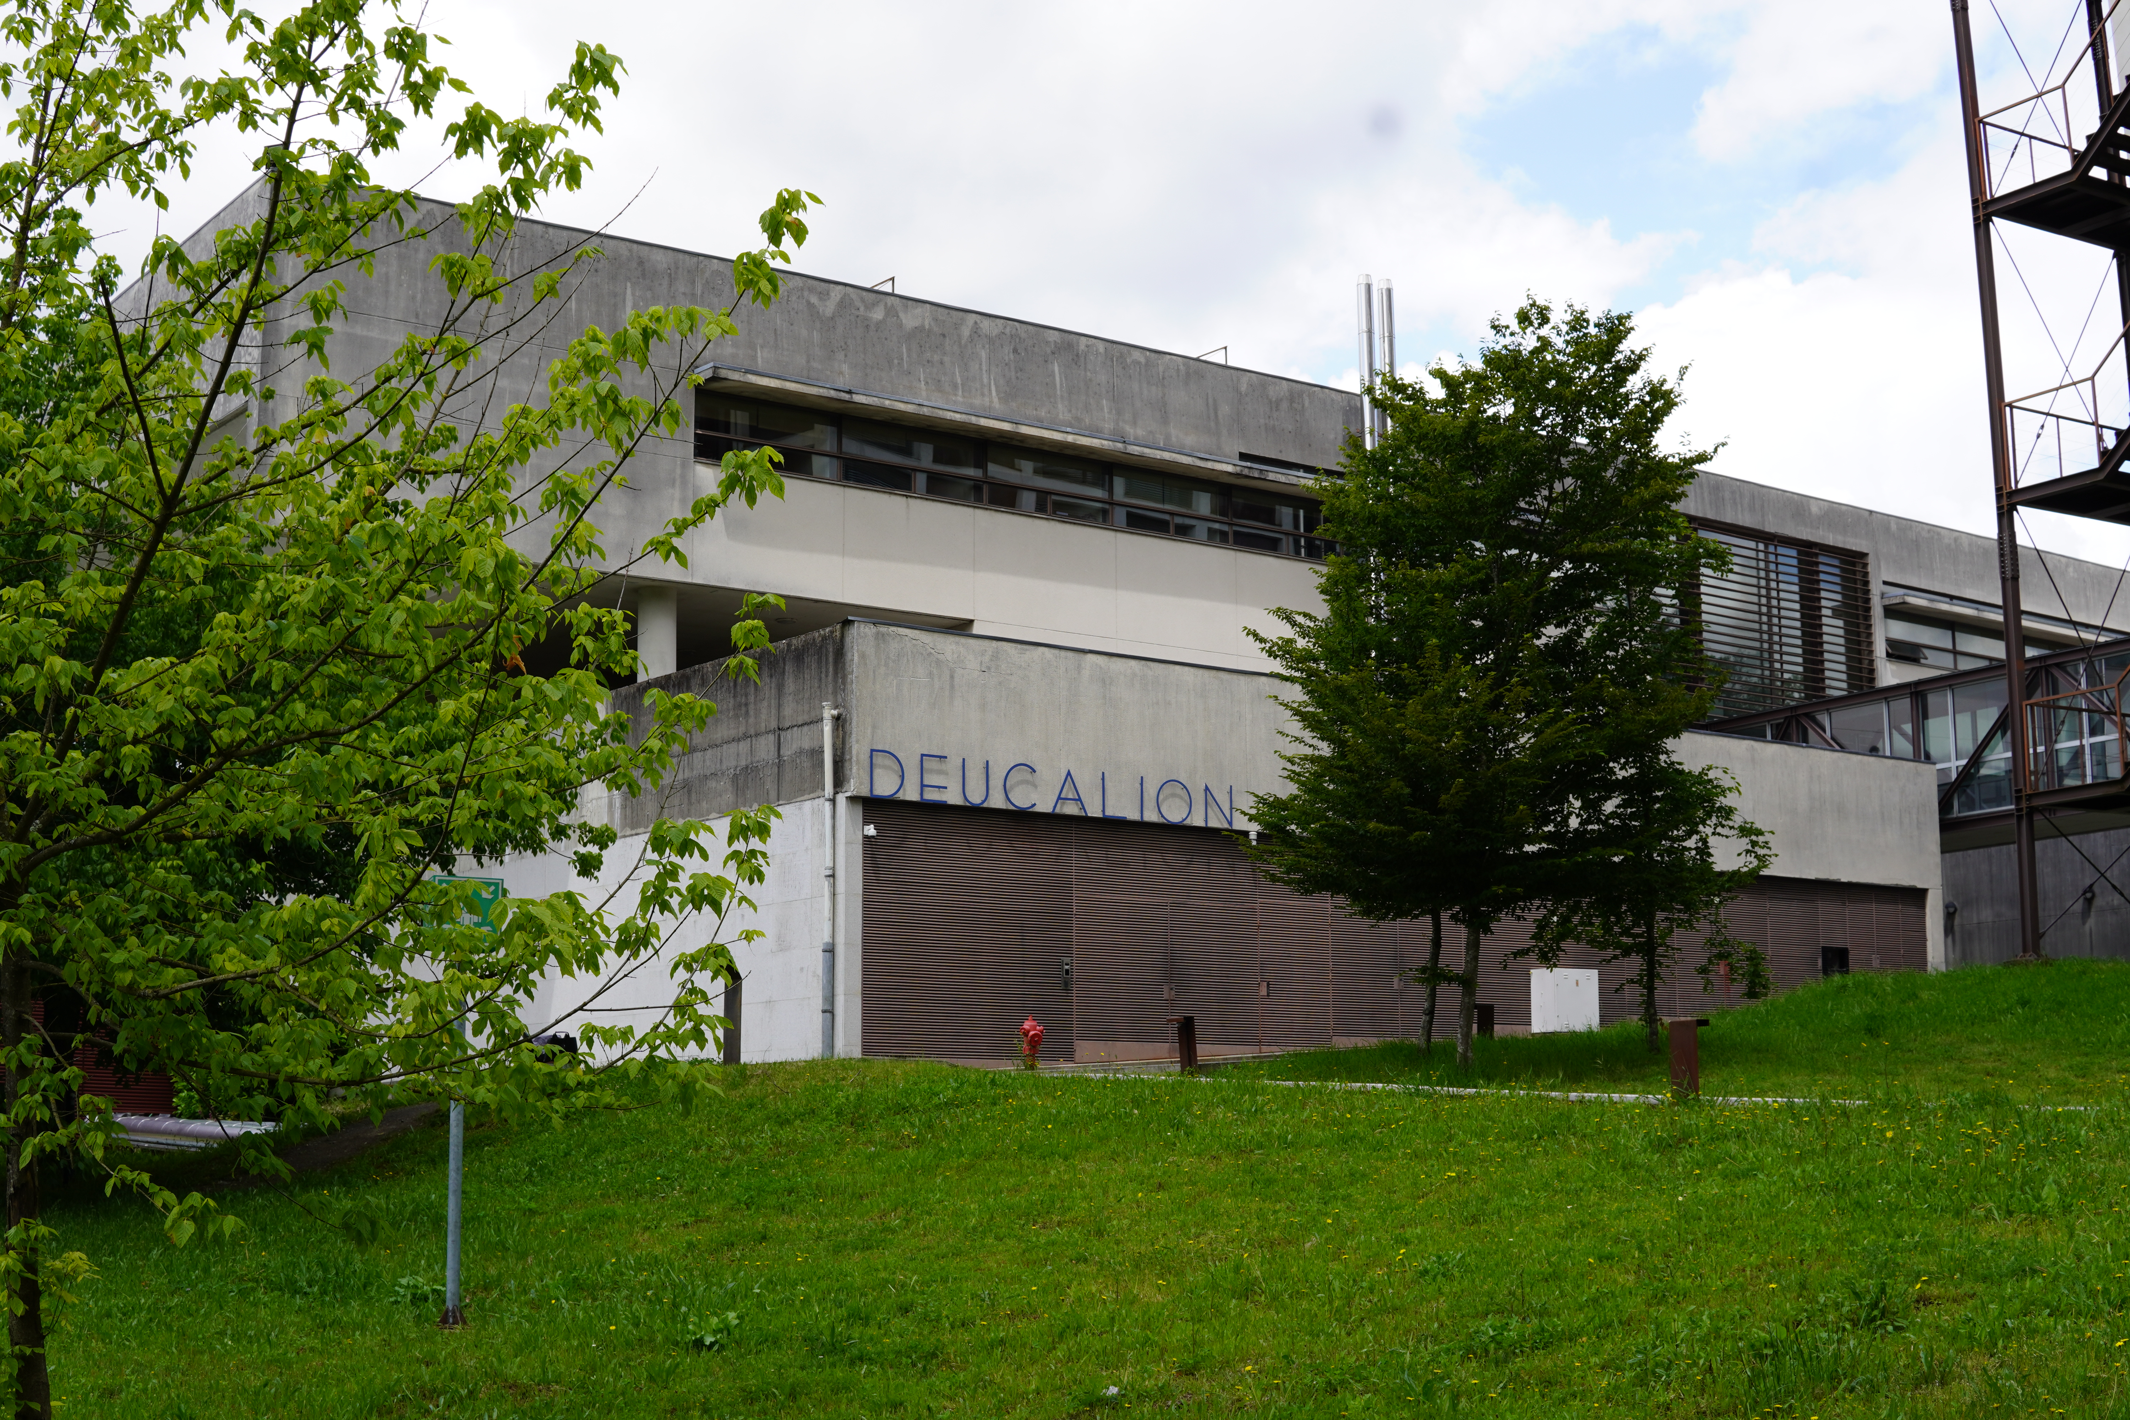









Profiling @Deucalion
B. Malaca
October 2025

Slide 2
Compiling zpic for the first time
Clone the repository:
cd /projects/F202500010HPCVLABUMINHO/<username> #quotaprojects
git clone https://github.com/BMalaca/zpic_CompParalela.git
Start a session in an ARM node:
srun -A f202500010hpcvlabuminhoa --time=04:00:00 -n 1 -p normal-arm \ --pty bash
Load modules (e.g. GCC) , compile and run:
ml GCC/13 #or GCC/14, etc.
cd zpic_CompParalela
#change input file tmax=40 to tmax=35
make clean; make
./zpic #don’t forget to exit at the end
Computação Paralela 2025/26, 27th October

Slide 3
Changing the input
Change input file (in a login node):
vi input/laser_particles.c #or nano
make clean; make
[user@ln02 zpic_CompParalela]$ cat input/laser_particles.c
(...)
void sim_init( t_simulation* sim ){
// Time step
float dt = 0.00095;
float tmax = 40; //change this to 35
(...)
}
(...)
Computação Paralela 2025/26, 27th October

Slide 4
Profiling
Change Makefile:
vi Makefile #or nano
[user@ln02 zpic_CompParalela]$ cat Makefile
(...)
# GCC options
CC = scorep gcc # Change this to scorep gcc
CFLAGS = -Ofast -g -std=c99 -pedantic -Wall
#CFLAGS = -Kfast -std=c99
LDFLAGS = -lm
(...)
Compile again and run (in an ARM node!!!!):
ml Score-P/8.4-gompi-2024a
make clean; make; ./zpic
Computação Paralela 2025/26, 27th October

Slide 5
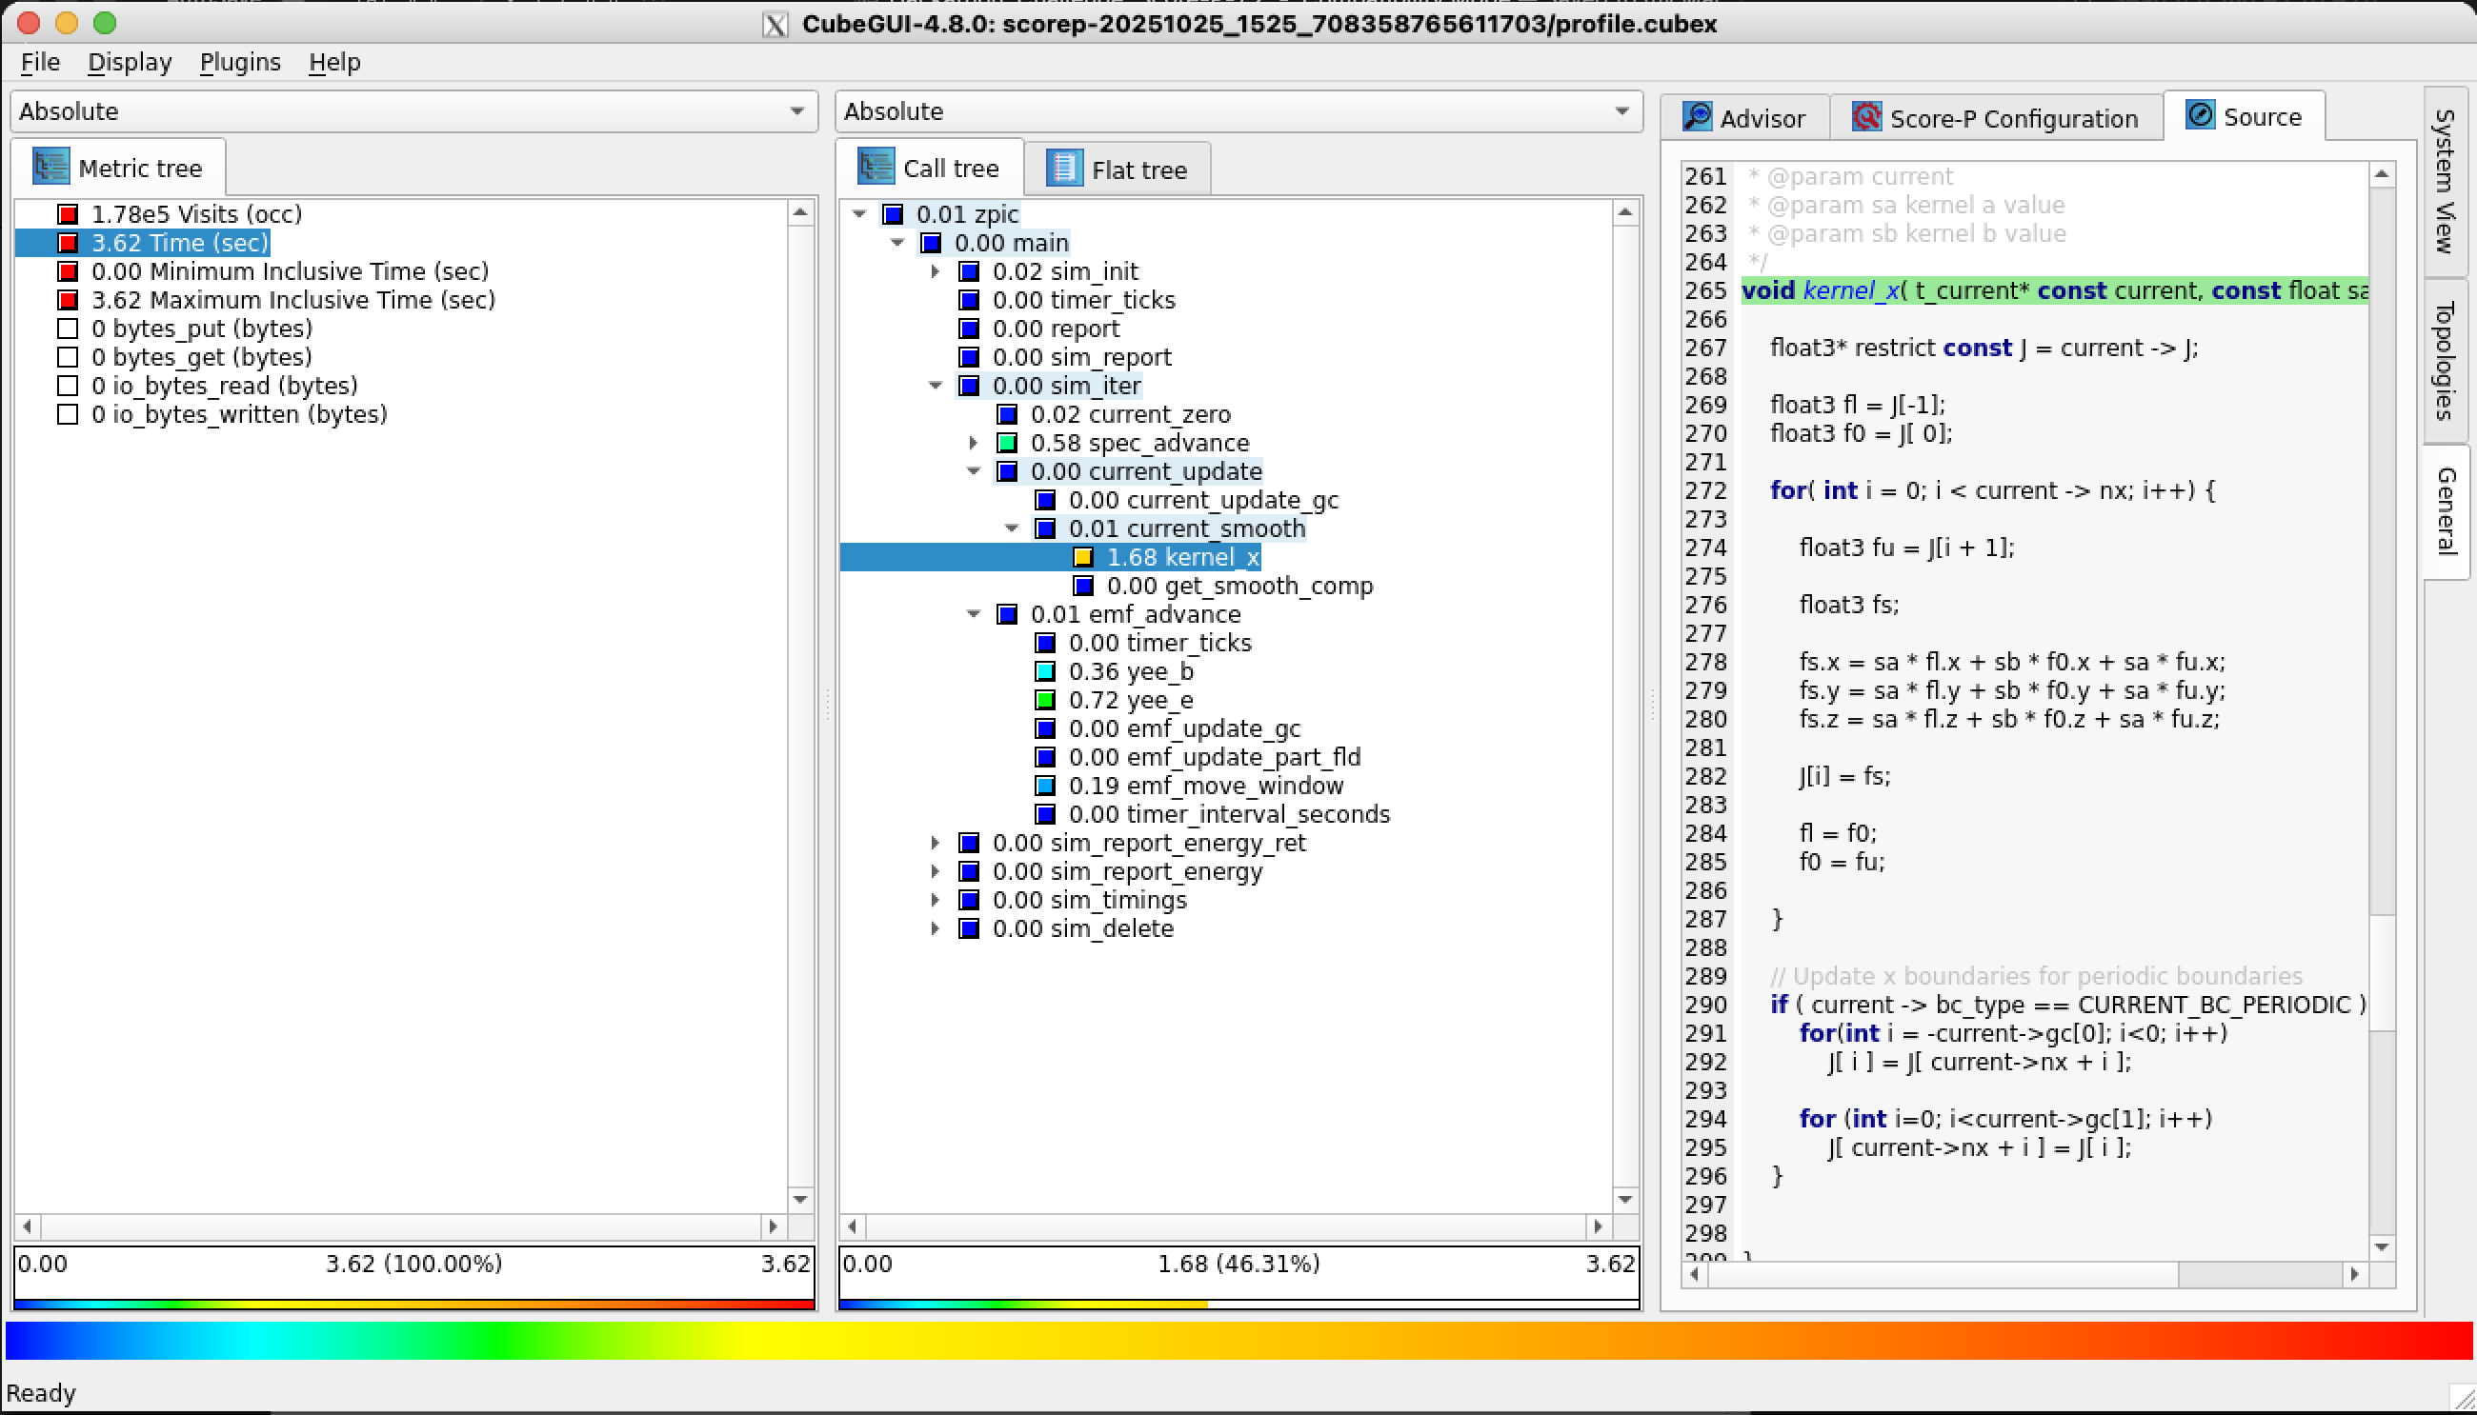
Profiling (use MobaXterm for windows)
Start another session in a login node (ssh –X or ssh -Y)
Load Cube:
ml CubeGUI
Read Cube file:
cd scorep-*
cube profile.cubex
Select time on Metric tree and verify hotspots in Call tree
Computação Paralela 2025/26, 27th October

Slide 6
Improving the code
Change emf.c and improve function yee_e:
vi emf.c
[user@ln02 zpic_CompParalela]$ cat emf.c
(...) inside function yee_e
// Canonical implementation
for (int i = 0; i <= nx+1; i++) {
E[i].x += ( - dt * J[i].x );
E[i].y += ( - dt_dx * ( B[i].z - B[i-1].z) - dt * J[i].y );
E[i].z += ( + dt_dx * ( B[i].y - B[i-1].y) - dt * J[i].z );
}
(...)
Does E[i] depend on E[j], j≠i?
How can one simply improve this function?
Computação Paralela 2025/26, 27th October

Slide 7
Improving the code
Change emf.c and improve function yee_e:
cd /path/to/zpic_CompParalela
vi emf.c
[user@ln02 zpic_CompParalela]$ cat emf.c
(...) inside function yee_e
// Canonical implementation
#pragma omp parallel for
for (int i = 0; i <= nx+1; i++) {
E[i].x += ( - dt * J[i].x );
E[i].y += ( - dt_dx * ( B[i].z - B[i-1].z) - dt * J[i].y );
E[i].z += ( + dt_dx * ( B[i].y - B[i-1].y) - dt * J[i].z );
}
(...)
Now redo the profiling and add the appropriate flags to activate openMP
Don’t forget to set OMP_NUM_THREADS (e.g., export OMP_NUM_THREADS=2)
Computação Paralela 2025/26, 27th October

