Slide 1
Machine Learning Offensive Tweet Detection
November 16, 2018
Diogo Daniel Ferreira 76504
Luís Davide Leira 76514
Departamento de Eletrónica, Telecomunicações e Informática
Universidade de Aveiro

Slide 2
Problem
Improve the Twitter implementation of “Safe Search”
Don’t show offensive tweets from users with “safe search” on
Also useful when large websites use Twitter widget to show tweets related with a topic
Twitter can suspend or delete accounts with successive violations of safe tweets
Notes:
The problem here is how can we improve the Twitter implementation of "Safe Search". It wants to detect offensive tweets from users to others. This can be very useful as Twitter can have the power to don't show them, suspend or delete accounts.

Slide 3
Dataset
20001 tweets
Human-labelled data in two categories:
1 (offensive)
0 (non offensive)
7822 labelled as offensive tweets and 12179 labelled as non offensive tweets
Source: https://www.kaggle.com/dataturks/dataset-for-detection-of-cybertrolls/

Slide 4
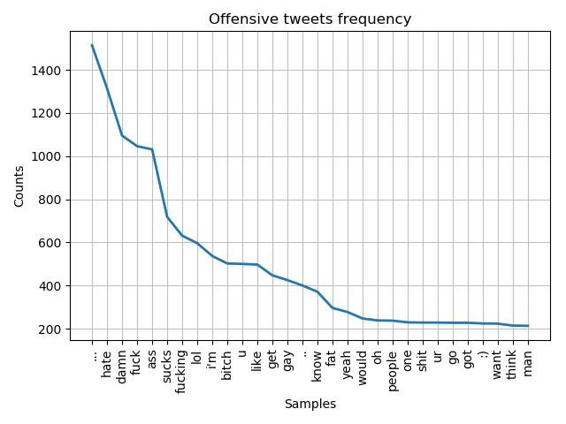
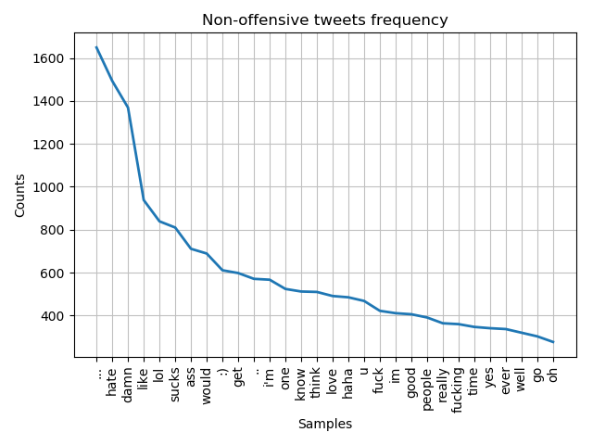
Dataset statistics
Notes:
bitch, like, gay, fat, yeah, shit, ur, got, want, man
get, love, haha, im, good, really, time, yes, ever, well
Each graphic contains 30 words. 20 of them are the same, the other 10 are different.

Slide 5
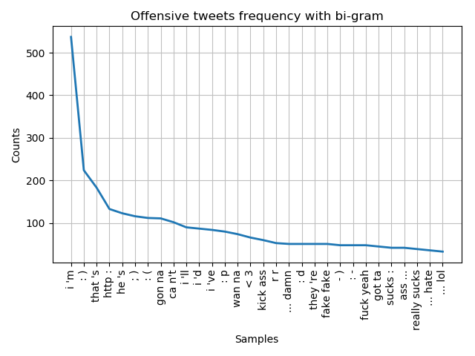
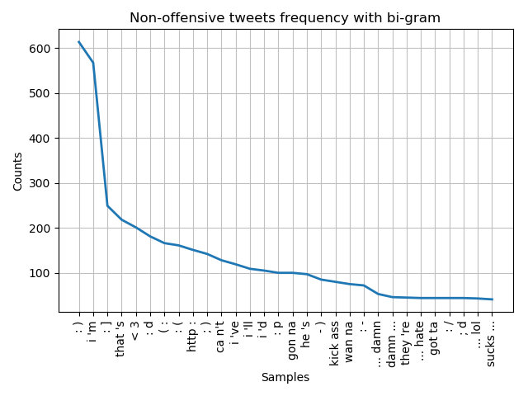
Dataset statistics

Slide 6
Data pre-processing
Convert all words into lowercase
Apply tokenizer
Remove punctuation
Remove stop words (the, and, or, …)
Lemmatize

Slide 7
Feature extraction
Tokens counting
Select the N most used tokens and transform them into features
Count the number of feature tokens that each tweet has
Normalize the counting
The pre-processed tokens can be grouped in a contiguous sequence: n-gram
We have chosen to treat each one as a word. Example:
1-gram: [“We”, “Love”, “AI”]
2-gram: [“We Love”, “Love AI”]
Notes:
A simple and effective model for thinking about texto documents in machine learning is called the Bag-of-Words model. It throws away the order information in the words and focuses on the ocurrence of words in a document.
It build a vocabular of known tokens and counts the number of times each token appeared in each document.

Slide 8
Feature extraction
TF-IDF weighting
Select the N most used tokens and transform them into features
Calculate the TF-IDF for the feature tokens that each tweet has
TF-IDF is a numerical statistic that reflects the importance of a token in a tweet
TF – term frequency
IDF – inverse document frequency
Notes:
It is an alternative to the token counts. It calculates word frequencies. The Tfidf Vectorizer learns the vocabular and invert document frequency weights.

Slide 9
Classifiers
Logistic Regression
SGD Classifier
Linear SVC
NuSVC
SVC
Gaussian Naive Bayes
Decision Tree
Random Forest
AdaBoost
XGBoost
Multi-layer Perceptrons
Initially, 11 classifiers were put to test:

Slide 10
Training & Testing approach
Dataset division: 80% train and cross-validation (5-fold cross-validation), 20% test
Parameters to be taken into consideration:
Maximum number of tokens to create features
Different N-gram parameters (for the tokens counting)
Token counting and TF-IDF weighting combination
Classifiers hyperparameters
Too many combinations!

Slide 11
Training & Testing approach
First phase:
Test all classifiers with the default hyperparameters
Test with tokens counting, TF-IDF and both combined
Test with the following number of most used tokens:
100, 1000, 5000, 10000, 25000
Test with 1-gram, 2-gram and both combined (only applied to tokens counting)
Perform 5-fold validation and store the confusion matrix

Slide 12
Training & Testing approach
Second phase:
Use the four best classifiers from the first phase
Perform 5-fold cross validation on those four classifiers with different hyperparameters
Select the best hyperparameters for each one of them and get the confusion matrix on the test data
Third phase:
Test the four best classifiers with the best hyperparameters from the second phase

Slide 13
Notes:
Models without 2-gram tokens as feature do not scale well to many tokens
Models with 2-gram tokens as features improve with the number of most used tokens
Best results since 5000 most used tokens are from 2-gram with TF-IDF
14922+6486=21408*.2=4281
62609+18458=81075*0.2=16213

Slide 14
Notes:
Results are not that different among classifiers
Decision Tree has the best recall, while Multi-layer Perceptrons has the second best
LinearSVC has the best F1-score, followed close by Logistic Regression, that has the best Precision

Slide 15
Multi-layer Perceptrons (Neural Network)
Activation function: ReLU
Solver: Adam
500 epochs
Early Stopping activated
Different network configurations tested:
100, 10-10, 20-20, 50-10, 10-10-10, 20-20-20, 50-50-10
Different lambda values tested:
0, 0.0001, 0.001, 0.01, 0.1, 1

Slide 16
Multi-layer Perceptrons

Slide 17
Multi-layer Perceptrons

Slide 18
Decision Tree
Criterion: measures the quality of a split
Gini
Entropy
Maximum depth of decision tree
100
200
400
600
No maximum depth (~800)

Slide 19
DecisionTree

Slide 20
DecisionTree

Slide 21
Linear SVC
Penalty: norm used in the penalization
l1
l2
C: penalty parameter C of the error term
0.1
1
5
…
1000

Slide 22
Linear SVC
Notes:
Best results are from penalty=‘l2’ as they give more accuracy in most cases.

Slide 23
Linear SVC
Notes:
For C=1, accuracy=0.91788 and recall 0.86876 (TP=1093 and FN=165). For C=5, accuracy=0.91313 and recall 0.87409 (TP=1100 and FN=158). C=10 almost the same as C=5. For this reason, we can consider that C=5 is the best value, but for a very small distance, being considered insignificant.

Slide 24
Logistic Regression
Penalty: norm used in the penalization
l1
l2
C: penalty parameter C of the error term
0.1
1
5
…
1000

Slide 25
Logistic Regression
Notes:
Best results are from penalty=‘l2’ as they give more accuracy in most cases.

Slide 26
Logistic Regression
Notes:
For C=1, accuracy=0.92112 and recall 0.86006 (TP=1082 and FN=176). For C=5, accuracy=0.92431 and recall 0.86964 (TP=1094 and FN=164). C=10 almost the same as C=5. For this reason, we can consider that C=5 is the best value, but for a very small distance, being considered insignificant.

Slide 27
Final results
Classifier | Accuracy | Precision | Recall | F1-Score
Logistic Regression | 0.956 | 0.940 | 0.946 | 0.943
Linear SVC | 0.952 | 0.924 | 0.952 | 0.938
Decision Tree | 0.871 | 0.764 | 0.959 | 0.850
Multi-layer Perceptrons | 0.944 | 0.943 | 0.907 | 0.925
Data division: 80% train and 20% test

