Slide 1
Montijo, Portugal — Ten Common Trees
Environment, Comfort and Energy Efficiency — tree / local architecture links
Montijo municipality — Tagus estuary, montado and urban green corridors

Slide 2
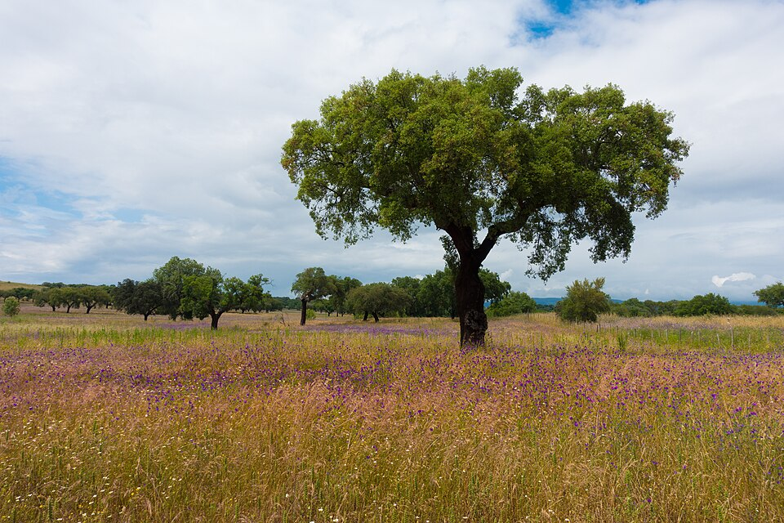
1. Sobreiro
Quercus suber
EVIDENCE IN MONTIJO
Centenary specimen in Canha; 750 planted in Semana Verde; long cork-industry history; protected species.
ARCHITECTURE LINK
Cork as natural wall/roof insulation for sun-exposed south-bank housing; evergreen shade for quintas in Canha/Pegoes.
PREDOMINA: Montado interior (Canha) — n.º 1
1 / 10 — Montijo municipality

Slide 3
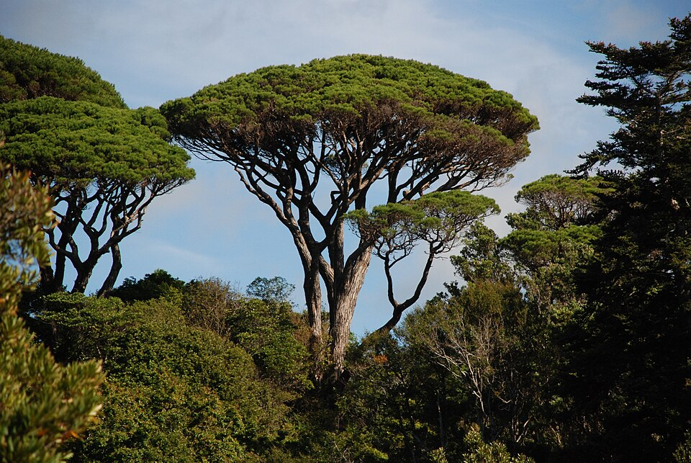
2. Pinheiro-manso
Pinus pinea
EVIDENCE IN MONTIJO
Listed in the municipal species tables; suited to sandy soils.
ARCHITECTURE LINK
Umbrella crown shades pracas and the Parque Municipal; open trunk keeps sightlines and winter sun.
PREDOMINA: Pinhal interior — n.º 2
2 / 10 — Montijo municipality

Slide 4
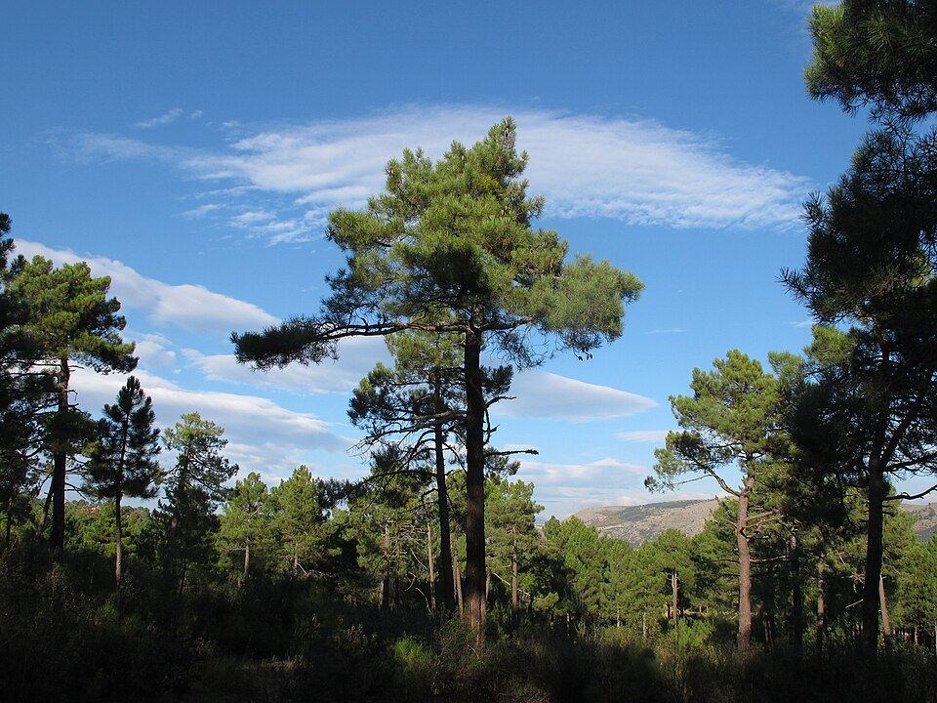
3. Pinheiro-bravo
Pinus pinaster
EVIDENCE IN MONTIJO
Listed in the municipal species tables; rural stands around the municipality.
ARCHITECTURE LINK
Construction timber and formwork; windbreaks buffering estuary winds against low-rise neighbourhoods.
PREDOMINA: Pinhal interior — n.º 3
3 / 10 — Montijo municipality

Slide 5
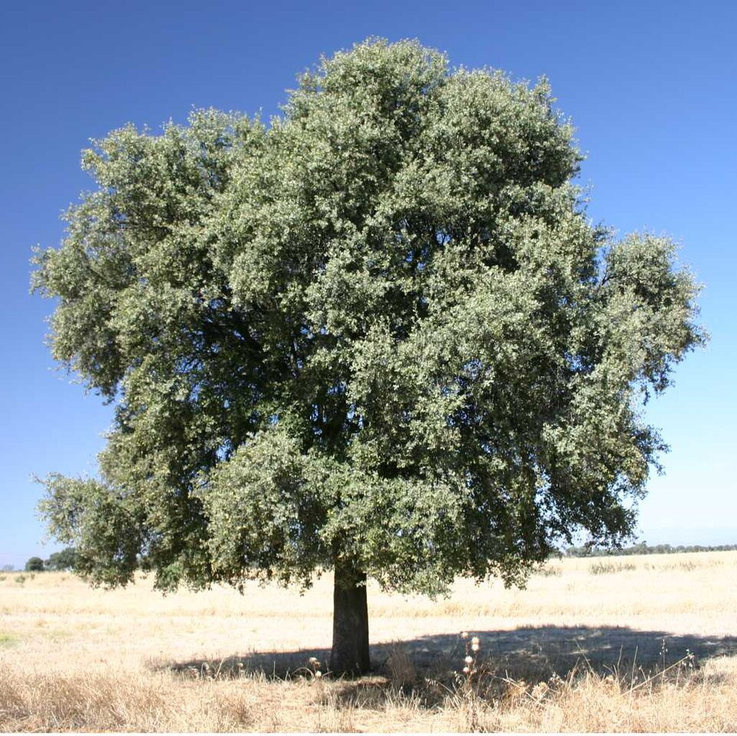
4. Azinheira
Quercus rotundifolia (listed as Q. ilex)
EVIDENCE IN MONTIJO
Protected species in the regulation; montado misto with sobreiro.
ARCHITECTURE LINK
Dense evergreen shade for courtyards and schoolyards; extreme drought tolerance suits low-irrigation planting.
PREDOMINA: Montado misto — n.º 4
4 / 10 — Montijo municipality

Slide 6
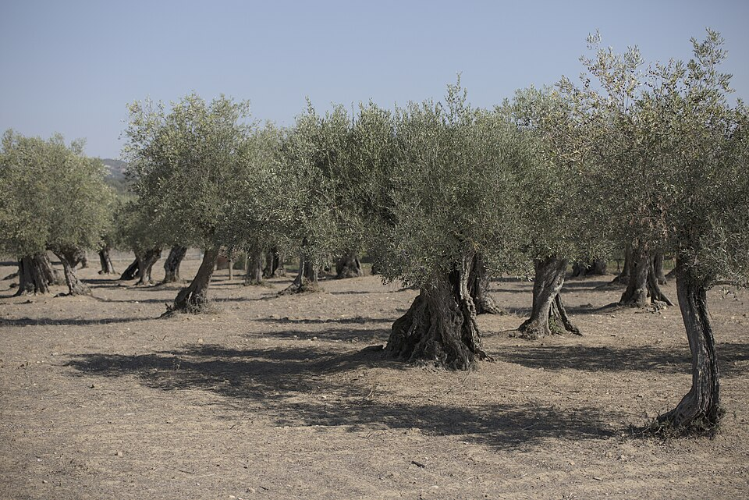
5. Oliveira
Olea europaea var. europaea
EVIDENCE IN MONTIJO
Planted by the municipality at Pateo d'Agua 2026; in the species tables.
ARCHITECTURE LINK
Small-scale courtyard and patio tree that never threatens foundations or roofs; longevity symbolism for civic spaces.
PREDOMINA: Páteo d'Água — n.º 5
5 / 10 — Montijo municipality

Slide 7
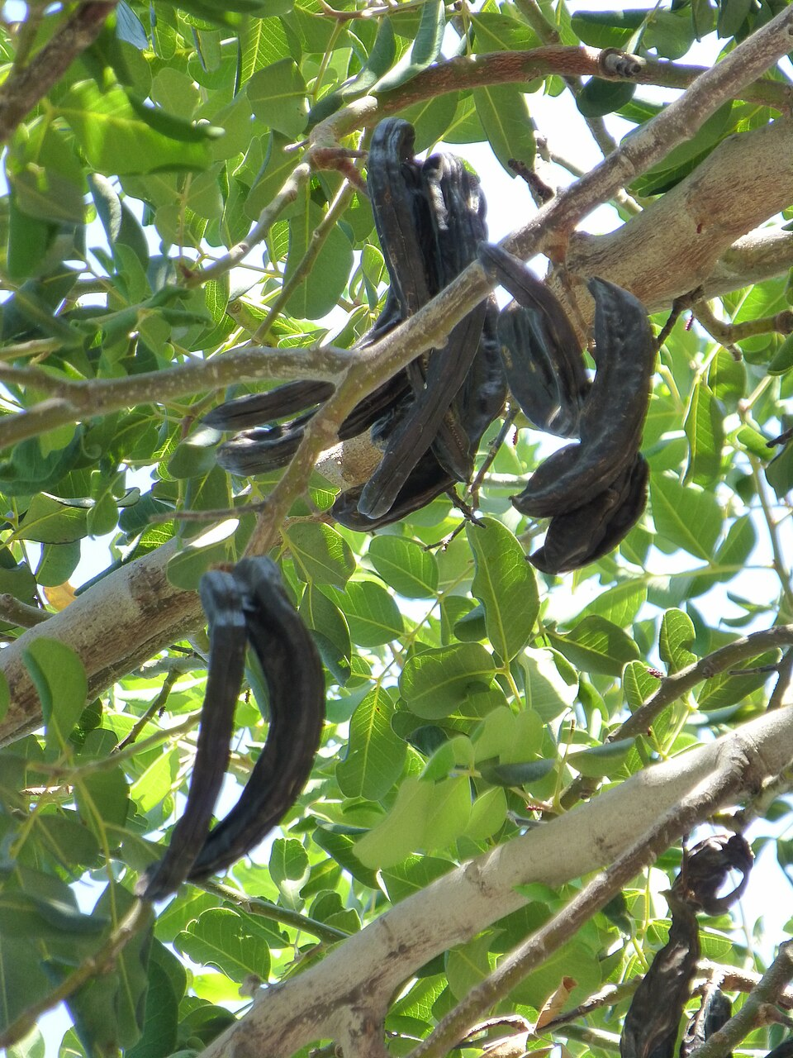
6. Alfarrobeira
Ceratonia siliqua
EVIDENCE IN MONTIJO
Species distributed to residents in Semana Verde 2026 as climate-adapted.
ARCHITECTURE LINK
Slow-growing, low-water garden tree for private logradouros; dense evergreen crown cools patios with almost no pruning or irrigation.
PREDOMINA: Quintais urbanos — n.º 6
6 / 10 — Montijo municipality

Slide 8
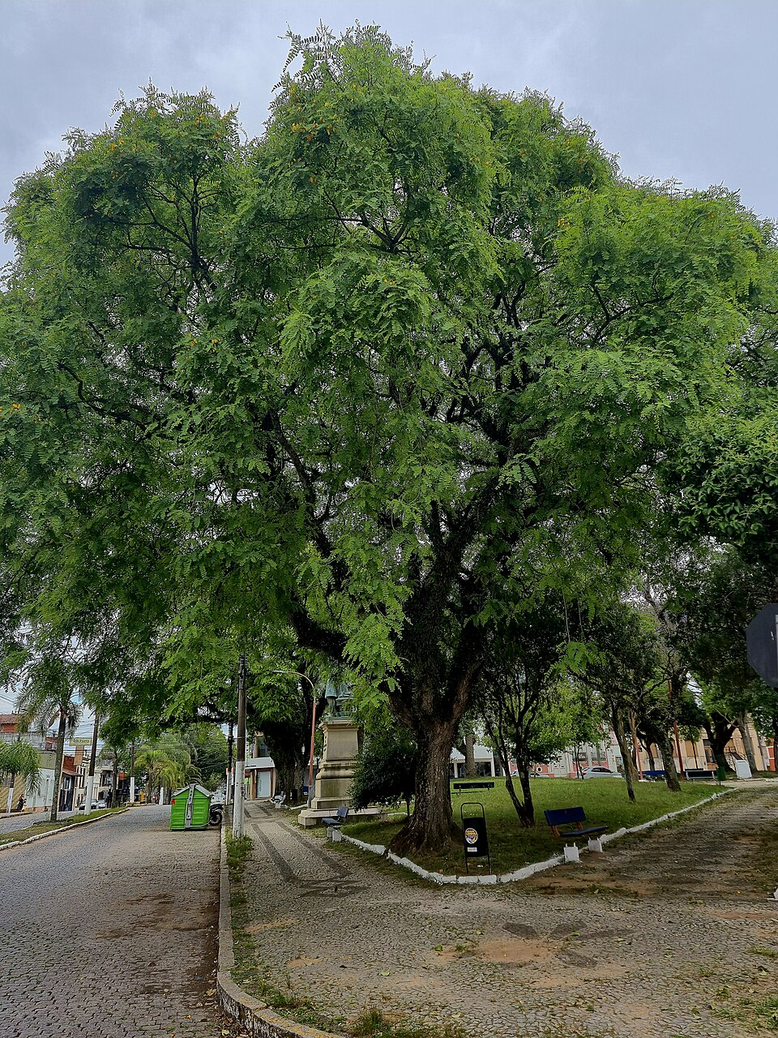
7. Tipuana
Tipuana tipu
EVIDENCE IN MONTIJO
Street tree with its own pruning window in the regulation (mid-March to end April).
ARCHITECTURE LINK
Fast-growing arruamento shade with yellow flowering; needs the crown-lifting the regulation prescribes to clear vehicles and aerial infrastructure.
PREDOMINA: Arruamentos — n.º 7
7 / 10 — Montijo municipality

Slide 9
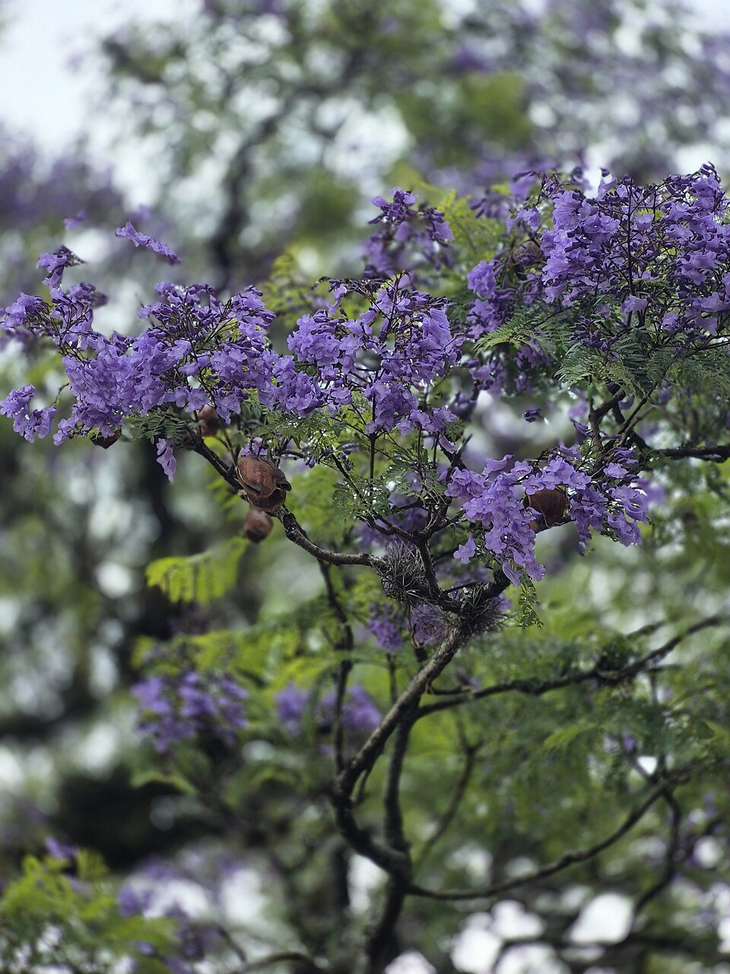
8. Jacaranda
Jacaranda mimosifolia
EVIDENCE IN MONTIJO
Same dedicated pruning regime - an established Montijo street tree.
ARCHITECTURE LINK
Violet spring bloom as seasonal landmark in streets and small largos; light filtered shade suits narrow streets where platano would be oversized.
PREDOMINA: Arruamentos — n.º 8
8 / 10 — Montijo municipality

Slide 10
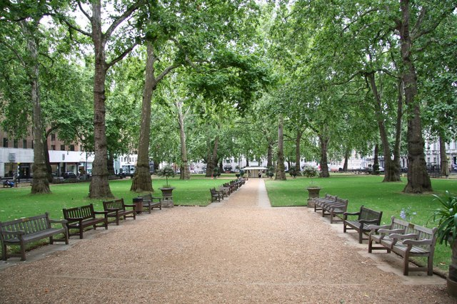
9. Platano
Platanus x hispanica
EVIDENCE IN MONTIJO
Listed in the municipal species tables.
ARCHITECTURE LINK
Large-leaf high-transpiration shade for largos and riverside promenades; evaporative cooling pairs with the Tagus estuary breeze.
PREDOMINA: Largos — n.º 9
9 / 10 — Montijo municipality

Slide 11
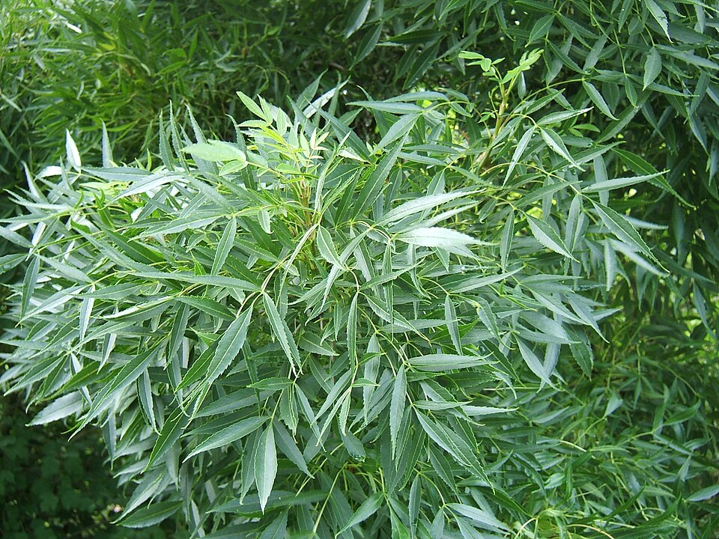
10. Freixo
Fraxinus angustifolia
EVIDENCE IN MONTIJO
Listed in the tables; the riparian type of Sitio das Nascentes.
ARCHITECTURE LINK
Lines the corridor's water courses, stabilising banks; deciduous canopy gives summer shade on paths and winter sun.
PREDOMINA: Sítio das Nascentes — n.º 10
10 / 10 — Montijo municipality

Slide 12
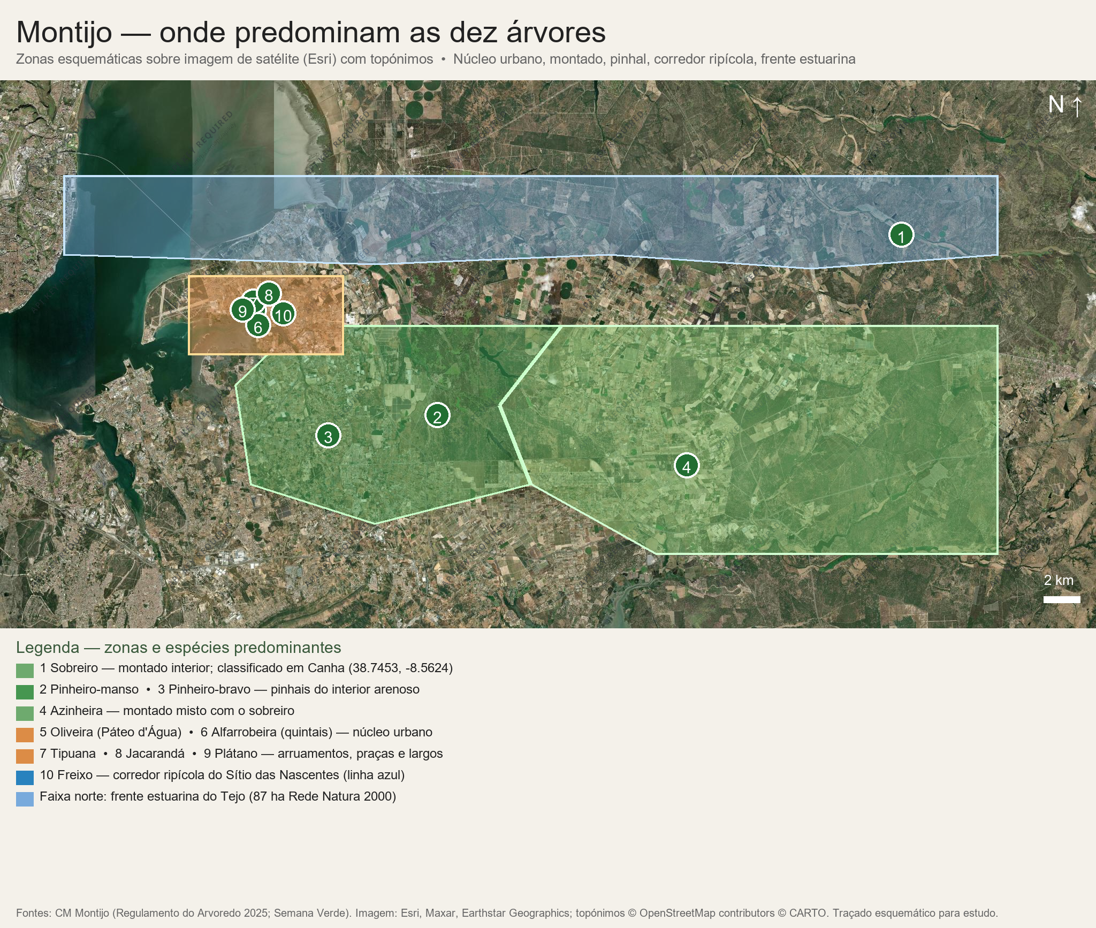
Mapa — concelho: onde predominam

Slide 13
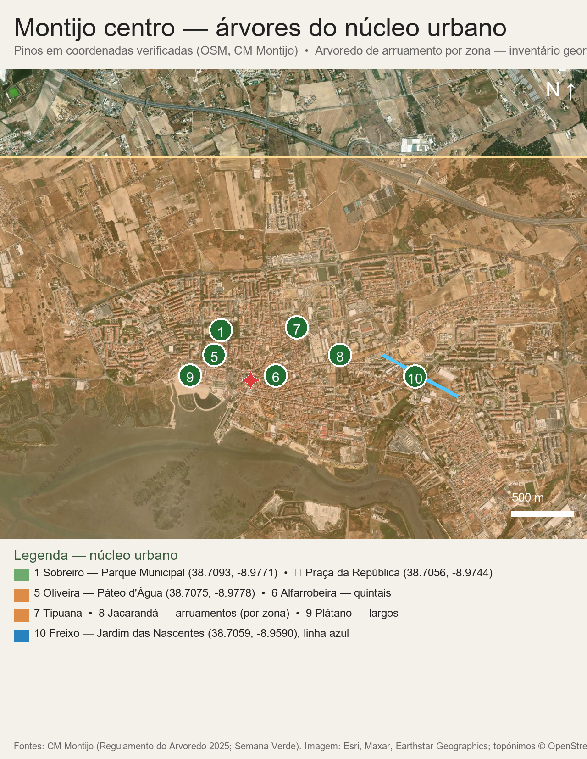
Mapa — centro de Montijo (zoom)

Slide 14
Portuguese sources — Montijo focus
CM Montijo — Regulamento Municipal de Gestão do Arvoredo (2025): 11,450-tree inventory, protected species, pruning calendar, species tables
https://www.mun-montijo.pt/cmmontijo/uploads/document/file/20462/projeto_de_regulamento_municipal_de_gestao_do_arvoredo.pdf
CM Montijo — Semana Verde 2024 + Diario do Distrito (sobreiro: 750 trees, centenary tree in Canha)
https://diariodistrito.sapo.pt/montijo-semana-verde-faz-homenagem-ao-sobreiro/
SAPO — oliveira at Pateo d'Agua, alfarrobeira distribution (2026) + CM Montijo Sitio das Nascentes corridor
https://sapo.pt/artigo/montijo-planta-uma-oliveira-com-peso-simbolico-69be7ad0fed9c03ea1aaa68d
Images: Wikimedia Commons, openly licensed (see per-slide credits).

