Slide 1

Language as a Measure of Welfare
Priya Saha, Diogo F. Pacheco, Ronaldo Menezes
Florida Institute of Technology

Slide 2
Development Measures
GDP is intended to measure the productivity of a nation and is used as an indicator of prosperity.
Economic growth alone cannot capture the all round development of a nation.
An insufficient measure to quantify the social development.
The social development of a nation or the quality of life (QOL) is a multi-dimensional concept.

Slide 3
Development Measures - HDI
The United Nations introduced a measure called Human Development Index (HDI).
The HDI is a composite metric that considers life expectancy, education and per-capita income in its equation, and is consequently a better indicator of QoL of people than GDP.
GDP does not always correlate to HDI.
Cuba which according to the 2007 data, has low GDP of PPP US$6,876 and very high HDI of 0.863 (the max is 1).

Slide 4
Related Work
Ranis et al. (2000) showed the vicious cycles between economic growth and human development.
McLaren (2007) investigated the relationship of social economic status and obesity.
Ronen et al. (2014) created language networks using book translations, Wikipedia, and Twitter. The showed a strong correlation between language and fame.

Slide 5
Research Question
Can languages used by people on Twitter act as a proxy to their development scale?
Notes:
As we will see, in this work we will show that languages do play a role in the human development. In other words, we will show that somehow the position of a language in a language network is correlated with the human development index of the countries where those languages are spoken.

Slide 6

Twitter as a social platform
Twitter data can be accessed by the Twitter API.
Twitter data has gained a lot of interest among the research scientists who are trying to understand the specific aspects of human behavior because it can act as a large real-time sensor of society.
The diversity of languages in Twitter makes it an interesting source for us to analyze.

Slide 7
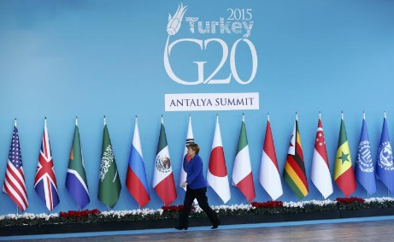
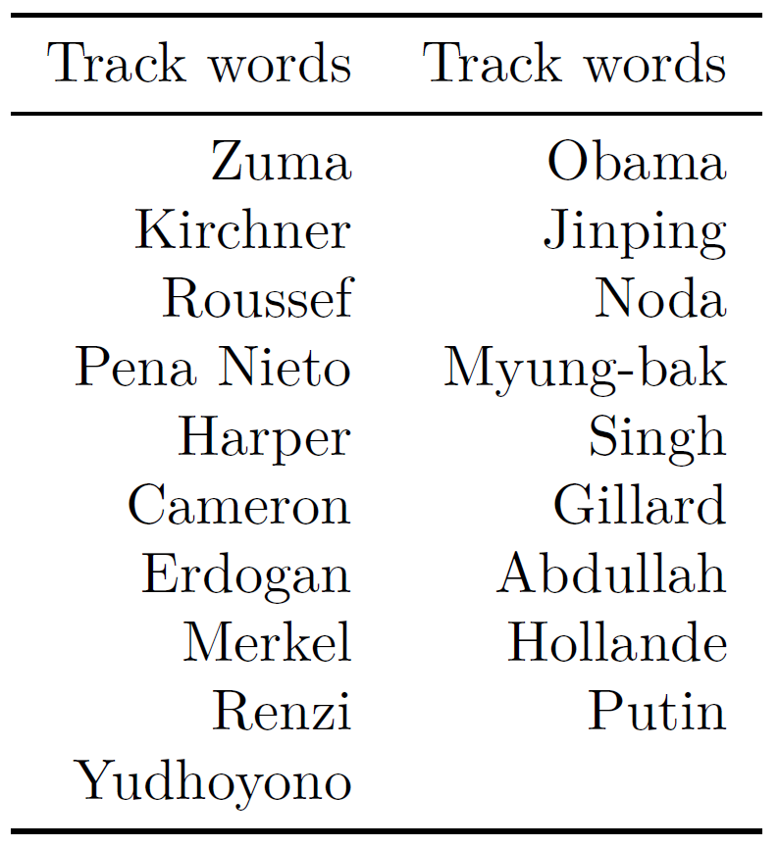
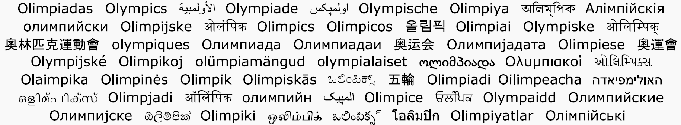
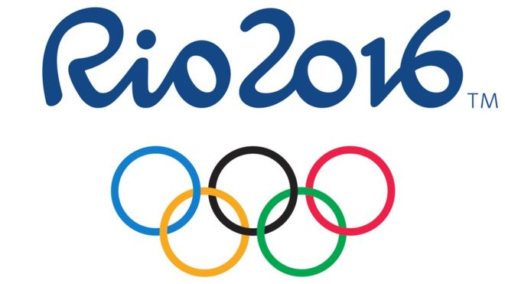
Twitter Datasets
G20
Olympics

Slide 8
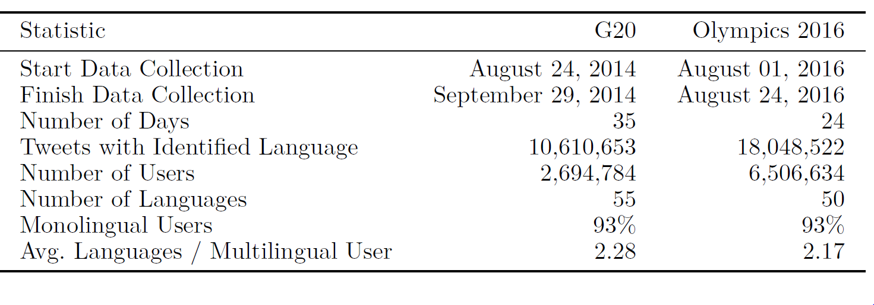
Twitter Datasets

Slide 9
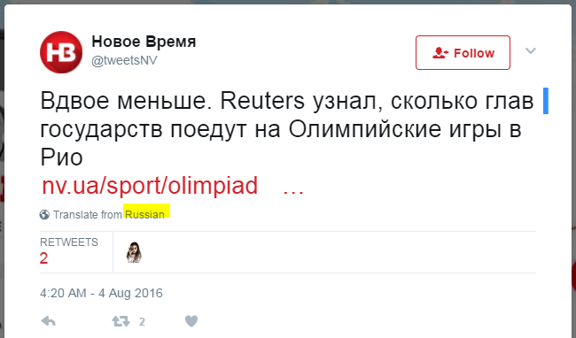
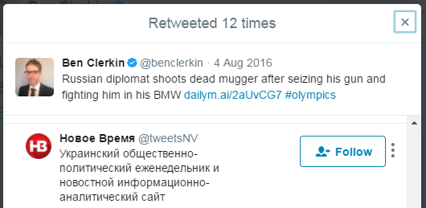
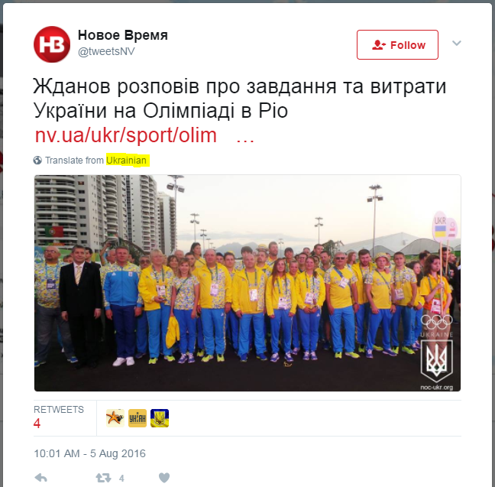
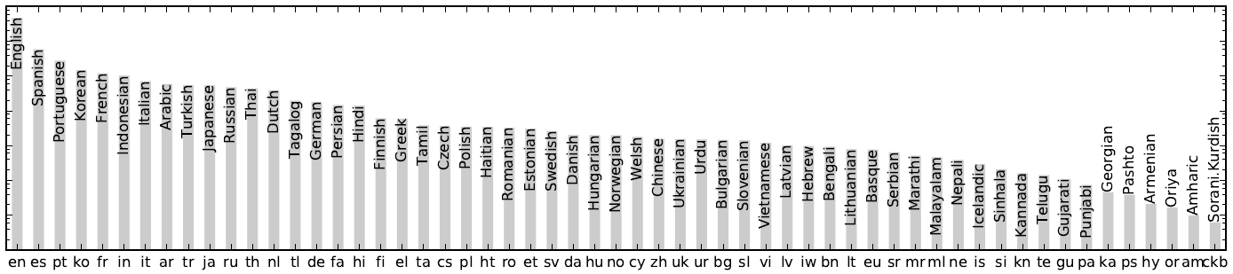
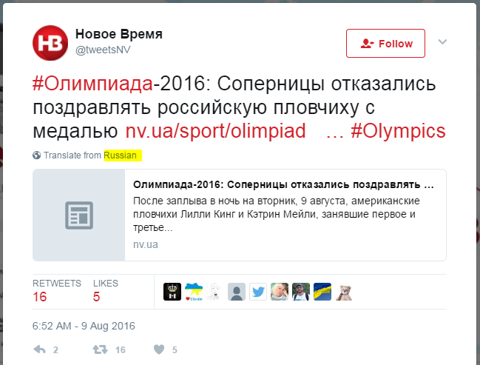
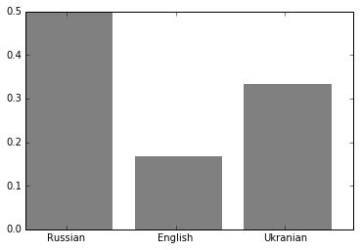
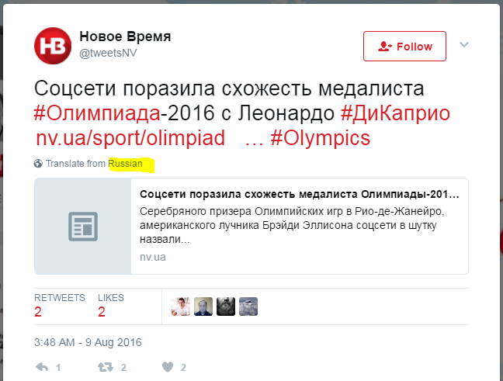
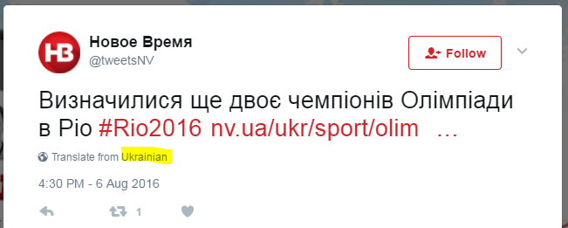
Characterizing Users

Slide 10
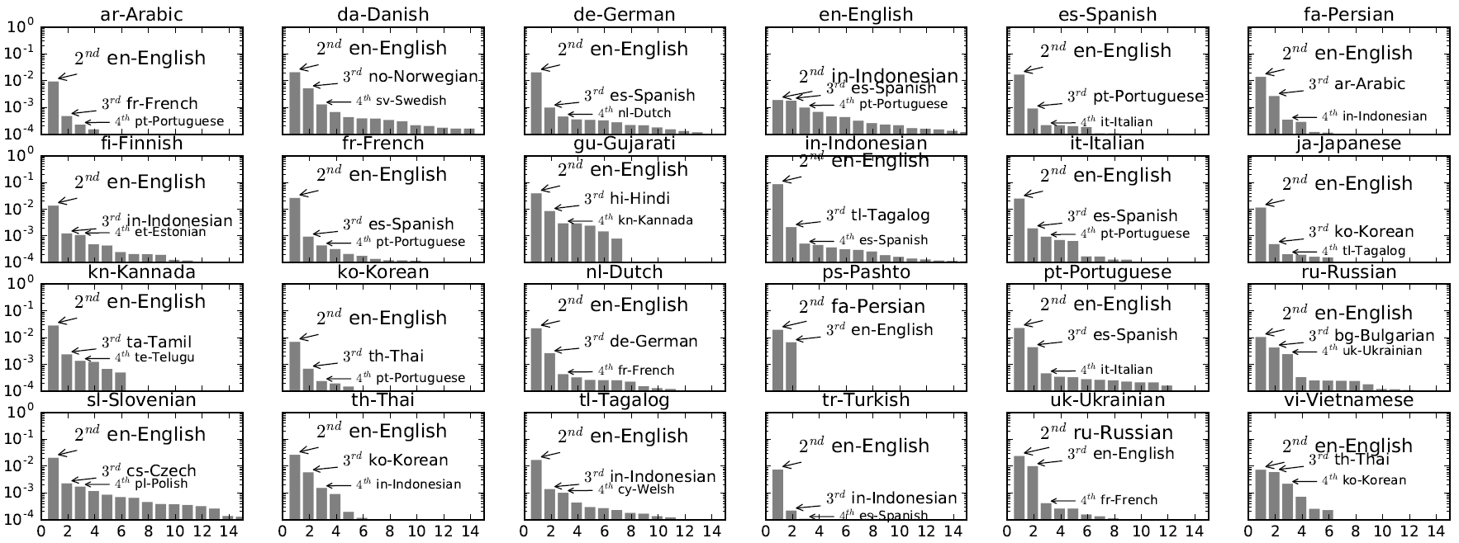
Characterizing Languages

Slide 11
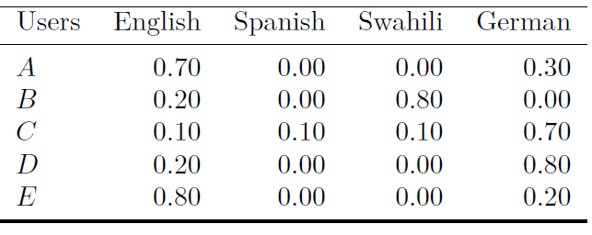
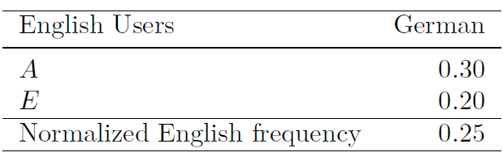
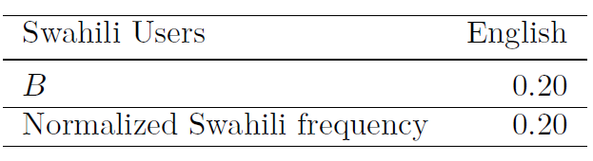
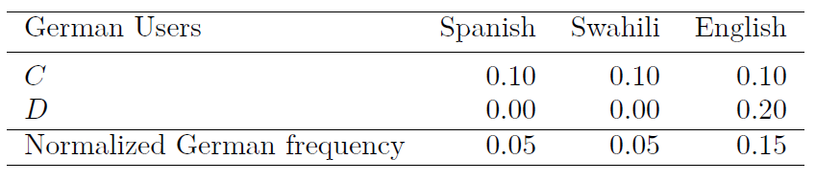
Twitter Network
English
0.20
0.25
0.15
Swahili
0.05
German
0.05
Spanish

Slide 12
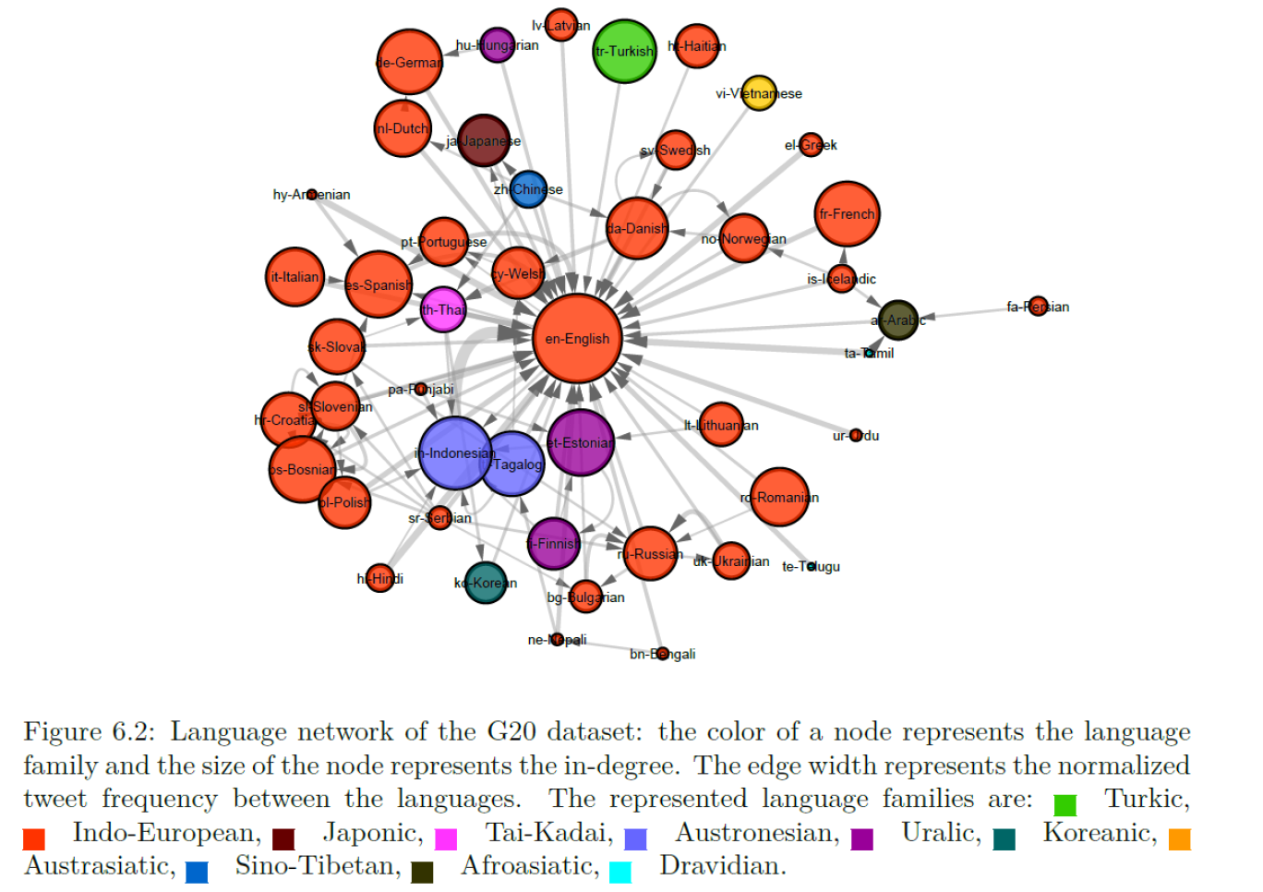
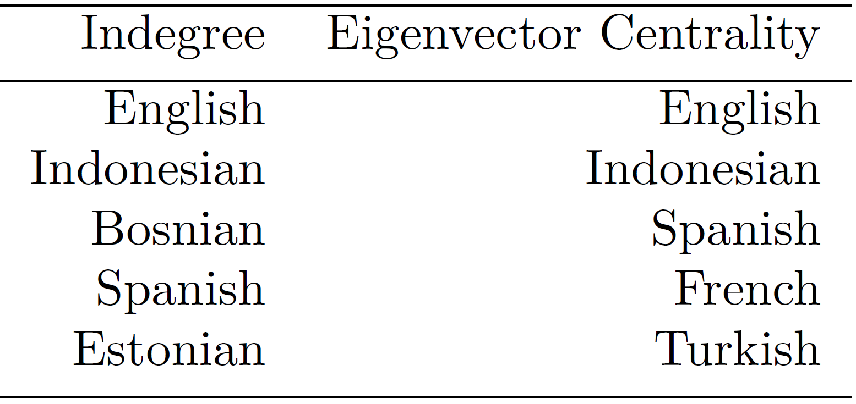
Twitter Network – G20

Slide 13
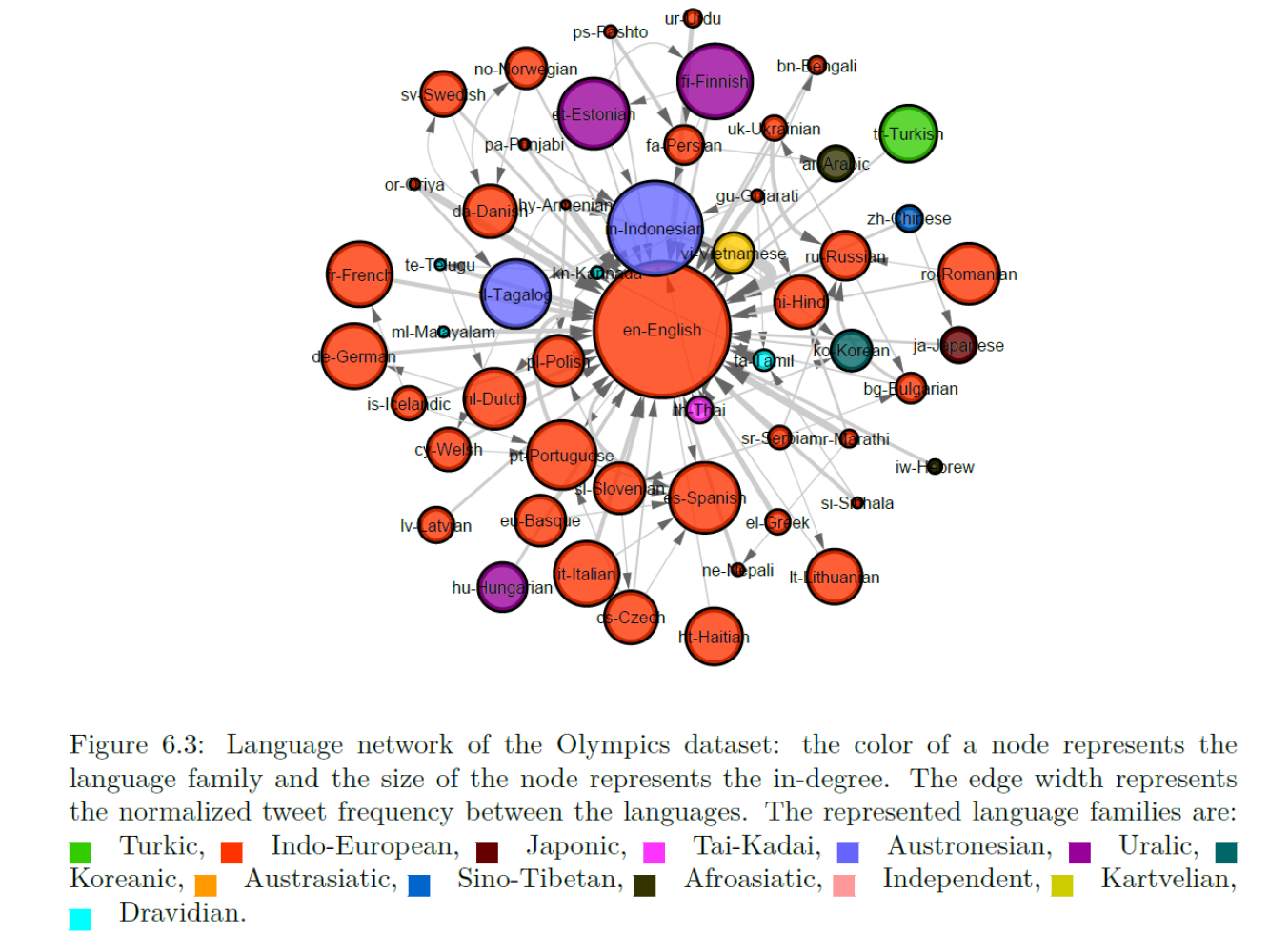
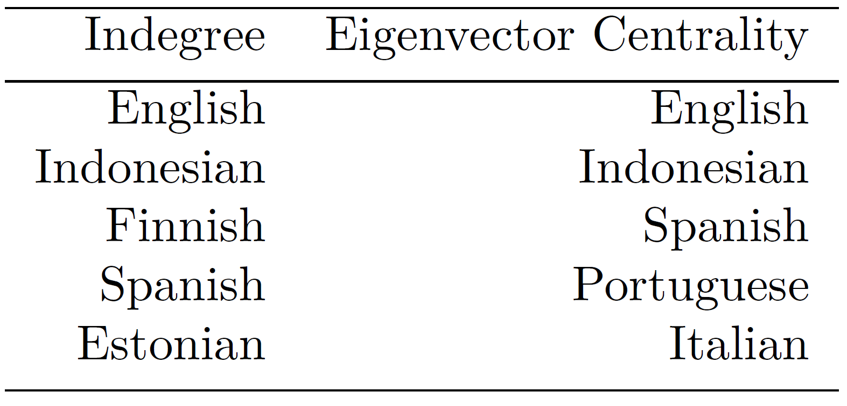
Twitter Network – Olympics

Slide 14
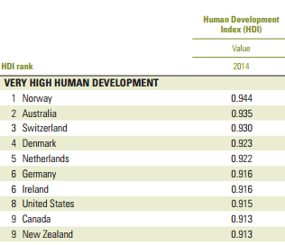
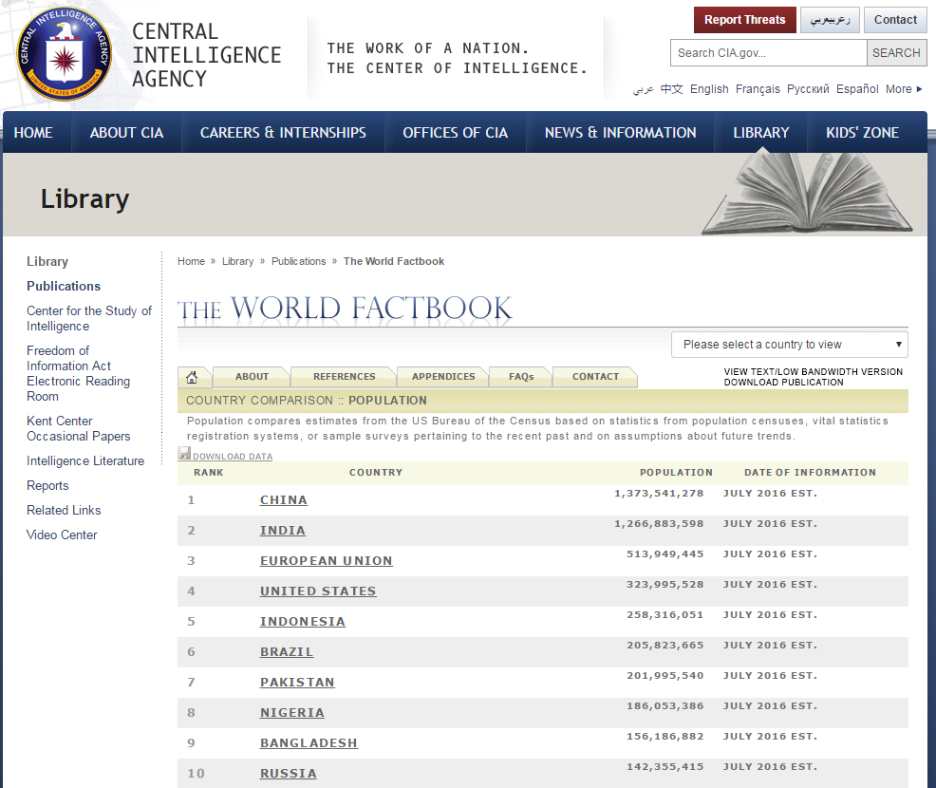
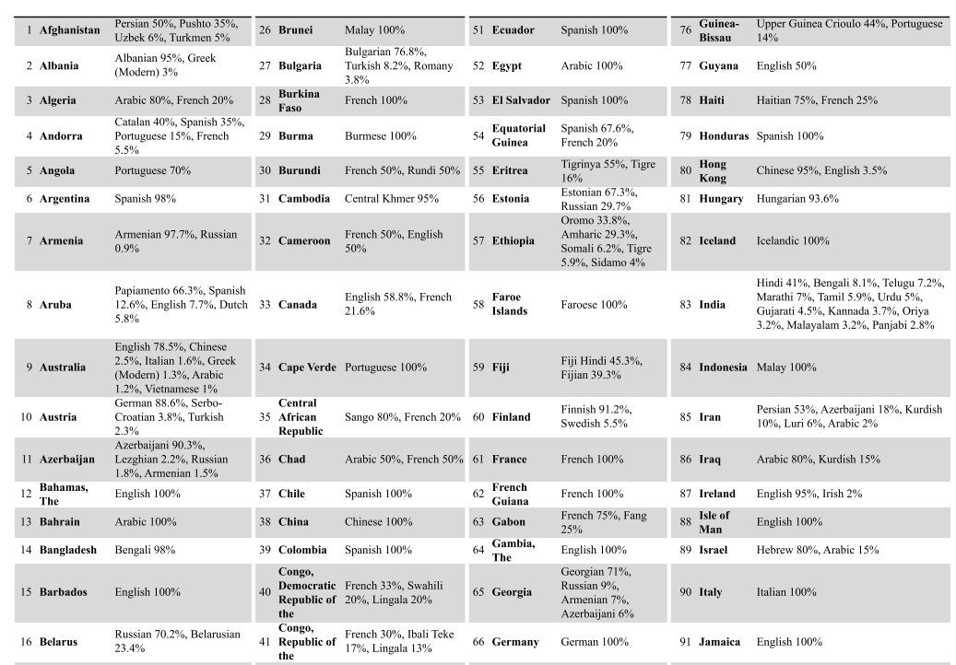
HDI of Languages

Slide 15
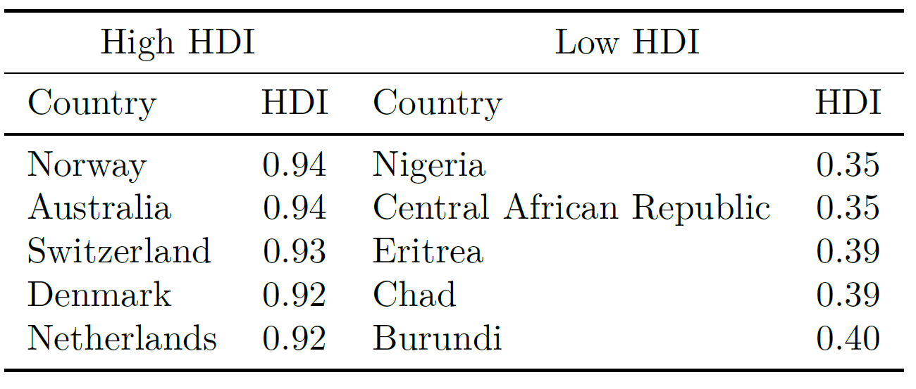
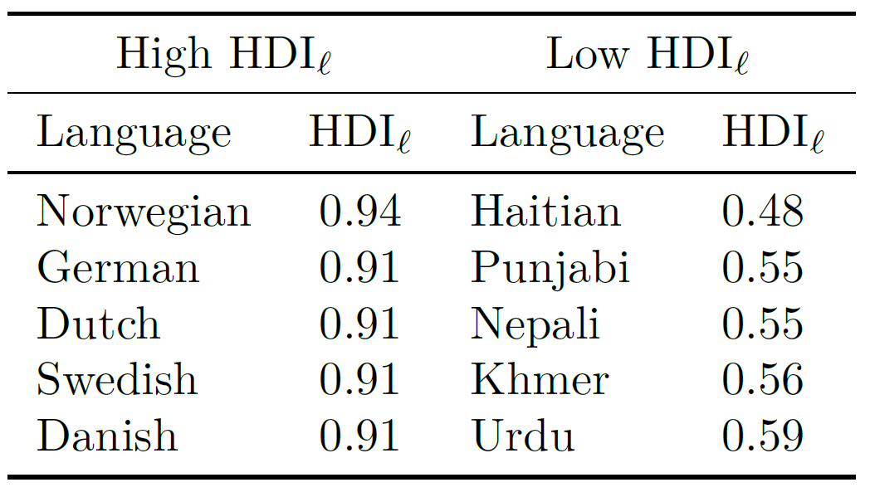
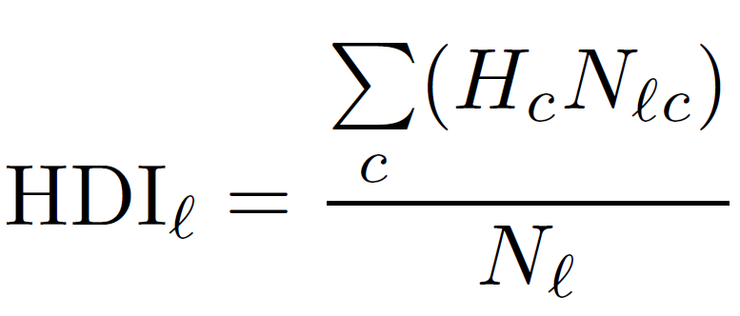
HDI of Languages

Slide 16
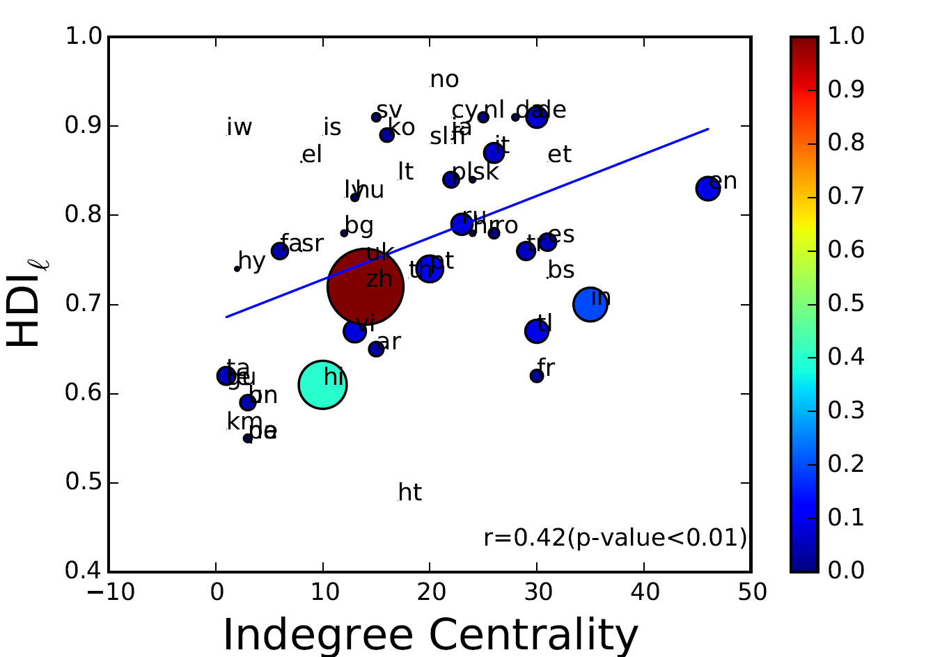
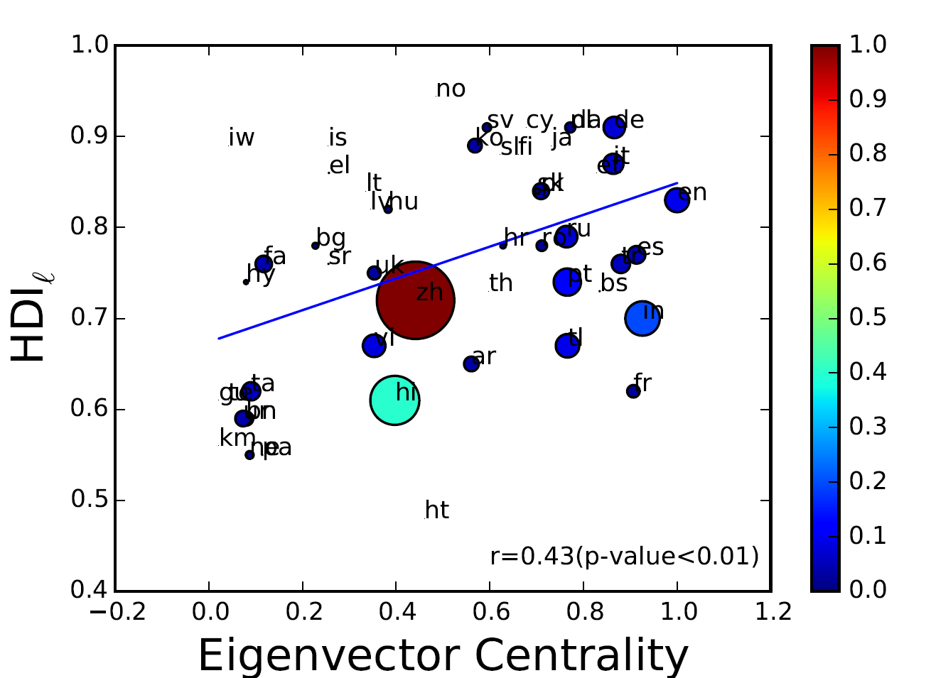
Twitter Network – G20

Slide 17
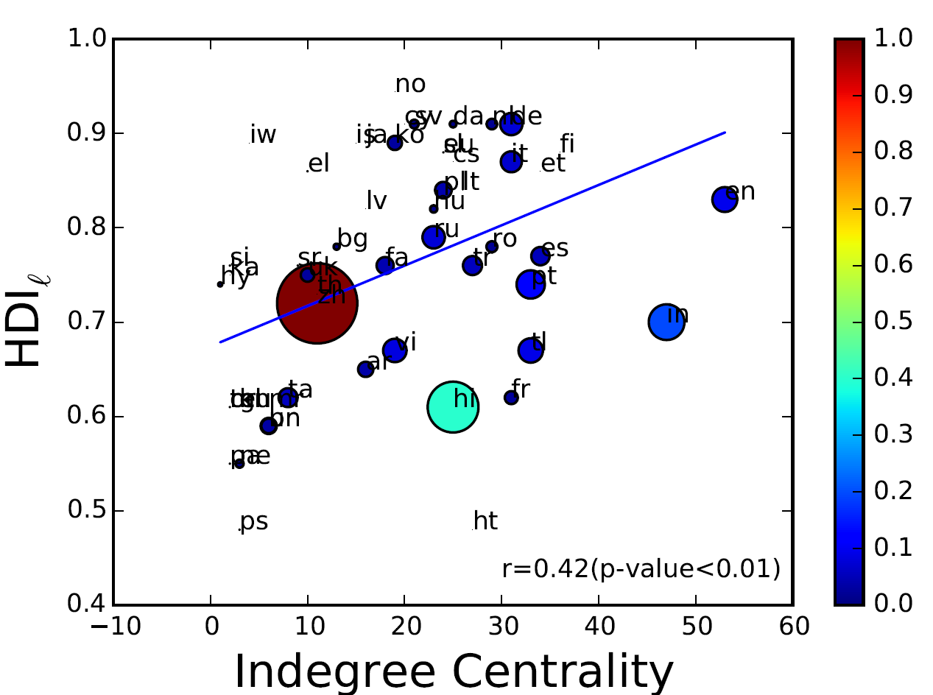
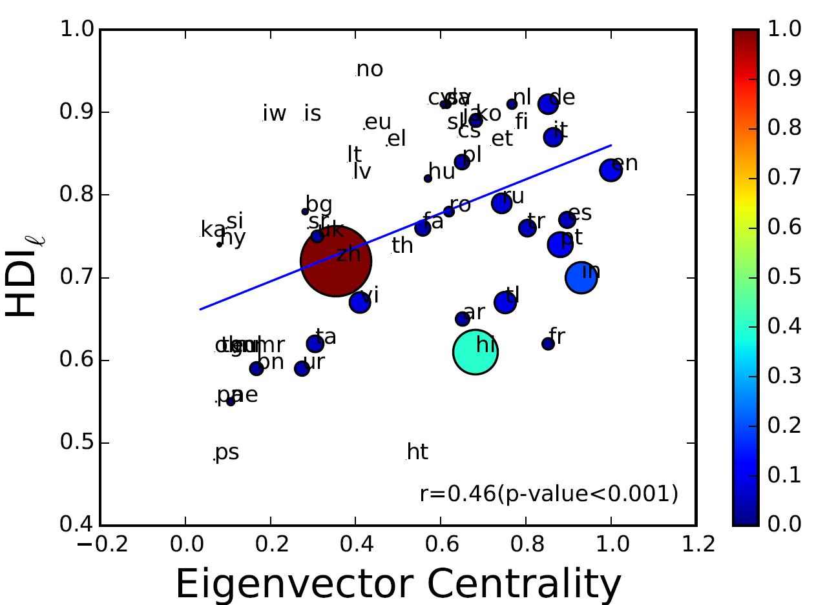
Twitter Network – Olympics

Slide 18
Conclusions
This study shows that the users of languages that hold favored positions in the networks tend to have better life more than a chance.
Twitter data is capable to caputre language variations
We also observed that a few popular languages that have very high in-degree and eigenvector centrality do not tend to be the ones with very high HDI. It is worth noting that some of the popular languages are spoken in different parts of the world (high standard deviation).

Slide 19
Limitations and Future Work
Although it is interesting to extract and analyze the entire Twitter language network, it is rather a very time consuming and expensive procedure. Hence, we used different sets of data from different time periods which demonstrate that the language networks we generated are robust.
Twitter penetration is not even all over the world.
Tweets language identified by Twitter.
Can we use the language network to infer countries’ HDI?

Slide 20
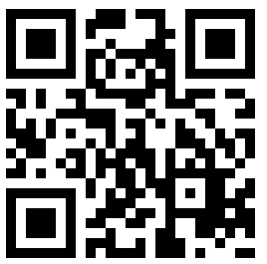
Language as a Measure of Welfare
Questions?
Diogo F. Pacheco - http://diogofpacheco.github.io
dpacheco@biocomplexlab.org

